Slide 1
Evaluating Cambridgeshire Constabulary’s “No Cold Calling” scheme: an application of spatial-temporal data modelling.
Robert Haining
Department of Geography,
University of Cambridge, England.
Cambridge Oct. 2012

Slide 2
1. CONTEXT
Recent trends in policing in the UK (Crime and Disorder Act 1998):
    greater use of intelligence-led, proactive, inter-agency, crime prevention measures;
    recognition of the importance of people’s fear of crime and the need to provide “re-assurance”.
The importance of the neighbourhood for delivering crime prevention strategies and tackling the fear of crime.
    targeted strategies (no cold calling zones; crime hotspot responses);
    tailored strategies (situational crime prevention measures; reassurance policing).

Slide 3
Together with the availability of geo-coded offence, offender, victim data =>
- opportunities to explore the importance of place and space in crime and criminality;
- provide inputs into policing practice at different scales:
      crime mapping and modelling;
      crime hotspot detection;
      policy assessment.

Slide 4
2. THE PROJECT:
Policy evaluation: ‘no-cold calling’ zones in Peterborough, England.
With: Guangquan Li, Sylvia Richardson and Nicky Best
Imperial College, London

Slide 5
Background to project
Cold calling is a visit or a telephone call to a consumer by a trader, whether or not the trader supplies goods or services, which takes place without the consumer expressly requesting the contact.
Not illegal but often associated with “rogue trading”; and doorstep cold calling associated with burglary.
Creation of “no cold calling” (NCC) zones.

Slide 6
Setting up an NCC zone combines:
    “re-assurance policing”
        Reducing fear of crime by prioritising a crime and disorder threat that concerns neighbourhood residents.
    situational crime prevention
        reducing crime by altering the “environment” so as to (i) reduce the opportunity to offend and (ii) increase the risk of getting caught if the motivated offender chooses to offend.
        has roots in Rational Choice Theory (Cornish and Clarke, 1986); Routine Activity Theory (Cohen and Felson, 1979)

Slide 7
advice to residents on how to deal with cold callers;
police presence through street and household signage;
Trading Standards approve legitimate cold calling;
Target hardening;
Higher levels of surveillance; information sharing
But do these schemes reduce burglaries in the targeted NCC zones?

Slide 8
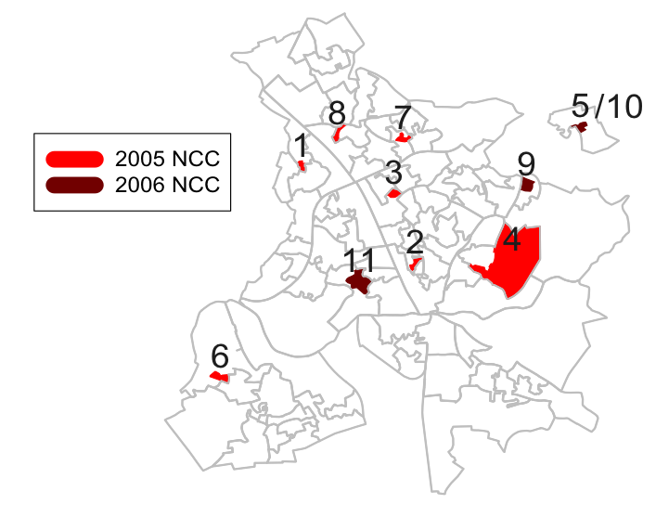
NCC areas in Peterborough
Notes:
rm(list=ls(all=TRUE))
#
# produce the above map
#
mac <- "/Volumes/WorkSpace/BIAS/crime/crimeWorking"
workdir <- mac
setwd(workdir)
require(spdep)
oa.shp <- readShapePoly("../Cammap_shp/CambridgeshireCOA.shp")
lsoa.shp <- readShapePoly("../Cammap_shp/CambridgeshireLSOA.shp")
oa.data <- slot(oa.shp,"data")
lsoa.data <- slot(lsoa.shp,"data")
oa.poly <- slot(oa.shp,"polygons")
lsoa.poly <- slot(lsoa.shp,"polygons")
peter.oa <- as.character(read.dbf("../Cammap_shp/PeterboroughOA.dbf")$COA_CODE)
# load NCC data
load("data/NCC/DwellBurglaryNCC0506PeterboroughLSOAAnnual.RData")
ncc.areas <- rownames(burg0108$ncc)
ncc.year <- burg0108$ncc[,"NCC.year"]
ncc.oa.poly.ind <- sapply(ncc.areas,function(x){which(as.character(oa.data$COA_CODE)==x)})
ncc.oa.poly <- oa.poly[c(ncc.oa.poly.ind)]
all.oa <- unique(c(peter.oa,ncc.areas))
all.lsoa <- unique(sapply(all.oa,function(x){as.character(oa.data$LSOA04CD)[c(which(as.character(oa.data$COA_CODE)==x))]}))
all.lsoa.names <- names(sapply(all.lsoa,function(x){which(as.character(oa.data$LSOA04CD)==x)}))
all.lsoa.poly.ind <- sapply(all.lsoa.names,function(x){which(as.character(lsoa.data$LSOA04CD)==x)})
all.lsoa.poly <- lsoa.poly[c(all.lsoa.poly.ind)]
# plotting
plot(SpatialPolygons(as.list(all.lsoa.poly)),border="grey",lwd=2)
# locating each NCC areas
my.col <- colorRampPalette(c("red","black"))
for (i in 1:length(ncc.oa.poly)) {
col <- my.col(10)[1]
if (ncc.year[i]==2006) col <- my.col(10)[6]
plot(SpatialPolygons(list(ncc.oa.poly[[i]])),add=TRUE,col=col,border=col)
}
plot(SpatialPolygons(as.list(all.lsoa.poly)),add=TRUE,border="grey",lwd=1.3)
# legend
legend(510137,302525,c("2005 NCC","2006 NCC"),col=my.col(10)[c(1,6)],lty=c(1,1),lwd=rep(16,2),cex=1.3)
# label the NCC areas
ncc.order <- c(1:4,6:9,5,6,10)
ncc <- ncc.areas[c(ncc.order)]
ncc.poly <- ncc.oa.poly[c(ncc.order)]
for (i in c(1:9,11)) {
cen <- slot(ncc.poly[[i]],"labpt")
text(cen[1],cen[2]+500,i,col=4,cex=2)
}
cen <- slot(ncc.poly[[10]],"labpt")
text(cen[1]+900,cen[2]+500,"/10",col=4,cex=2)

Slide 9
Selection criteria:
- up to c50 properties close together and occupied by older and vulnerable residents;
- areas with large numbers of incidents (e.g. of doorstep calling; distraction burglary)
Selection of areas made by Police and Trading Standards with the involvement of Neighbourhood Watch co-ordinators.

Slide 10
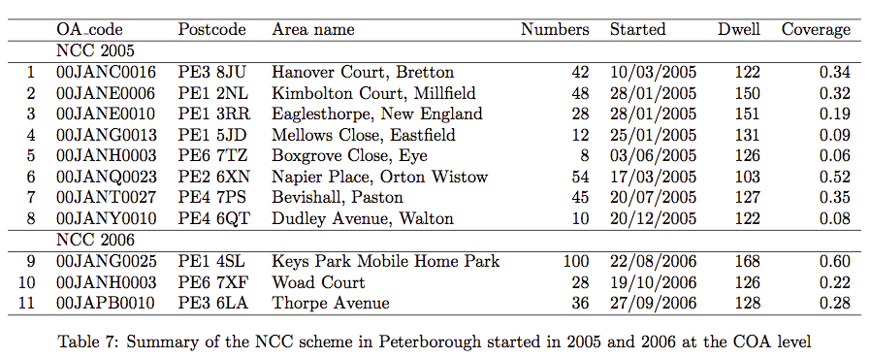
Data on “No Cold Calling”

Slide 11
Raw data: aggregated temporal profile
Positive impact of policy?

Slide 12
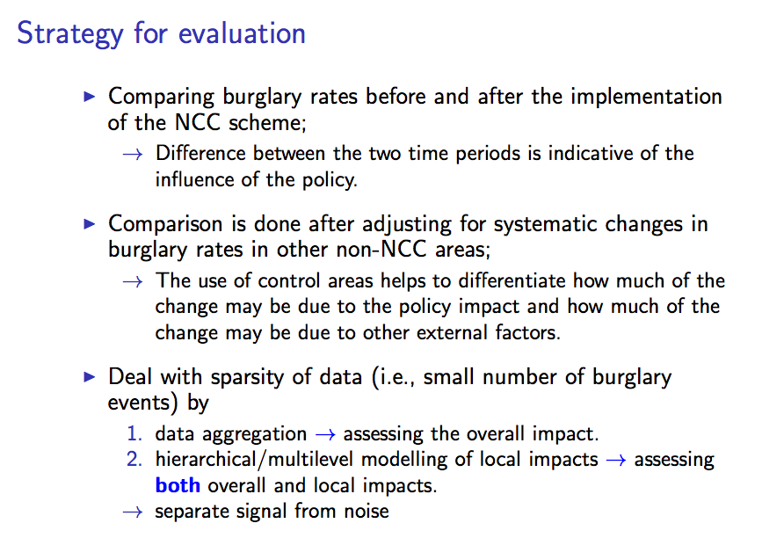

Slide 13
Constructing control groups
To form a control group, areas are selected on the basis of having similar local characteristics (e.g., burglary rates or deprivation scores) to those in the NCC-targeted group.
  Lower Super Output Areas (LSOAs) are the basic units.
ID | Matching criterion | No. of LSOAs
1 | All LSOAs in Peterborough | 88
2 | ±10% burglary rate of the NCC group in 2005 | 9
3 | ±20% burglary rate of the NCC group in 2005 | 20
4 | ±30% burglary rate of the NCC group in both 2004 and 2005 | 8
5 | LSOAs containing the NCC-targeted COAs (but excluding the NCC-targeted COAs) | 9 (one LSOA is outside Peterborough)
6 | LSOAs that had “similar” multiple deprivation scores (MDS) to those for the NCC LSOAs in 2004 | 46

Slide 14
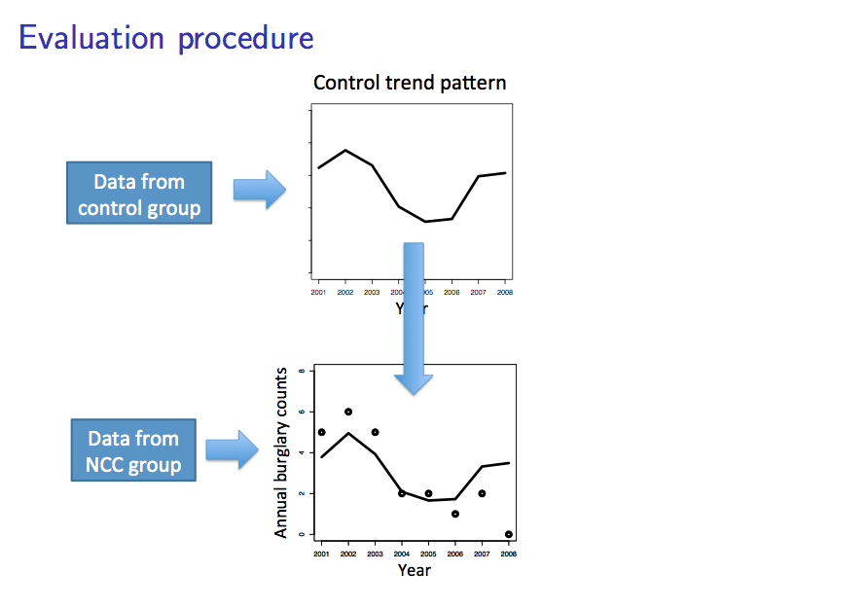

Slide 15
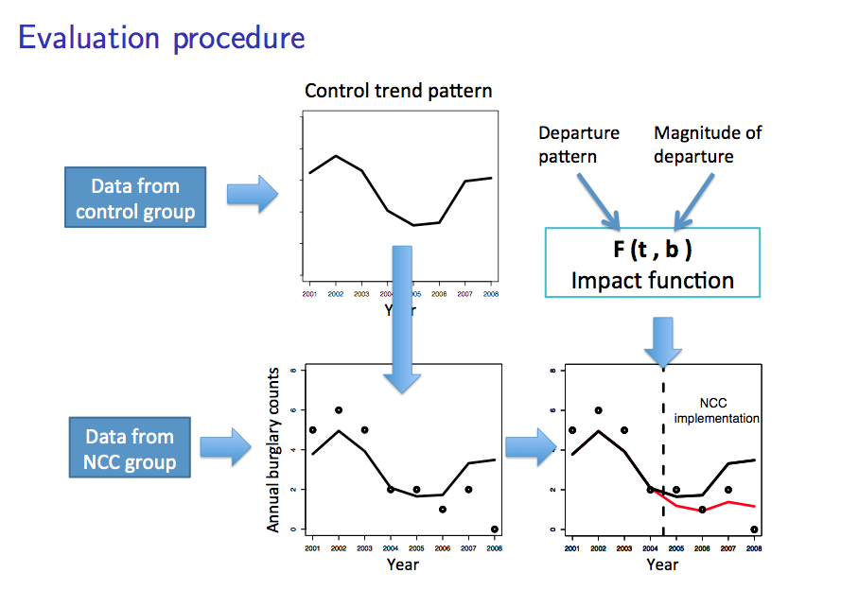

Slide 16
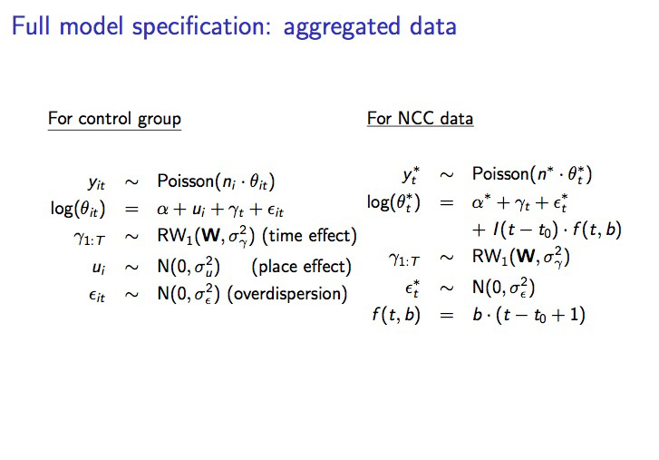

Slide 17
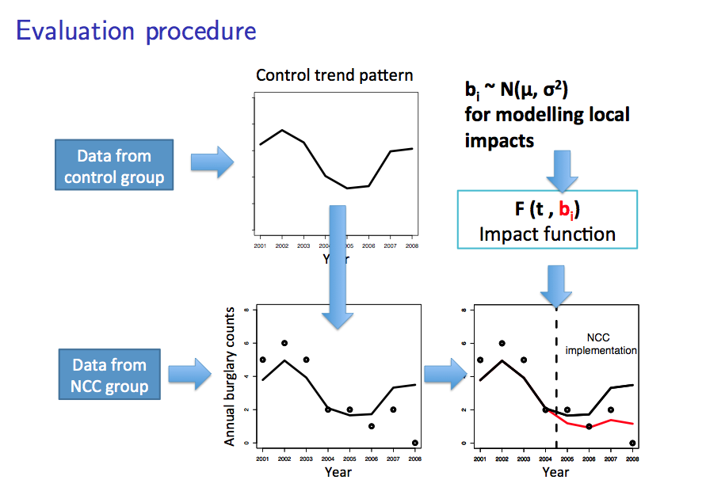

Slide 18
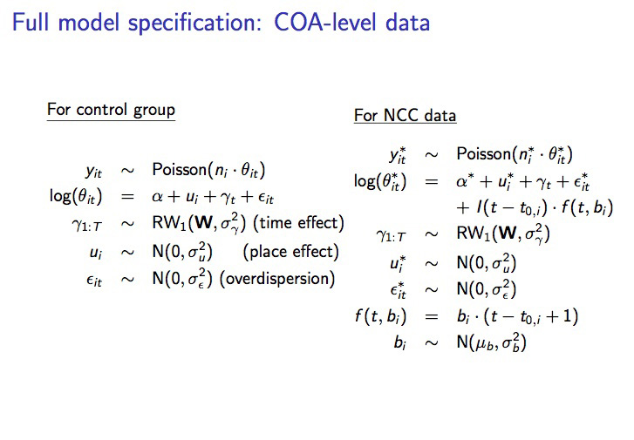

Slide 19
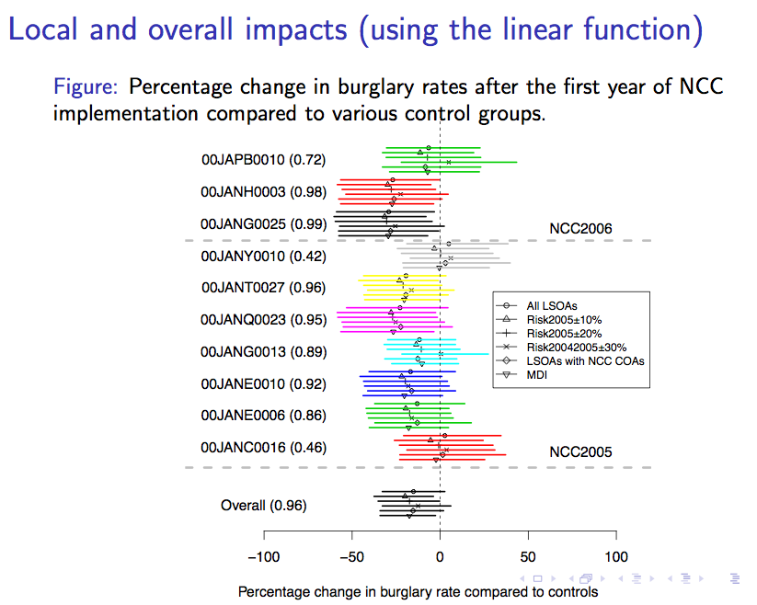

Slide 20
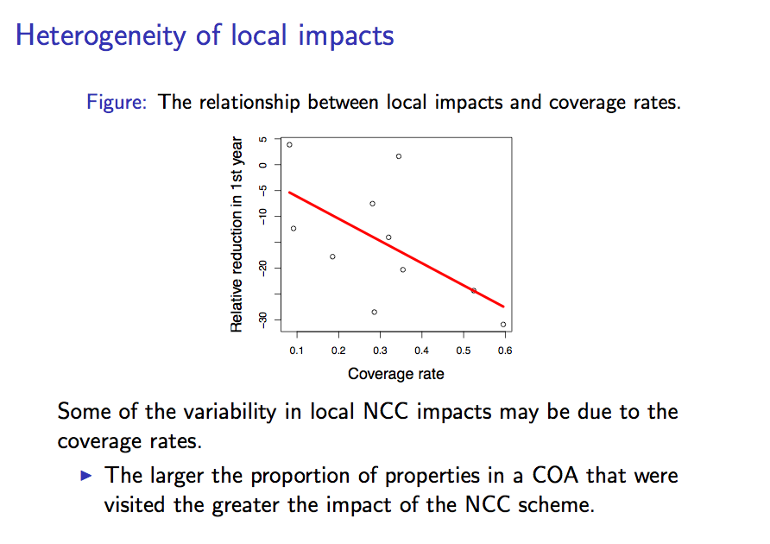
Some wider questions arising from the evaluation:
    Data limitations
      burglary count as the measure of success
      short length of time series
    Impacts before implementation (publicity effects?)
    Displacement effects? (diffusion of benefits?; net effect?)
: threshold or dilution?

Slide 21
    How generalizable are these findings?:
Urban schemes
Rural schemes

Slide 22
3. Concluding reflections: (i) The No cold calling initiative
Overall, implementation of NCC has been associated with a reduction in burglary in those areas;
But implementation has not been associated with reductions in burglary rates in every NCC targeted neighbourhood.
Gillham (1992) argued that targeted crime prevention strategies tended to be most effective in certain types of neighbourhood:
    persistently high rates of particular crimes;
    residents want to “fight back”;
    high levels of social cohesion.

Slide 23
But Gillham also notes that in some places, implementing a neighbourhood “crime reduction” scheme can lead to an increase in crime. (Pease 1999 also notes this - assessing the impacts of improved street lighting).
There are other criteria by which schemes such as this NCC scheme might be judged.

Slide 24
Concluding reflections: (ii) The statistical approach
- Benefits of fitting Multilevel/hierarchical models
Multilevel/hierarchical models offer a natural framework to combine information and hence to strengthen estimation.
The sparsity issue, often encountered in analysing geo-referenced and/or time-series data, can be addressed by “borrowing information” from neighbouring areas or time periods to produce better (more stable, less noisy) estimates in each area.
Modelling spatial or temporal structure achieved by appropriate choice of random effects distribution.

Slide 25
- Benefits of fitting Bayesian models:
Since all parameters are treated as random variables with associated posterior distributions, probability statements about the parameters can be easily made,
    the probability of success
Uncertainty can be naturally accounted for and/or propagated if necessary:
  e.g., uncertainty associated with the reference trend estimates can be propagated into measuring the NCC policy's impact.

Slide 26
- Implementation and other issues
Estimation of BHM requires computationally intensive simulation methods (McMC)
  Implemented in free WinBUGS and GeoBUGS software: www.mrc-bsu.cam.ac.uk/bugs
  Need to ensure the McMC chains have converged to the target distributions.
  Free software INLA (Rue et al, 2008) implements fast approximation: www.r-inla.org
Assessing sensitivity of the results to different prior specifications.
Notes:
Checking convergence to ensure the MCMC chains have converged to the target distribution is a crucial thing to look out for when running MCMC chains. Also user needs to ensure the MCMC chains have been run long enough to obtain posterior summaries.
It is recommended to perform sensitivity analysis on the robustness of results against various prior specifications.

