Slide 1
2 REGRESSION ANALYSIS
OR Mixing the ingredients
Peter Watson

Slide 2
What is regression?
Regression is a common technique in behavioural and social sciences
Explores relationship between 2 or more variables
Aim is to find best fitting model

Slide 3
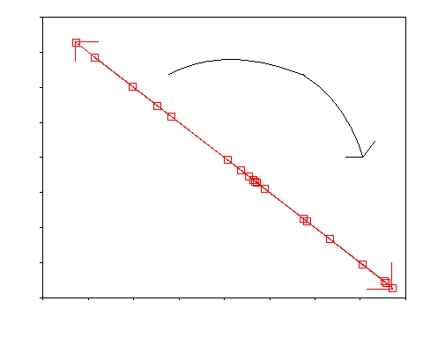
Correlation of -1; 180 degrees

Slide 4
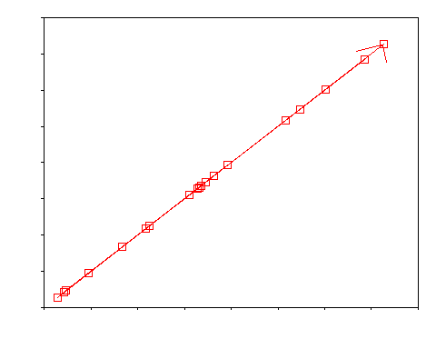
Correlation +1; 0 degree angle

Slide 5
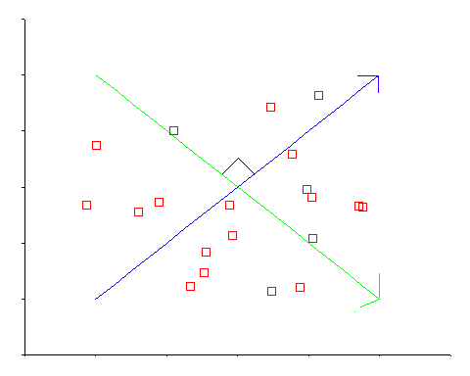
Zero correlation; 90 degree angle

Slide 6
Quadrants
RESIDUAL

Slide 7
Correlation - Need a range of values
“The quantity of the correlation is inversely proportional to the density of the control (the fewer the facts, the smoother the curves).” Anon.
Usually correlate pairs of continuous variables that can take a lot of values.
Missing variable
Drowning & ice cream consumption are positively correlated. Why?

Slide 8
Restriction of range
Can underestimate a correlation
Full range of values :
r = 0.86, p<0.001
Comprehension values 34 or 35
(in blue)
r = 0.38, p=0.25

Slide 9
Scatterplots
Check the relationship between X and Y is linear
Check for outliers
Draw Scatterplots before you do a regression
DEMO: ANSCOMBE.SPS
Bishara AJ and Hittner JB (2012) suggest a rank based transformation if outliers are a problem

Slide 10
FOUR DATA SETS (ANSCOMBE)
Each has outcome, Y and a predictor, X
For all four:
Y = 3.002 + 1.124*X
Correlation between X and Y=0.82
Scatter of points very important - don’t be fooled by a regression line!

Slide 11
DATA SET ONE

Slide 12
DATA SET TWO

Slide 13
DATA SET THREE

Slide 14
DATA SET FOUR

Slide 15
CHECK FOR GROUPS
Correlation = 0.87
Y=-0.05 + 0.96*X
Scatterplot shows existence of groups

Slide 16
Ignoring groups can ignore a correlation
r(Y,X1) = 0.01, p=0.98 (N=11)
Using Groups:
Group 1:
r(Y,X1) = 0.99, p<0.01 (N=5)
Group 2:
r(Y,X1) = 0.98, p<0.001 (N=6)
include group as a “third party” in explaining Y, X1 correlation

Slide 17
Parcel strings (Joseph Petrucelli)
Quality control (breaking strengths of strings) Manufacturers claim that breaking strengths of strings are 20lbs.
Parcel string tested every five minutes consecutively on each of 3 days

Slide 18
Taking sequence into account (Days 1 & 2)

Slide 19
Day 3
Conclude - breaking strengths vary differently over time on each day

Slide 20
Assumptions (1)
Continuous outcome
  methods available for categorical outcome
  categorical predictors need special coding
Linearity of relationships

Slide 21
Assumptions (2)
Random error
  Ball shaped centred around zero
Variance of outcome the same for all x
  (homoscedasticity)
  equal precision of model for all x

Slide 22
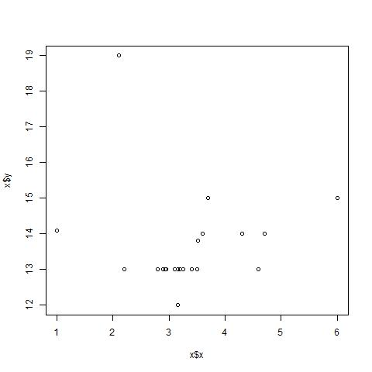
Percentile Bend r=0.24, (downweights outliers; Alternative to nonparametric correlations)
Pearson r = -0.03

Slide 23
Nonconstant variance (Funnel)

Slide 24
Non-linear plot
Suggests:
Transform predictor or response
to give a random plot
Fit a curve

Slide 25
Unequal residual variances
Residual is observed - expected value
(or difference between regression line and actual value)
Try a log transform

Slide 26
Comparing a pair of correlations
        Zero-order Semi-Partial***
Independent samples Fisher’s test* Interaction test (e.g. REGRESSION)
t-test / path analysis
Same sample Williams-Hotelling test**
Pearson-Filon t-test/ MANOVA
* Available using ‘equalcor’ UNIX program or a downloadable program, FZT.EXE, at http://www-class.unl.edu/psycrs/statpage/comp.html which also does an alternative to Williams test due to Steiger(1980)
**SPSS syntax for Williams-Hotelling test (rAX=rAY), Pearson-Filon (rAB=rXY) and Fisher’s test at DEMO WILLIAMS.XLS
*** Partials may also be used (Dugard, Todman & Staines, 2010)

Slide 27
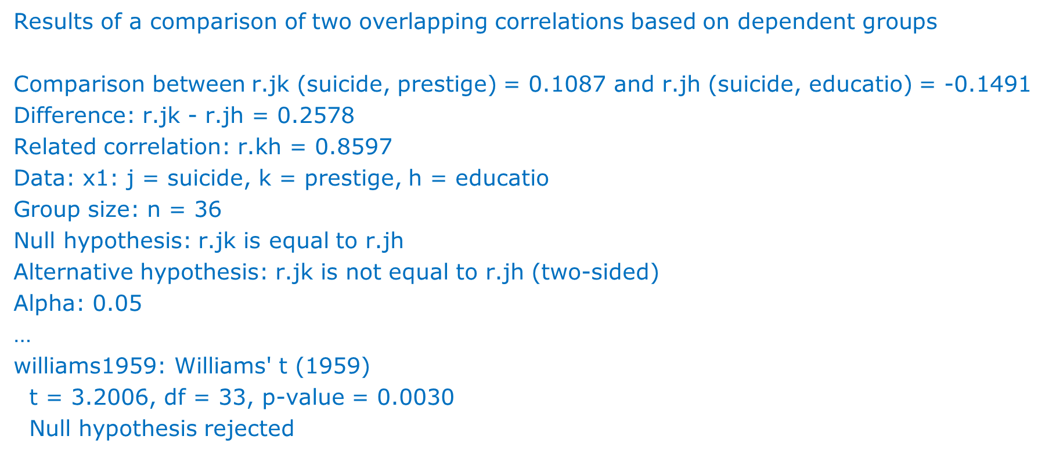
Cocor in R: comparisons of zero order correlations

Slide 28
Comparing regression coefficients in the same sample using a single regression
Comparing semi-partial correlations is equivalent to comparing regression coefficients (Cohen, 1983)
E.g….
Site 1: Dep=Crime rate; Indep=age, education get B(Cr1,A|E)
Site 2: Dep=Crime rate; Indep=age, education get B(Cr2,A|E)
Test of coefficients B(Cr1, A|E) = B(Cr2, A|E) is test of
Interaction (site x age) given site, age and education
Compares the correlation of Crime rate and age adjusted for years in education in the two locations
Do age and education have similar effects on crime rate when adjusted for each other?
t(df) = (Difference in Bs) / √[V(B1) + V(B2) – 2Cov(B1,B2))]

Slide 29
Interaction age*site of crime plot
x1 <- data.frame(x)
x4 <- na.omit(x1)
plot(c(110,180),c(20,240), axes=F, type="n",
main="Crimes committed in two locations", xlab="Age", ylab="Number of Crimes committed")
axis(1, at=c(0,110,120,130,140,150,160,170,180))
axis(2, at=c(0,20,40,60,80,100,120,140,160,180,200,220))
points(x1$age0,x1$crime0,pch=0)
z <- lm(x1$crime0 ~ x1$age0)
abline(z,lty=3)
points(x1$age1,x1$crime1,pch=1)
z1 <- lm(x1$crime1 ~ x1$age1)
abline(z1,lty=1)
legend(x=155,y=220,c("Manchester","Newcastle"), pch=c(0,1),lty=c(3,1))

Slide 30
Regression assumptions
Correlation does not imply causality
Handles linear relationships
May not apply outside range
At least 5 times as many subjects as variables (Hair et al,1998)
Must make psychological sense

Slide 31
Multiple Regression
more than one predictor
Squared semi-partial correlations (R-squareds)
Fit criterion:
  0<= R-squared <= 1
e.g. R-sq(X2, Y | X1, X3) = A/area of Y circle
A

Slide 32
Where to draw the line
Prediction of y at x =
intercept + slope * x
where
  intercept=value of y when x=0
  y=dependent variable (plotted on y axis)
  x=independent variable (plotted on x axis)
  In general : slope = Pearson correlation * sd(y) / sd(x)

Slide 33
How we fit the line
y estimated from x by Least Squares
  minimizes sum of squared differences between observed y and predicted y
  maximizes r(predicted y, observed y)

Slide 34
Means are least squares estimates
4 Scores of Y with values 1,2,4,9
Sum of Squared distances (D) from the mean is always a minimum
Mean = 16/4=4; D=(4-1)²+(4-2)²+(4-9)²=38
Median = (2+4)/2=3; D=42

Slide 35
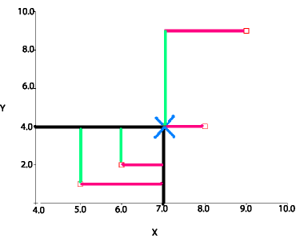
Scatterplotting the means
X,Y means marked by cross minimize total length of red lines and total length of green lines

Slide 36
Beta=correlation (one predictor)
(Standardised) outcome = beta x (standardised) predictor + residual
Find beta to minimize sum of squared residuals
Min Σ_{i} (outcome i - Beta x predictor i)² (observations i=1 to n)
beta ( for observations i = 1 to n)
= Σ_{i} outcome i x predictor i
predictor i x predictor i
= Σ_{i} { outcome i x predictor i }
√ (Σ_{i} {predictor i x predictor i} x {outcome i x outcome i} )
= Pearson Correlation
(because Σ_{i} (predictor i) ² = Σ_{i} (outcome i) ² = n )

Slide 37
Venn Diagrams
SS Total =
SS Reg(ression) + SS Res(idual)
R²=SS Reg / SS Total
(From ANOVA table)
0% <= R² <= 100%

Slide 38
SS(Reg)/SS(Total)=squared correlation
(Simple regression)
> m1 <- lm(suicide ~ prestige, data=x1)
> anova(m1)
Analysis of Variance Table
Response: suicide
Df Sum Sq Mean Sq F value Pr(>F)
prestige 1 58.0 58.044 0.4064 0.5281
Residuals 34 4856.3 142.834
t(34) =sqrt(0.406), p=0.52)

Slide 39
Fit criteria
summary(m1)
Call:
lm(formula = suicide ~ prestige, data = x1)
Residuals:
Min 1Q Median 3Q Max
-20.053 -8.919 -0.875 6.743 34.394
Coefficients:
Estimate Std. Error t value Pr(>|t|)
(Intercept) 27.07477 3.68353 7.350 1.62e-08 ***
prestige 0.04113 0.06452 0.637 0.528
---
Signif. codes: 0 ‘***’ 0.001 ‘**’ 0.01 ‘*’ 0.05 ‘.’ 0.1 ‘ ’ 1
Residual standard error: 11.95 on 34 degrees of freedom
Multiple R-squared: 0.01181, Adjusted R-squared: -0.01725
F-statistic: 0.4064 on 1 and 34 DF, p-value: 0.5281

Slide 40
Standardised residual plots
plot(m1$fitted.values,m1$residuals)

Slide 41
Stepwise methods
Parsimony - obtain fewest number of important features
ALL variables in a model independently associated with outcome
Shtatland ES et al(2003) criticise the over-reliance of stepwise on p-values and suggest a best subsets approach
LARS (Least Angle regression) available in R is another alternative to stepwise choosing the most parsimonious model

Slide 42
2 kinds of stepwise methods
Bottom Down (Backward)
Start with ALL variables
Remove least important one-by-one
Backward less biased by strong correlations between predictors than forward
(Hutmacher and Kowalski, 2015)
Top up (Forward)
Start with NO variables
Add most important one-by-one

Slide 43
What makes a good model?
There are various methods which are used to identify good model fits
F ratios
  Stepwise regression option in SPSS: find best one-variable model (according to hypothesis test), then best two-variable model with that first variable included, etc., until no additional variables are significant.
  Stepwise schemes do not necessarily find the best model among all the possible variable combinations
Akaike’s Information Criterion
Mallows Cp
  A good model if its Mallows Cp is close to p
The difference between Mallows Cp and AIC is explained in Venables & Ripley(1999) Chapter 6 for linear models, and is usually not great.

Slide 44
What are these fit criteria?
In R Using lm() with Step():
AIC = n ln(RSS/n) + 2 number of terms in model
In SPSS using all possible subsets approach
Cp = [RSS / MSE(full model)] + 2 number of terms in model – n
Where RSS = unexplained variance (Residual Sum of Squares)
MSE = RSS fitting all possible predictors / its df(error)
Both of form: model lack of fit term + number of terms in model
So want to minimize AIC and Cp

Slide 45
F tests vs model selection crit
AIC and Cp choose between models balancing goodness of fit with simplicity
Stepwise F tests do not directly compare all models and focus on statistical significance and goodness of fit
Kuiper, RM and Hoijtink (2010) Comparison of means using exploratory and confirmatory approaches. Psychological Methods 15(1) 69-86.
Sterba and Pek (2012) Individual Influence on model selection.
Psychological Methods 17(4) 582-299.

Slide 46
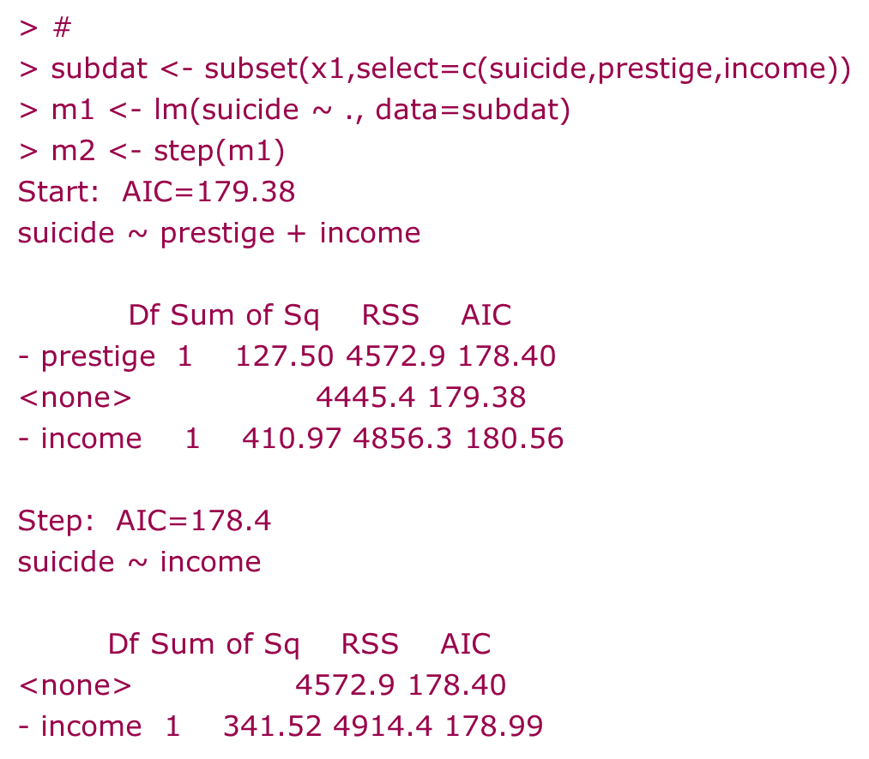

AIC backward stepwise
> attach(x1,2)
> m1 <- lm(suicide ~ ., data=x1)
> m2 <- step(m1)
Start: AIC=172.17
suicide ~ prestige + income + educatio
Df Sum of Sq RSS AIC
<none> 3442.3 172.17
- prestige 1 253.7 3696.0 172.73
- income 1 306.3 3748.6 173.24
- educatio 1 1003.1 4445.4 179.38

Slide 47
Facilitator Variables
(Median) Income (in dollars)
Male
Suicide rates
(20-64 years)
(Hand,1994) (Median Years in) Education
After removing effect of income a longer time in education has a lower rate; education has no effect on suicide rate on its own
Need to take both income & education into account when explaining suicide rate
Example of a synergistic relationship

Slide 48
Synergy - verbal score
total verbal score = score left brain + score right brain (deterministic); negative left,right brain correlation = -0.70
left brain (score A) right brain (score B) total verbal score (A+B)
2 4 6
5 6 11
6 5 11
8 2 10
10 1 11
score A ONLY - R²=53%, score B ONLY - R²=0%
score A AND score B = 100%!
0.03*INCOME-2.17*EDUCATION correlates with suicide rate
INCOME, EDUCATION themselves do not

Slide 49
Mountain racing…..
grip of footwear, temperature predicting time to race up and down a mountain
temp (deg C) grip (roughness coeff) race time (minutes)
10 10.2 200
20 0.4 180
15 8.4 150
8 16.8 120
9 16.0 95
12 14.0 90
Better gripping soles tended to be worn in lower temperatures…
r(temp,grip) = -0.93 (badly designed study!)

Slide 50
Results
Temperature ALONE: t₄=0.98, p=0.38, R²=19%
Grip ALONE: t₄=-2.04, p=0.11, R²=51%
Temperature & Grip TOGETHER: R²=95%
Temperature: t₃=-5.04, p=0.015
Grip: t₃=-6.63, p=0.007
Temperature and grip predict race time together but not separately!
A synergistic relationship again!
May not have occurred if greater range of grips used at each temperature

Slide 51
Memory - collinearity example
Correlation in IQ:
(time1, time2)=0.98; both correlate > 0.5 with memory (y)
Collinearity (highly correlated predictors):
Tolerance < 0.1, VIF > 10
(Tolerance=1/VIF)
Should combine times or use one time to predict memory score
Collinearity:
Can give inflated Std errors, wrongly signed regression estimates
> m1 <- lm(MEMORY~TIME1+TIME2)
> vif(m1)
TIME1 TIME2
55.55081 55.55081 > 10

Slide 52
Collinearity and synergy
In mountains example tolerance = 0.12, VIF=8.2
So, just outside range indicative of collinearity.
In general synergy may result from highly correlated predictors
but the correlations will usually not be high enough to cause collinearity problems.
But check!
Lasso and Ridge Regression can reduce collinearity

Slide 53
Handling Collinearity
LASSO regression (Tibshirani, 1996): minimised sum of regression coefficients so that sum tend to and reach zero
Ridge regression (Hoerl and Kennard, 1970) minimises the squares of the regression coefficients
Elastic net regression (Zou and Hastie, 2005) is a hybrid of LASSO ans Ridge regressions

Slide 54
Fit indices
Can assess regression models using fit indices such as
MSE = Sum (observed – predicted)^2
MAE = Sum Abs(observed – predicted)
MAPE = Sum( [observed – predicted]/predicted) * 100
R-squared = 1 - MSE / Total variance
Glmnet in R parameter alpha=1 (LASSO), alpha=0 (Ridge) otherwise Elastic net

Slide 55
Kovac et al (2024)
Ridge, LASSO, and Elastic Net regression gave very similar model fits on a linear regression of emotional competency (EC), Distress tolerance, cognitive flexibility, alexithymia and childhood trauma (TRAU) to predict internal shame
Perf. metric | Ridge | LASSO | Elastic Net
MSE | 46.49 | 45.82 | 46.05
MAE | 5.36 | 5.37 | 5.36
MAPE | 7.29 | 7.29 | 7.28
R2 | 72.39 | 72.78 | 72.65

Slide 56
Thanks to
Ian Nimmo-Smith
David Boniface & Michaela Cottee
John Hall/ Joseph Petrucelli
Ref: Hair JF, Anderson RE, Tatham RL, Black WC (1998, 2006)
Multivariate Data Analysis Fifth, Sixth Editions
Both in CBU library
(Good “rules of thumb”)
John F Hall | Independent Researcher | Talks - Academia.edu
http://independent.academia.edu/JohnFHall/Talks
(“Crash Course in R”)
http://www.staff.ul.ie/mackenzieg/Assess/R_Integration_Tools/r_integration_tools.html

Slide 57
Next week…11am
The General Linear Model

