Slide 1
8: SAMPLE SIZE DETERMINATION
OR
May the power be with you
Peter Watson
http://imaging.mrc-cbu.cam.ac.uk/statswiki/FAQ/powerFAQ

Slide 2
Sample Size
Sample size needed is independent of population size
Too large a sample in a study
  economic and ethical problems
Too small a sample in a study
  risk failing to find a large effect e.g. group difference
  File drawer problem
need just enough to enable accurate detection (or power)
Make sure you take account of response rates: e.g. cancer sibling study: 222 required to sample but 80% response rate will reduce sample;
New N = 1/(1-L) x old N: New N = 278. L = proportion lost (1-80%=20% in our example)

Slide 3
Hypothesis Testing
Specify:
  Null Hypothesis - no effect
  Alternative Hypothesis - an effect
  do a statistical test
  probability of a false positive result

Slide 4
Hypothesis Testing (2)
True situation
Decision No Effect Effect
No Effect √ Type 2 (False ‘-’)
(p=1-α) (p=β)
Effect Type 1 (False ‘+’) √=POWER
(p= α) (p=1- β)

Slide 5
Everitt BS, 1995
Power is
“The probability of rejecting the null hypothesis when it is false. Power gives a method of discriminating between competing tests of the same hypotheses, the test with the higher power being preferred.”

Slide 6
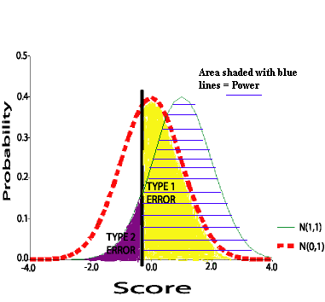
Power = 1 - Type II error
Type 1 Error is area in yellow
Power in blue lines
Criterion Value is black line
Power increases with Type 1 error

Slide 7
Type I error (α)
Wrongly reject the “no effect” hypothesis, ie P(false positive result)
Usually α=0.05 or 0.01
Size of Type 1 error specified before data collection

Slide 8
Prediction of difference
Specified before the data is collected
Two-tail is non-directional
  (e.g. Mean = 0 vs Mean ≠ 0)
One-tail is directional
  (e.g. Mean<=0 vs Mean > 0)

Slide 9
Type II error
Wrongly conclude there is no effect
(chance of a false negative result)
Usually β=0.2 (or even 0.1)
Increasing Type 1 error decreases Type 2 error and increases power

Slide 10
Power
Ability to correctly detect real effects
Power=1-P(wrongly concluding “no effect”)
Power usually 80%; ideally 90%

Slide 11
Boosting power
Use one-tail instead of two-tail tests
Use parametric instead of non-parametric equivalents
Increase sample size
Increase smallest interesting effect size
In multivariate analyses (e.g. MANOVA) use fewer variables

Slide 12
Effect Size
Decide smallest clinically important effect
Power tells us how many needed to reliably detect this effect or a larger one
Smaller effects more difficult to detect
Requested in APA guidelines
P-values can be misleading : e.g. chi-square highly sensitive to sample size; Earth is round, p<0.05

Slide 13
Examples of effect sizes
t-tests: Minimum Number of sds between 2 means to be clinically useful
regression: amount explained in outcome to be clinically useful (correlation)
crosstab chi-squares: odds ratios
Bakker et al. (2019) Avoid using ‘canned’ effect sizes if possible

Slide 14
2 samples of size 10; Type I error = 0.05

Slide 15
Effect size: t-tests
Scale Group Sd Diff/Sd
Difference
inches 10 5 2
cm 25.4 12.7 2
ratio of discriminability and precision

Slide 16
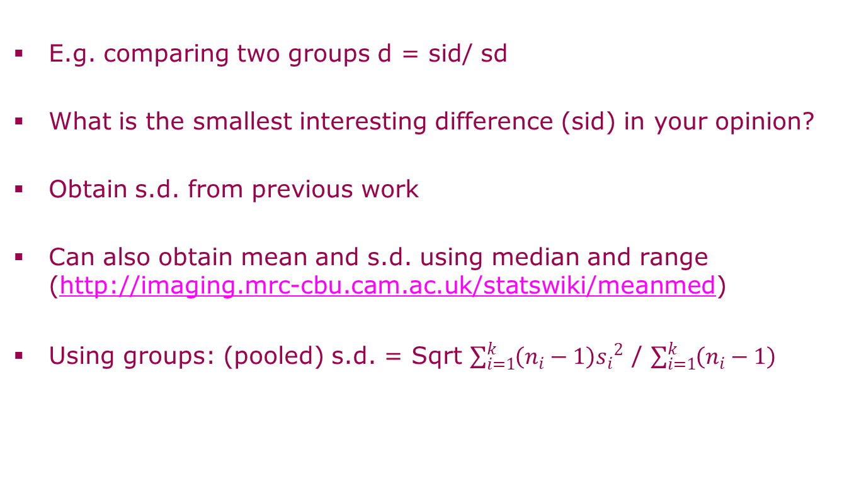
Use own judgement

Slide 17
Example 1
Cornell Medical index (CMI) (Cohen, 1992)
Coffee drinkers > Non-Coffee drinkers?
Effect Size
= sid / CMI s.d.
sid = 3.5 (because CMI increases by 3.5 per person per decade)

Slide 18
Example 2
Caliper (1/1000ths inch)
sid=.001 (inch)
sd=.002 (prev. study)
Effect= .001/.002= .5
School ruler (1/16ths inch)
sid=.5 (inch)
sd=1 (prev. study)
Effect = .5/1 = .5

Slide 19
Effect size: rules of thumb
t-test (difference in sds)
correlation
ANOVA:
  SS(Groups)____ =
  SS(Groups)+SS(W)
Regression: f-sq = R² / (1 - R²⁾
(R² also called eta-squared)
Odds Ratio (also: d = ln(Odds Ratio) x sqrt(3)/pi)
(Mantel-Haenszel pooled estimate available for 2xC tables)
[Phi = Sqrt(chi-square/N)
(Cohen,1988) used in G*POWER
small medium large
0.20 0.50 0.80
0.10 0.30 0.50
0.10 0.25 0.40
0.02 0.15 0.35
(equivalently R²=0.02 0.13 0.26)
See also Haddock et al (1998)
1.50 3.50 9.00
1.39 2.28 3.74 (Cox, 1970)
0.10 0.30 0.50]
Chi-square increases with N

Slide 20
Effect Size:rules of thumb
Proportions
p1 v p2 (2x2 χ²)
p v 0.5 (2x1 χ²)
Correlations
r1 v r2 (Fisher)
Conversion formulae can be used see
http://www.stat-help.com/ spreadsheets.html
Including d, r, r^2, Odds Ratios which all measure correlations
Cramer’s V extends Phi to larger 2-way tables
(Cohen, 1992)
small medium large
p2 0.50 0.65 0.78 (p1=0.4)
p 0.55 0.65 0.75
r1 0.10 0.29 0.46 (r2=0)

Slide 21
Key Features
Choice of test
One-tailed or Two-tailed
Effect Size
Desired power
Type 1 error(chance of a false positive)
Sample Size

Slide 22
Power evaluation methods
Nomogram
G*Power freeware
R syntax (also available in SPSS)

Slide 23
Example
Patient vs Control group: measure of spatial memory.
From earlier work on memory:
Smallest interesting difference (sid)=3
Common group standard deviation=4

Slide 24
Deciding analysis
Two independent groups; continuous Normally distributed outcome measure
Suggests unpaired t-test

Slide 25
Nomogram
Graphical display in Altman (1991)
(Two-tailed tests)
Input Effect Size=sid/memory s.d.=3/4
Power=0.90
Read off Total sample size using a ruler!

Slide 26
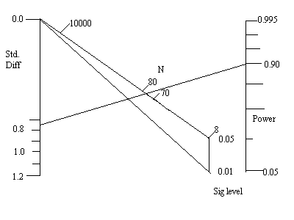
Nomogram : N=38 (=75/2) per group; Type 1 =0.05;

Slide 27
Power computations using software
Input: Type 1 error, Effect Size + either power or sample size
Input power: output = sample size
Input sample size: output = power
DEMOS
GPOWER
PEPI
SPREADSHEET
R (http://www.statmethods.net/stats/power.html)
SPSS (also has in-built routines added V27+)

Slide 28
Freeware
G*Power (versions 2 and 3)
http://www.psycho.uni-duesseldorf.de/aap/projects/gpower/index.html
(Also has an on-line manual with applications to AN(C)OVAs and chi-square)
(Correlations and groups)
http://www.sagebrushpress.com/PEPI.html

Slide 29
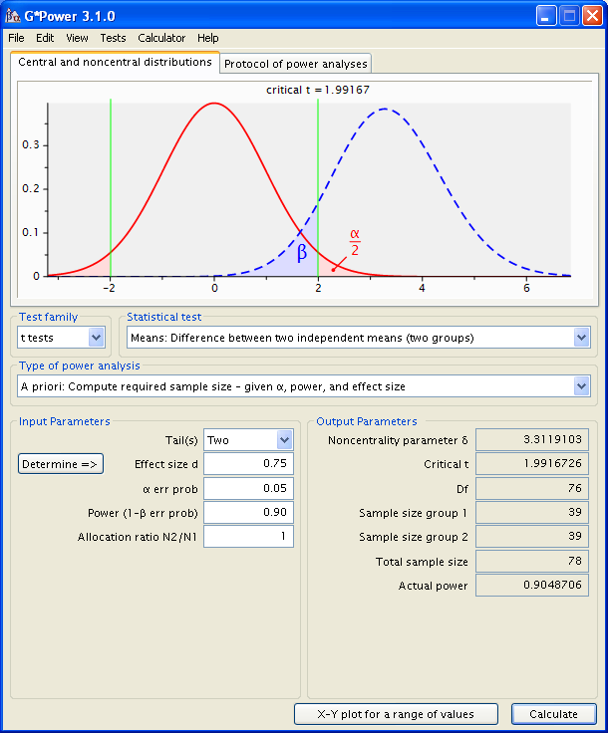
G*POWER 3
Enter ingredients
Sample size required
Click calculate button

Slide 30
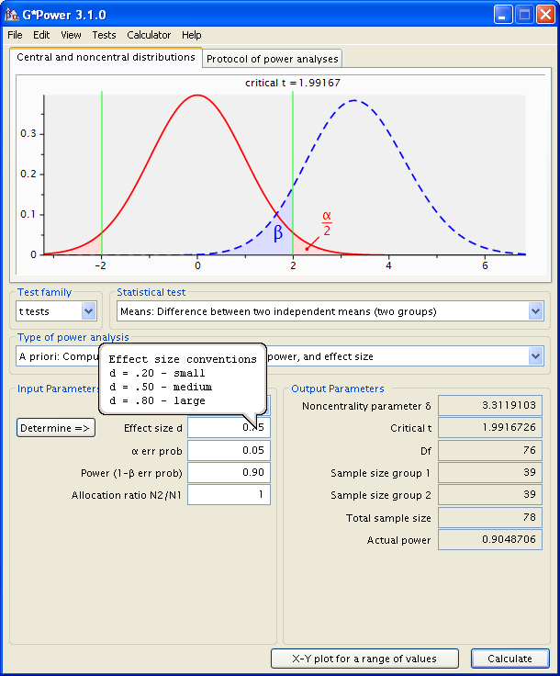
Can also obtain Cohen’s effect size rules of thumb
Just hover cursor over effect size box

Slide 31
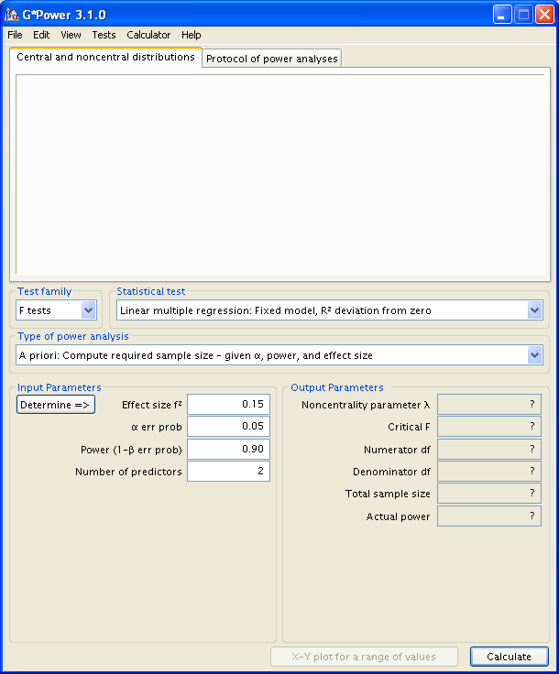
Regression : uses R²/(1-R²)

Slide 32
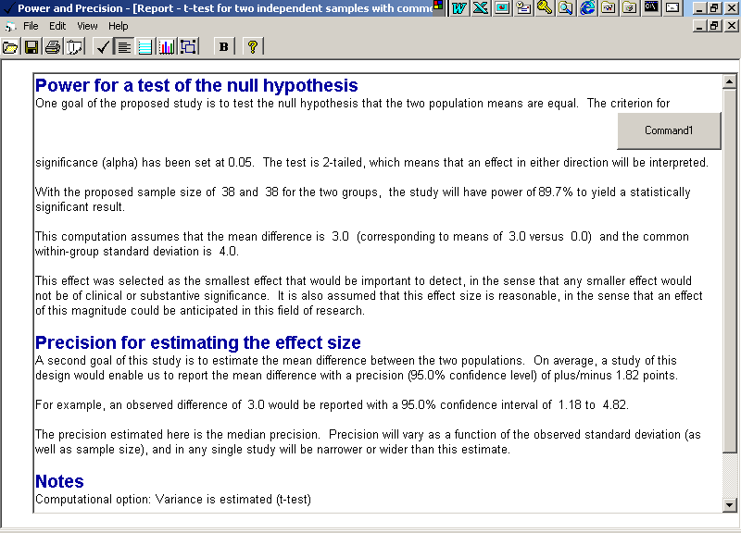
Incorporating into a report

Slide 33
Power Curves: group means differ by 3; Group sds of 4

Slide 34
Unequal sample sizes (Nomogram)
Use TOTAL number used for equal sample sizes
Use a formula to obtain new TOTAL for unequal groups sizes

Slide 35
Nomogram: unequal group sizes, 90% Power
Input:
Total Number=75 in our example
Ratio sizes:
group 2 / group 1=2 in our example
Total Number =
75x(1+2)x(1+2) = 85
4 x 2
Sample sizes 29 and 58

Slide 36
Unequal group sizes:Web Software
Power Calculator: input any group size and obtain a power value
PEPI: specify ratio of 2

Slide 37
Power Curves: group means differ by 3; group sds = 4

Slide 38
Power=0.90, N₂=2N₁, 2-tailed Type 1 =0.05, sid=3, sd=4
Nomogram & PEPI &
Calculator & Power
Curves:
N₁ N₂ Sum
-----------------
Equal 38 38 76
Uneq 29 58 87
For equal samples of size n to get unequal sample sizes , N1/N2=k
N2 = 0.5n(1+(1/k))
N1 = 0.5n(1+k) – see Lehana Thabane pdf in the demo folder
In R:
pwr.t.test(n=NULL,d=0.75,sig.level=0.05,power=0.90,type="two.sample", alternative="two.sided")
n = 38.34604
pwr.t2n.test(d=0.75,n1=29,power=0.90,alternative="two.sided")
n1 = 29
n2 = 56.13635

Slide 39
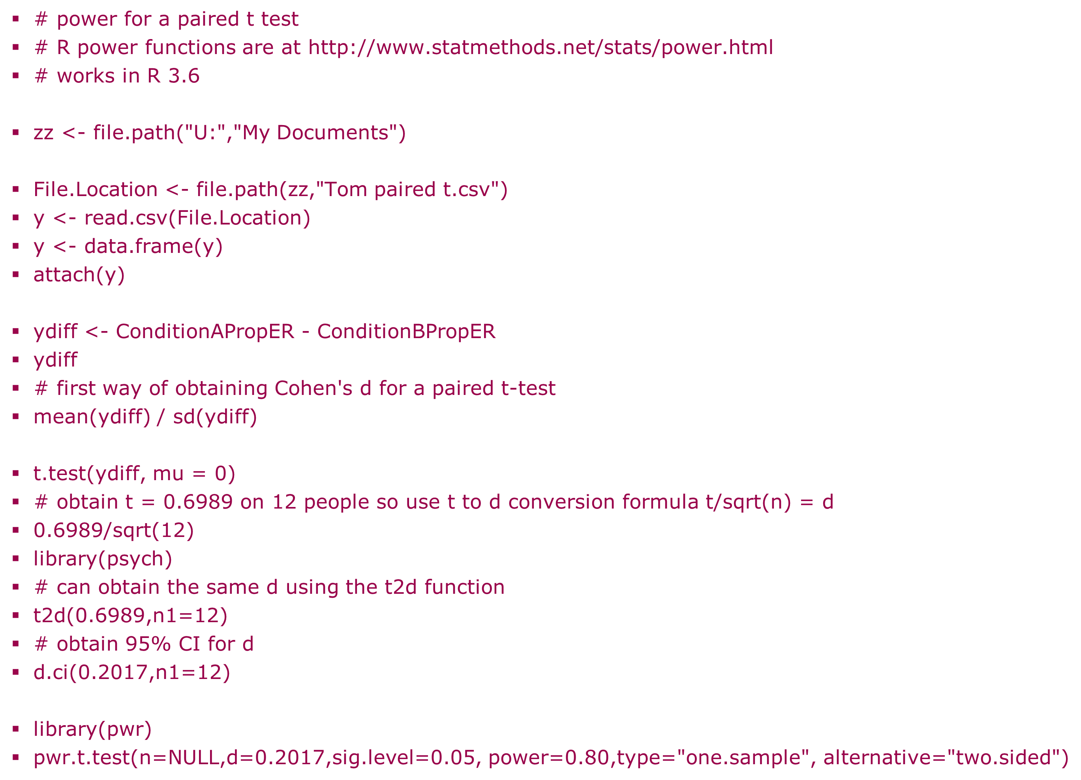
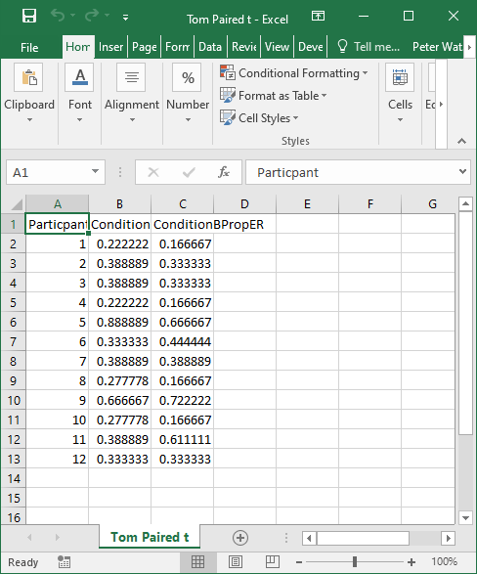
Power for a paired conditions difference in R
Power for paired t-test
Data

Slide 40
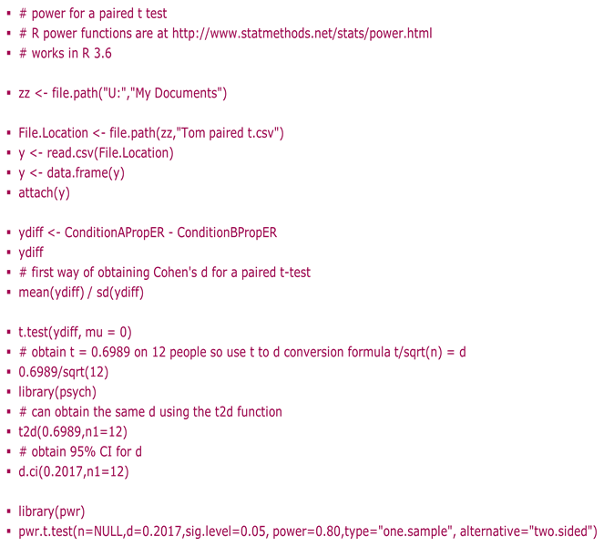
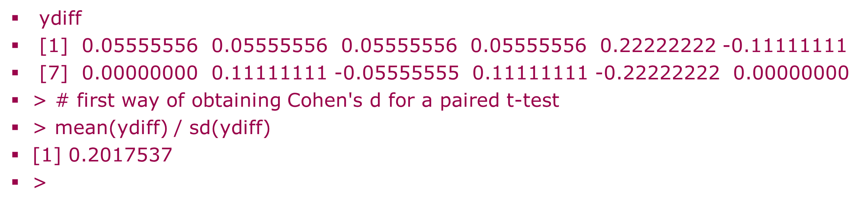

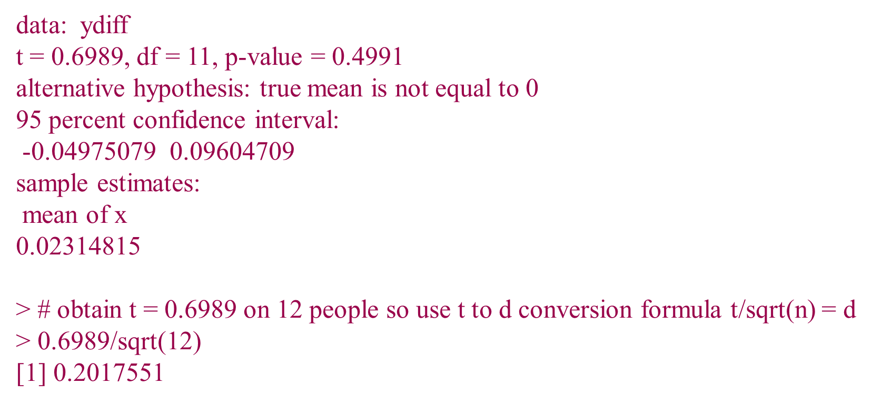
Paired conditions example cont.
Syntax
Output
n = 194.8573
d = 0.2017
sig.level = 0.05
power = 0.8
alternative = two.sided

Slide 41
Confidence Intervals
Can obtain 95% Confidence intervals for effect sizes
2 methods
Asymptotic e.g. d.ci in R, Geoff Cummings ESCI for Cohen’s d
(See also MBESS in R (eta^2 CIs))
Bootstrap (but need raw (pilot) data)

Slide 42
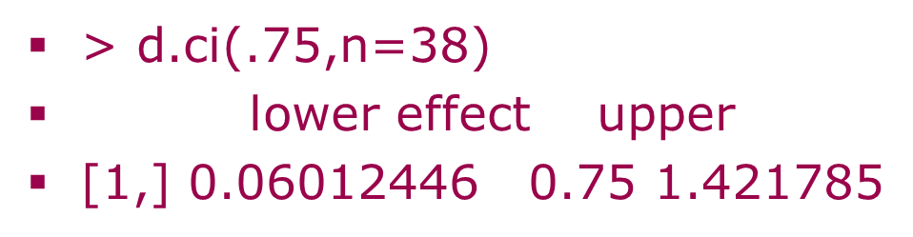
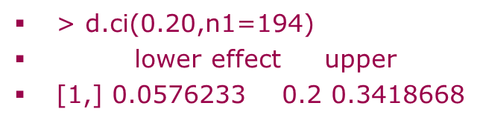
Confidence intervals for Cohen’s d
Unpaired CI, n=38 in each group
Paired conditions CI

Slide 43
Conclusions
Important consideration in study feasibility (e.g. in grant proposals)
Safeguards in the case of null results
Close agreement between methods
Power can be boosted using equal sized groups, higher Type 1 error (e.g. 1 tailed tests), larger effect sizes and univariate analyses,

Slide 44
Decide analysis
Decide one or two-tailed
(significance level)
Decide analysis
Decide Sample Size
Decide effect size
Find Power
Find Sample Size
Decide Power
Baker and Mudge (2012(9), Significance magazine) however suggest combining Type I and II errors to determine N

Slide 45
References
Altman DG (1991) Practical Statistics for Medical Research. Chapman & Hall.
Boniface DR (1995) “Experiment Design
and Statistical Methods for Behavioural and Social Research.” Chapman & Hall.
Field A. (2005) Discovering Statistics using SPSS. Sage.
(section on power in ANOVAs)
Other formulae for sample sizes: See Lehana Thabane’s class notes (pdf file in demo folder)

Slide 46
Next week… 11am
Analysis of Longitudinal Data

