Slide 1
MRC Cognition and Brain Sciences Unit
Graduate Statistics Course
http://imaging.mrc-cbu.cam.ac.uk/statswiki/StatsCourse2024

Slide 2
7: Post-hoc tests, Multiple comparisons, Contrasts and handling Interactions
What to do following an ANOVA
Peter Watson
(with thanks to Ian Nimmo-Smith)

Slide 3
Aims and Objectives
Why do we use follow-up tests?
Different ways to follow up an ANOVA
  Planned vs. Post Hoc Tests
  Contrasts and Comparisons
  Choosing and Coding Contrasts
  Handling Interactions

Slide 4
Example: Priming experiment
Between subjects design
Grouping Factor: Priming
Dependent variable: Number correct

Slide 5
Example: Priming experiment (II)
One-way ANOVA
ANOVA: F(3,36)=6.062
P=0.002**
So what?

Slide 6
Why Use Follow-Up Tests?
The F-ratio tells us only that the experiment had a positive outcome
  i.e. group means were different
    or, more precisely, are not all equal
It does not tell us specifically which group mean differ from which.
We need additional tests to find out where the group differences lie.

Slide 7
How?
A full toolkit
  A: Standard Errors of Differences
  B: Multiple t-tests
  C: Orthogonal Contrasts/Comparisons
  D: Post Hoc Tests
  E: Trend Analysis
  F: Unpacking interactions

Slide 8
A: Standard Errors are the basic Yardsticks
Between subjects ANOVA with a constant number n of subjects per cell
Standard Error of the Mean (SEM)
  SEM = SE / √ n = √ (MS(Error)/n)
  SEM =√ (2.139/10)=0.46
  N.B. we are using the same SEM for all mean based on (pooled) error term
Standard Error of the Difference of Means
  SED = √2 × SEM =0.65
  E.g. Semantic-Phobic=6-5.1=0.9=1.38×SED
    Unlikely to be significant

Slide 9
A: Standard Errors from SPSS

Slide 10
A: Plotting Standard Errors
Means +/- 1 SEM

Slide 11
A: Plotting Standard Errors of the Differences http://seriousstats.wordpress.com/
Means +/- 1 SED

Slide 12
A: Plotting 95% Confidence Intevals of Differences
Means +/- 95% CI for Differences of Means

Slide 13
B: ‘LSD’ option
with(mdata,
pairwise.t.test(score, mood, p.adjust.method="none", paired=T))
Pairwise comparisons using paired t tests
data: score and mood
1 2 3
2 0.1323 - -
3 0.0043 0.1066 -
4 9.2e-07 0.0044 0.1212
P value adjustment method: none
1=C,2=S,3=L,4=P
C>L,P
S>P
(all p<.05)
But NB

Slide 14
B: ‘LSD’ option
The problem with doing several null-hypothesis tests
  Each test is watching out for a rare event with prevalence α [Type I Error Rate].
  The more tests you do the more likely you are to observe a rare event.
    If there are N tests of Size α then the expected number of Type I Errors is N.α
    With α = 0.05 we can expect 5/100 tests will reject their Null Hypotheses ‘by chance’.
  This phenomenon is known as Error Rate Inflation.

Slide 15
Multiple Comparisons: Watch your Error Rate!
Various ways of thinking about comparisons
  Relating to Post-Hoc vs A Priori Hypotheses?
  Comparison?
    between a pair of conditions/means
  Contrast?
    between two or more conditions/means

Slide 16
Type I Error Rates
Per Comparison (PC) error rate (α)
  probability of making a Type I Error on a single Comparison
Family-wise (FW) error rate
  probability of making at least one Type I error in a family (or set) of comparisons (also known as Experiment-wise error rate)
PC ≤ FW ≤ cα or 1-(1-α)^{c}
  where c is the number of comparisons

Slide 17
Problem of Multiple Comparisons
A numerical example of Error Rate inflation
  Suppose C independent significant tests with size α.
  And suppose all the null hypotheses are true.
  The probability (α*) of at least one significant result (Type I error) is bigger.
    α*=1-(1- α)^{C}
      α=0.05
      C=6 (Say, comparable to all contrasts between 4 conditions)
    α*=0.26 !!!
    So the Familywise Error Rate is 26%, though each individual test has Error Rate 5%.
  What is to be done?

Slide 18
Various Approaches
  Orthogonal Contrasts or Comparisons
  Planned Comparisons vs. Post Hoc Comparisons
  (See also Boniface(1995, p.80) and Howell 1997 (p.350-1,354) for discussion of apriori tests). Field (2005, page 336) using a “more conservative probability level” when using non-orthogonal planned comparisons.

Slide 19
Orthogonal Contrasts/Comparisons
  Hypothesis driven
  Planned a priori
  Usually accepted that nominal significance can be followed (i.e. no need for adjustment)
  Rationale: we are really interested in each comparison/contrast on its own merits. We have no wish to make pronouncements at the Family-wise level.

Slide 20
A Priori (= Planned)
Typically there is a rationale which identifies a small number of (sub)-hypotheses which led to the formulation and design of the experiment.
These correspond to Planned or A Priori comparisons
So long as there is no overlap (non-orthogonality) between the comparisons

Slide 21
Post Hoc Tests
Not Planned (no hypothesis)
  also known as a posteriori tests
E.g. Compare all pairs of means

Slide 22
Planned Comparisons or Contrasts
Basic Idea:
  The variability explained by the Model is due to subjects being assigned to different groups.
  This variability can be broken down further to test specific hypotheses about ways in which groups might differ.
  We break down the variance according to hypotheses made a priori (before the experiment).

Slide 23
Rules When Choosing Contrasts
Independent: contrasts must not interfere with each other (they must test unique hypotheses).
Simplest approach compares one chunk of groups with another chunk
At most K-1: You should always end up with one less contrast than the number of groups.

Slide 24
How to choose Contrasts?
In many experiments we have one or more control groups.
  The logic of control groups dictates that we expect them to be different from some of the groups that we’ve manipulated.
  The first contrast will often be to compare any control groups (chunk 1) with any experimental conditions (chunk 2).

Slide 25
Contrast 1
Between subject experiment
  One-way ANOVA
Control vs. Experimental
Control - (Semantic+Lexical+Phobic)/3
(1,-1/3,-1/3,-1/3) or (3,-1,-1,-1)
> lin <- -3*y$control-y$semantic+y$lexical+3*y$phobic
> t.test(lin,mu=0)
One Sample t-test
data: lin
t = -10.154, df = 9, p-value = 3.151e-06
alternative hypothesis: true mean is not equal to 0
95 percent confidence interval:
-10.760536 -6.839464
sample estimates:
mean of x
-8.8

Slide 26
Contrasts 2 and 3
Phobic versus Non-phobic priming
  (Semantic+Lexical)/2 - Phobic
  (0,1,1,-2)
Semantic vs Lexical
  Semantic - Lexical
  (0,1,-1,0)

Slide 27
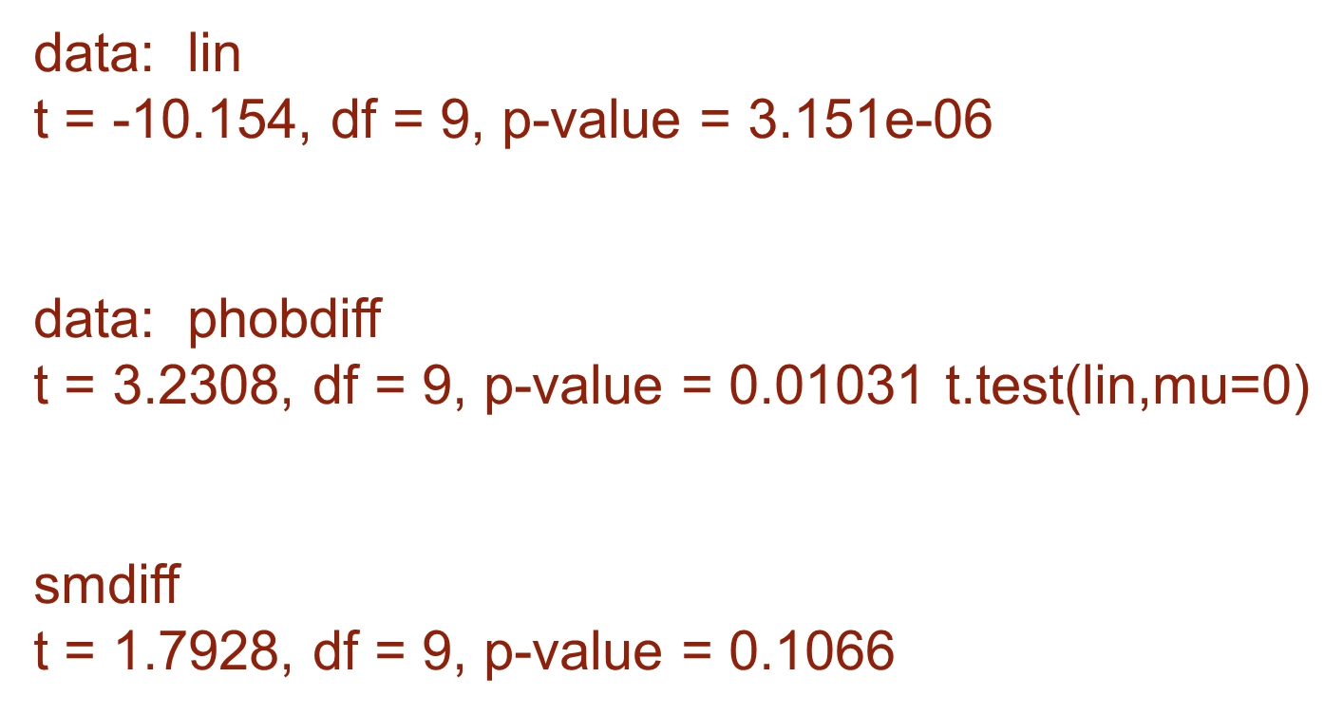
One-way ANOVA contrasts (one sample t)
Contrast Coefficients
C > ave(S,L,P)
ave(S,L)>P
S,L do not differ

Slide 28
Rules for Coding Planned Contrasts
Rule 1
  Groups coded with positive weights will be compared to groups coded with negative weights.
Rule 2
  The sum of weights for a contrast must be zero.
Rule 3
  If a group is not involved in a contrast, assign it a weight of zero.

Slide 29
More Rules …
Rule 4
  For a given contrast, the weights assigned to the group(s) in one chunk of variation should be equal to the number of groups in the opposite chunk of variation.
Rule 5
  If a group is singled out in a comparison, then that group should not be used in any subsequent contrasts.

Slide 30
Partitioning the Variance
38.90 = 20.83 + 14.02 + 4.05
This additivity is a consequence of insisting on orthogonal contrasts

Slide 31
Contrasts in GLM (I)
Only particular ‘off-the-shelf’ sets of contrasts are provided via the menus
  but can generate bespoke contrasts by using ‘Special’ via syntax
‘Deviation’
  compare each level with average of preceding
    (1,-1,0,0)
    (1,1,-2,0)
    (1,1,1,-3)

Slide 32
Contrasts in GLM (II)
‘Simple’
  compare each level with either the first or the last
    (1,-1,0,0) (1,0,0,-1)
    (1,0,-1,0) or (0,1,0,-1)
    (1,0,0,-1) (0,0,1,-1)

Slide 33
Contrasts in GLM (III)
‘Helmert’ and ‘Repeated’
compare each level with mean of previous or subsequent levels
  (1,-1,0, 0) (3,-1,-1,-1)
  (2,-1,-1,0) or (0,2,-1,-1)
  (3,-1,-1,-1) (0,0,1,-1)

Slide 34
Contrasts in GLM (IV)
‘Polynomial’
  Divide up effects into Linear, Quadratic, Cubic … contrasts
  Appropriate when considering a Trend Analysis over time or some other covariate factor

Slide 35
Non-orthogonal a priori contrasts
To correct or not to correct?
Typically, if the number of planned comparisons is small (up to K-1), Bonferroni type corrections are not applied.

Slide 36
Post Hoc Tests (I)
Compare each mean against all others.
  In general terms they use a stricter criterion to accept an effect as significant.
  Hence, control the Familywise error rate.
  Simplest example is the Bonferroni method:
    divide the desired Familywise Error Rate α by the number of comparisons c and use α/c as the Bonferroni Corrected Per Comparison Error Rate α∗.
    With 2 means, α=0.05, c=1 then α∗=0.050
    With 3 means, α=0.05, c=3 then α∗=0.017
    With 4 mean, α=0.05, c=6 then α∗=0.008

Slide 37
Post Hoc Tests (II)
What to include?
  All experimental treatments vs. a control treatment
  All possible pairwise comparisons
  All possible contrasts
These all need different handling.

Slide 38
Simple t
Fisher's Least Significant Difference: LSD
  unprotected
Fisher's protected t
  Only proceed if the omnibus F test is significant.
  Controls familywise error rate, but may miss out needles in the haystack.

Slide 39
The significance of the overall F
An overall significant F test is not a pre-requisite for doing planned comparisons.
There still remains a considerable amount of confusion arising from earlier statements to the contrary.
Not least in the minds of some reviewers

Slide 40
Bonferroni formulae
Seeking α-familywise of α
Bonferroni t or Dunn's test
  Set α-per-comparison = α/c
    Bonferroni correction
    conservative
Dunn-Sidak
  Set α-per-comparison = 1-(1-α)^{1/c}
    improved (exact, less conservative) Bonferroni correction which usually makes very little difference
E.g. to achieve FWER of 0.05 with all 6 possible comparisons of 4 means use α*=0.05/6=0.0083
α*=1-(1-0.05)^(1/6)=0.0085

Slide 41
Multi-stage Bonferroni procedures (I)
For controlling family-wise error rate with a set of comparisons less than all pairwise comparisons.
Partitions target family-wise α in different ways amongst the comparisons.

Slide 42
Multi-stage Bonferroni procedures (II)
Holm procedure
http://www.sagebrushpress.com/PEPI.html
(adjustp.exe); also in R
Larzelere and Mulaik procedure
Can be applied to subsets of correlation from a correlation matrix.
http://imaging.mrc-cbu.cam.ac.uk/statswiki/FAQ/pvs

Slide 43
Limitations of Bonferroni
These procedures are based on ‘worst case’ assumption that all the tests are independent.

Slide 44
Beware SPSS’s ‘Bonferroni adjusted’ P value
http://imaging.mrc-cbu.cam.ac.uk/statswiki/FAQ/SpssBonferroni
The problem
  SPSS has sought to preserve the ‘Look at the P Value to find out if the Test indicates the Null Hypothesis should be rejected’ routine
  So SPSS quotes artificial ‘Bonferroni Adjusted P Values’ rather than advising of the appropriate Bonferroni Corrected α
  Can end up with oddities like P=1!!!!
  (if cα>1 then SPSS Bonferroni Adjusted P is set to 1)

Slide 45
What to do about SPSS and Bonferroni t
Avoid!
Either
  use LSD (ie pairwise t tests regardless of significant F) and work out the Bonferroni corrected α yourself
Or
  use Sidak adjusted P’s

Slide 46
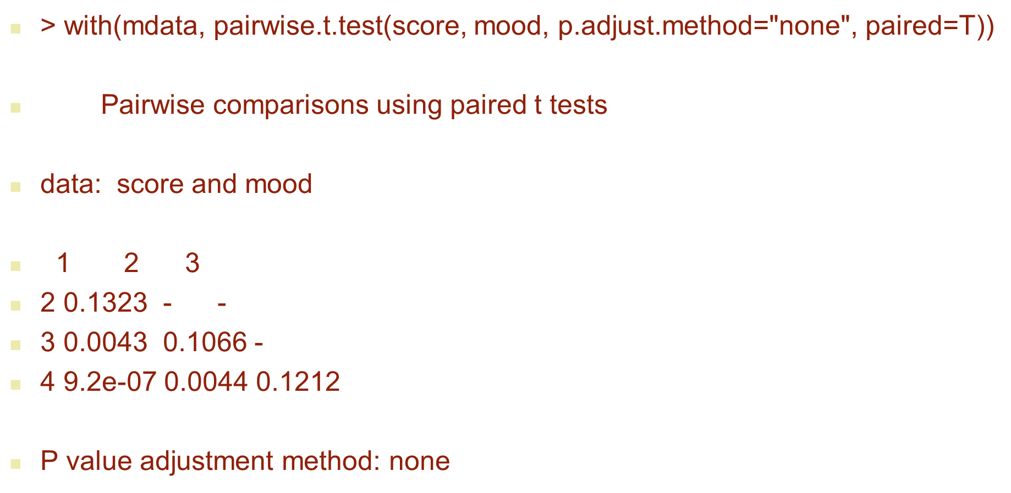
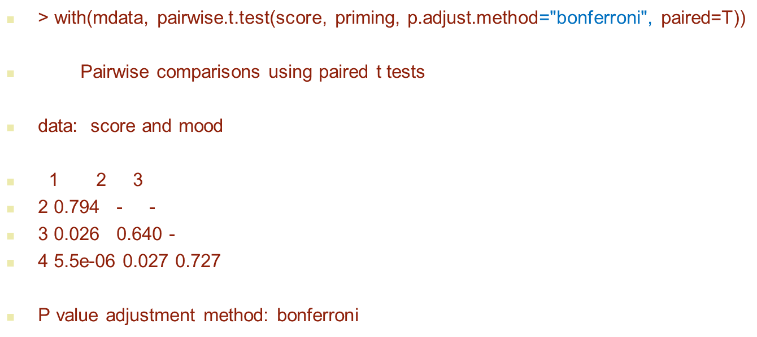
Priming multiple comparisons
No adjustment
Adjustment

Slide 47
Sidak adjusted p-values in R
library(MHTdiscrete)
>Sidak.p.adjust(c(0.132,0.0043,0.1066,0.0000092,0.0044,0.1212))
[1] 5.723206e-01 2.552424e-02 4.915179e-01 5.519873e-05 2.611130e-02
[6] 5.393827e-01

Slide 48
Studentized Range Statistic
Based on dependence of the ‘range’ of a set of means on the number of means that are being considered.
  Expect a wider range with a larger number of means
Tables of Q(r, k, df)
  r = number of means current range
  k = number of means overall
  df = degrees of freedom in mean square error

Slide 49
Newman-Keuls Procedure
Critical difference is a function of r and k (and the degrees of freedom)
Strong tradition but some recent controversy.
A 'layered' test which adjusts the critical distance as a function of the number of means in the range being considered at each stage.
The nominal family-wise error rate α may not actually be achieved

Slide 50
Critical distance procedures
Tukey's Test: HSD
  Honestly Significant Difference
  Unlike Newman-Keuls, only uses the largest (outmost) critical distance throughout.
Ryan's Procedure: REGWQ
Ryan: α_{r}= r α/k
Einot and Gabriel: α_{r}=1-(1- α)^{r/k}

Slide 51
Scheffé's test
All possible comparisons
Most conservative

Slide 52
Post Hoc Tests: Recommendations
Field (2000):
  Assumptions met & large number of comparisons: REGWQ or Tukey HSD; can also type ‘mc’ at a Unix prompt
  (Ramsey & Ramsey (2008) suggest Tukey-Kramer HSD as Tukey HSD analogue for unequal group sizes). Can also type ‘mcneq’ at a Unix prompt
  Safe Option & few comparisons: Bonferroni (but note the problem with SPSS’s approach to adjusted P values).
  Unequal Sample Sizes: Gabriel’s (small), Hochberg’s GT2 (large).
  Unequal Variances: Games-Howell.
  (spreadsheet programmes available for tests in blue)

Slide 53
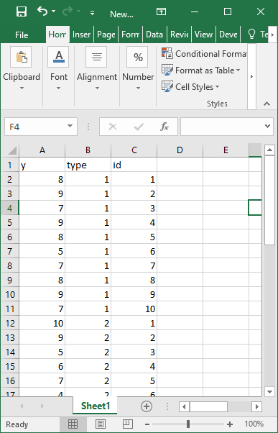
Tukey example RM data

Slide 54
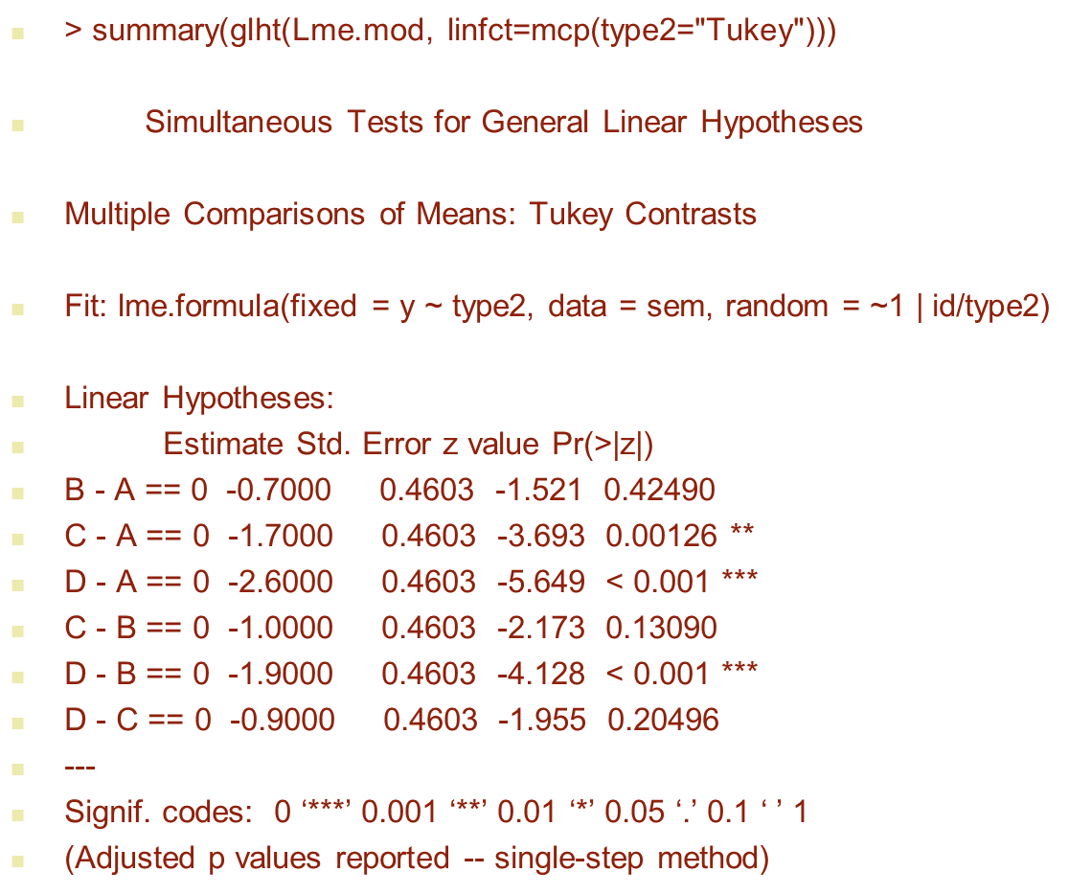
Tukey HSD on Priming scores

Slide 55
Control of False Discovery Rate (FDR)
Recent alternative to controlling FW error rate
FDR is the expected proportion of false rejections among the rejected null hypotheses
  If we have rejected a set of R null hypotheses, and V of these are wrongly rejected, then the FDR= V/R (FDR=0 if R=0).
  We will know R but don’t know V.
  Good power – See Lix and Sajobi (2010) Psychological Methods who look at a related procedure

Slide 56
False Discovery Rate (FDR)
An alternative approach to the trade-off between Type I and Type II errors
Logic
  a type I error becomes less serious the more the number of genuine effects there are in the family of tests
Now being used in imaging and ERP studies
See http://imaging.mrc-cbu.cam.ac.uk/statswiki/FAQ/FDR for SPSS and R scripts

Slide 57
FDR Example
Suppose we do 10 t-tests and observe their P values:
  0.021, 0.001, 0.017, 0.041, 0.005, 0.036, 0.042, 0.023, 0.07, 0.1
Sort P values in ascending order
  0.001, 0.005, 0.017, 0.021, 0.023, 0.036, 0.041, 0.042, 0.07, 0.1
Compare with 10 the prototypical P-values scaled to α namely (1/10)α, (2/10)α, ..., (10/10)α,
  0.005 0.010 0.015 0.020 0.025 0.030 0.035 0.040 0.045 0.050
Get the differences:
  -0.004 -0.005 0.002 0.001 -0.002 0.006 0.006 0.002 0.025 0.050
The largest observed P-value which is smaller than its corresponding prototype (last negative) is 0.023
  0.021, 0.001, 0.017, 0.041, 0.005, 0.036, 0.042, 0.023, 0.07, 0.1
The five underlined tests for which P<0.023 are declared significant with FDR α=0.05.

Slide 58
FDR output: p=0.023 highest p with adjusted p<0.05
p <- c(0.021,0.001,0.017,0.041,0.005,0.036,0.042,0.023,0.07,0.1)
p.adjust(p,method="fdr",n=10)
[1] 0.04600000 0.01000000 0.04600000 0.05250000 0.02500000 0.05250000
[7] 0.05250000 0.04600000 0.07777778 0.10000000

Slide 59
Westfall & Young Minimum p
Approach to multiple testing used in genetics more powerful than Bonferroni approaches when lots of comparisons
Compares obtained p-value with minimum of p-values obtained in data sets obtained by randomly allocating people in original data set into groups (bootstrapping); Repeat
Adjusted p-value equals proportion of minimum p-values < observed p (Available in R & SAS)

Slide 60
Unpacking Interactions
Components of Interaction
  doing sub-ANOVA or contrasts
  E.g. if factors A and B interact, then look at 2 by 2 ANOVA for a pair of levels of A combined with a pair of levels of B
Simple Main Effects
  by doing sub-ANOVAs followed up by multiple comparisons
Cannot use reverse argument to claim presence of interaction
Can use EMMEANS/COMPARE in SPSS

Slide 61
A caveat on higher order interactions
Stevens J (1999) Intermediate statistics: a modern approach. P.182 recommends using a Sidak corrected alpha for unpacking unplanned higher order interactions
The number of comparisons increases with the order of interaction. May be so many possible comparisons that post-hoc testing becomes infeasible.

Slide 62
Within Subject Factors? (I)
Problems of ‘sphericity’ re-emerge
Need for hand-calculations as SPSS has an attitude problem
http://imaging.mrc-cbu.cam.ac.uk/statswiki/FAQ/TukeyKramer

Slide 63
Within Subject Factors? (II)
Calculate new variables from within-subject contrasts and analyse them separately
Extends the idea of doing lots of paired t-tests
In SPSS can be done by MMATRIX option in GLM using Syntax

Slide 64
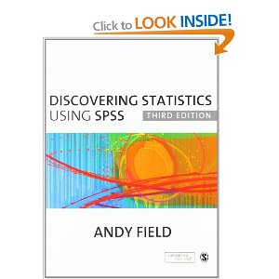
Next week
Power Analysis
Andy Field:
  http://www.cogs.sussex.ac.uk/users/andyf/teaching/statistics.htm

