Slide 1
1. Exploratory Data Analysis
OR An ABC of EDA
Peter Watson
COMPLETE TALK SURVEY AT https://www.surveymonkey.com/r/ZCXQT36

Slide 2
No apriori ideas (model) in EDA!
For classical analysis, the sequence is
    Problem => Data => Model => Analysis => Conclusions
For EDA, the sequence is
    Problem => Data => Analysis => Model => Conclusions

Slide 3
EDA - Exploratory data analysis
Informal graphical techniques (Tukey, 1977) which
look at underlying structure
identify outliers
check assumptions in later formal analyses (Normality, equality of variance)
Most of the EDA techniques are graphical and quite simple
“A picture is worth more than ten thousand words” Chinese proverb

Slide 4
Graphical displays
Histograms
Boxplots
Error Bar plots (groups)
Stem and Leaf Displays
Scatterplots (especially for checking linearity of correlations, residual plots from regressions)
(see also regression talk)
Under SPSS EXPLORE

Slide 5
Symmetry
Clustered around median
median=mean=mode
no skewness
CIs of mean assume symmetry

Slide 6
Skew and kurtosis
Skew
  <0 upper straggle
  =0 symmetric
  >0 downward straggle
Rules of Thumb (Hair et al,1998;Simon,2002):
Negative skew <-1
Positive Skew > 1
Kurtosis
  <0 flat (Platikurtic)
  =0 normal peak
  >0 peaked about mean (Leptokurtic)
Rules of Thumb (Simon, 2002)
  Positive Kurtosis > 3
  Negative Kurtosis < -3

Slide 7
Peakedness
Kurtosis measures peakedness
DeCarlo in his 1997 Psychological Methods paper shows kurtosis influenced by the tails of the distribution
Don’t want too peaked or too uniform distributions
Too peaked -no variation
Too flat - no one ‘typical’ value

Slide 8
Types of Kurtosis (Miles & Shevlin, 2001)

Slide 9
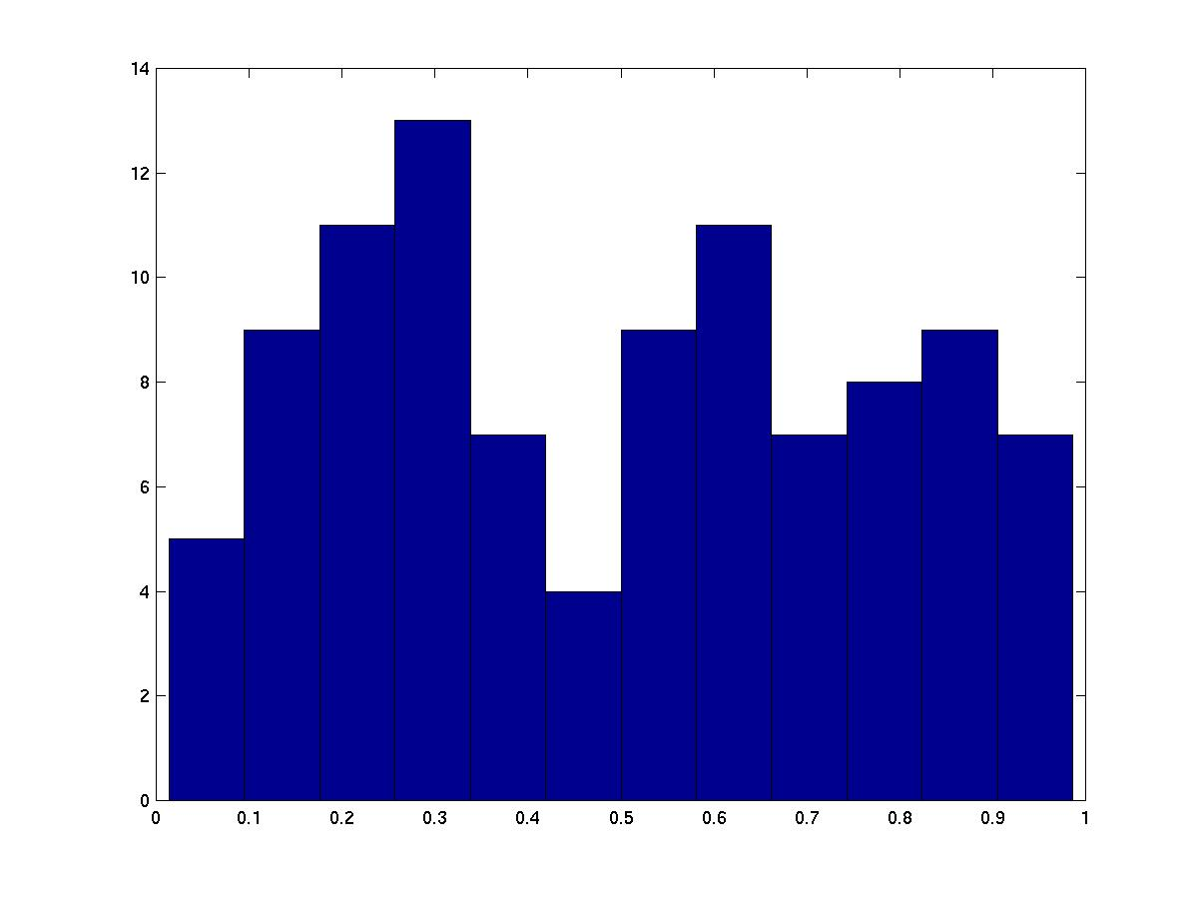
Bimodality
This is a mixture of two distributions (clear dip around the middle; multipeaked)
Histograms are usually good at spotting this
Suggests modelling the first half and second half separately

Slide 10
Beck Score
Positive skew (>1.0)
Most scores around zero
Scores above 13 - clinically depressed
One score of 46!
(Max=63)
install.packages("moments","e1071")
>
> library(moments)
> kurtosis(x1$beck,na.rm=T)
[1] 6.599262 compare to 6
> skewness(x1$beck,na.rm=T)
[1] 1.497913
> library(e1071)
> skewness(x1$beck,na.rm=T)
[1] 1.496713
> kurtosis(x1$beck,na.rm=T)
[1] 3.592214 compare to 3

Slide 11
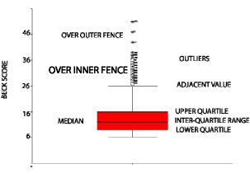
Boxplots

Slide 12
Boxplots
median = line in red box
Middle half in red box (=1.3 sds)
Outliers = circles and stars
Shape of data

Slide 13
Outliers in boxplots
Inner fence - moderately weird. Over 1.5 boxlengths from upper/lower quartiles; Circles in R and SPSS
(2.67 sds from mean in normal data)
Outer fence - decidedly weird. Over 3 boxlengths from upper/lower quartiles; Asterisks in SPSS, not used by R
(4.67 sds from mean in normal data)

Slide 14
Boxplot of Beck score
Positive skew
Concentration of outliers above median score

Slide 15
Effect of an outlier
biases mean (green line)
inflates variance of mean
median more robust

Slide 16
Robustness to outliers
Number of positive responses (max=6)
0,0,0,4,4,5,5,5,6,6,6,6,6,6,6
1000 random samples of size equal to original sample (N=15)
Results
Point estimates :Mean=4.37; Median=5
95% CIs: Mean [3.07, 5.40]; Median [4, 6]
Outliers exerting undue influence on the mean
See: http://imaging.mrc-cbu.cam.ac.uk/statswiki/FAQ/boot

Slide 17
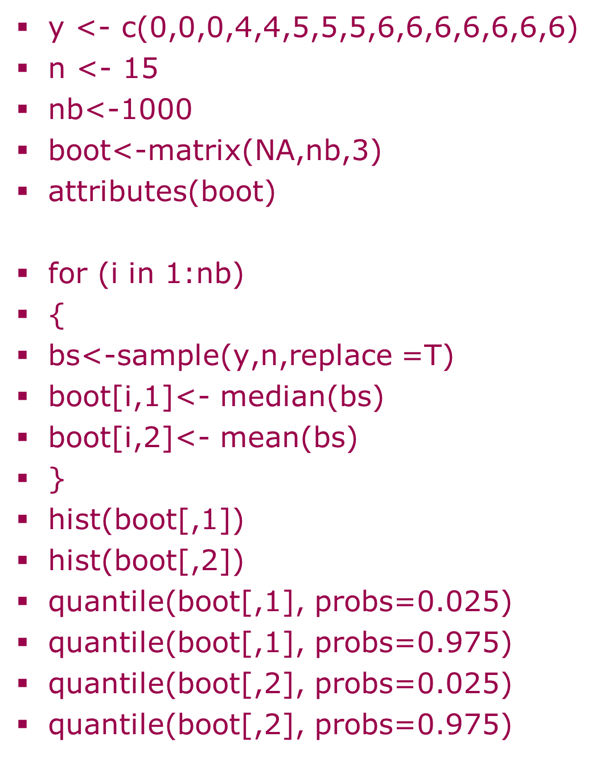
Bootstrap Cis for median and mean
R code
R output
Quantile[boot[,1],probs=0.025)
2.5% 4
Quantile[boot,1],probs=0.975)
97.5% 6
(similarly for mean)

Slide 18
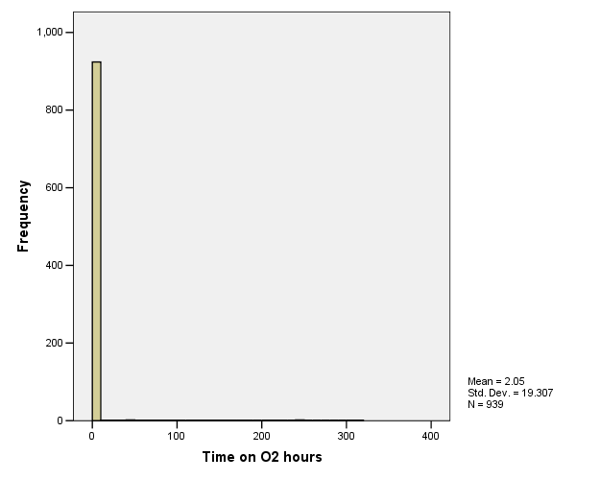
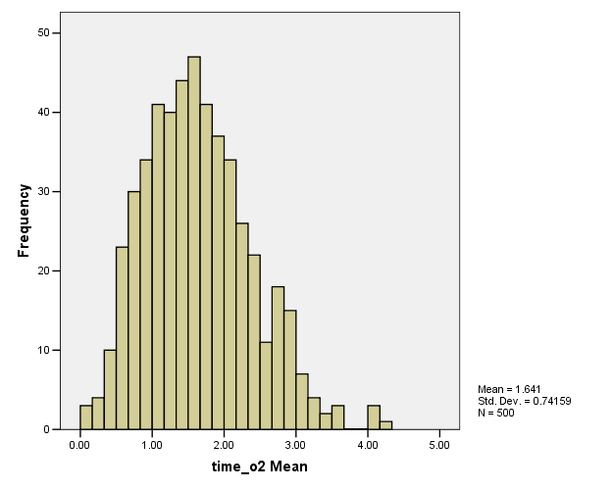
Obtaining 95% CIs for skewed data: Bootstrapping (Efron & Tibshirani, 1993)
See also:http://onlinestatbook.com/stat_sim/sampling_dist/

Slide 19
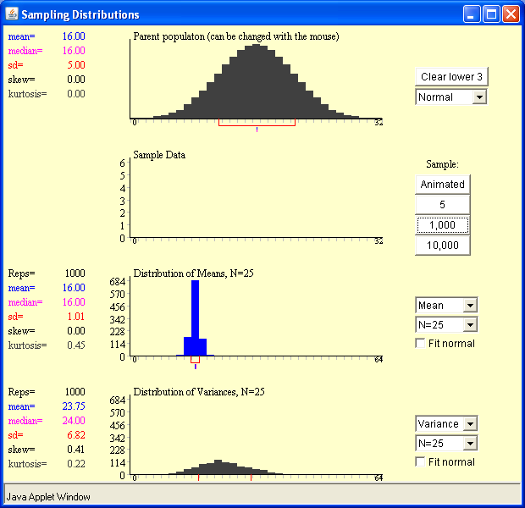
The sampling distribution of the variance follows a chisquare which tends to N(n-1,2(n-1)) as n increases
should=s.e.(mean) =5/sqrt(25)=1
N=25; normal(24,48); observed mean is 23.75, observed variance=6.82*6.82=46.5

Slide 20
Other approaches to identifying outliers (besides boxplots)
Cases with z-scores exceeding 2.5
(z-score subtracts mean and divides by s.d.)
Grubb’s test (http://imaging.mrc-cbu.cam.ac.uk/statswiki/FAQ/RegressionOutliers)

Slide 21
Quantile Plots
Raw beck score
deviates from straight line
Substantial skew
Limits choice of statistical tests we can use to analyse beck score
Bump above line = positive skew
qqplot(x1$beck,qnorm(ppoints(x1$beck)))
qqline(x1$beck,qnorm(ppoints(x1$beck)))

Slide 22
Reverse scored Beck
beck is now negative skewed
the bump is now under the line

Slide 23
S shapes
Symptoms of Kurtosis
uniformity
peakedness

Slide 24
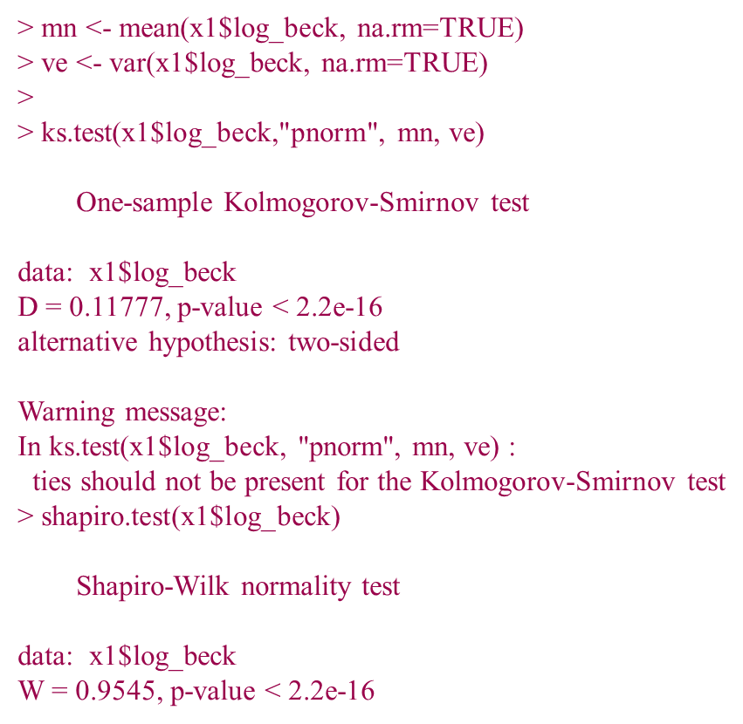

Testing normality more formally
Kolmogorov-Smirnov test
Micceri (1989) "The unicorn, the normal distribution, and other mythical beasts". Psych Bulletin 105(1) 156-166 says if you have a sample of over 200, you will NEVER pass the K-S test of normality, in a real dataset.
Shapiro-Wilks
Overly sensitive for large samples
Similar for raw beck
Non-Normal

Slide 25
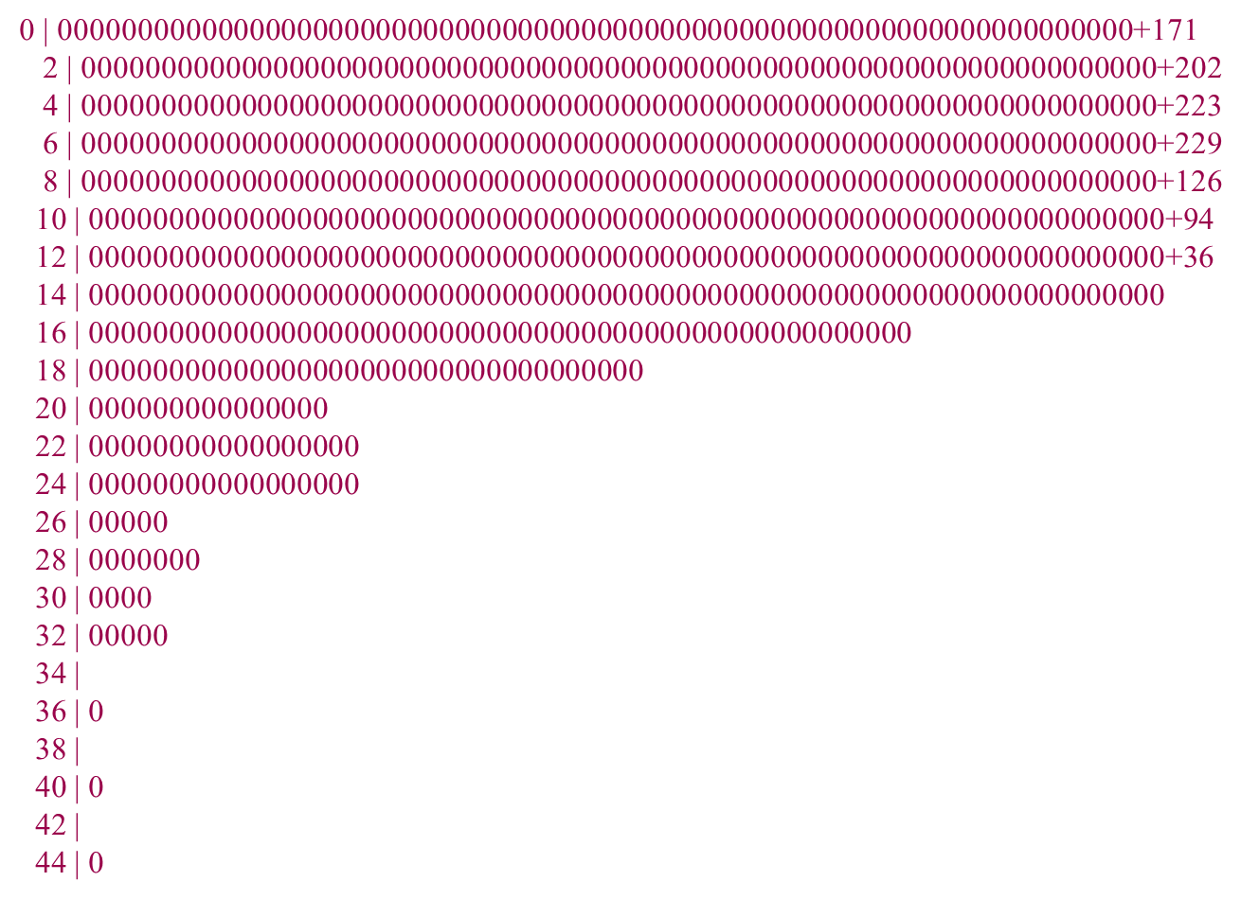
Stem and Leaf of Beck Score
Stem Leaf
6 . 0 =6.0
stem(beck)

Slide 26
Temperature
What is unusual about this
distribution? (Exercise)
Clue: spacing.
Each leaf=two temperatures
STEM LEAF
-6 6 = -6.6 Degrees C
Frequency Stem & Leaf
2.00 -6 . 6
4.00 -5 . 00
10.00 -4 . 44444
6.00 -3 . 338
14.00 -2 . 2227777
14.00 -1 . 1116666
8.00 -0 . 0055
12.00 0 . 005555
6.00 1 . 616
14.00 2 . 7777777
16.00 3 . 33333888
14.00 4 . 4444444
13.00 5 . 555555
11.00 7 . 22227
7.00 8 . 888
6.00 9 . 444

Slide 27
Error Bar Charts
Interactive Bar charts
Bar length represents Standard error of the mean
females have higher depression scores than males
y <- data.frame(y)
attach(y)
sex <- factor(sex)
se=sd/sqrt(n)
ggplot(y, aes(x=sex, y=lnbeck, fill="red")) +
geom_bar(position=position_dodge(), stat="identity") +
geom_errorbar(aes(ymin=lnbeck-se, ymax=lnbeck+se),width=0.2,
position=position_dodge(.9))

Slide 28
Bubble Plots (in R) years in education related to income/prestige
Hans Rosling – bubble plots over years (http://www.ted.com/talks/lang/eng/hans_rosling_shows_the_best_stats_you_ve_ever_seen.html)
plot(x1$income ~ x1$prestige, data=x1, xlab='Prestige', ylab='Income', main='Years in education', xlim=c(0,100), ylim=c(1000,10000), pch=".")
symbols(x1$prestige, x1$income, circles=x1$educatio, inches=0.2, add=TRUE)

Slide 29
Multiple scatter plots (R)
x1 <- data.frame(x)
pairs(x1)

Slide 30
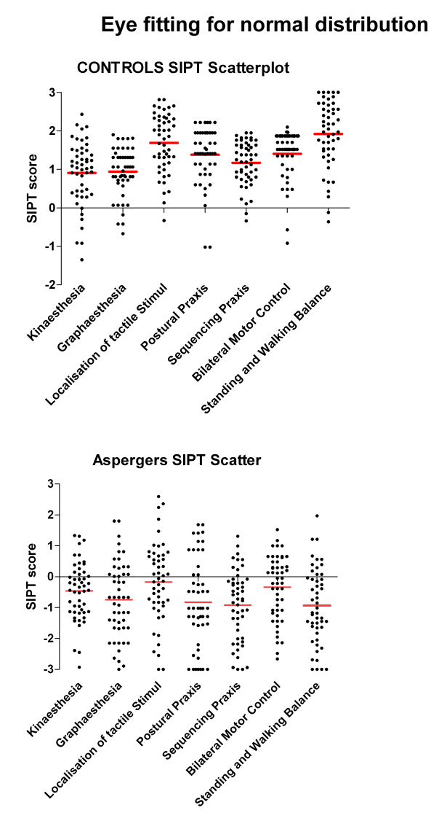
Done using PRISM software (Thanks to Kate McAlister)

Slide 31
Ladder of Powers (Marsh,1988)
Powers (double star function in SPSS COMPUTE) e.g. 3**2=9
2 square
1 untransformed
0.5 square root
0 (natural) log
-0.5 inverse square root
-1 reciprocal
-2 inverse square

Slide 32
Choosing a power
Trial and Error
Box-Cox transformation

Slide 33
Box-Cox rationale
Log likelihood for regression with predictor weights, B and error variance σ² = (Y-XB)²/n if σ² is not known , predictors X and outcome Y
log L(B, σ² | X; Y ) = - n/2 (log(2π) + log σ²) – 1/2σ² (Y-XB)²
Minimizing the error variance increases the likelihood of it being normally distributed
We also assume the errors Y-BX are random (Normally distributed with a mean of zero and constant variance)

Slide 34
Box-Cox applied to Beck score
Looks for a power that minimises Beck score variance
Suggests a power of 0.3 (near to log transform (power=0))
Regression: improve fit of a covariate to predict a test score Box-Cox can flag up a non-linear relationship
Can be used to help determine z-scores and means but can be misleading for very skewed data e.g. when floor and ceiling effects are present

Slide 35
Box-Cox solution
beck1 <- beck+1
bc <- boxcox(beck1 ~ 1)
(lambda <- bc$x[which.max(bc$y)])
lambda
[1] 0.3030303

Slide 36
Box Cox on residual variance
test score = constant + A*item score + residual
Can use boxcox on residuals of fitting item score on test score
suggests using square root of y
This is the transform of test score which minimizes the residual variance
DEMO:
BOXCOX.SPS

Slide 37
Predicted test score using a covariate vs actual test score (raw and square rooted)
More linear relationship taking square root (right hand side picture)

Slide 38
Exponential
Clicks = AE^{-B Age}
⁽log Clicks = log A – B Age)
Another type of non-linear relationship. Characterised by ever increasing rates of changes as you get older

Slide 39
Log Beck
Skew=0.60
Kurtosis=-0.06
Acceptable using rule of thumb

Slide 40
Quantile plot - log Beck
Fits closer to a straight line
Log transform has made the distribution more Normal
Log transform enables the use of more powerful statistical tests
qqplot(x1$log_beck,qnorm(ppoints(x1$log_beck)))
qqline(x1$log_beck,qnorm(ppoints(x1$log_beck)))

Slide 41
Rank transform
Downweight outliers
Useful if power transformations fail
Useful summary measures
  Medians
  Interquartile ranges (Boxplots)
  Rank sums (Non-parametric tests)

Slide 42
Using ranks - example
Compare cost (in £) of two care centres
Care Centres O & R
Any patient cost saving?

Slide 43
Centre O stem & leaf display
STEM WIDTH=200
2 EXTREMES
POSITIVE SKEW

Slide 44
Centre R - Stem and Leaf
(stem width=100)
outliers present
positive skew
rank test needed

Slide 45
RESULTS
UNRANKED
t(147) = 0.30, p=.76
centre costs the same
Uses means
> t.test(x1$cost~x1$centre)
data: x1$cost by x1$centre
t = 0.30984, df = 83.755,
p-value = 0.7575
RANKED
mean Rank
Study O 65.11
Study R 85.58
M-W: Z=-2.94,p=.003
Centre R costlier
Uses ranks
> wilcox.test(x1$cost ~ x1$centre)
data: x1$cost by x1$centre
W = 2010.5, p-value = 0.003282

Slide 46
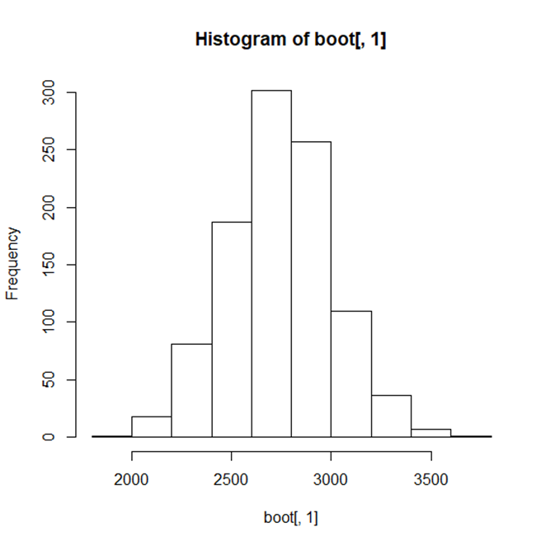
Randomisation p-value for Cost Centre data
Mann-Whitney
W= 2010.5
In far left of distribution

Slide 47
Nonparametric tests
PROS
Downweight outliers
Fewer assumptions
Useful for skewed distributions (See Lantz (2013) for Kruskal-Wallis for three or more groups)
CONS
Less powerful
Lose information
Limited range of tests

Slide 48
Equal Group Variances
Important for t-tests and ANOVAs
No covariate by group interaction in ANCOVA; Quade’s (1967) method is a nonparametric equivalent
May need to transform outcome
Tests available to identify problems

Slide 49
Levene’s test
Are group variances equal?
Gets slope of spread vs location
Compares slope to 0
    produces F-test
  Cribbie et al (2012) in Br J Math Stat Psych suggest a variety of adjusted tests including Welch’s (1951) adjustment for use with one-way ANOVAs
> library(car)
> leveneTest(x1$beck ~ x1$sex, data = x1)
Levene's Test for Homogeneity of Variance (center = median)
Df F value Pr(>F)
group 1 5.4955 0.01917 *
1870
---
Signif. codes: 0 ‘***’ 0.001 ‘**’ 0.01 ‘*’ 0.05 ‘.’
Bland JM, Altman DG. Statistical methods for assessing agreement between two methods of
clinical measurement. Lancet 1986; i: 307-10. Comparing within subject using paired t-test on deviations

Slide 50
Proportions
Variance of a proportion depends on value of proportion!
Arcsine transform resolves this:
In R use : 2 * asin(sqrt(p))
however
Jaeger TF (2008) Categorical data analysis:away from ANOVAs.
J Mem Lang 59(4) 434-446
suggests difficulties using arcsines on proportions near 0 or 1.
(arcsine also may be used when correlating proportions)

Slide 51
And Finally...
“ A Statistician is someone who can have their head in an oven and their feet in an ice box and say that on the whole they are feeling perfectly normal”
Check you are using appropriate summary measures
Boxplot illustrations:
Lane, DM and Sandor, A (2009) Designing better graphs by including distributional information and integrating words, numbers and images. Psychological Methods 14(3) 239-257.
Further details including references on EDA at:
http://www.itl.nist.gov/div898/handbook/eda/eda.htm
Thanks to Frank Duckworth [RSS News article on scales]
Allan Reese (CEFAS, graphical comments)
Barney Dunn (Bimodality)
Next week (Thursday)…11am
Simple and Multiple Linear Regression

