Slide 1
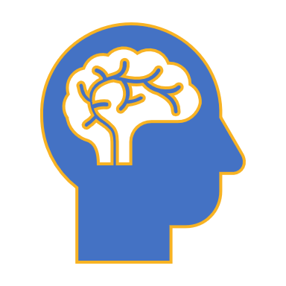
Brain stimulation methods
Catriona Scrivener
MRC Cognition and Brain Sciences Unit
catriona.scrivener@mrc-cbu.cam.ac.uk
01/02/21

Slide 2
Overview
Why use brain stimulation?
TMS and tES
Mechanism
Protocols
Safety
CBU equipment
Combined neuroimaging: TMS-fMRI

Slide 3
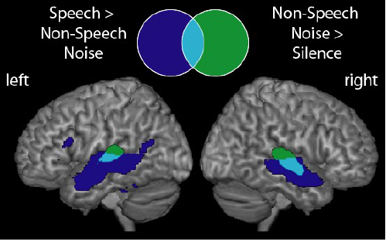
Motivation
Common experimental approach: manipulate presented stimuli as independent variable, measure neural activity
Activity in some areas is stronger for speech than noise, but are these areas necessary or causal?
Davis & Johnsrude, 2003

Slide 4
Motivation
TMS approach: selectively ‘disrupt activity’ in a region of interest, and compare changes in behaviour (and potentially neural activity) to a control region/session
If TMS results in a relevant behaviour change, indicates that this region is important
Davis & Johnsrude, 2003

Slide 5
Motivation
TMS approach: selectively ‘disrupt activity’ in a region of interest, and compare changes in behaviour (and potentially neural activity) to a control region/session
How can we established causation? (Bergmann & Hartwigsen, 2021)
Notes:
Bergmann, T. O., & Hartwigsen, G. (2021). Inferring causality from noninvasive brain stimulation in cognitive neuroscience. Journal of Cognitive Neuroscience, 33(2), 195-225.

Slide 6
Transcranial magnetic stimulation (TMS)
Part 1

Slide 7
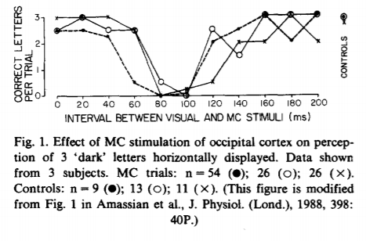
What is TMS?
‘Classical dip’ – TMS to the visual cortex disrupts perception of visual stimuli when applied ~100ms after stimulus onset
Amassian et al. (1989)

Slide 8
What is TMS?
TMS relies on basic principles of
electromagnetism (Faraday’s law)
Electric charge stored in a capacitor is discharged producing a brief, high-current pulse in a coil of wire.
Electrical current momentarily generates a magnetic field.
Magnetic field can reach up to about 2T and lasts approx. 100 µs
Magnetic field penetrates scalp and skull - induces a current in the brain in a direction opposite to the original current in the coil.
More accurately – “transcranial magnetically induced electrical stimulation”

Slide 9
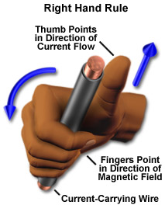
What is TMS?
The electric field induced is perpendicular to the magnetic field

Slide 10
What is TMS?
The shape and depth of the electric field is dependent on the coil type, with less focal fields penetrating deeper (Hallet, 2007; Deng, 2013)
NB: field strength can be less than half strength after only ~2 cm! (Barker, 1999)
Notes:
‘The figure-8 configuration consists of a pair of adjacent circular loops with current flow in opposite directions, producing a relatively focal electric field maximum under the center of the coil where the two loops meet’
https://www.ncbi.nlm.nih.gov/pmc/articles/PMC3568257/

Slide 11
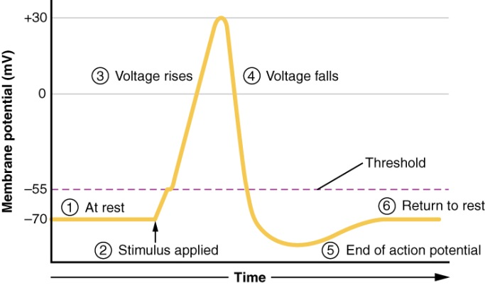
What is TMS?
Mechanism of action:
The ﬂow of ions brought about by
the induced electric ﬁeld alters the
electric charge stored on both sides
of cell membranes.
When the direction of the current is across the membrane, the induced current depolarizes cell membranes - eliciting action potentials.
Currents induced by TMS will most likely stimulate nerve fibres that align tangential to the scalp.
Stimulation occurs at a lower threshold where axons terminate, or bend sharply, in the relatively uniform electric field induced by TMS stimulation.
Ilmoniemi et al. (1999)

Slide 12
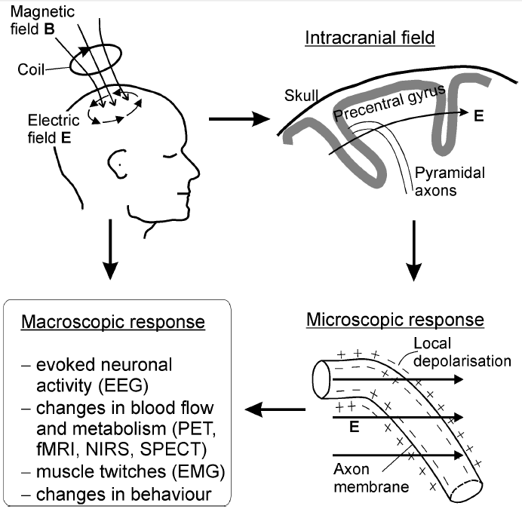
What is TMS?
Stimulation is dependent on the orientation of axons and dendrites with respect to the magnetic field
In the case of single pulse over M1:
Cortical neurons at bends, terminals, and branches
The axons of pyramidal cells projecting from the bank of the precentral gyrus to the spinal cord
Ilmoniemi et al. (1999)

Slide 13
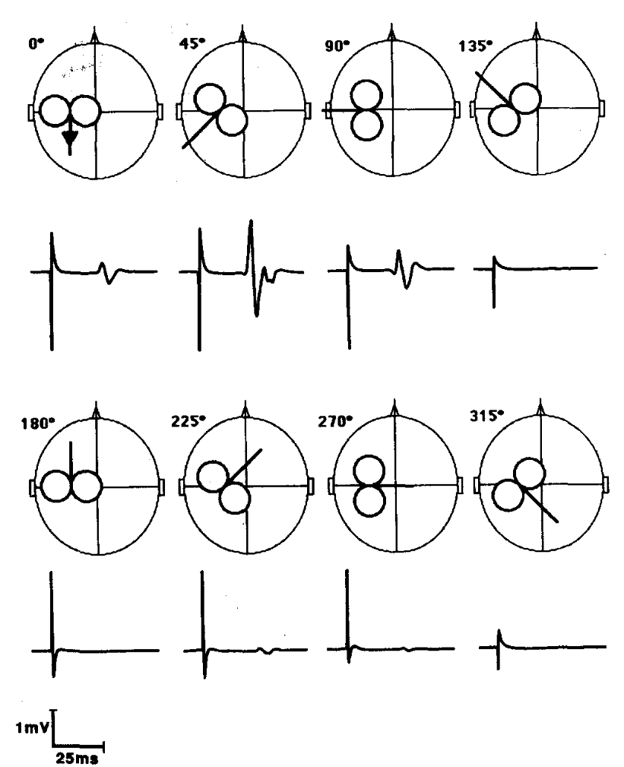
What is TMS?
Stimulation is dependent on the orientation of axons and dendrites with respect to the magnetic field
In the case of single pulse over M1:
Because of the usual orientation of the motor cortex, a 45 degree angle is the most likely to produce an MEP
However, there is some variation across subjects (Balslev, 2007)
TMS pulse
MEP
Mills et al. (1992)
Notes:
Balslev, D., Braet, W., McAllister, C., & Miall, R. C. (2007). Inter-individual variability in optimal current direction for transcranial magnetic stimulation of the motor cortex. Journal of neuroscience methods, 162(1-2), 309-313.

Slide 14
Stimulation protocols
Characterised by five main factors:
Intensity (%)
Frequency (Hz)
Duration (ms)
Inter-train interval (ms)
Online or offline

Slide 15
Intensity
Resting motor threshold
Coil orientation must be 45°, coil handle posterior, coil surface orthogonal to skull
Stimulate at a low level to show the participant what to expect
Then, Rossini et al. (2015) method, participant hand relaxed
  Start around 35% maximal stimulator output (MSO)
  Increase by 5% until you consistently evoke MEPs with
  peak-to-peak amplitudes of >50 µV
  Reduce by 1% until you no longer induce 10/20 >50 µV
  This value plus 1 is the RMT
Groppa et al. (2012)

Slide 16
Stimulation protocols
Single pulse TMS
Good temporal specificity
Single pulse effects are not thought to last long beyond the time of stimulation (Pascual-Leone et al., 2002)
Can for example be used for mapping of motor cortical outputs or studying motor conduction time
Paired pulse TMS (Inter pulse interval 1-100ms).
Inter pulse interval 1-100 ms
Delivered to a single target or two different brain regions using two different coils
Timing can be varied to selectivity stimulate inhibitory or excitatory neurons (Fitzgerald et al., 2006)
  Interval of 3 ms - excitatory
  Interval of 1.5 ms - inhibitory
Can for example be used to study cortico-cortical interactions

Slide 17
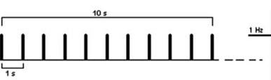
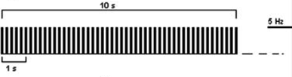
Stimulation protocols
Repetitive TMS (rTMS)
  Low frequency rTMS (<1Hz) reduces excitability
  High frequency rTMS (>5Hz) increases excitability (Padberg et al., 2007)
10 s of rTMS at 1 Hz
10 s of rTMS at 5Hz
Rossi et al. (2009)

Slide 18
Stimulation protocols
Repetitive TMS (rTMS)
However, in a recent meta analysis (Beynel et al., 2019)
10 Hz and 20 Hz disrupted accuracy and slowed down reaction times
No effects with 1 Hz or 5 Hz
Rossi et al. (2009)
Notes:
Beynel, L., Appelbaum, L. G., Luber, B., Crowell, C. A., Hilbig, S. A., Lim, W., ... & Deng, Z. D. (2019). Effects of online repetitive transcranial magnetic stimulation (rTMS) on cognitive processing: a meta-analysis and recommendations for future studies. Neuroscience & Biobehavioral Reviews, 107, 47-58.
. Meta-analytically, rTMS at 10 Hz and 20 Hz disruptedaccuracy for attention, executive, language, memory, motor, and perception domains, while no effects werefound with 1 Hz or 5 Hz. Stimulation applied at and 10 and 20 Hz slowed down RTs in attention and perceptiontasks. No performance enhancement was found. Meta-regression analysis showed that fMRI-guided targeting andshort inter-trial intervals are associated with increased disruptive effects with rTMS

Slide 19
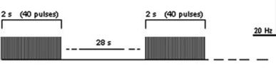
Stimulation protocols
Patterned TMS (rTMS)
  Repetitive application of short rTMS bursts at a high inner frequency interleaved by short pauses of no stimulation
20 Hz application (trains of 2 s interleaved by a pause of 28 s)
Rossi et al. (2009)

Slide 20
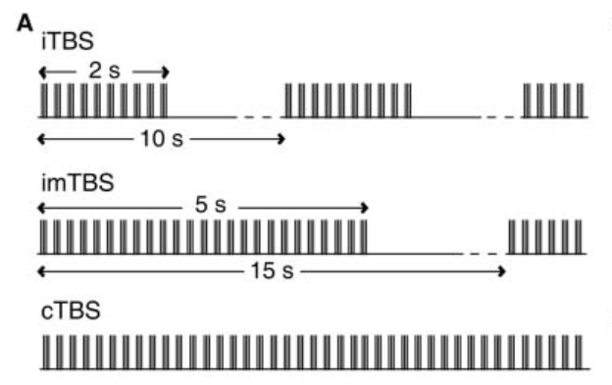
Stimulation protocols
Theta burst stimulation (TBS): Based on natural firing pattern of pyramid cells in hippocampus (Kanel & Spencer, 1961) - theta-frequency pattern of neuronal firing
Three pulses of stimulation are given at 50 Hz, repeated every 200 ms (5 Hz)
iTBS: 2s train repeated every 10s for 190s (600 pulses)
imTBS: 5s train repeated every 15s for 110s
cTBS: 40s uninterrupted train
(Huang et al., 2005)

Slide 21
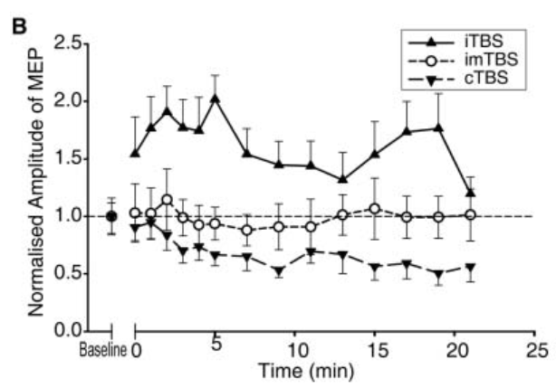
Stimulation protocols
Continuous theta burst (cTBS):
Depression of cortical excitability
Reduction in MEP amplitudes
Impaired behaviour?
Intermittent theta burst (cTBS):
Increase in cortical excitability
Increase in MEP amplitudes
Facilitated behaviour?
(Huang et al., 2005)

Slide 22
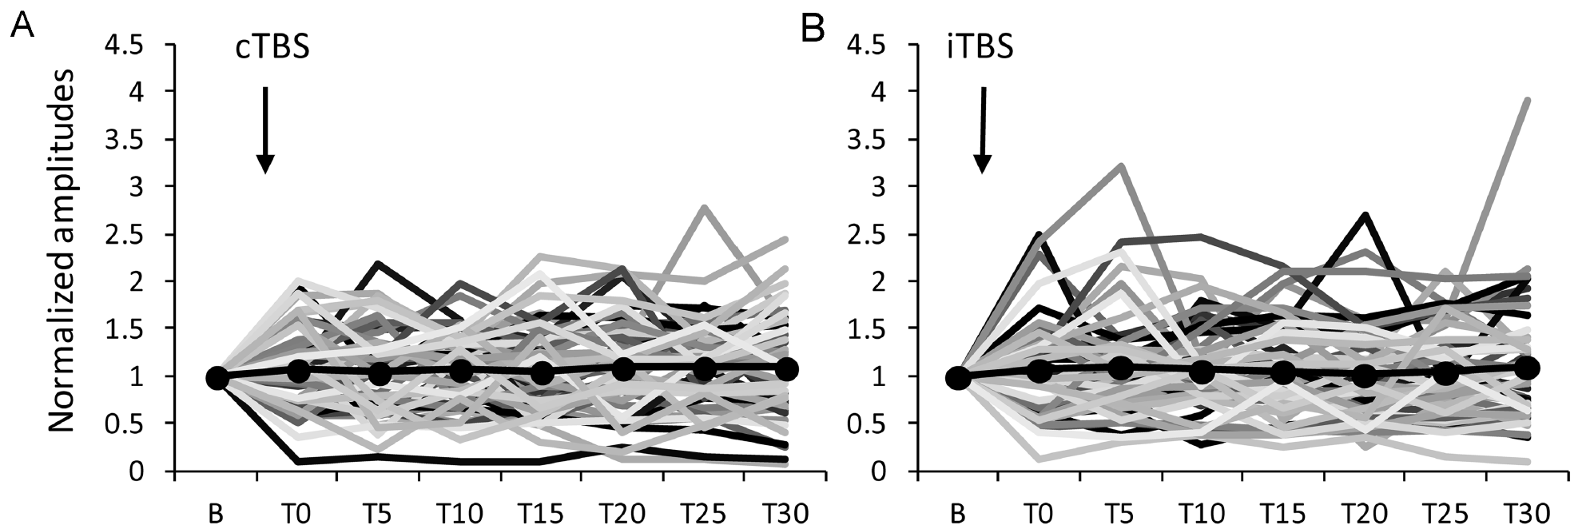
Stimulation protocols
However, cTBS vs. iTBS might not be as clear cut
Hamada et al. (2013): large interindividual variability (in both directions)

Slide 23
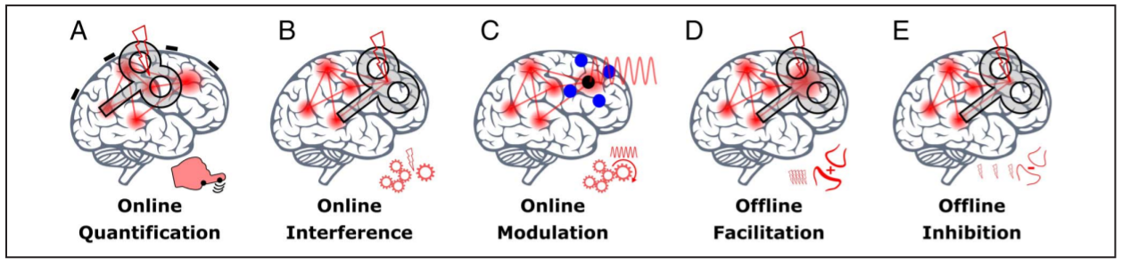
Stimulation protocols
Bergmann & Hartwigsen (2021)
Notes:
Figure 2. Schematic representation of noninvasive brain stimulation approaches. (A) Online quantification: a stimulation strong enough to cause a direct output of the targeted region/network (with TMS, not TCS) that allows to quantify cortical excitability via motor-evoked potentials or phosphene reports. (B) Online interference: a disruption of ongoing task-related or spontaneous brain activity (with TMS, rather not TCS) that disturbs a cognitive function. (C) Online modulation: a moderate modulation of the level (“gating” via low-intensity TMS or TDCS) or timing (“entrainment” via TACS or rhythmic TMS) of neuronal activity that interacts with ongoing task-related or spontaneous neuronal activity without disrupting it. (D) Offline facilitation: an increase in cortical excitability (triggered by repetitive TMS [rTMS] rTMS or prolonged TCS) presumably mediated via long-term potentiation of the stimulated synapses. (E) Offline inhibition: a decrease in cortical excitability (triggered by rTMS or prolonged TCS) presumably mediated via LTD of the stimulated synapses

Slide 24
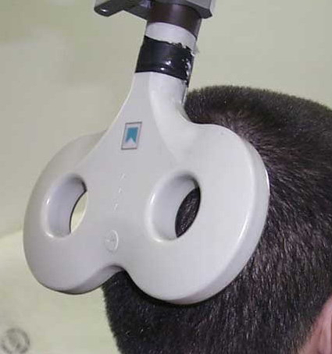
‘Virtual lesion’?
How useful is the term ‘virtual lesion’? (Miniussi et al., 2010)
TMS often described as inducing a temporary reversible lesion in the stimulated area
If this is correct, how can TMS sometimes lead to enhanced performance? (Harris et al., 2008b)
Does TMS suppress neural signals, or does it add random neural noise in the stimulated area?
Adding noise may enhance performance if the induced activity is synchronised with a weak underlying signal

Slide 25
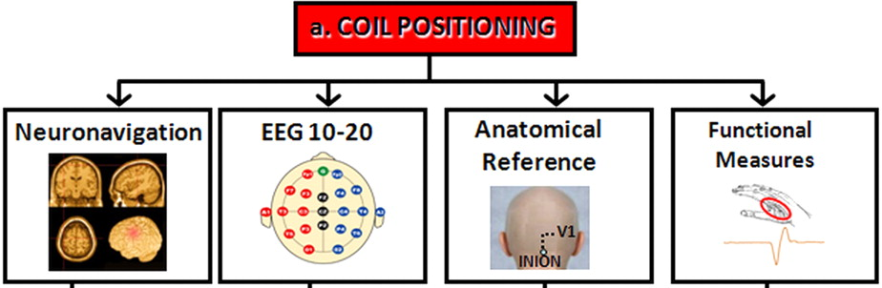
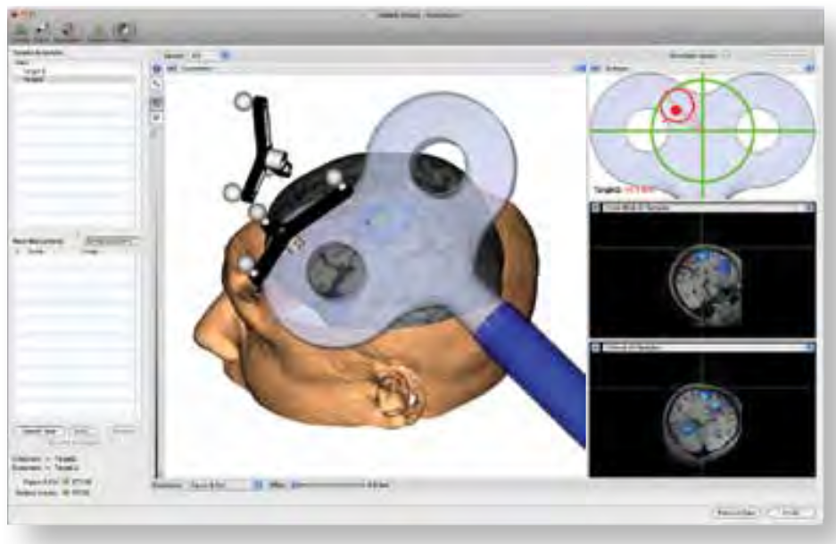
Where to stimulate?
(Bolignini & Ro, 2010)

Slide 26
What is the best control?
Meteyard & Holmes (2028)
https://tms-smart.info/
Notes:
Meteyard, L., & Holmes, N. P. (2018). TMS SMART–scalp mapping of annoyance ratings and twitches caused by transcranial magnetic stimulation. Journal of neuroscience methods, 299, 34-44.

Slide 27
Safety
Common side effects include
  Headache
  Pain or discomfort in neck
  Pain or discomfort in ears
  Temporary hearing loss or impairment
  Toothache
  Paraesthesia
Rare: syncope (fainting)
Very rare: seizure
Safety guidelines: Rossi et al., (2020)

Slide 28
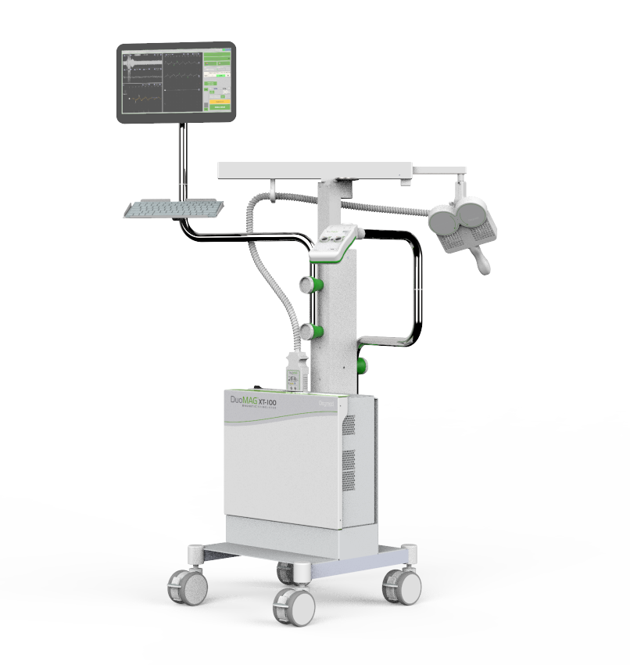
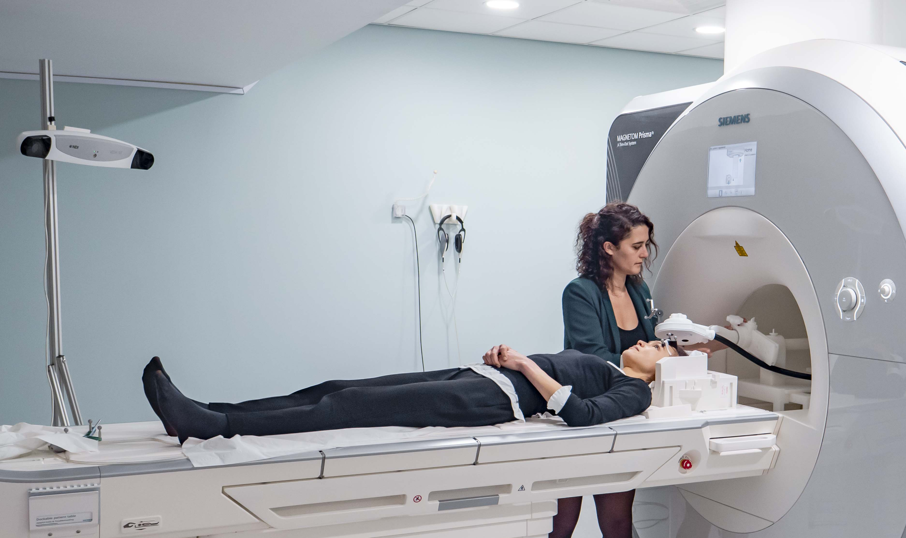
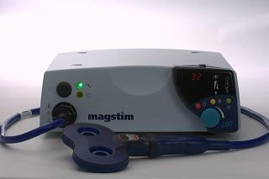
TMS at the CBU
CBU stand-alone TMS
DuoMag XT-100
Frequencies up to 100Hz
Biphasic pulses
Minimum inter-train interval of 10ms
Brainsight2 neuronavigation
CBU MRI-TMS
MagPro XP
Frequencies up to 250Hz
Biphasic pulses
Minimum inter-train interval of 10ms
Localite neuronavigation
TMS machines at HSB:
Magstim® Rapid2, 2002
Bistim System
Brainsight2 neuronavigation
EEG

Slide 29
Reading
Pitcher, D., Parkin, B., & Walsh, V. (2021). Transcranial Magnetic Stimulation and the understanding of behavior. Annual Review of Psychology, 72.
Rossi, S., Antal, A., Bestmann, S., Bikson, M., Brewer, C., Brockmöller, J., ... & Hallett, M. (2020). Safety and recommendations for TMS use in healthy subjects and patient populations, with updates on training, ethical and regulatory issues: Expert Guidelines.

Slide 30
Questions?

Slide 31
Break

Slide 32
Transcranial electrical stimulation (tES)
Part 2

Slide 33
tES
A small electrical current (0.5-2 mA) is passed between two electrodes places on the scalp
Stimulation is ~100x weaker than TMS, so does not directly cause action potentials

Slide 34
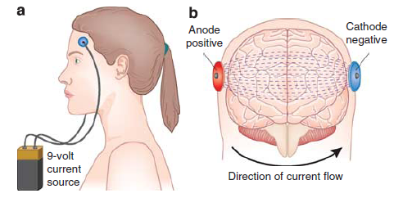
tES
Current is delivered through the anode electrode, propagates through the head and is returned at the cathode
This modulates cortical excitability, with increased excitability at the anodal electrode, and decreased at the cathodal electrode
N.B. a large amount of the signal will take the path of least resistance along the scalp!
Notes:
Herrmann, C. S., Rach, S., Neuling, T., & Strüber, D. (2013). Transcranial alternating current stimulation: a review of the underlying mechanisms and modulation of cognitive processes. Frontiers in human neuroscience, 7, 279.

Slide 35
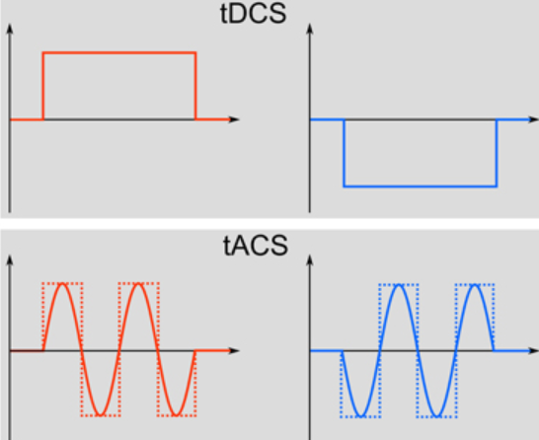
tES
Direct current stimulation (tDCS) - Application of a constant current (Nitsche and Paulus,2000)
Notes:
Herrmann, C. S., Rach, S., Neuling, T., & Strüber, D. (2013). Transcranial alternating current stimulation: a review of the underlying mechanisms and modulation of cognitive processes. Frontiers in human neuroscience, 7, 279.

Slide 36
tES
Direct current stimulation (tDCS) - Application of a constant current (Nitsche and Paulus, 2000)
Alternating current stimulation (tACS) – Current is not constant (DC) but alternates between the anode and the cathode (switching polarity) with a sinusoidal waveform. Uses waveform at a specific frequency (e.g. 12Hz) (Antal et al.,2008). Alternating fields can increase or decrease power of oscillatory rhythms in the brain in a frequency-dependent manner - synchronizing or desynchronizing neuronal networks.
Notes:
Herrmann, C. S., Rach, S., Neuling, T., & Strüber, D. (2013). Transcranial alternating current stimulation: a review of the underlying mechanisms and modulation of cognitive processes. Frontiers in human neuroscience, 7, 279.

Slide 37
tES
Direct current stimulation (tDCS) - Application of a constant current (Nitsche and Paulus,2000)
Alternating current stimulation (tACS) – Current is not constant (DC) but alternates between the anode and the cathode (switching polarity) with a sinusoidal waveform. Uses waveform at a specific frequency (e.g. 12Hz) (Antaletal.,2008). Alternating fields can increase or decrease power of oscillatory rhythms in the brain in a frequency-dependent manner - synchronizing or desynchronizing neuronal networks.
Random noise stimulation (tRNS) - Several frequencies applied within a normally distributed frequency spectrum (0.1 to 100Hz low-frequency; 101 to 640Hz high-frequency) (Terney et al.,2008).
Notes:
Herrmann, C. S., Rach, S., Neuling, T., & Strüber, D. (2013). Transcranial alternating current stimulation: a review of the underlying mechanisms and modulation of cognitive processes. Frontiers in human neuroscience, 7, 279.

Slide 38
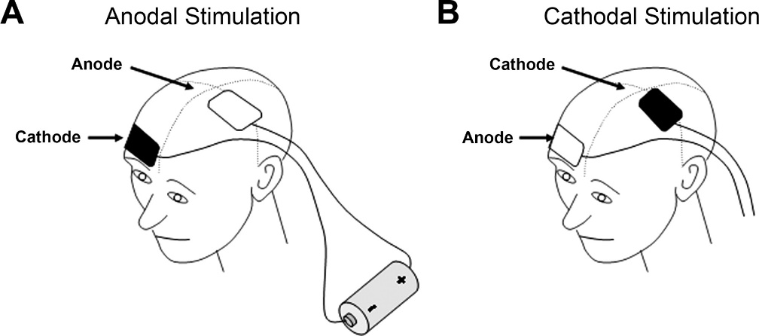
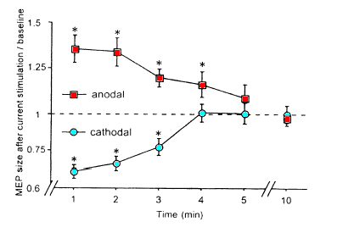
tDCS
tDCS induces excitability changes in motor cortex (Nitsche & Paulus, 2000)
Scalp tDCS stimulation (for 5 min at 1 mA).
“After-effects" last up to 90 minutes after stimulation (depending on intensity and duration of stimulation)

Slide 39
tDCS
Current flow (inward) under anodal electrode induces a lack of positive ions (shifts membrane potential towards depolarization). Increases excitability.
Current flow (outward) under the cathodal electrode induces an excess of positive ions (shifts membrane potential towards hyperpolarization). Decreases excitability.

Slide 40
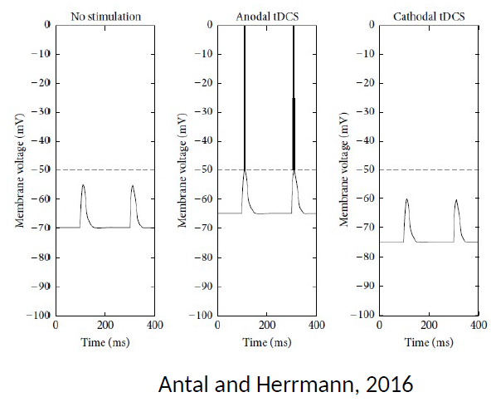
tDCS
Current flow (inward) under anodal electrode induces a lack of positive ions (shifts membrane potential towards depolarization). Increases excitability.
Current flow (outward) under the cathodal electrode induces an excess of positive ions (shifts membrane potential towards hyperpolarization). Decreases excitability.

Slide 41
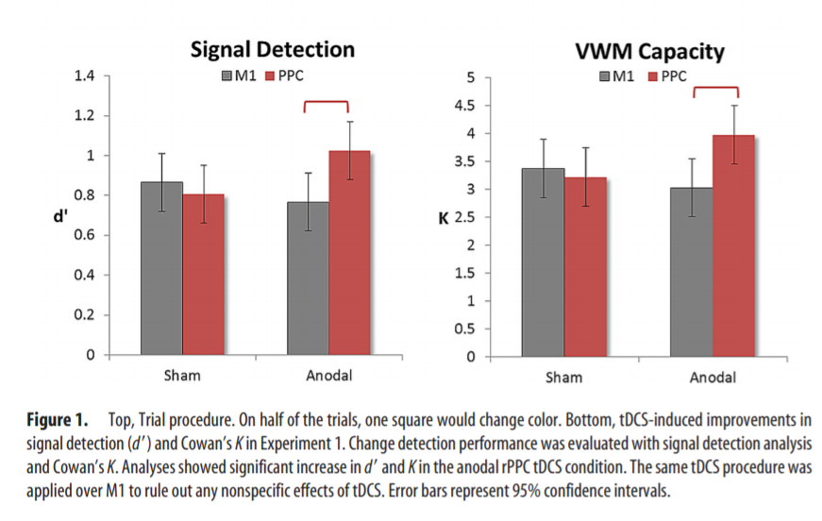
tDCS
For example, anodal tDCS to the right posterior parietal cortex increased performance on a visual working memory (change detection) task (Tseng et al., 2012)
Notes:
Tseng, P., Hsu, T. Y., Chang, C. F., Tzeng, O. J., Hung, D. L., Muggleton, N. G., ... & Juan, C. H. (2012). Unleashing potential: transcranial direct current stimulation over the right posterior parietal cortex improves change detection in low-performing individuals. Journal of Neuroscience, 32(31), 10554-10561.
The current was applied for 15 min with an intensity of 1.5 mA, which can create an excitatory effect for up to 90 min (Nitsche and Paulus, 2001). The sham tDCS condition followed an identical procedure, including electrode placements, but stimulation only lasted 30 s. rPPC was located as P4 according to the international 10 –20 system for EEG electrode placement. Since tDCS requires two electrodes that simultaneously stimulate one brain region and inhibit another, the reference electrode was placed on the left cheek (Berryhill et al., 2010; Hsu et al., 2011)

Slide 42
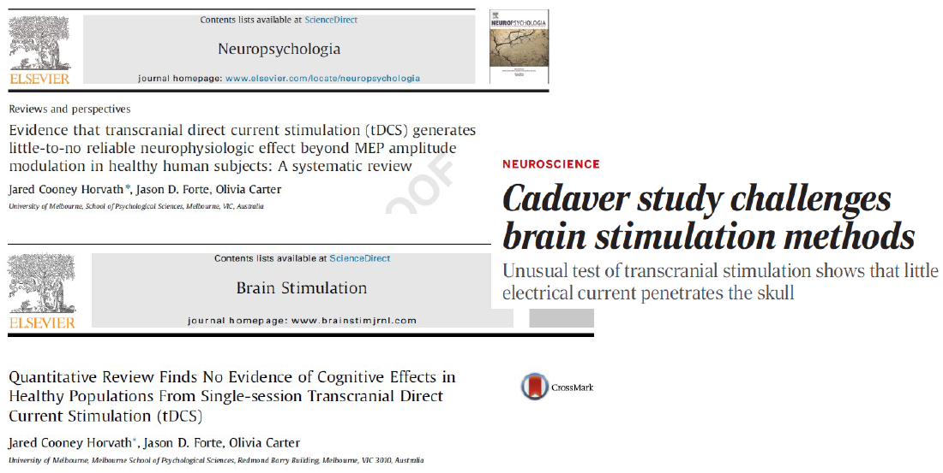
Replicability?
Underwood, Science 2016

Slide 43
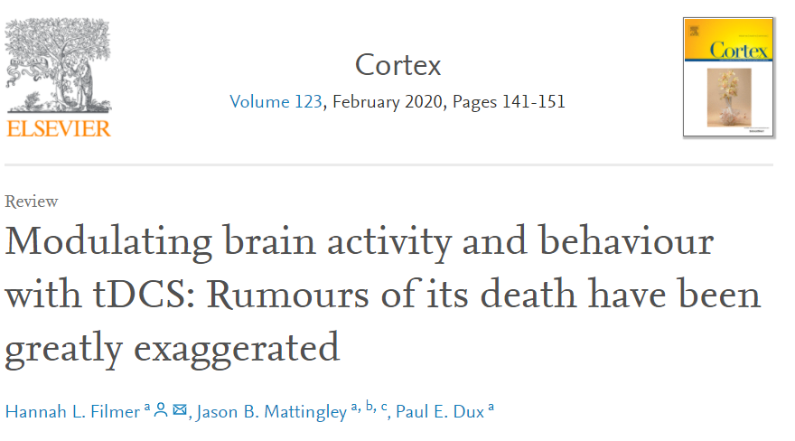
Replicability?

Slide 44
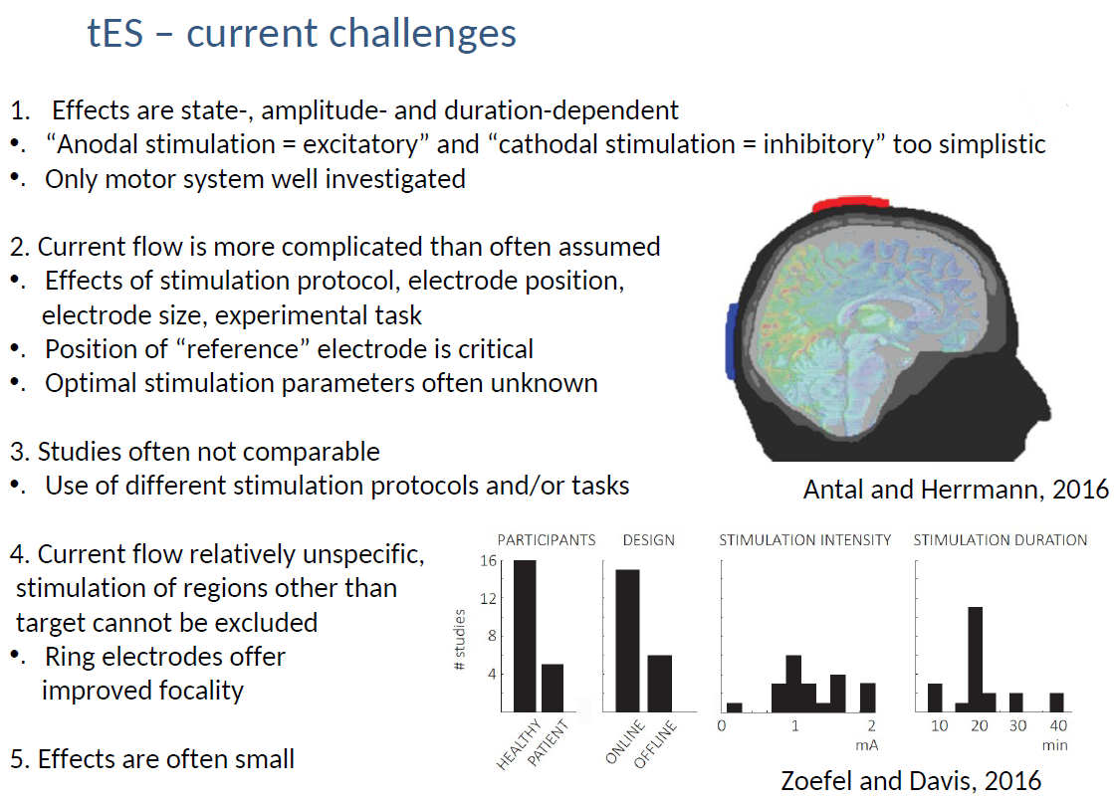
Challenges

Slide 45
Safety
Seizure induction
tDCS does not cause epileptic seizures or reduce seizure threshold in animals (Liebetanz et al., 2006). No reports of seizures using tES in humans.
Skin burning
Slight itching or heating under the electrode - (tRNS and tACS are less easily detectable). Follow recommended guidelines.
Other symptoms
Headache, fatigue, and nausea only in very small minority of cases (Poreisz et al., 2007).
Cathodal or (reference electrode) can be placed on an extracephalic location (e.g. shoulder). Never place both electrodes on any other part of the body apart from the head - currents passing across the heart can be dangerous!
Sham stimulation
Not easily detectable, doubled-blinded.

Slide 46
CBU equiptment
Two stimulators on site:
neuroConn DC-STIMULATOR PLUS
Single channel stimulator suitable for non-invasive tDCS, tACS or tRNS.
neuroConn DC- STIMULATOR MR
MR compatible version of DC-STIMULATOR PLUS.

Slide 47
TMS vs. tES
tES – less expensive, more portable, easier to design blind sham conditions, generally well tolerated
TMS – greater effect on neural tissue, higher temporal and spatial resolution

Slide 48
Reading
Herrmann, C. S., Rach, S., Neuling, T., & Strüber, D. (2013). Transcranial alternating current stimulation: a review of the underlying mechanisms and modulation of cognitive processes. Frontiers in human neuroscience, 7, 279.
Reed, T., & Kadosh, R. C. (2018). Transcranial electrical stimulation (tES) mechanisms and its effects on cortical excitability and connectivity. Journal of inherited metabolic disease, 41(6), 1123-1130.
Westwood, S. J. (2020, February 12). Investigating cognitive and therapeutic effects of transcranial electric stimulation (TES): a short guide for reproducible and transparent research. https://doi.org/10.31234/osf.io/8qms2

Slide 49
Combined TMS-fMRI
Part 3

Slide 50
TMS-fMRI
TMS
Did stimulation affect interconnected networks?
fMRI
Are activations necessary for specific functions?
TMS-fMRI allows us to stimulate one part of the brain and measure changes in activity at:
- site of stimulation
- entire brain
We can then relate these effects to participants behaviour

Slide 51
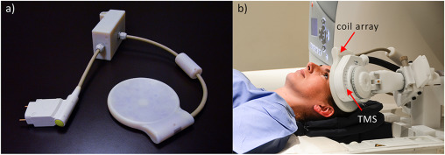
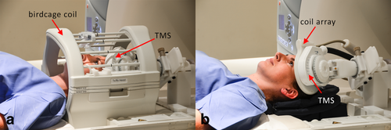
Surface coils
The MR coil array is placed between the TMS and head of the participant
Restricted coil placement
Avoids signal loss at site of stimulation
Allows flexibility in coil placement
Increases participant comfort

Slide 52
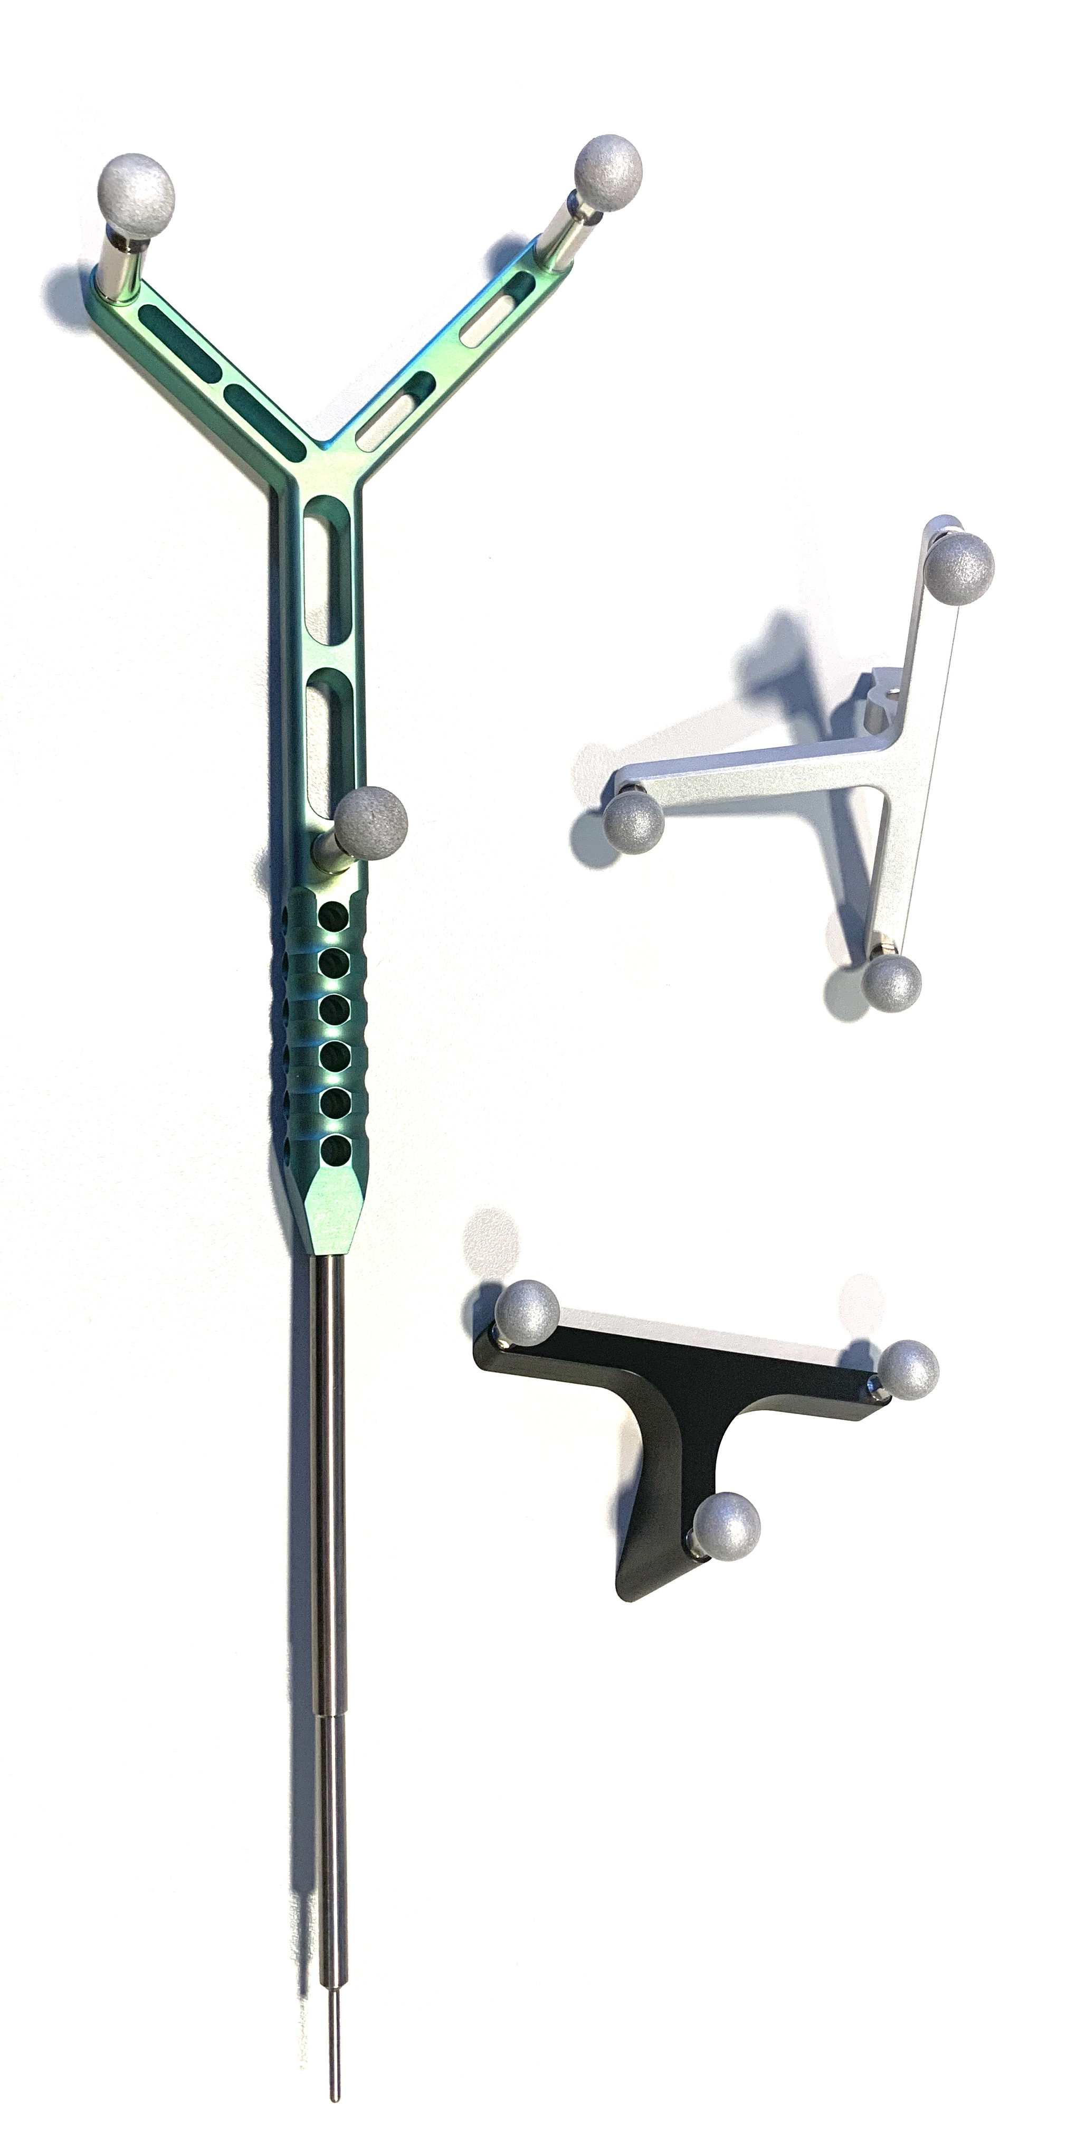
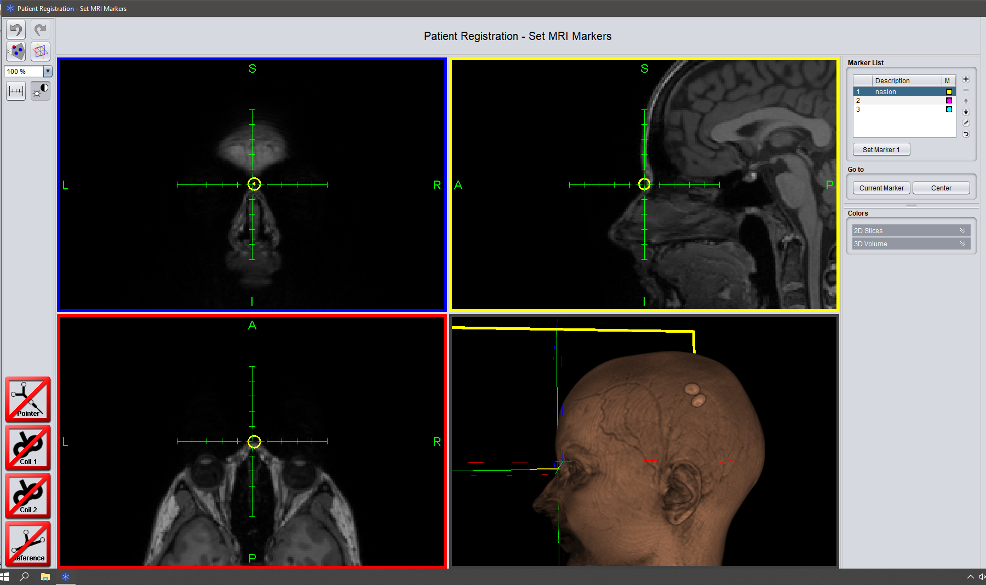
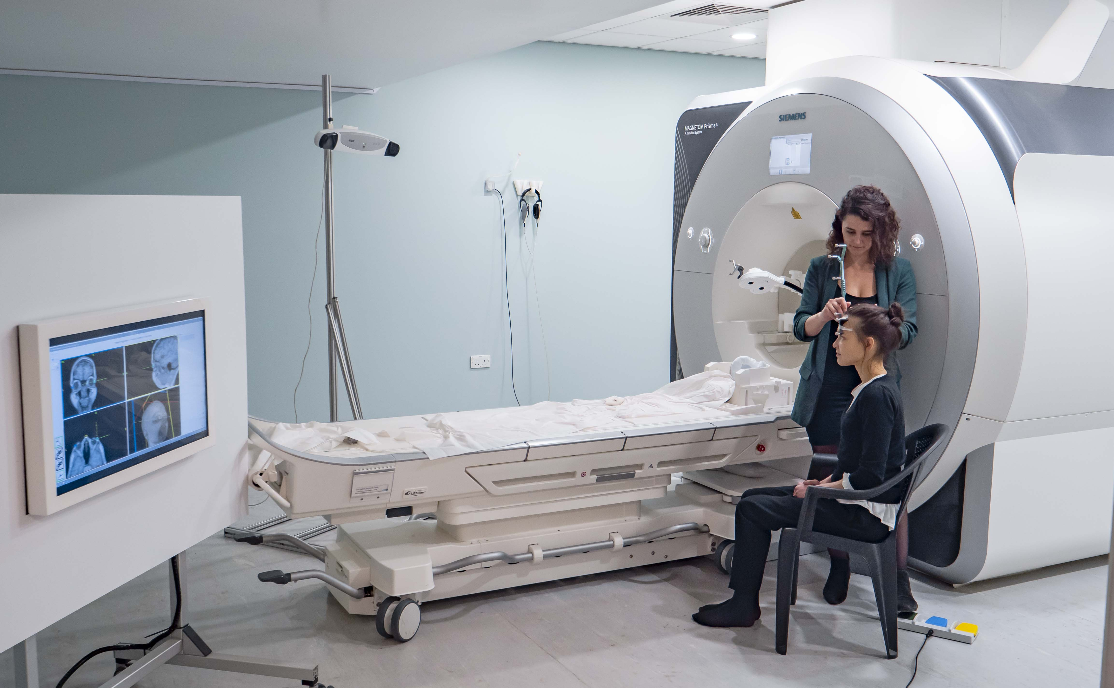
Neuronavigation

Slide 53
Neuronagivation

Slide 54
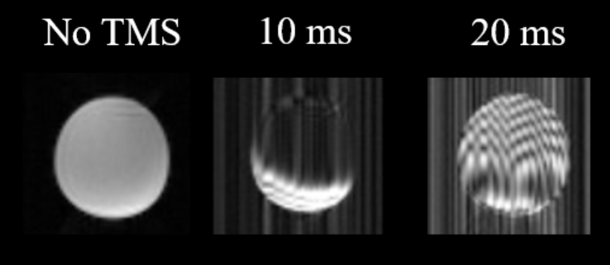
Protocol
Remove the affected slices (interpolation)
Stimulate during gaps in acquisition
-Pulses delivered in delay at the end of TR
-Pulses delivered in silent gaps in between slices
TR
TR

Slide 55
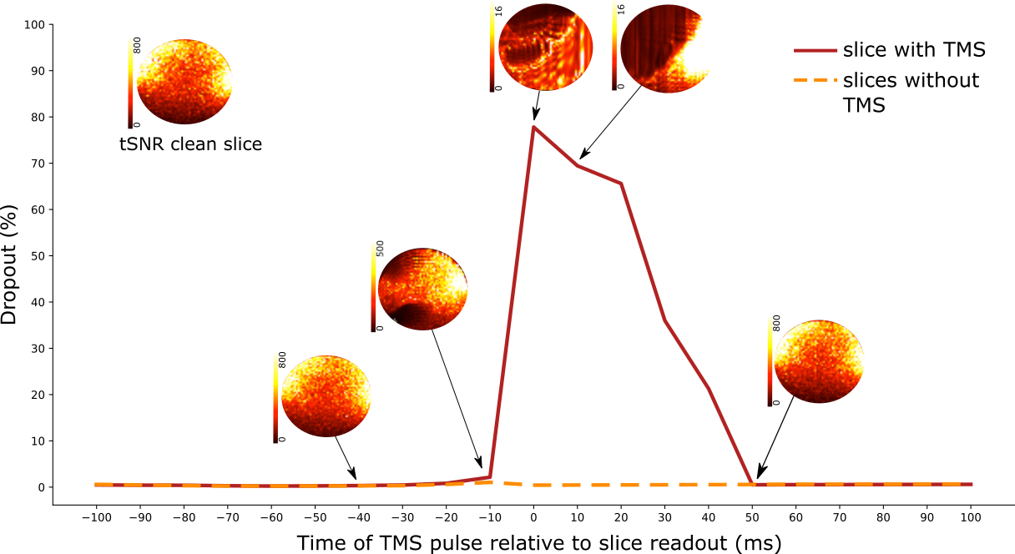
Interslice TMS-fMRI
Scrivener, Jackson, Correia, Mada & Woolgar

Slide 56

The future of TMS?
https://www.youtube.com/watch?v=qJ3OvleTV4I&ab_channel=BrainboxLtd

Slide 57
Questions?

