Slide 1


Recording psychophysiology in the fMRI environment:
Overview of CBU psychophysiology equipment and a fear conditioning case example
Barney Dunn
IIG: January 2011

Slide 2
Acknowledgements
I am shamelessly borrowing from:
Iole Indovina & Sonia Bishop
Powerpoint presentation on recording SCR in the scanner

Slide 3
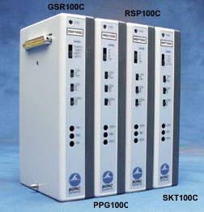
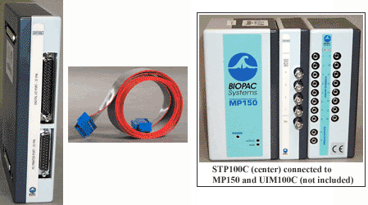
Equipment Available
(in the scanner)
BIOPAC MP150 system recording electrodermal (EDA; measure of sympathetic ANS) and heart rate (HR; measure of sympathetic and para-sympathetic ANS)
Lots of potential for upgrade to record additional signals.

Slide 4
Equipment available
(out of the scanner)
2 MP100 systems: one available for booking in lab 436 (for pilot testing, behavioural data), one in lab 442 for Dalgleish group; can record EDA + HR (widely used) and EMG + EEG (less widely used)
Portable system MP35, in combination with two testing laptops, available for remote patient testing to record HR and EDA only.

Slide 5
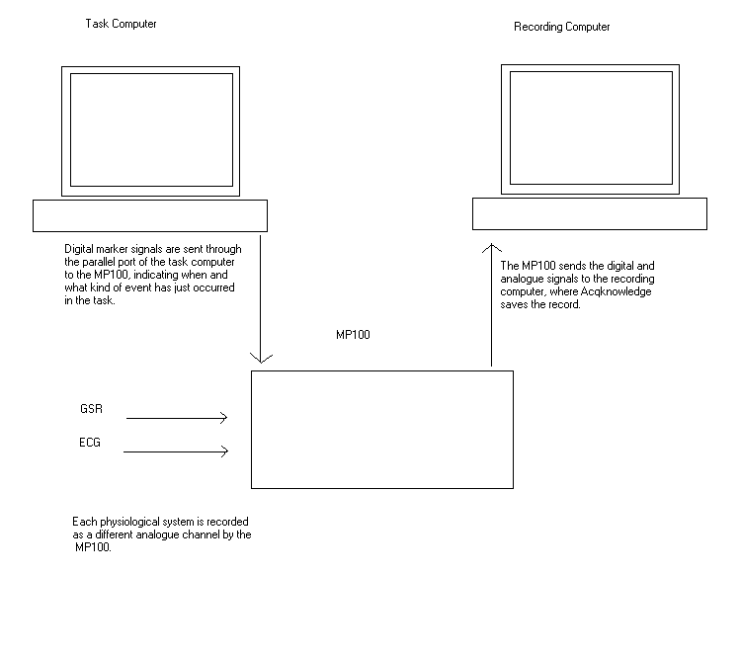
Schematic of setup

Slide 6
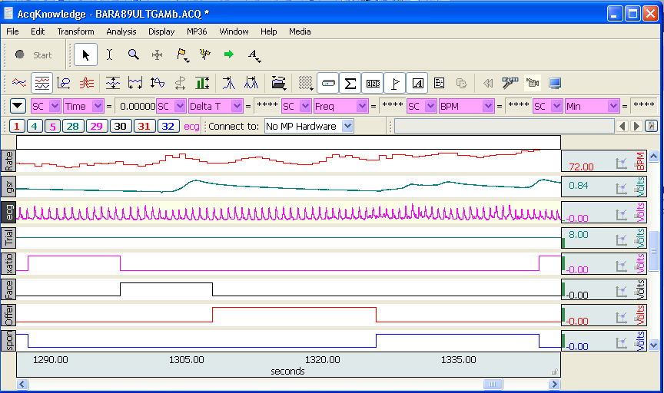
Example Acqknowledge record

Slide 7
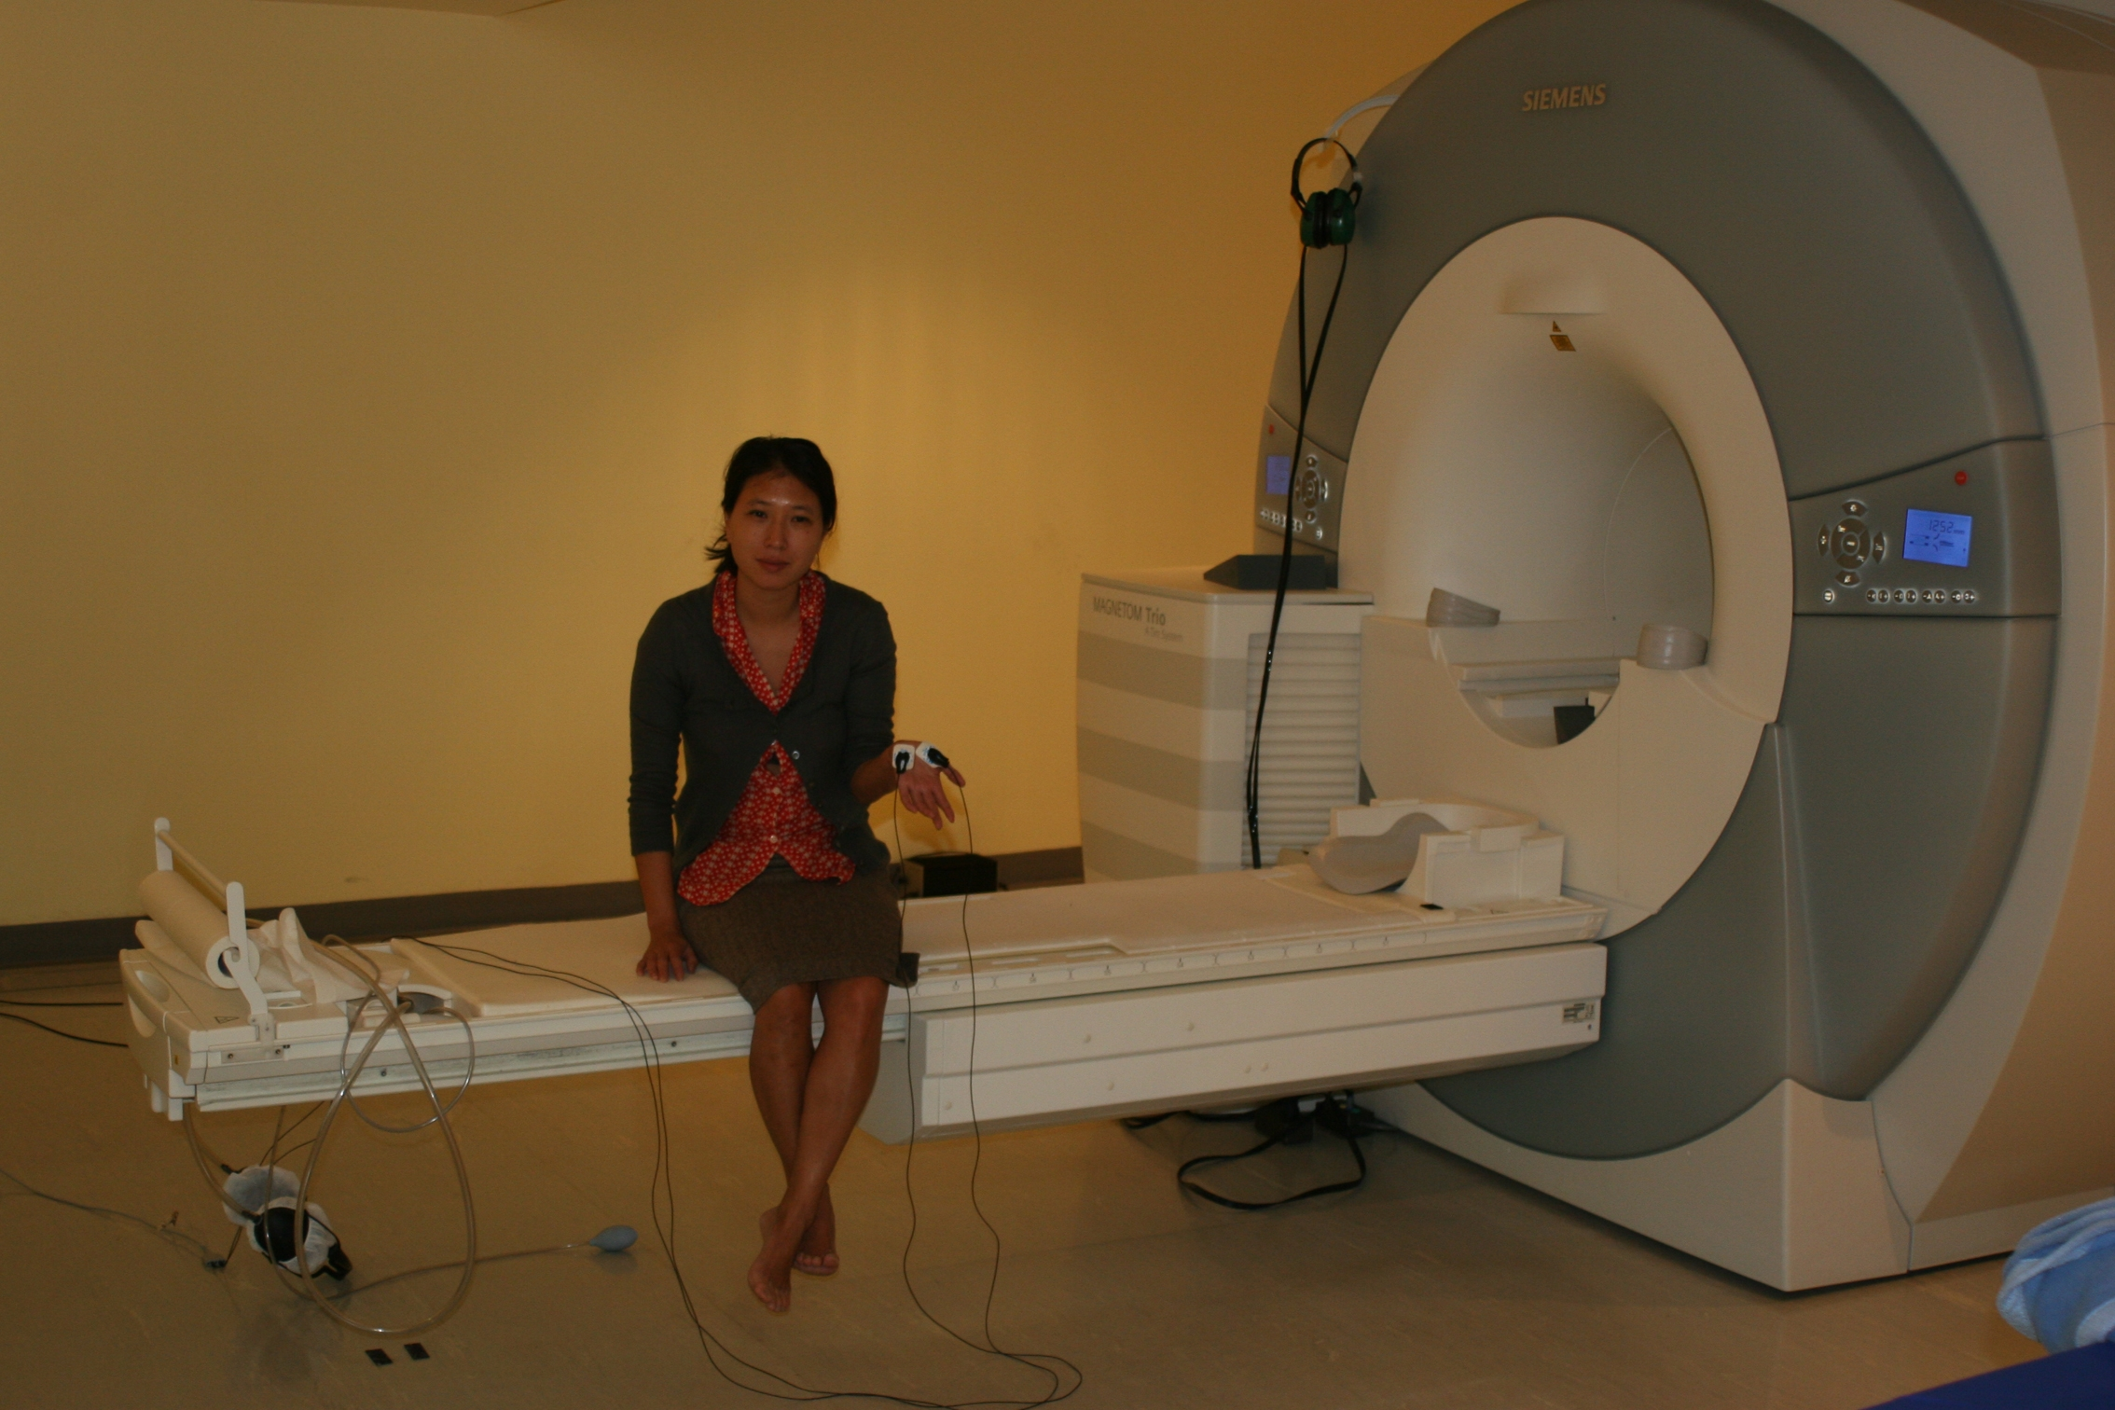
SCR is measured through 2 Biopac MECMRI-3 EL509 dry disposable electrodes spread with Biopac electrolyte (gel 101) and positioned on the palm of one hand

Slide 8
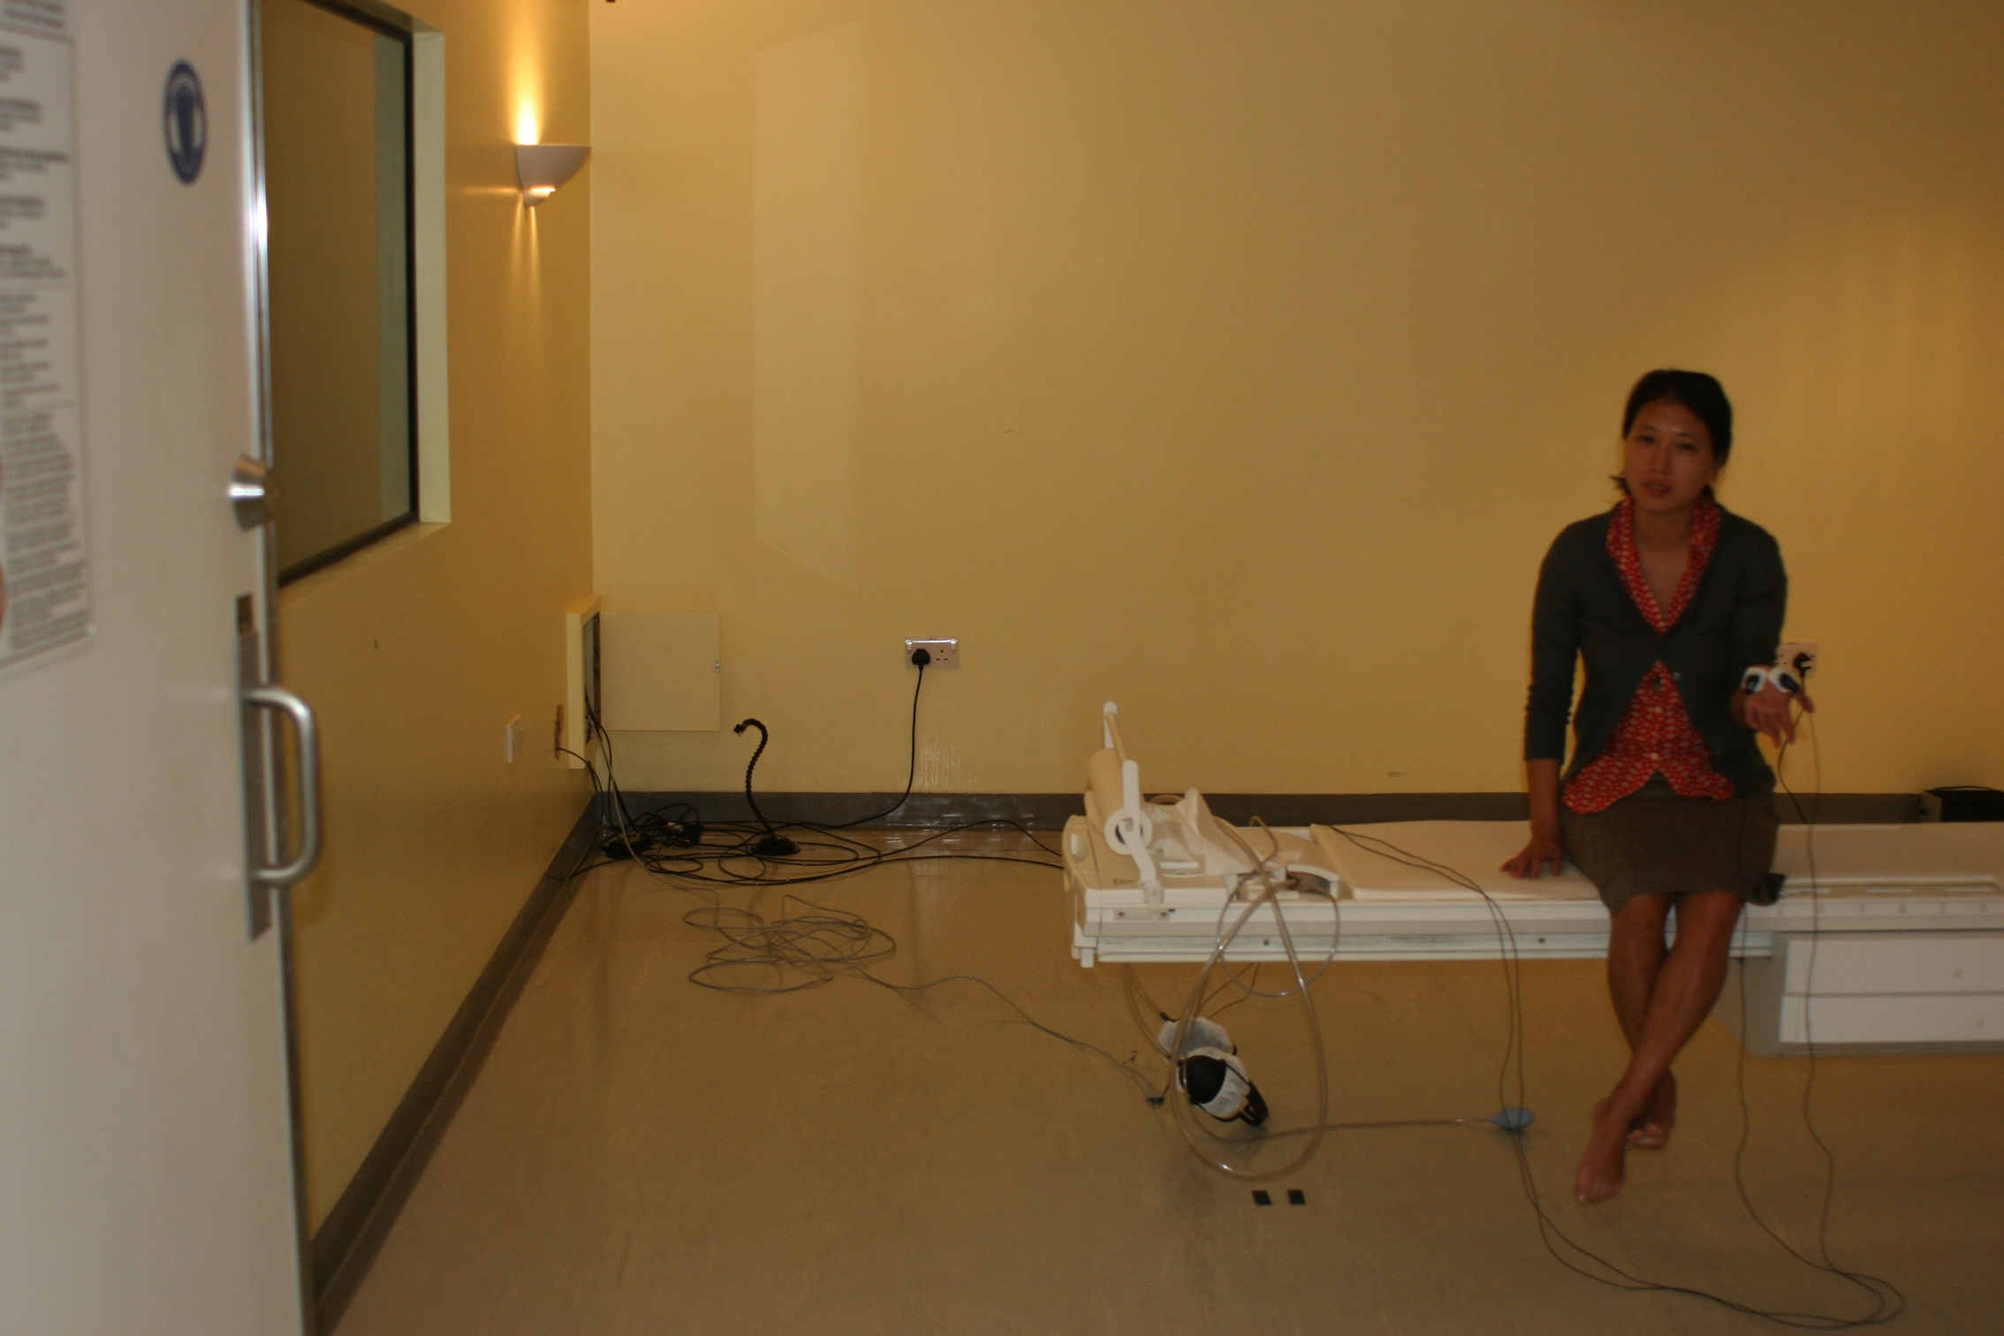
The electrodes inside the scanner room are connected though the MECMRI-3 lead to a filter box.
The connection lead MECMRI-1 on the right wall under the table in the scanner console room goes to the GSR 100C.

Slide 9
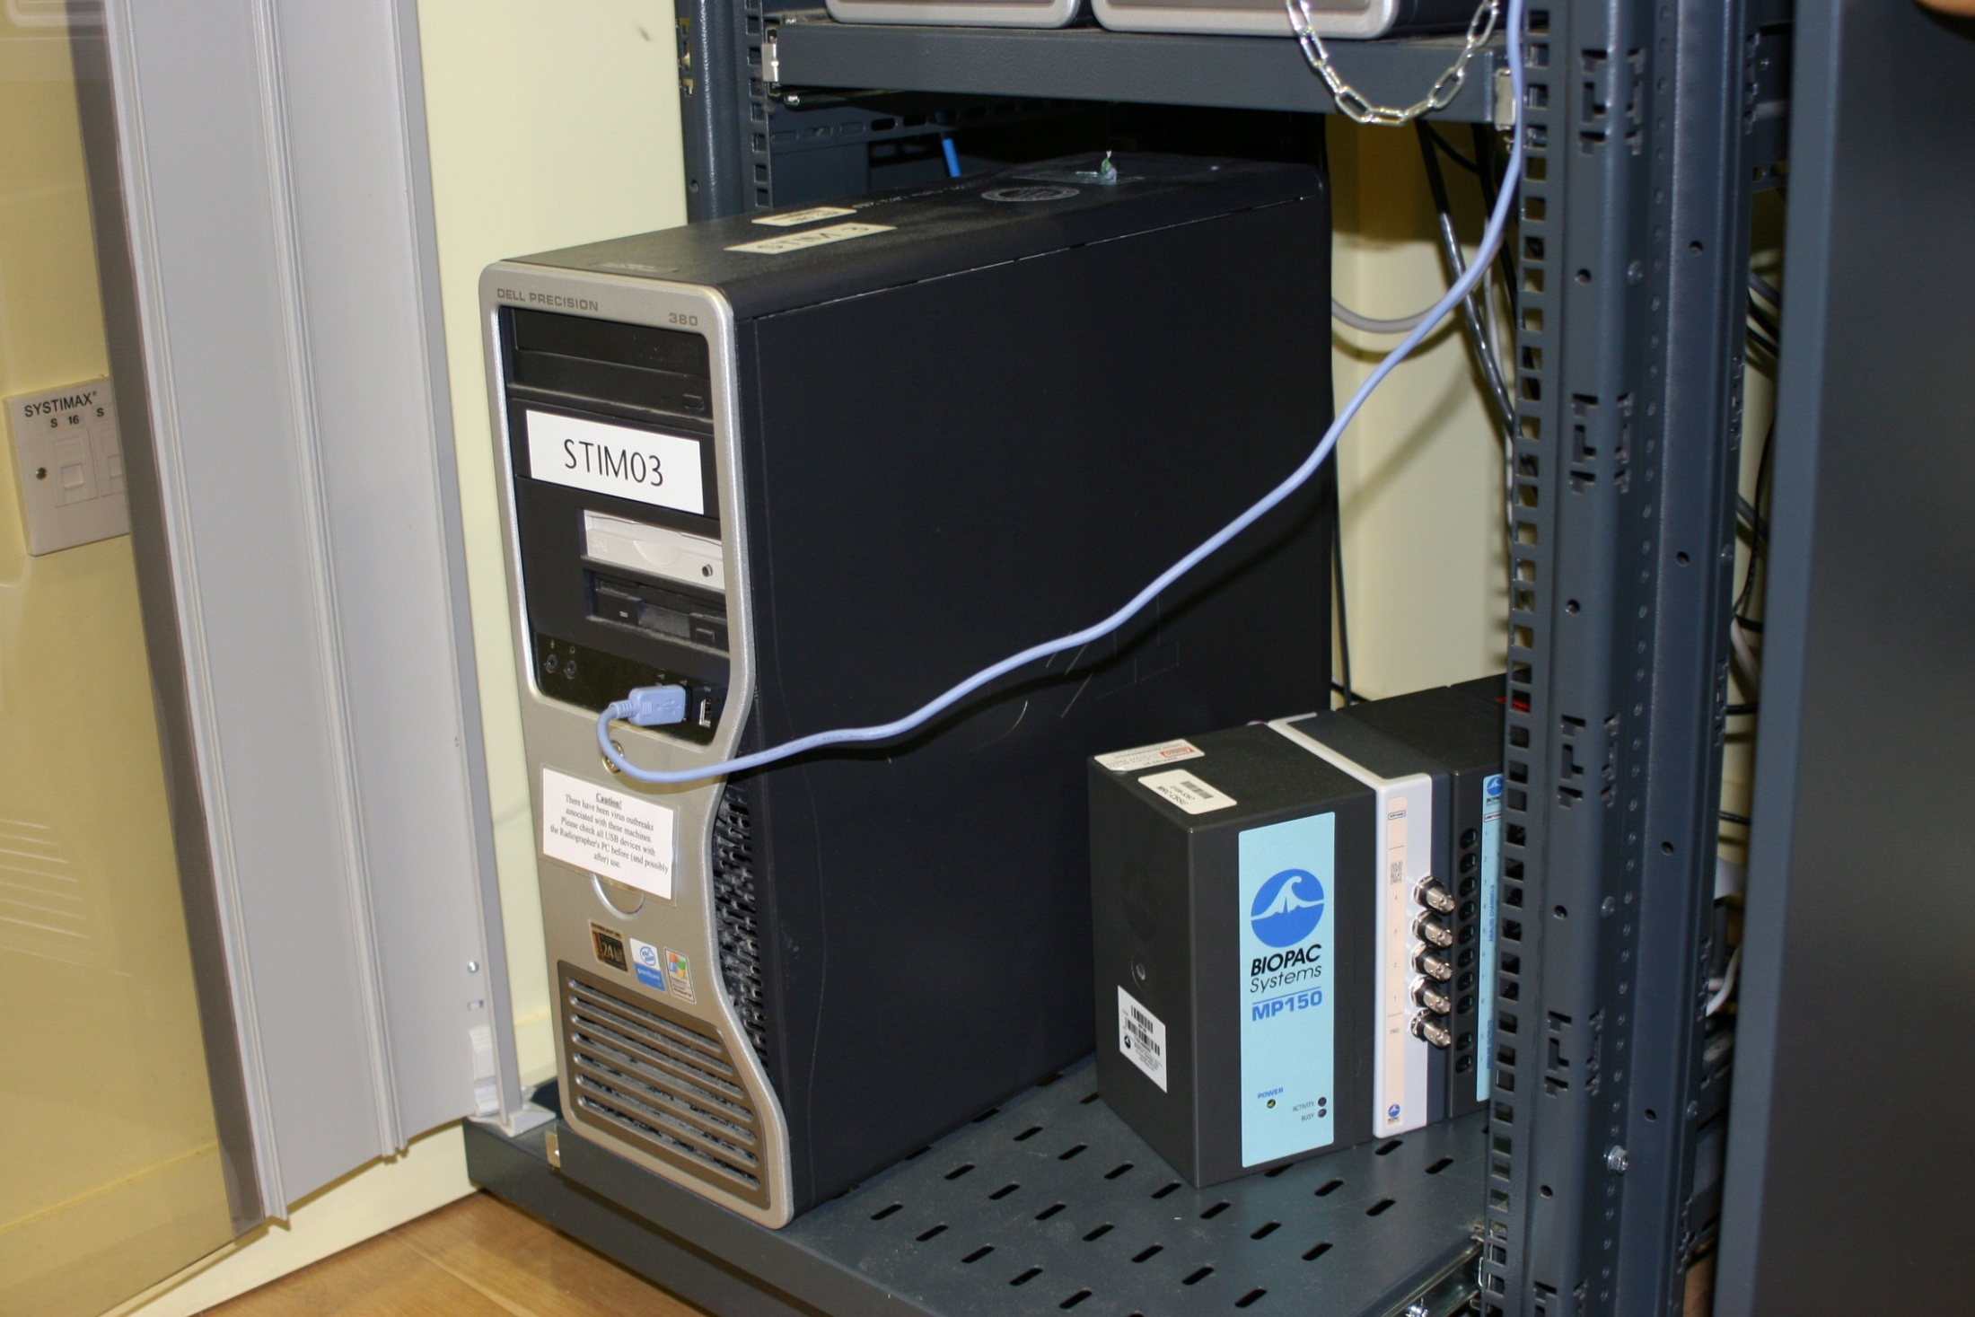
MECMRI MP150 transducer and amplifiers (Galvanic skin response module GSR 100C, insulation module STP100C, and the ECG module) are interconnected to form a single block and positioned by Stim Deliv Comp 3

Slide 10
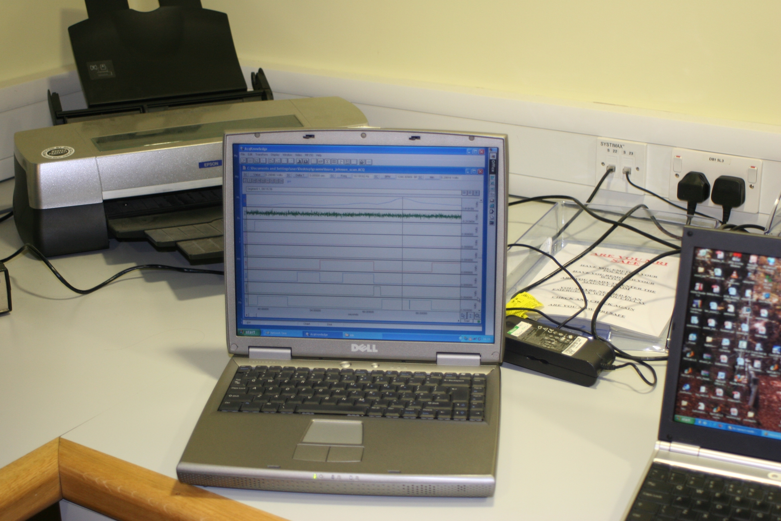
Digital and analogue (SCR) signals are sent to an acquisition computer which must have AcqKnowledge 3.9.1 software (or later) installed

Slide 11
GSR 100C
The GSR 100C applies a constant voltage (0.5 V) between the two electrodes attached to the palm. Since the voltage is constant, the current flowing between the electrodes is proportional to the skin conductance (G), or inversely proportional to the skin resistance (R). SCR is typically measured in microSiemens, μS, this can be calculated by multipling the recorded signal by the gain factor used.

Slide 12
GSR 100C setup
The GSR 100C has a number on settings that allow you to adjust gain and filtering.
We usually select the following:
Gain 5 micro-mho/V
(optimal to record a signal between 0 and 50 micro-mhos)
Low Pass filter (LP) 1Hz
High Pass filter (HPs) DC
The pin number selected on the top of the GSR 100C must correspond to the analogical channel number on the AcqKnowledge template

Slide 13
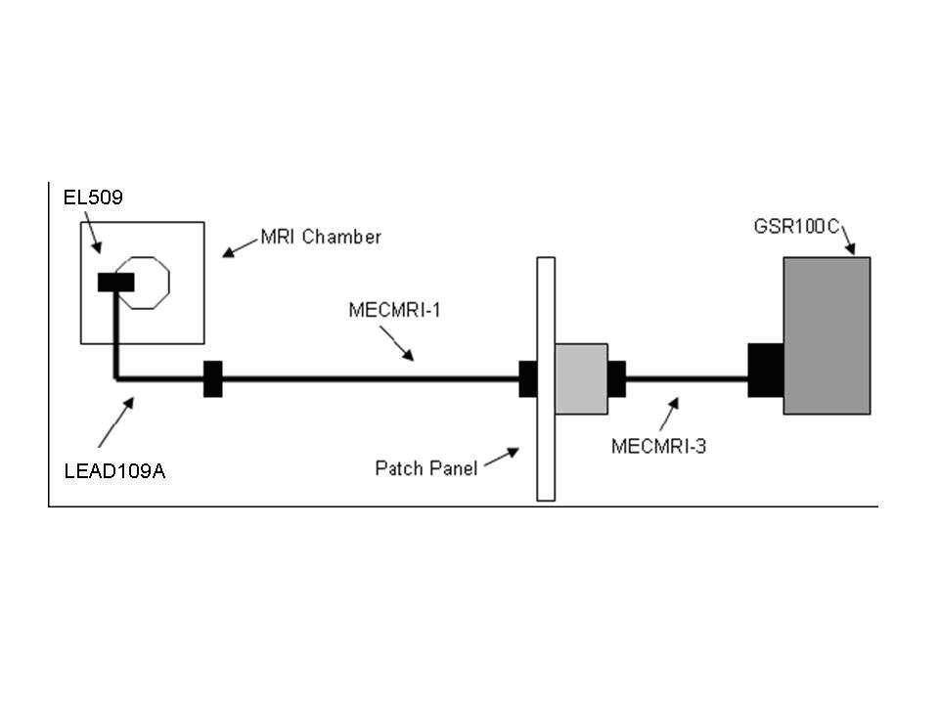
Schematic of fMRI setup

Slide 14
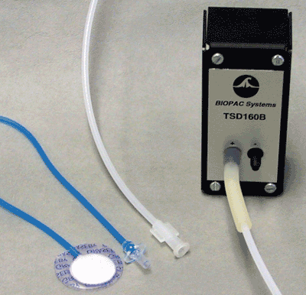
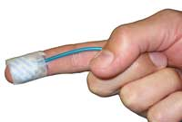
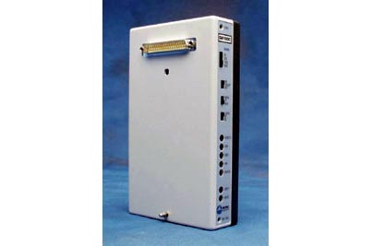
Pulse rate
(yet to be used)
The TSD110-MRI consists of a differential pressure transducer (TSD160A), sensor (RX110), and tubing (two AFT30-XL). The TSD110 interfaces to an MP150/MP100 via a DA100C amplifier. The AFT30-XL tubing will add a delay of less than 50 msec to the sensing of the waveform peak.
The Pressure Pad/Respiration Transducer (TSD110-MRI) requires no electrical connections inside the chamber and works on a number of body locations.

Slide 15
Analysis Primer
Early stages of analysis involve extracting summary statistics for each trial:
- mean, max, min activity during event, relative to pre-event baseline (difference score, covariate or residuals approach)
- variability of a signal over time(e.g. HRV)
Then averaging across like event for each participant. These means are then analysed in SPSS using standard approaches.
They can be ported into SPM, for example as a covariate in a regression.

Slide 16
Analysis software
Can analyse in Acqknowledge software but this is clunky and hard to batch process.
I save .acq files as .txt files and then batch process in scripts I have written in vb.net. These need to be adpated for each specific study, but this is quick and easy to do.
Good for heart rate variability is (freeware)CMetX:
http://jallen.faculty.arizona.edu/qrstool_and_cmetx_software_calculating_metrics_cardiac_variability
Need to purchase additional licences of Acqknowledge software if likely to be increased use of this software.

Slide 17
Product support
BIOPAC website (including useful product support documents and e-mail help: http://www.biopac.com/
BIOPAC uk supplier is Linton instruments. Key contact is Rob Jones. http://www.lintoninst.co.uk/ Tel 01379 650970
Both of these are useful on hardware issues but know relatively little about psychology/neuroscience applications. Both have a sales focus!
Other labs running BIOPAC in Cambridge include Luke Clark and Mike Aitken in experimental psychology, who use an identical setup.

Slide 18
A case example:
Fear conditioning
Aims to examine how individual differences in neural mechanisms underlying conditioning can account for anxiety vulnerability
- cue-specific fear (e.g. in phobias) modelled with cued fear conditioning; neutral CS paired with aversive US over time triggers same response as US.
- diffuse, non-cue specific fear (e.g. in GAD) modelled with contextual fear conditioning; environment in which aversive US is delivered over time triggers same response as US.
Full reference: Indovina, Bishop et al., 2010, Fear Conditioning Mechanisms Associated with Trait Vulnerability to Anxiety in Humans, Neuron, 69, 563-571.

Slide 19
Method
23 non-clinical participants recruited, with varying levels of trait anxiety (M=40, SD=8, range 25-53).
Trained on contextual conditioning task
Repeated task in fMRI scanner 48 hours later
Electrodermal activity taken as a measure of conditioning in both sessions (using BIOPAC setup)

Slide 20
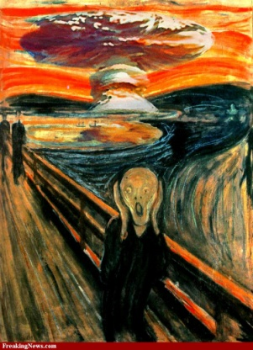
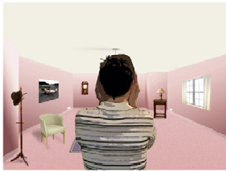
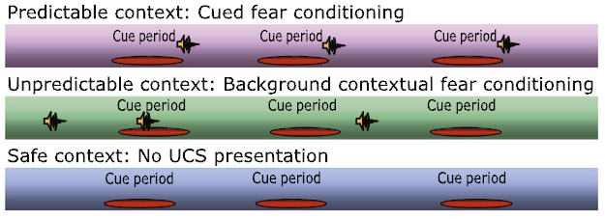
Task
US: 750ms 103 db scream
CS: virtual actor putting hands to ears
Contexts are rooms, with different furniture and colour schemes

Slide 21
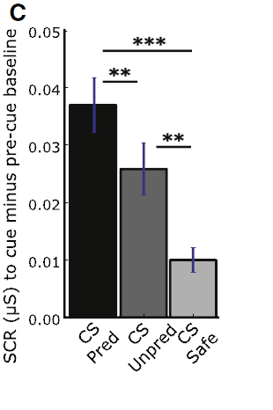
Response to CS
(early acquisition)
Greater response to predictable room
Cued conditioning has worked

Slide 22
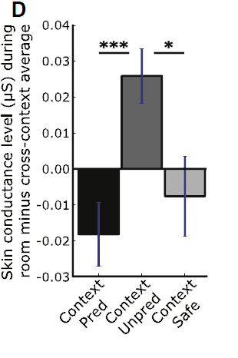
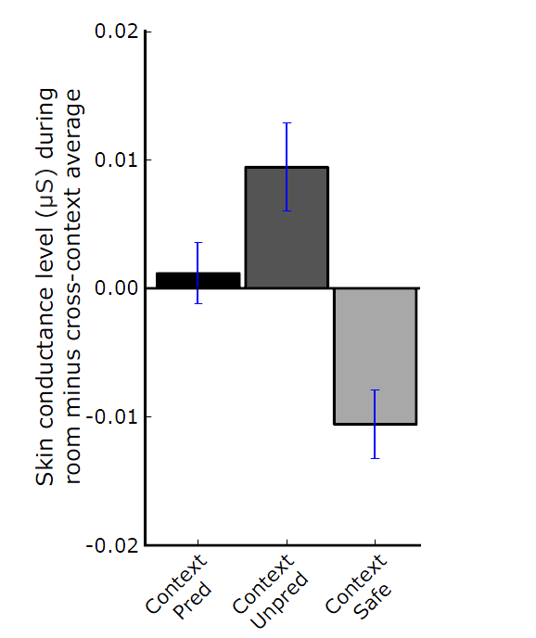
Response to context
Early acquisition
During scan
Greater response to unpredictable room
Contextual conditioning has worked

Slide 23
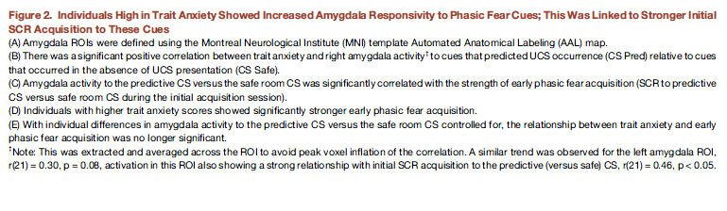
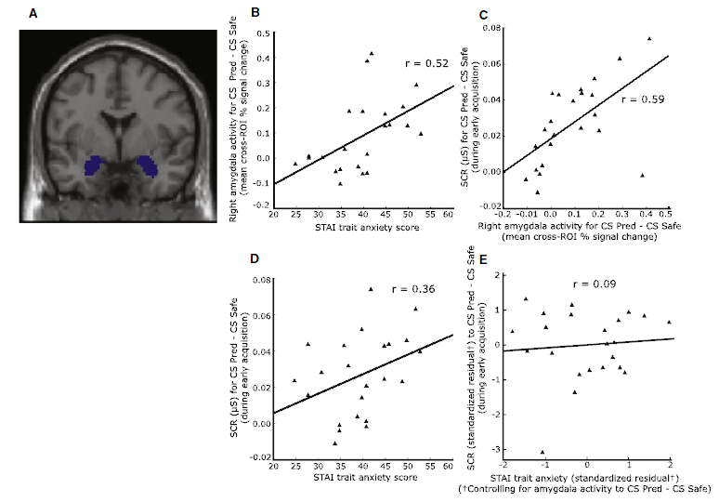
Notes:
Graph 1 – more anxious show greater amygdala activation
Graph 2 – more amygdala show greater SCR response (pred-safe) to CS
Graph 3 – more anxious show greater SCR response (pred-safe) to CS
Graph 4 – anxiety-SCR relationship no longer holds when controlling for amygdala reactivity

Slide 24
Route One
Differential amygdala responsivity mediated the link between trait anxiety and cued fear acquisition (SCR responses), Sobel indirect test P<.05.
In other words, anxious individuals show greater amydgala reactivity in response to phasic fear cues
Suggests this is one neural mechanism conferring risk for development of pathological fear processes.

Slide 25
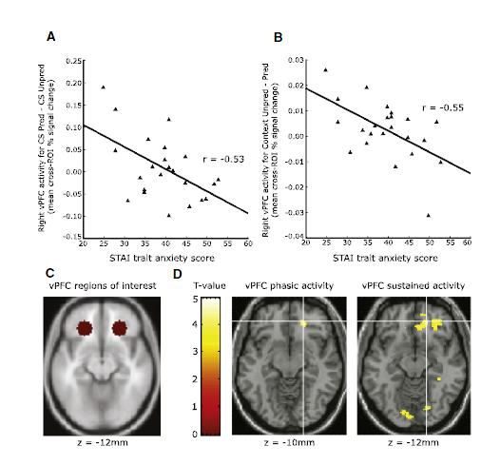
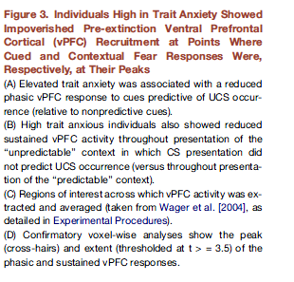
vPFC 1
Notes:
Graph 1: more anxious show less recruitment of vPFC where cued fear responses at peak (pred – unpred)
Graph 2: more anxious show less recruitment of vPFC where contextual fear responses at peak (unpred-pred)

Slide 26
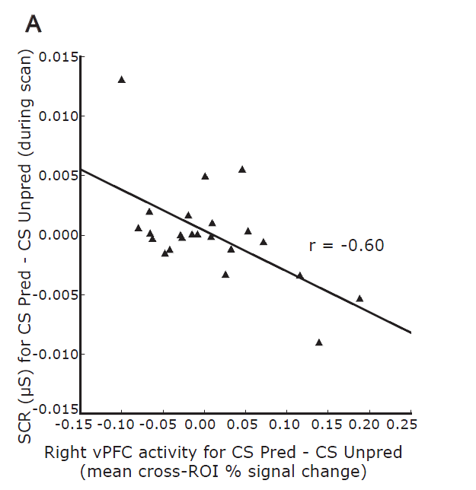
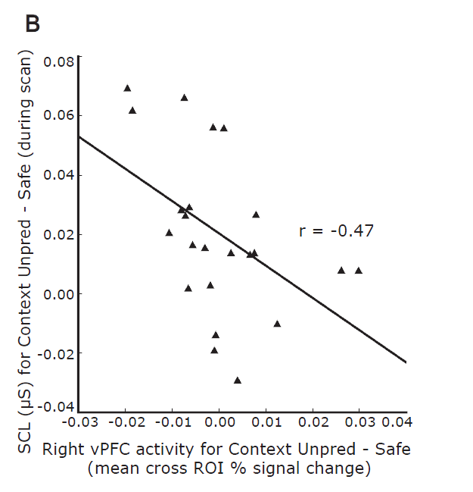
vPFC 2
Notes:
This shows SCR response on relation to right vPFC for a) cued and b) context
Mediation analysis did not hold here

Slide 27
Route Two
Impoverished contingency appropriate recruitment of vPFC regulatory mechanisms are associated with trait anxiety
Suggests this is a second neural mechanism conferring risk for development of pathological fear processes.

Slide 28
Conclusions
We have kit to measure psychophysiology in and out of fMRI
Its easy and quick to setup and analyse
We have shown that it can produce meaningful data
Feel free to use it!
There are some further ‘spare’ slides that will be of practical use to anyone wanting to use the equipment

Slide 29
Spare slides

Slide 30
Electrodermal System
Also referred to as EDA, GSR, SCR
Records eccrine sweat gland activity, index of autonomic/sympathetic nervous system
Measured via changes in electrical conductivity through finger-tips or palm of non-dominant hand
Linked to emotion, arousal, attention, and motor control

Slide 31
Components of EDA Response
amplitude
latency rise time half recovery time

Slide 32
Evaluation of EDA
Strengths
relatively pure measure of ANS
easily to discriminate if response has occurred
relatively easy to record
Weaknesses
signal sensitive to temperature, electrode placement and tightness
marked individual differences, which can wash-out group differences
use of non-dominant hand - laterality differences?
habituation effects
slow signal response, relatively long time period to return to baseline
multiply determined, so hard to be sure SCR task specific

Slide 33
Heart Rate (HR)
Frequency of heart contraction, measured by electrocardiogram (ECG) or pressure pads
Counts R-wave component of cardiac cycle to estimate beats per minute
Heart period = inverse of heart rate
HR increase due to either increase in sympathetic division or decrease in para-sympathetic division of PNS
Triphasic response seen to stimuli: initial deceleration, subsequent acceleration, final deceleration
Deceleration = initial defensive orienting
Acceleration = preparation for action/mentalisation
Increasing interest in heart rate variability (e.g. as measure of emotion regulation)

Slide 34
Evaluation of Heart Rate
Strengths
non-invasive
can visually inspect quality of signal
Weaknesses
movement artefact.
unclear if effects due to sympathetic or para-sympathetic influences.
can be caused by multiple psychological factors
Issues to Consider
participant response and electrode siting in relation to movement

Slide 35
EMG: Facial Muscle Activity
Electromyography (EMG) records activity in the skeletomuscular system
Particular focus on facial muscles e.g. when smiling (zygomatic), frowning (corrugator), and blinking/startle (orbicularis oculi)
Startle primarily measured by acoustic startle: spike of EMG activity on orbicularis oculari muscle (‘eye blink’) in response to burst of white noise
Startle greater for negative than positive stimuli, often interpreted as ‘fear potentiated’

Slide 36
Evaluation of EMG
Strengths
fast-acting system, less problem with return to baseline
Weaknesses
invasive for participant
difficulties with electrode placement; overlap of recording sites
electrode fragility
noise in the signal
facial hair
hard to visually scan whether you are getting a good signal (except blink)
mixed success in generating reliable data!

Slide 37
Some Applications
As a measure of bodily-component of specific emotional response
psychophysiology response to emotional images
conditioned emotional response to ‘biologically prepared’ stimuli
emotional modulation of startle reaction
As a way to measure interoceptive awareness
heart-rate monitoring accuracy in Panic Disorder as a test of the cognitive model
relationship between heart-rate monitoring and emotional responsiveness as test of James-Lange model
As a more ‘implicit’ measure of emotion or emotional learning
anticipatory SCRs on the Iowa gambling task to test Damasio’s somatic marker hypothesis (Bechara et al., 1996)
response to emotional stimuli presented with backward masking (Ohman & Soares, 1994)
Index of conditioned learning

Slide 38
Setting up a template in AcqKnowledge
Open a blank AcqKnowledge file.
Go to MP150 –> set-up channels –> analogue
Enter the physiology channel you are recording. The numbers correspond to the red switches on the top of each amplifier. Check all three boxes for each channel you wish to record and give it a sensible name (e.g. scr).
Go to MP150 -> set-up channels –> digital
Enter the digital marker signals you wish to record. The numbers correspond to the pin you are writing out to on the parallel port. Again, check all three boxes of each channel and give it a sensible name (e.g. the name of the event in your task).
Go to MP150 -> set-up acquisition.
Select ‘record once save to disk’. Enter your sampling rate (200 is sufficient for SCR; the rule is to record at a sampling rate two times higher than your maximum frequency of interest). Enter how long you want to record for (specifying units also). In general, set this much longer than your task will last – you can always stop it mid recording.

Slide 39
Parallel port
Can write out from the task computer through the parallel port or a parallel port simulation card (Quatach for express port) to mark on the Acqknowledge record onset and offset of stimuli.
0 = no pins
1 = pin 1
2 = pin 2
4 = pin 3
8 = pin 4
for combinations, add together numbers (e.g. 6 = pins 2 and 3).
Use inpout32.dll or TVciPort :
http://logix4u.net/parallel-port/16-inpout32dll-for-windows-982000ntxp
http://www.entechtaiwan.com/dev/port/index.shtm
David Hayes knows everything there is to know about parallel ports and has a handy light box to test if the write pins are being turned on and off.

Slide 40
Stimulus delivery/ timing issues
Accessing the parallel port to mark SCR trace for occurrence of events of interest
A problem with Windows NT/2000 and Windows XP, is its strict control
over I/O ports. Unlike Windows 9x & ME, Windows NT/2000/XP will
cause an exception (Privileged Instruction) if an attempt is made to
access an IO port that a user-mode program is not privileged to talk too.
PortTalk is installed on computer 3 in the scanning room and allow access to
the parallel port.
The file PortTalk.sys is in /windows/system32/drivers (as it is on disk C, it may get deleted if computer 3 is upgraded).
To start your stimulus presentation program (Matlab in this example) you have to use the following command on computer 3
C:\Program Files\PortTalk>AllowIO /a c:\MATLAB701\bin\matlab.exe
On computer 3, there are desktop shortcuts to start Matlab (AllowIO_Matlab) and VisualBasic (AllowIO_VB) with AllowIO.

Slide 41
Common problems
If the MP system wont synchronise with the recording computer, turn off the task computer and try and re-establish connection.
If you leave menus open when recording in acqknowledge you get a buffer overflow error and you will lose your data
If signal disappears, first thing to do is to rescale the display. If this does not work, check electrodes still attached!
EDA electrodes in behavioural labs are fragile; avoid participant pulling wire by having them point down the finger to the arms.
HR is particularly sensitive to movement artefact; encourage participants to sit still

Slide 42
Issues with the parallel port and timing.
Sending the time stamp signal to the parallel port can introduce a delay that may impact your stimulus delivery.
For example, using cogent (in Matlab), we found a delay of about 100 ms.
Depending on when you send signals to the parallel port (i.e whether you ‘mark’ stimulus onset, offset etc) you may end up introducing this delay into the onset or offset of your stimuli or possibly into the response time measurement.
Rhodri Cusack has written a shared Windows Component (an activeX DLL) that overcome the delay problem. It is a small tool installed on the stimulus delivery and mimic machines called “CBUParallelPortTool” that replaces the functionality of Cogent’s “outportb” but operates more quickly.
It is recommended to use PortTalk instead of Cogent’s program UserPort. This allows access to the parallel port but behaves strangely on machines with 2 CPUs/ a dual core CPU, or even a Pentium-4 with Hyper-threading turned on in the BIOS (which emulates 2 CPUs)

Slide 43
Running a session measuring SCR
Setting up the equipment
Ensure Computer 3 and SCR equipment next to it are turned on.
Connect your laptop with AcqKnowledge software to the Ethernet cable coming from the wall (labelled “Biopac Socket”, on the right of the monitor of computer 3 in the scanner console room). This cable is connected through a fixed crossed Ethernet cable to the MP150.
Turn it on and start AcqKnowledge3.9.
Open your template. If the communication with the MP150 is correct a green “start” button will appear at the bottom right corner of the template.
ERRORS.
If there is a problem with the communication, restart the laptop after having verified that you connected the Ethernet cable.
Be sure that you are running AcqKnowledge3.9.1 and not AcqKnowledge3.7.

Slide 44
Running a session measuring SCR
Getting your participant ready
Ask your participant to wash their hands without soap.
The radiographer will set them up as normal in the scanner and attach the 2 electrodes (with gel) for SCR
We advise that you wait 10-15 minutes before starting to record the SCR to allow the signal stabilize.
Recording SCR
To start the SCR recording, push the start green button at the bottom right corner of the AcqKnowledgetemplate.
Use Display -> auto-scale waveform, to better visualize the signal.
Use Display -> auto-scale horizontal, to modify the time scale.
At the end of the SCR recording period (data acquisition) push stop button at the bottom right corner of the template.
Save the data with a unique filename. Be very careful not to overwrite your data before you saved them. Save two files for each measure: one in ACQ format, and another one in txt format (useful for analysis with software different from AcqKnowledge.)

Slide 45
Analysis Primer 2
Potential for multilevel approaches (e.g. STATA) to look at coupling between physiological response sand behavioural/neural response for individuals trials nested across individuals.
Key is checking and removing recording artefacts, especially in HR data.
- visual inspection and correction
- medians rather than means
- non-parametric approaches

Slide 46
Handover
I am leaving unit and am currently main user of this kit
I will leave behind relevant methods articles (e.g. [now outdated] publication guidelines for EDA and HR recording).
Key textbook is Cacioppo et al Handbook of Psychophysiology in the library.
I will leave behind my lab manuals that I use to train up new students and also the manual Sonia Bishop’s team developed for EDA in the scanner.
I will leave behind some examples of VB code to analyse data and some example data sets.
I am happy to train someone (from methods group?) up in use of equipment and analysis if useful
I am very happy to have ongoing consultancy/collaborative role if useful.

