Slide 1

An introduction to
Multi-Variate Pattern Analysis (MVPA) with examples using scikit-learn & nilearn and
The RSA Toolbox
Introduction to Neuroimaging Methods, 10/3/2025
Daniel Mitchell
Daniel.Mitchell@mrc-cbu.cam.ac.uk

Slide 2
Overview
Part 1
Introduction to MVPA
  What is MVPA?
  Why do it?
  How does it work?
scikit-learn
  What is it?
  Why you might want to use it
  (plus alternatives)
  How does it work?
    examples focusing on classification, using simulated data and fMRI data
Part 2
Introduction to RSA
  What is RSA?
  Why do it?
  How does it work?
The RSA Toolbox
  What is it?
  Why you might want to use it
  (plus alternatives)
  How does it work?
    demos using simulated data and fMRI data
Notes:
Warnings:
This a condensed version of a longer workshop for COGNESTIC, so I will go fast and not spend long on the demos – Check out the COGNESTIC website if you want to go through these on your own
Audience has wide variability in experience. So parts will seem simple to some people, but complicated to others. If the latter, don’t worry! You don’t need to understand everything (nobody does)! Feel free to ask questions.
It doesn’t matter if we don’t cover everything.

Slide 3
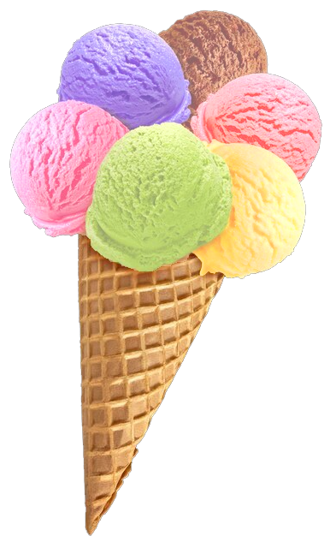
What is MVPA?
“Multi-Variate Pattern Analysis” (MVPA)
relates response patterns
to experimental conditions
Many (overlapping) flavours
Encoding vs decoding
(MVPA can be either)
Activation vs information?
MVB
IEM
cvMANOVA
PCM
RSA
Classification
MVPA
Notes:
For Multivariate Bayes, see e.g. Friston et al., 2008: https://pubmed.ncbi.nlm.nih.gov/17919928/
For Pattern Component Modelling see Diedrichsen et al. 2018: https://www.sciencedirect.com/science/article/pii/S1053811917306985 (this uses priors so is a hierarchical Bayesian model)
For cross-validated MANOVA see Allefeld & Haynes, 2014: https://pubmed.ncbi.nlm.nih.gov/24296330/ (I think this is equivalent to, or a specific case of, PCM)
For Inverted Encoding Models, see e.g. Sprague…Serences 2015: https://www.ncbi.nlm.nih.gov/pmc/articles/PMC4532299/
(IEM and related reconstruction techniques involve predicting multiple experimental features at once)

Slide 4
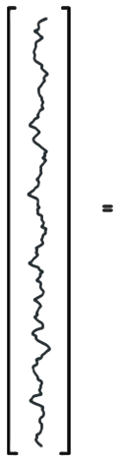
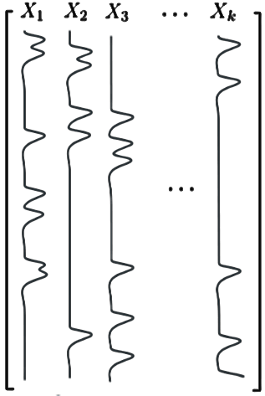
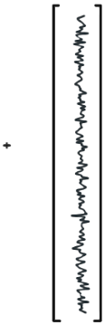






Per voxel (univariate) General Linear Model (GLM)…
…is an encoding model: can we predict the amount of activity in a voxel from the experimental conditions in X?
Activation
coefficients
Error
time
(t)
Data
(measured
BOLD signal)
Design
Matrix
In (multivariate) decoding we try to predict the experimental condition from the pattern of responses

Slide 5
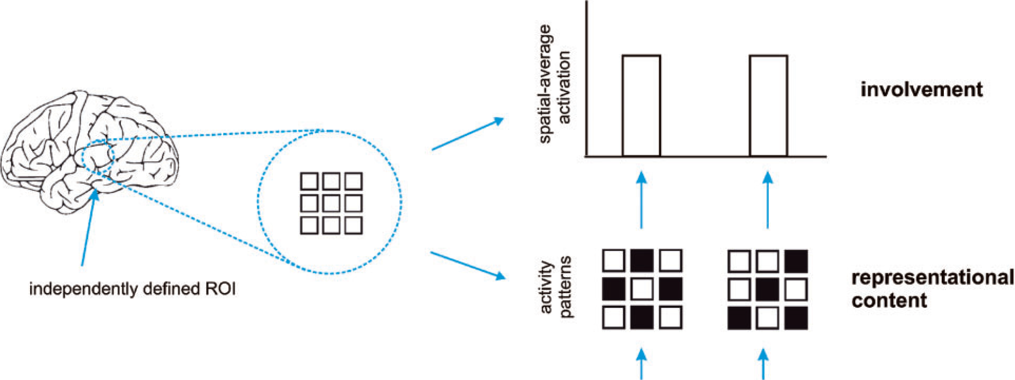
Activation-based (univariate) analysis
Pattern-information analysis
If we can classify experimental conditions based on activity patterns (better than chance)…
Then the activity pattern carries information about the experimental conditions.
Mur et al. (2009)
Notes:
…Real data are noisy, so we need to test whether pattern differences are consistent across repeated presentations…

Slide 6
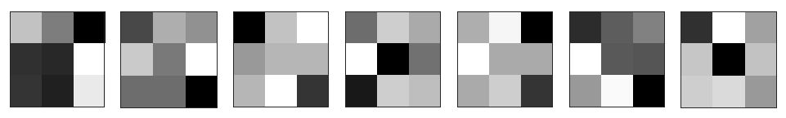
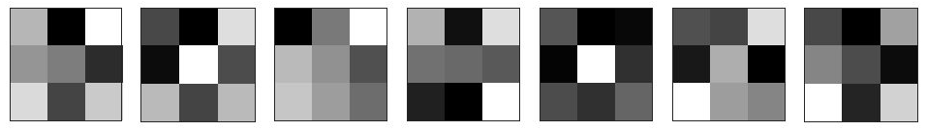
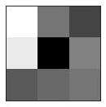
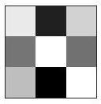
Terminology:
Sample / observation
Label
Class / condition
Patterns
Training set
variable,
feature,
dimension
(e.g. voxel)
Partition /
split /
fold
?
Testing
set

Slide 7
Why do MVPA?
Popularity
Scientific questions
  What information does a brain region represent?
  (classification: are patterns reliably different?)
  In what format does it represent the information?
  (RSA: what are distance relations between patterns?)
To make predictions based on brain data
  Disease status? Covert thoughts?
Typically more sensitive than univariate analysis
Notes:
Listed in reverse order of importance: It’s the sensitivity that allows interesting questions to be addressed, and in turn this makes it popular.

Slide 8
How does MVPA work?
classification example
1
2
Weight
vector
Classification boundary
True labels:
?
?
Compare
Voxel 2 activation
?
?
?
Predictions:
Voxel N
Voxel 1 activation
Notes:
Each pattern can be interpreted as a point in space. Each feature represents a separate axis of this space, and values are coordinates. Easiest to visualise in 2 dimensions.
Note – we won’t cover multivariate regression, but it’s conceptually similar: instead of predicting a binary label, the model predicts a continuous label. To evaluate performance, the predicted labels across items in the test set can be correlated with their actual labels
“To deal with … a 14 dimensional space, visualize a 3D space and say ‘fourteen’ very loudly. Everyone does it.” (Geoffrey Hinton)

Slide 9
Play with SVMs…
LIBSVM:
https://www.csie.ntu.edu.tw/~cjlin/libsvm/

Slide 10
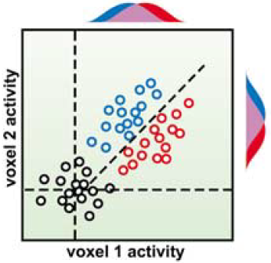
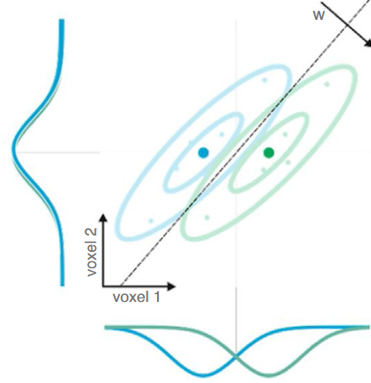
Why can MVPA be more sensitive?
Flexibly combines weak/noisy signal
across features
(including relative activation, non-uniform responses)
Suppresses correlated noise (Hebart & Baker 2018;
interpreting weight vector is tricky: Haufe et al., 2014)
Abstracts from subjects’ idiosyncratic response patterns
(information versus activation)
Cox & Savoy (2003)
Kriegeskorte
& Douglas (2019)
SUBJECT A
SUBJECT B
Voxel 2
Voxel 2
Voxel 1
Voxel 1
Notes:
Point 2 implies that it can be useful to include “noise voxels” in the pattern (to the extend that noise is correlated).
Note that MVPA is not always more sensitive. Requirement for cross-validation means that 1) model does not use all data at once and 2) there is a risk of overfitting. Univariate analysis on smoothed/averaged data might be more sensitive if its assumptions of homogeneous and consistent activation are correct. (See e.g. Kriegeskorte 2006)

Slide 11
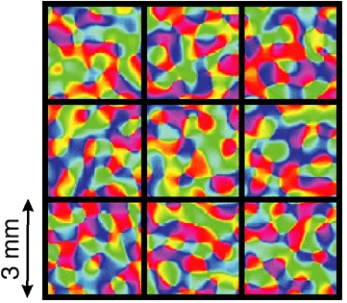
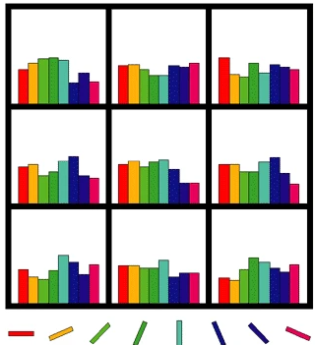
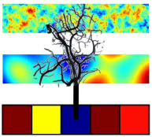
Physiology: fine or coarser scale patterns?
Original view: biased sampling of sub-voxel patterns
Later spatial filtering experiments:
  Removing high spatial frequencies doesn’t always hurt
  (e.g. Op de Beeck, 2010)
  Therefore sampled patterns may be coarse
Much evidence that information is represented at multiple scales
(e.g. FFA/PPA, Haxby 2001; radial orientation bias, etc.)
Veins as multipronged sensors?
(We sample from veins, which sample from neurons)
Often unimportant…
(we want to ask “is there information?”
not “what scale is the information?”),
but could have practical consequences
(consider smoothing and motion)
Kamitani & Tong (2005)
Haynes & Rees (2005)
Boynton (2005)
Kriegeskorte et al. (2009)
Notes:
Orientation column in human is about 0.8mm diameter (Yacoub 2008)
In general, the matched filter theorem (see Rik’s session) implies that it is optimal to smooth your data with a kernel matched to the spatial resolution at which you think your experimental feature is encoded in the brain patterns.

Slide 12
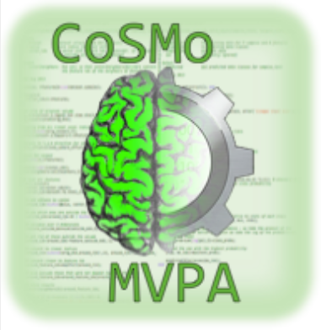

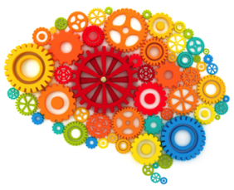

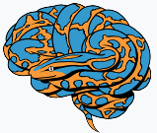


Many MVPA toolboxes are available…
Matlab (or Octave) | Python
CoSMoMVPA http://cosmomvpa.org/ | PyMVPA http://www.pymvpa.org/
The Decoding Toolbox sites.google.com/site/tdtdecodingtoolbox/ | MNE-python (for EMEG) https://mne.tools/stable
PRoNTo (for SPM) http://www.mlnl.cs.ucl.ac.uk/pronto/ | NiLearn (general/fMRI) https://nilearn.github.io/stable
Princeton Decoding Toolbox (discontinued) | BrainIAK (+advanced non-MVPA) https://brainiak.org/
MVPA-Light, https://github.com/treder/MVPA-Light
Searchmight (focus on searchlights) http://www.franciscopereira.org/searchmight/
Built-in functions | General ML packages e.g. https://scikit-learn.org/
RSA Toolbox (focus on RSA) https://git.fmrib.ox.ac.uk/hnili/rsa https://github.com/rsagroup/rsatoolbox
Within larger packages (e.g. BrainVoyager; MNE; 3dSVM in AFNI)
Yet more in Matlab: MANIA, MANAS, MVPANI, Brain Decoder Toolbox 2…

Slide 13
Why use scikit-learn?
Pros:
  Open source (Python)
  Popular: basis of many more specialised toolboxes
  “Simple and efficient”
  Built on standard packages (Numpy, SciPy, matplotlib)
  Good documentation, and examples:
  https://scikit-learn.org/stable/
  Extensive and actively developed
Limits:
  Not specialized for neuroimaging data
  (but integrated with neuroimaging packages, like nilearn)
  Doesn’t have deep learning capabilities
  (not needed for typical neuroimaging applications)
  Parallelization not straightforward

Slide 14
Python environment for demo:
See https://imaging.mrc-cbu.cam.ac.uk/methods/COGNESTIC2024
Uses a previously created conda environment including the following packages
that we must “import”:
    numpy (so python can process arrays, like Matlab)
    matplotlib (so python can plot graphs like Matlab)
    seaborn (extra plotting functions, based on matplotlib)
    pandas (to use “dataframes” – like tables in Matlab)
    nilearn (many useful functions for loading/processing/viewing MRI data)
    scikit-learn (major, general-purpose machine learning package)
    os, time (to interact with operating system, and system clock)
Demo is a jupyter notebook, called “DECODING_demo_djm.ipynb”
which can be opened using: jupyter lab (or jupyter notebook)
For Matlab demos using The Decoding Toolbox, see:
https://imaging.mrc-cbu.cam.ac.uk/methods/COGNESTIC2022
For Octave demos using CoSMoMVPA, see:
https://imaging.mrc-cbu.cam.ac.uk/methods/COGNESTIC2023
Notes:
scipy can load .mat files with io.loadmat and adds other matlab functionality like squareform and standard statistics (e.g. t-tests)
glob to search filenames with wildcards (not used here)
collections provides extra datatypes e.g. defaultdict
nibabel can process analyze/nifti files with load() and load().get_fdata
Can do: from [package] import [module] as [newname]
To use VScode:
Install Remote SSH
Click green button at bottom left; connect current window to host
Enter e.g. dm01@login-j03 + password
“conda env list” to see available environments
“conda list” to see software in active environment

Slide 15
Python(+Numpy) vs Matlab/Octave
Python(+Numpy) and Matlab/Octave are both high-level programming languages with many similarities
But note some differences:
If unsure, just ask! (or Google e.g. “numpy-for-matlab-users”)
Python | Octave/Matlab
Zero-based indexing, with [ ]: e.g. a[0:3] returns first 3 elements of a | One-based indexing, with ( ): e.g. a(1:3) returns first 3 elements of a
Transpose with: a.conj().T | Transpose with: a’
Comment with # | Comment with %
Print values with: print(a) | Print values with: a, or disp(a), or fprintf( ‘%g’ , a)
Loop with e.g.: for i in range(1, 4): # indented code | Loop with e.g.: for i = 1:3 % optional indent end
Can store arbitrary items in a list, e.g.: a = [10, “hello” ]; get last item with: a[-1] | Can store arbitrary items in cell array, e.g.: a = {10, “hello” }; get last item with: a{end}
Get help with: func? | Get help with: help func

Slide 16
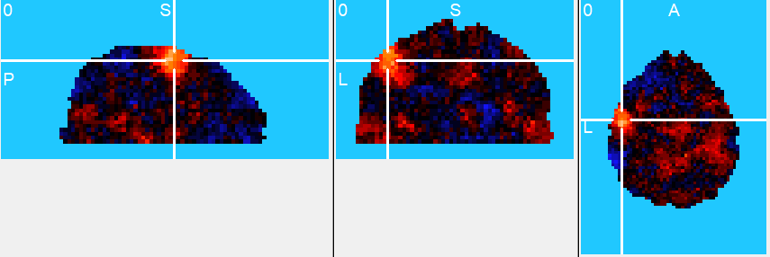
An example dataset/experiment
single participant
2 conditions: thumb vs pinky finger right-hand button presses, in alternating blocks, each lasting 16 s.
4 fMRI runs with 3 repeats of each condition per run
→ 4 x 3 x 2 = 24 volumes of beta coefficient (or t-value) maps
We might ask – where in the brain is there information about which finger is moving?
Or – in a region of interest, is there information about which finger is moving?

Slide 17
An example dataset/experiment
Where in the brain is there information about which finger is moving?
What choices do we need to make to produce this output?
  Which voxels will we include?
  How will we partition/cross-validate?
  Which method/classifier will we use?
  Which output measure will we use?
  (Also, choice of pre-processing etc…)
What question should we ask next?
  Is the information significant?
    for this participant?
    on average across participants?

Slide 18
Partitions, classifiers & metrics
Partition schemes, for cross-validation, e.g.:
  “hold out” (e.g. odd/even split)
  “k-fold” (repeated? stratified? grouped?)
  “cross-generalisation”
  ...
Classifiers, e.g.:
  Logistic regression (LR)
  Fisher’s Linear discriminant analysis (LDA)
  Support vector machine (SVM)
  Gaussian naïve Bayes (GNB)
  K-nearest neighbour (k-NN)
  ...
Performance metrics, e.g.:
  ‘accuracy’, ‘balanced accuracy’, ‘area under ROC curve’, ‘d prime’,
  ‘mean probability of true class’, ‘mean signed distance to hyperplane’, ...

Slide 19
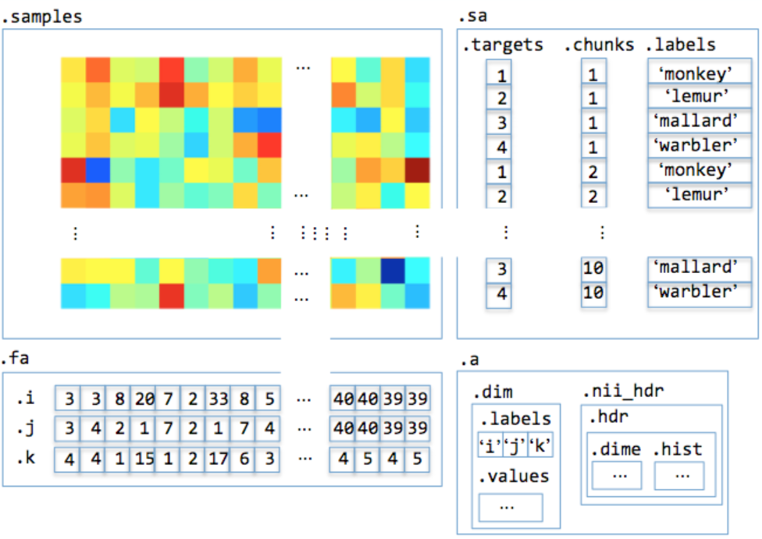
Basic “data set” structure:
How does MVPA work?
“features” (e.g. voxels)
sample
“attributes”
E.g.:
condition label;
run number
“samples”
data set attributes
E.g.:
volume dimensions;
subject number
feature attributes
E.g.: voxel coordinates
Notes:
This example is from CosmoMVPA, but same basic idea applies in general.
Foe decoding, we provide the “labels” vector, which makes this “supervised” learning.
What sample attributes can you think of?
What feature attributes can you think of?
What dataset attributes can you think of?
For fMRI, features might be surface nodes rather than voxels.
For EMEG, features might be sensors and/or timepoints and/or frequency bands
Samples can be defined as GLM estimates (per trial, or per condition etc.) or time-points.
Getting all samples from a single GLM is sometimes called the Least-squares all (LSA) approach.
The least-squares separate (LSS) design involves fitting a separate model per trial. Each model contains one regressor for the trial that you want to estimate and, for each condition in your experimental design (in case of a categorical design), another regressor containing all other trials.
(See Mumford et al. & Abdulrahman & Henson, 2016.)
(The “nibetaseries” package could be considered for trial-wise estimates in python.)
It’s not obvious which is best: “ratio of trial-to-trial variability to scan noise impacts both the optimal SOA and optimal GLM, especially for short SOAs b 5 s: LSA is better when this ratio is high, whereas LSS [is] better when the ratio is low.”
Soch et al 2020 looks like an interesting alternative method to account for correlation between overlapping regressors? (Adjust patterns matrix R, by calculating: (X^{T}X)^{0.5}R )
If using GLM, could use t-stats instead of beta/contrast estimates to implement univariate noise normalisation.

Slide 20
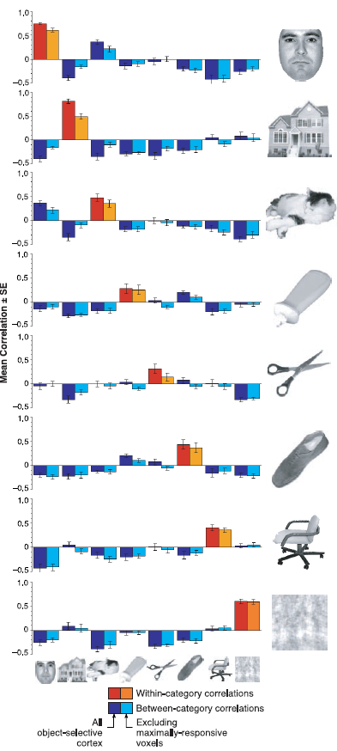
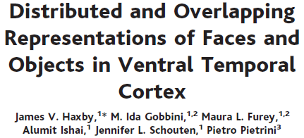
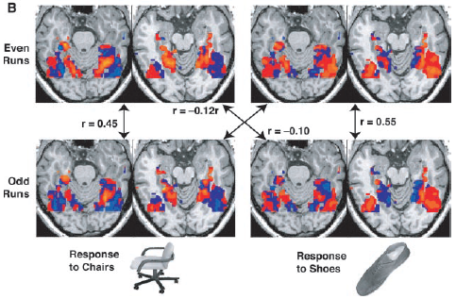
Notes:
Many of the examples in the CoSMoMVPA toolbox use this approach.
It’s fast and sensitive, but outperformed by other classifiers e.g. SVM. (See e.g. Haxby et al 2011; Haxby 2012), so we won’t use it here.
It can be thought of as 1-nearest neighbour classification, using correlation as a distance measure and one particular partition.

Slide 21
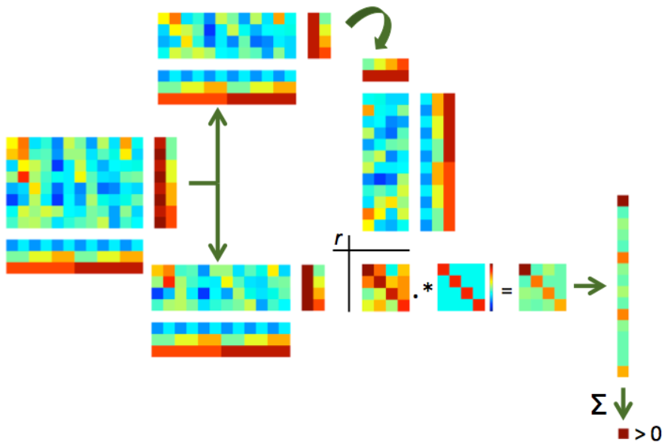
Schematic of “Haxby-style” split-half correlation approach:
Notes:
Figure from CoSMoMVPA

Slide 22
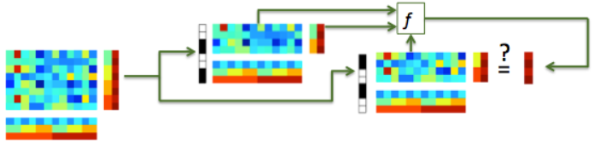
Typical classification uses multiple samples per class – by characterising the covariance of responses it is potentially more sensitive than split-half correlation analysis
Typical classifiers use Euclidean rather than correlation distance, which is invariant to shifts and rotations, and has a well-defined noise distribution.

Slide 23
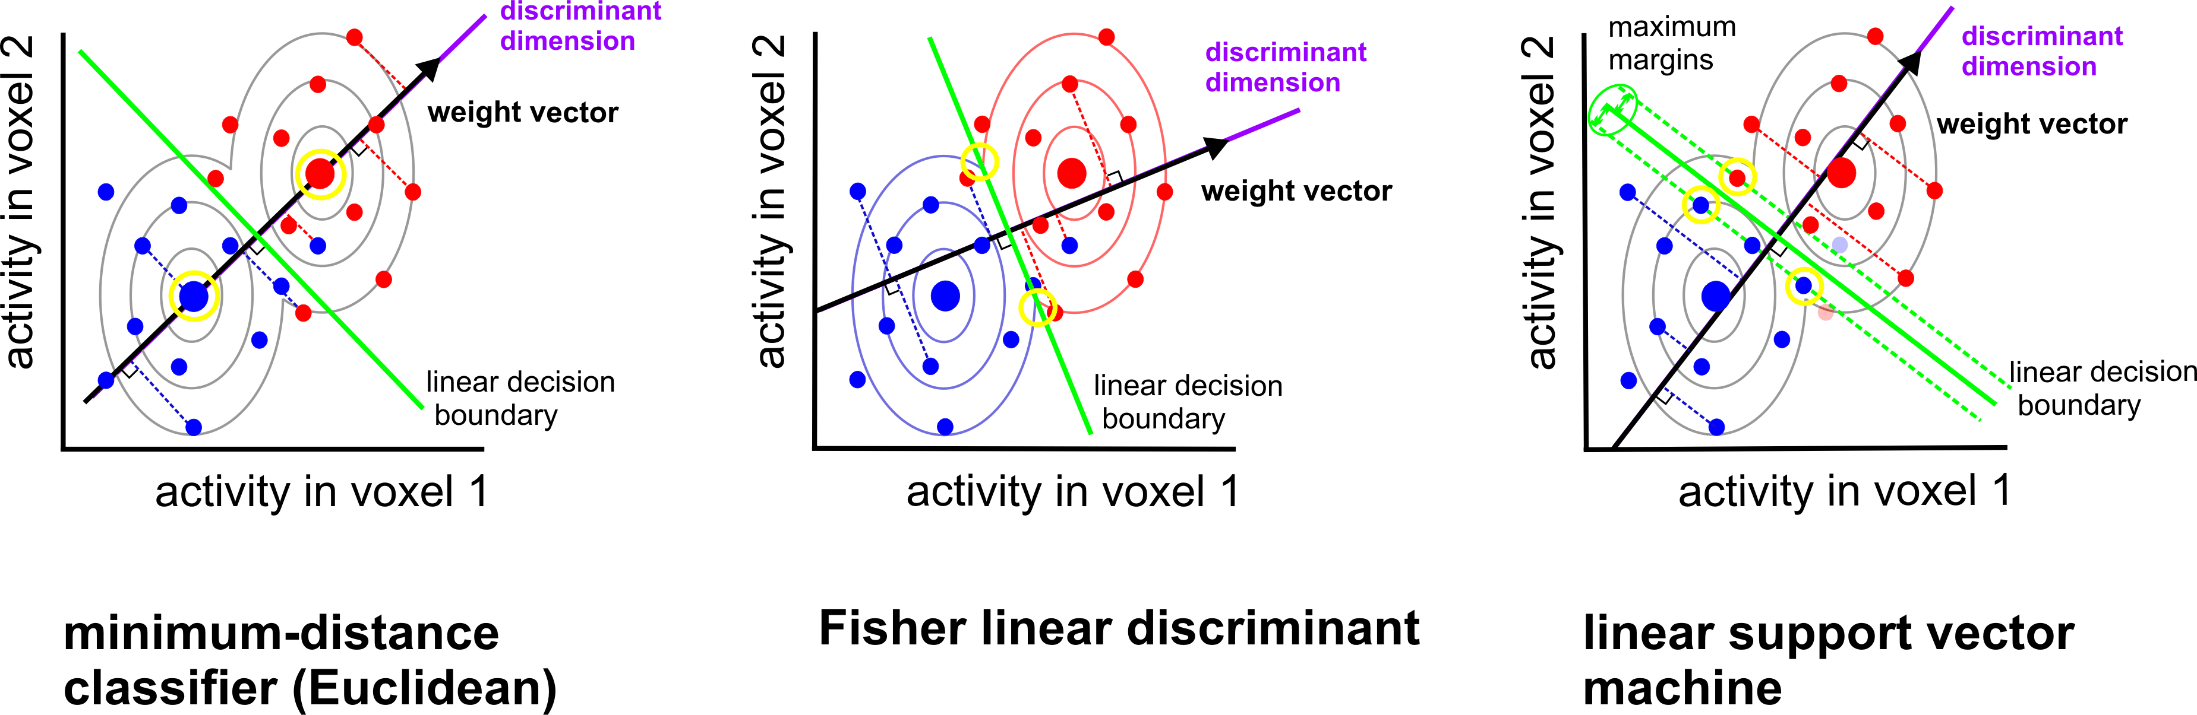
Boundary placement: some linear classifiers
(AKA LDA)
assumes identical and multivariate normal distributions (need to estimate covariance)
(AKA centroid-nearest neighbor)
assumes identical and isotropic distributions
no assumptions about distributions
(need to choose C, or nu)
Mur et al. (2009)
Notes:
LDA is equivalent to Linearly Constrained Minimum Variance Beamformer?
Another option is logistic regression (LR)
GNB, LDA and QDA are generative/parametric models.
Logistic regression (LR) & linear SVM are discriminative models. SVM has a hinge loss, whereas LR has a smoother loss.
Nearest neighbour classifiers are simpler in that no parameters are learned, but require a choice of distance metric and of neighbourhood definition
For the SVM (and similarly LR), decreasing C increases regularisation, which means that more datapoints become support vectors. For neuroimaging, with typically more dimensions than samples, all datapoints are support vectors anyway, so this has minimal effect. It also has less effect for the standard L2 penalty than an L1 penalty (See Varoquaux et al., 2017).
(Note that an L1 loss for neuroimaging data would typically lead to unstable voxel selection because of spatial autocorrelation (selecting a random subset of similar voxels.)

Slide 24
Which classifier is best?
Will depend on:
how well each classifier’s assumptions are met
how much data are available
desired inference/interpretation
Linear SVM and Fisher linear discriminant (with shrinkage covariance estimator) often perform well for fMRI data.
Misaki et al. 2010; Pereira 2011
Notes:
LDA can do simultaneous multiclass classification, but SVM needs to combine pairwise classifications.
Covariance matrix estimation can be slow, especially for many voxels.
So with few voxels and many classes, perhaps prefer LDA? With few classes and many voxels, perhaps prefer SVM?
They will also differ somewhat in their sensitivity to outliers.
LDA gives a more direct measure of class membership probability

Slide 25
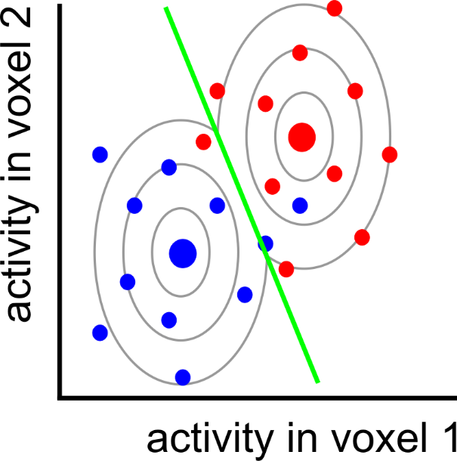
Can we do better?
Notes:
Here is the LDA classifier from before. It is making three mistakes on the training set.

Slide 26
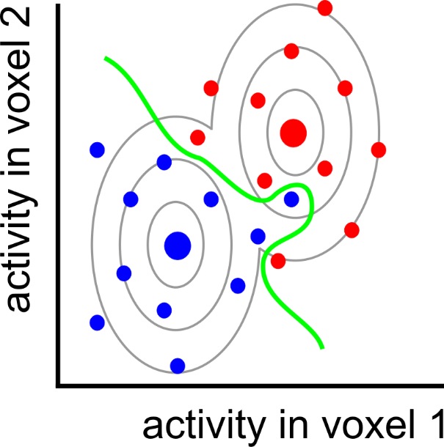
nonlinear
classifier

Slide 27
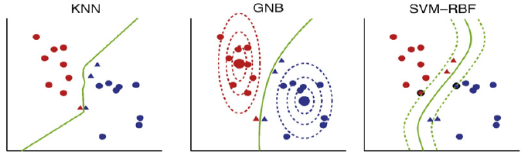
Some non-linear classifiers
K-nearest neighbour
(Quadratic)
Gaussian Naïve Bayes
SVM with radial/polynomial/sigmoid basis function
Nonparametric
(need to select k,
and distance metric)
Assumes multivariate, but non-identical, normal distributions
(ignores voxel correlation)
No assumptions about distributions
(need parameter selection)
Misaki et al. 2010

Slide 28
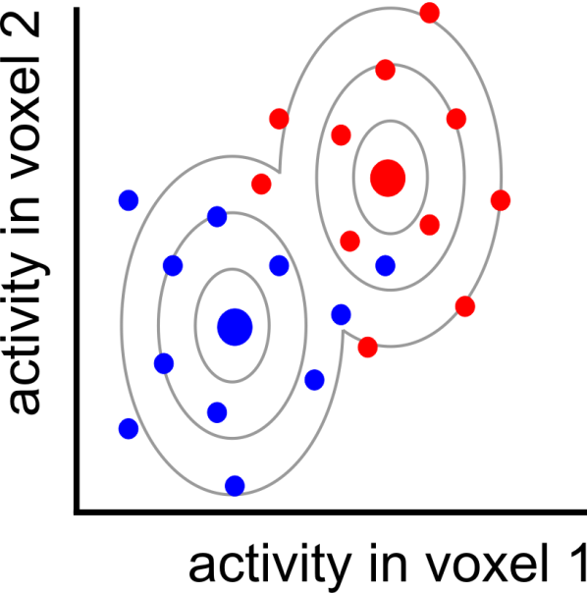
Pattern = signal + noise

Slide 29
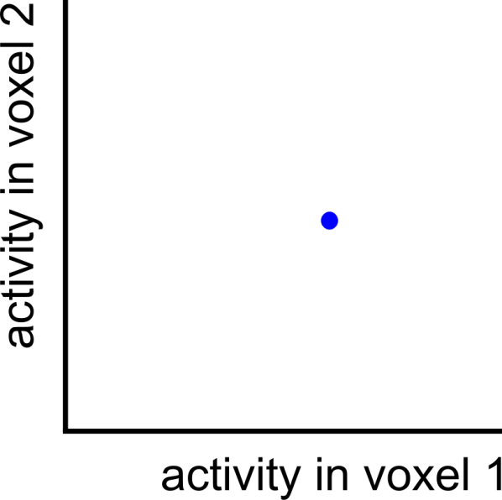
Pattern = signal + noise
measured pattern
(signal + noise)

Slide 30
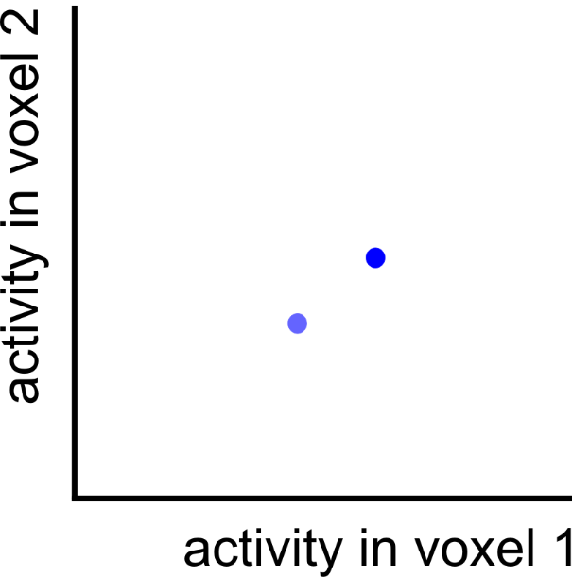
Pattern = signal + noise
measured pattern
(signal + noise)
true pattern
(signal)

Slide 31
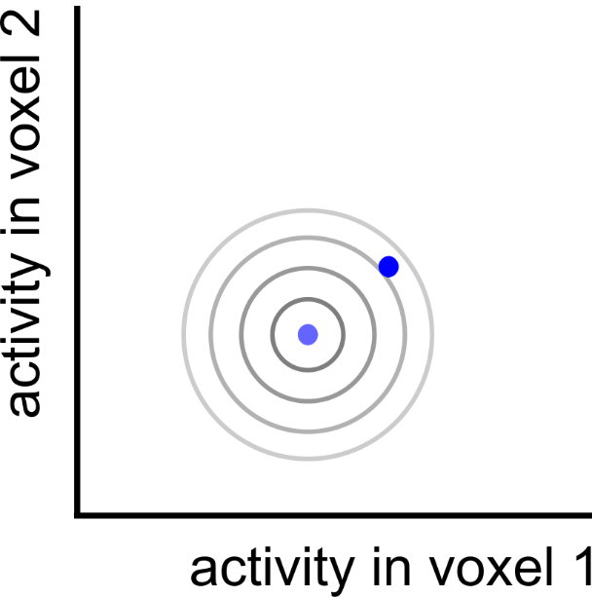
Pattern = signal + noise
measured pattern
(signal + noise)
true pattern
(signal)

Slide 32

Pattern = signal + noise
measured pattern
(signal + noise)
true pattern
(signal)
noise displacement

Slide 33
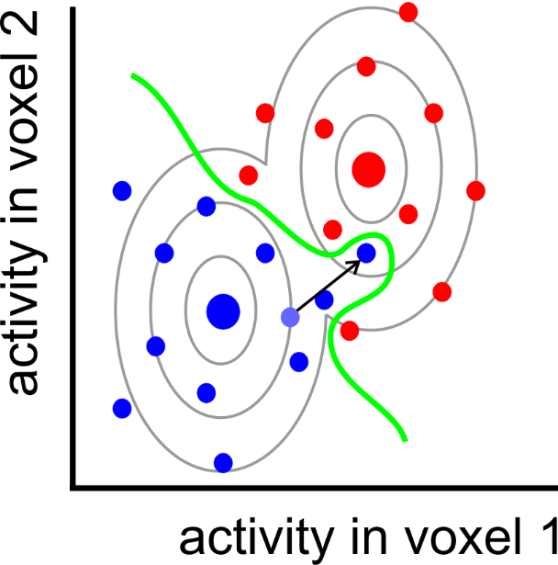
Overfitting

Slide 34
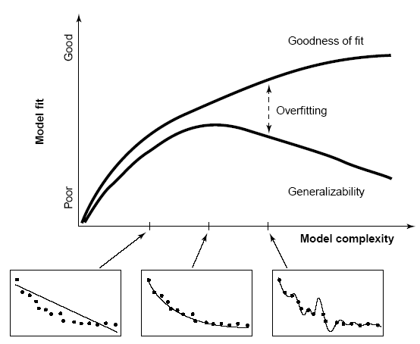

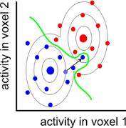
Overfitting & cross-validation
After determining the decision boundary, we need to test how well the boundary generalises to new data (cross validation), expected to have the same signal, but different noise.
Classifier accuracy will be inflated,
if it’s not cross-validated
Linear classifiers usually outperform
nonlinear classifiers on fMRI data.
Overfitting can be further reduced by:
regularisation
reduce dimensionality of activity patterns
(e.g. voxel selection or PCA)
increase sample size
(training data)
performance
(hold-out data)
boundary complexity
Notes:
Regularisation: use prior assumptions to constrain the ways in which the boundary is shaped and shifted so as to discriminate the categories in the training data.
See Poldrack et al 2020 for simulations of overfitting as functions of model order, number of variables, and sample size.
Reduced dimensionality can also be achieved by “sparse random projection”, while preserving pairwise sample distances. (See Johnson-Lindenstrauss lemma)

Slide 35
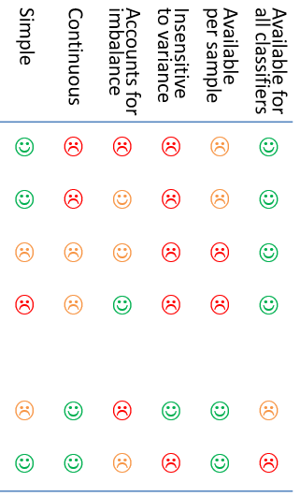
Performance measures
Possible pros/cons:
Several options, with pros/cons
e.g.:
Accuracy (proportion correct classifications)
Accuracy per class (balanced accuracy)
D-prime (and other sensitivity measures)
Area under ROC curve
Decision variable
  e.g. signed distance from margin
  Probability of correct classification
Simple | Continuous | Accounts for imbalance | Insensitive to variance | Available per sample | Available for all classifiers
☺ | ☹ | ☹ | ☹ | ☹ | ☺
☺ | ☹ | ☺ | ☹ | ☹ | ☺
☹ | ☹ | ☺ | ☹ | ☹ | ☺
☹ | ☹ | ☺ | ☹ | ☹ | ☺
☹ | ☺ | ☹ | ☺ | ☺ | ☹
☺ | ☺ | ☹ | ☹ | ☺ | ☹
Notes:
(Table converted to image because otherwise it flickers during other animations)
A simple Pearson correlation between the binary vectors (aka Phi, or Matthew’s correlation coefficient) might be even better than AUROC in terms of simplicity/intuitiveness and sensitivity (see e.g. Chicco & Jurman, 2023), but might not be suitable for imbalanced classes (Zhu, 2020). Wikipedia also says “if MCC equals neither −1, 0, or +1, it is not a reliable indicator of how similar a predictor is to random guessing because MCC is dependent on the dataset” (see Chicco et al 2021).

Slide 36
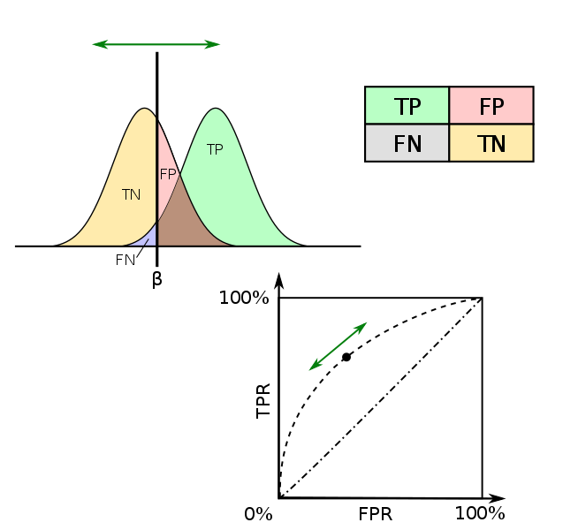
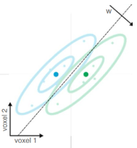
Signal detection theory, and ROCs
d’ (sensitivity)
Chance = 0
Hit rate
False alarm rate
Criterion
Correct rejection rate
Miss rate
ROC
(Receiver operating characteristic)
AUROC
(area under ROC)
chance = 0.5

Slide 37
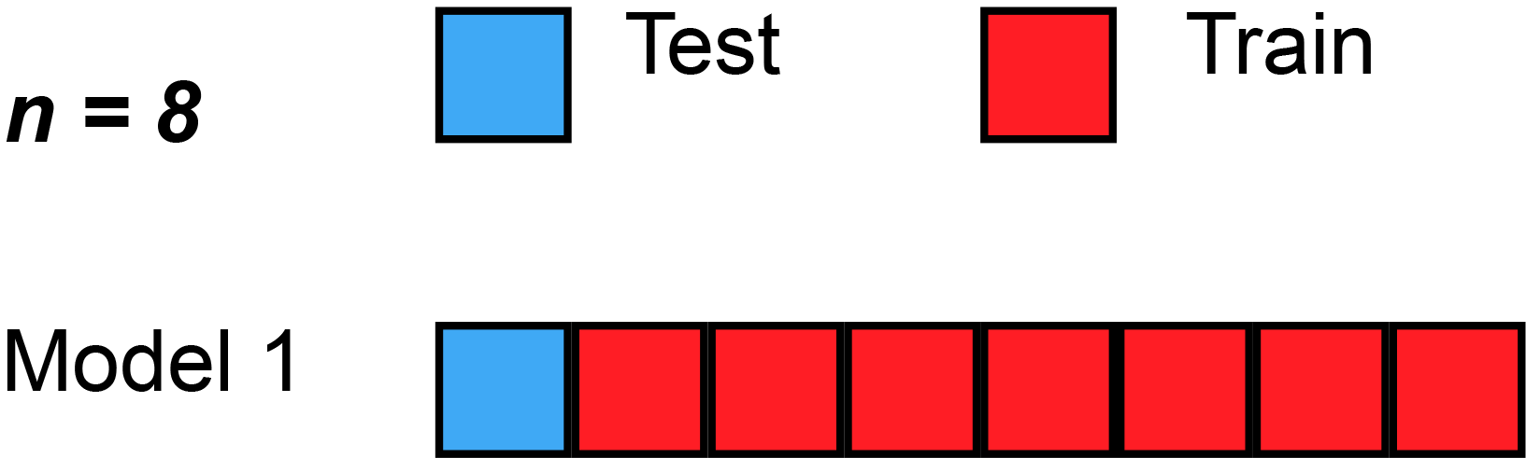
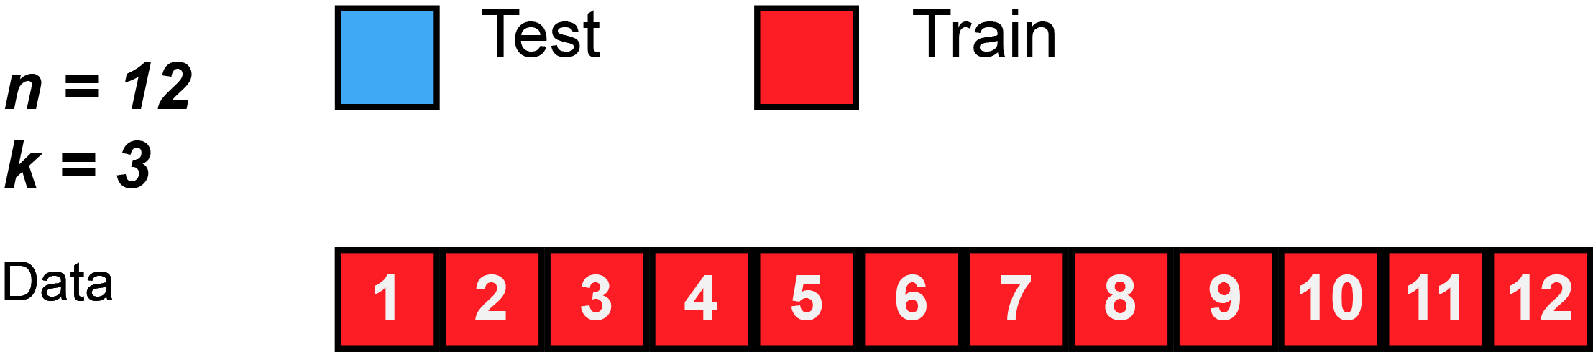
Data splitting/partitioning
Holdout/validation set from single context
  Safe but often not efficient/stable
Separate datasets from different contexts (“cross-classification”, “cross-generalization”)
  used to test generalization & demonstrate common format
  (e.g. train on perception, test on imagery;
  train at time-point 1, test at time-point 2)
Cross-validation within full single dataset
  Reuse data for both training and testing in different splits/folds
  Average performance across folds
  “split half”…
  …“k-fold”…
  … “leave-one-out”
  Training and testing data should be independent within a fold (“decoding step”), but will be dependent across folds
  Ideally want conditions balanced within each chunk
More ways to split… more precise performance estimate?
More training data per split… more sensitive?
Gifs from Wikipedia

Slide 38
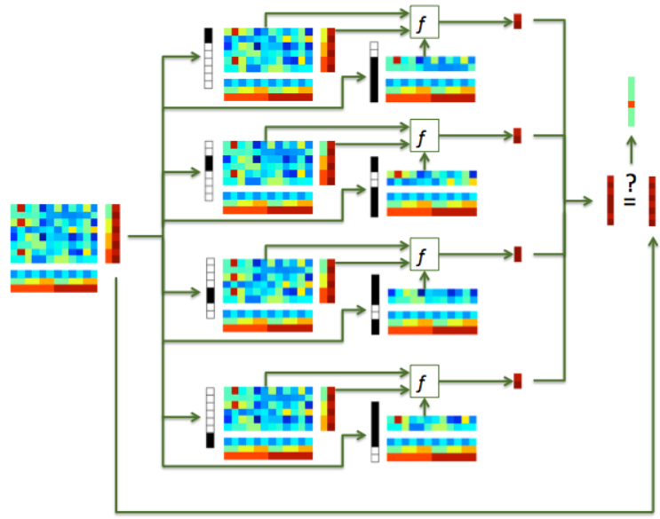
Data splitting/partitioning

Slide 39
Cross-validation granularity: generalise to….?
  new trial/stimulus pair
  (leave-stimulus-pair-out)
  new run (leave-run-out)
  new subject (leave-subject-out)
  (“hyperalignment”, Haxby, 2011; 2020)
Why do we need out-of-sample prediction at all?
  Classical univariate analysis uses within-sample statistical estimation
  (activation can be estimated in a direct and unbiased way)
  In MVPA we want to estimate “information”, and out-of-sample prediction provides an unbiased estimate of this (with minimal assumptions).
Fewer samples
More different distributions
Cleaner samples
More independence

Slide 40
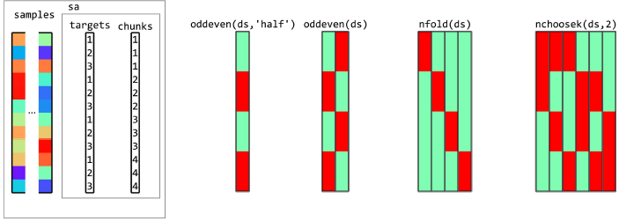

Some different ways to partition samples:
Examples with 3 conditions (targets) in each of 4 runs (chunks):
Oosterhof et al. (2016)

Slide 41
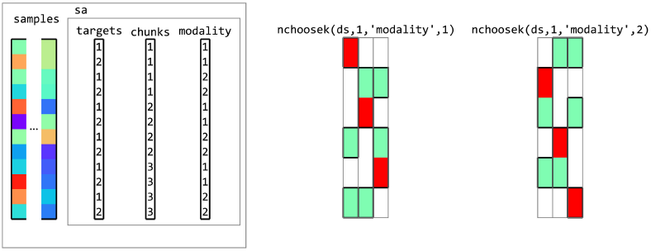
Partitions that “cross-generalise”
Example with 2 conditions (targets) in each of 3 runs (chunks), cross-generalized across “modality”:
Oosterhof et al. (2016)
(Could similarly cross-generalize across participants, or time points)

Slide 42
Specific considerations for fMRI data
Temporal autocorrelation:
  Dependencies between patterns within a run
  Safest for test/train patterns to come from different runs
Pre-processing:
  Similar to standard univariate analysis
    Probably:
      motion-correction
      Slice-scan-time correction
    Possibly:
      normalisation to template space (if random-effects searchlight analysis across subjects; could do this afterwards)
      Slight spatial smoothing (could increase or decrease SNR, depending on spatial scale of signal vs noise)

Slide 43
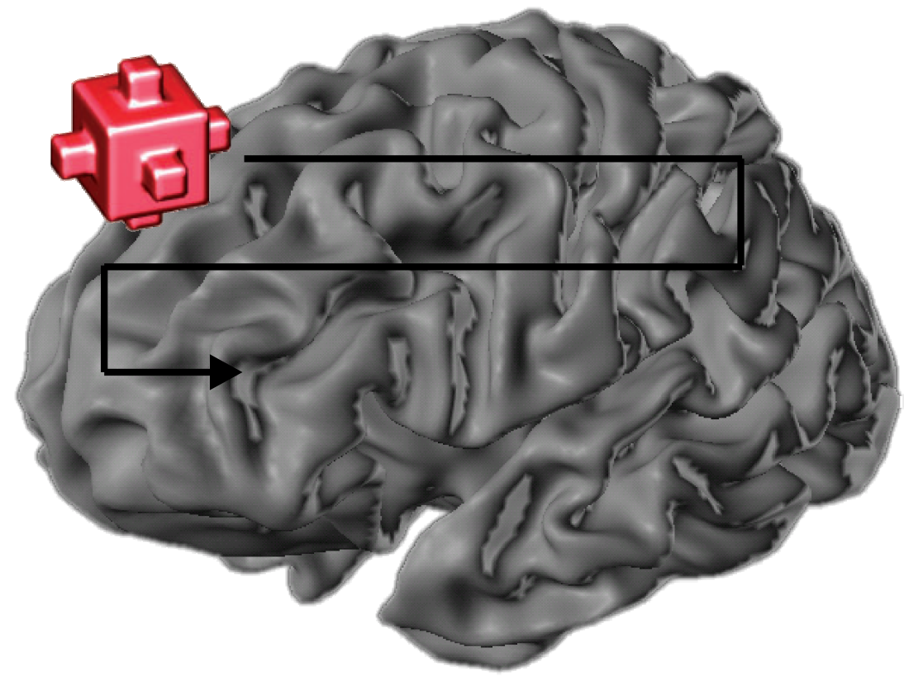
With many features, we need to choose, which of them we want to use
Voxel selection must be based on data independent from test data set
(not specific to MVPA!)
Choice of which features to use determines:
  inference that can be made;
  SNR/risk of overfitting
Most common ways of voxel selection:
  structural ROI (anatomy; e.g. traced per subject, or from an atlas)
  functional ROI (activity; e.g. from per-subject localizer, or coordinates from literature)
    univariate (activation differences)
    multivariate (pattern differences)
  “Searchlight” (roving ROI; often local/contiguous, but needn’t be)
  “whole brain” (global ROI; more for prediction applications)
Could do this at same time as training the model, but would need nested-cross-validation (complicated, slow, and loss of training data may outweigh any benefits)
Kriegeskorte et al.
2006

Slide 44
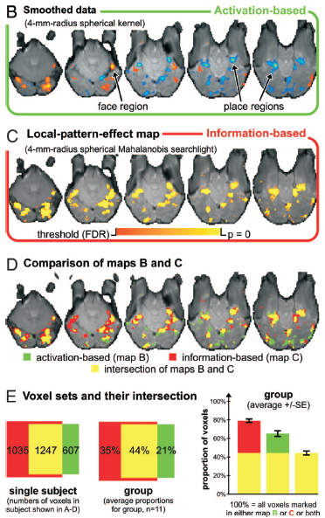
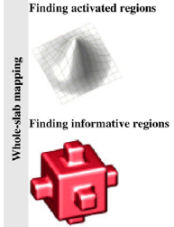
The first searchlight paper
Example comparison of activation-based and information-based mapping
Kriegeskorte et al. 2006, 2007

Slide 45
Selecting voxels, continued
How many voxels?
  Depends on the expected spatial extent of effects,
  and the scientific question.
  few → risk of missing signal
  many → risk of overfitting (too noisy) & weaker localization
Might information be distributed across
non-contiguous regions?
Sometimes people select the same number of voxels in each subject, and for each region of interest.
But beware direct comparisons between regions!
(Equating voxel number doesn’t make them equal;
e.g. MT neurons might encode motion more strongly than V1/V2, but decoding is weaker because neurons are more finely intermixed.
Often important to consider interaction with condition)

Slide 46
Statistical inference
Dominant in the literature:
Random-effects analysis across subjects, using standard one-sample
right-sided t test.
H₀: μ = 50% (for balanced 2-class); H_{a}: μ > 50%
Is this valid?
observations (i.e. subjects) are independent
reasonable to assume probability distribution of classification accuracy is identical across subjects
number of subjects is large enough for the central limit theorem to apply
(can assume sampling distribution approaches a normal distribution)
But, take care over chance level (especially for unbalanced classes)
If any doubt, can use permutation test instead; wise to include negative control
If true value of dependent measure cannot be negative, t-test only provides FFX inference (Allefeld et al. 2016)

Slide 47
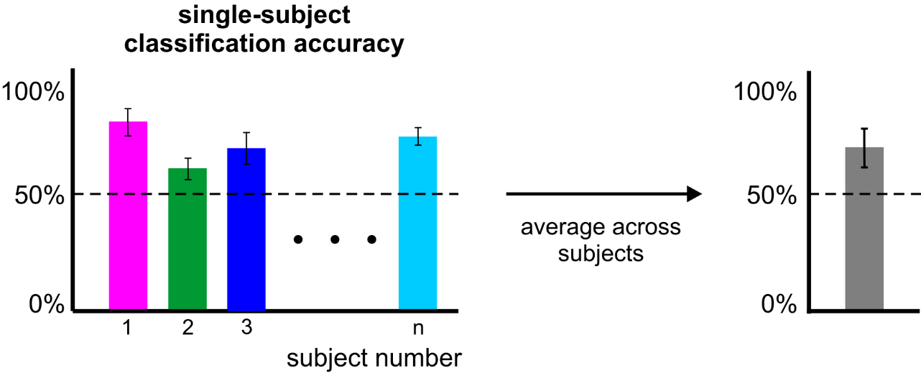
Statistical inference
Error variability
across folds
(Non-independent:
probably invalid)
Error variability
across subjects
(Independent:
probably valid)

Slide 48

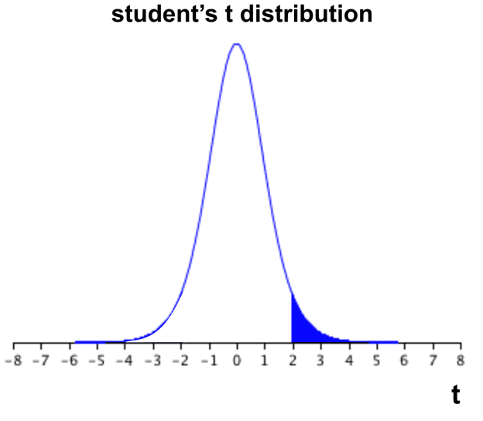

Statistical inference
subject-average
classification accuracy
If the computed t value falls within the top 5% (blue) of the t distribution → reject H₀.

Slide 49
Statistical inference
However:
are we sure that the accuracy is 50% under H₀?
What about stats within a subject?
→ use a permutation test:
  create null distribution by randomly shuffling condition labels many times (1000-10,000) before training
  remove relationship between labels and patterns
  assumes data are exchangeable (H₀: all classes come from same distribution)
  But:
    slow;
    permutations limited by number of samples/classes (insensitive)
    complicated: permutations must preserve balance/autocorrelation

Slide 50
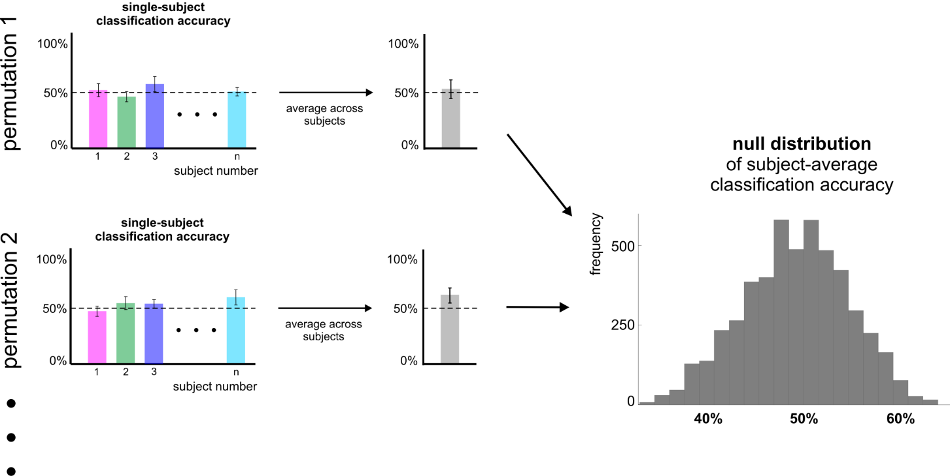
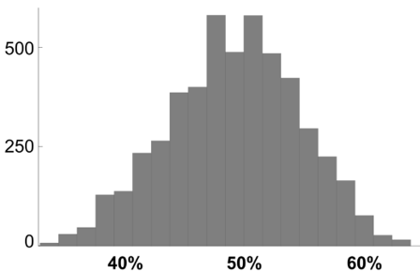
Statistical inference
Null distribution of
subject-n
classification accuracy

Slide 51

Statistical inference
If the actual classification accuracy falls within the top 5% (blue) of the null distribution → reject H₀.

Slide 52
Unbalanced samples
A classifier that doesn’t look at the test data should be at chance (on average)
In this case, what is the expected proportion of correct classifications (accuracy) for N balanced classes?
But what will happen if there are more samples from class A than class B (in both test and train sets)?
What could we do about this?
  Design the experiment to collect balanced data
  Resample the data at each fold to restore balance
  Tell the classifier to re-weight the samples to adjust for imbalance
  Use an output measure that is unbiased for unbalanced data
    This last one is orthogonal to the others, and is always a good idea in case attempts to balance the samples are imperfect. However it doesn’t stop the classifier being biased, it just ensures this bias does not propagate to the performance metric.

Slide 53

Example: Unbalanced samples; no true signal
Imagine a case with few samples in a red class and 4x as many in a blue class,
but both randomly sampled from the same distribution:
A classifier that uses the class proportions will be biased to choose blue.
Here, the classifier always predicts blue and is correct 4/5 of the time, even if no true signal:
“Simple accuracy” = 80%
Averaging “accuracy per class” corrects for the bias without changing the boundary, which is still biased:
In this example,
Blue accuracy = 100%
Red accuracy = 0%
Average = 50%
Subsampling the majority class will discard some data, but encourages unbiased placement of the decision boundary:
“Simple accuracy”
= “accuracy per class”
~ 50% ±

Slide 54


Example: Unbalanced samples; true signal
Again imagine a case with few red samples and this time 9x as many blue samples,
this time drawn from different distributions:
Without subsampling, the classification boundary will be somewhat biased to choose blue.
In this example, the classifier always predicts blue and is correct 90% of the time:
“Simple accuracy” = 90%
Averaging “accuracy per class” corrects for the bias without changing the boundary, which is still biased (suboptimal):
Blue accuracy = 100%
Red accuracy = 0%
Average = 50%
…despite some true signal
Subsampling or reweighting the majority class will discard some data, but can improve sensitivity by encouraging optimal placement of the decision boundary:
“Simple accuracy” =
“accuracy per class” > 50%

Slide 55
Example: patterns with same mean, but different variance
d
A non-linear classifier
(e.g. SVM with radial basis) can partially separate classes based on their variance:
Red accuracy = 100%
Blue accuracy >> 0%
Average >> 50%
A linear classifier can still achieve above-chance performance using a metric based on the proportion correct:
Red accuracy = 100%
Blue accuracy > 0%
Average > 50%
Other metrics can be insensitive to sample variance:
e.g. mean signed distance to hyperplane:
d – d = 0 = chance

Slide 56
Summary of some related principles:
 | Problems that might inflate performance (assumed to reflect real mean pattern differences):
 | Bias due to overfitting | Bias due to unequal class probability | Bias due to unequal class variance
Solution to reduce bias in classifier | Use a simpler model: fewer features fewer parameters more regularisation | Reduce imbalance in training set: by design by resampling by reweighting | Try to match class variance by design Use a classifier that’s less sensitive to class variance (e.g. linear rather than nonlinear)
Solution to remove bias from performance metric | Cross-validate | Use a metric that is insensitive to class probability, e.g.: Balanced accuracy Area under ROC curve Ensure test set is balanced | Use a metric that’s insensitive to pattern variance, e.g.: Mean signed distance to hyperplane

Slide 57



Example: below-chance decoding
Run 1
Run 2
Run 3
Run 4
Run 5
Run 6
Run 7
Run 8
100%
8 runs
2 activation patterns per run,
in response to coloured fruits
Fruit & colour fully counterbalanced
across the experiment
One of each fruit, and one of each colour, per run
Leave-one-run-out cross validation
Significantly below-chance decoding of fruit (apple vs pear)
50% (chance)
0%

Slide 58
Example: below-chance decoding
Run 1
Run 2
Run 3
Run 4
Run 5
Run 6
Run 7
Run 8
Train
Test
Within each run, features are balanced but not counterbalanced
Across the full experiment, features are counterbalanced, but with leave-one-run-out cross-validation, each training set is unbalanced
In this example fold, the classifier learns that apples tend to be blue
The test set has the opposite imbalance
So a classifier that’s more sensitive to colour will tend to guess wrongly for shape
Here the problem can be solved by choosing training sets that are fully counterbalanced (e.g. train on runs 1-6; test on runs 7 & 8)

Slide 59
A small selection of influential/interesting papers and example applications…

Slide 61






Slide 62




Slide 63





Slide 64






Slide 65



Slide 66



Slide 67





Mitchell & Cusack (2016) Scientific Reports 6:20232
200 objects, presented one each per condition
2 conditions (occasional cues to imagine knives or dolphin)

Slide 68





Slide 69



Slide 70



Slide 71
References (a selective list)
Linear classification tutorials
Mur M et al. (2009) Soc Cogn Affect Neurosci 4: 101-109. [conceptual introduction]
Pereira F et al. (2009) Neuroimage 45(1 Suppl): S199-S209. [introduction]
Schreiber K, Krekelberg B (2013) PLoS ONE 8(7): e69328. [cautionary comments on statistical inference]
Kriegeskorte N et al. (2006) PNAS 103(10): 3863-3868. [multivariate searchlight]
Linear classification reviews
Norman KA et al. (2006) Trends Cogn Sci 10(9): 424-430.
Haynes JD, Rees G (2006) Nat Rev Neurosci 7: 523-534.
Linear classification: a few example applications in neuroscience
Kamitani Y, Tong F (2005) Nat Neurosci 8(5): 679-685. [vision: classify orientations]
Formisano E et al. (2008) Science 322: 970-973. [voices: classify speakers & vowels]
Haynes JD et al. (2007) Curr Biol 17(4): 323-328. [cognitive control: task preparation]
Emrich et al. (2013) J.Neurosci. 33(15):6516–6523 [visual working memory]

Slide 72
References (a selective list)
Recursive feature elimination (RFE)
De Martino F et al. (2008) Neuroimage 43: 44-58.
Thoughts on choice of classifier & preprocessing options
Mourao-Miranda J et al. (2005) Neuroimage 28: 980-995. [SVM vs FLDA]
Kriegeskorte et al. (2009) Nat Neurosci 12(5): 535-540. [how to prevent selection bias]
Misaki M et al. (2010) Neuroimage 53: 103-118. [compares 6 different classifiers]
Garrido L et al. (2013) Front Neurosci 7(174): 1-4. [subtract the mean pattern?]
Relationships between classification (decoding), encoding, and RSA
Naselaris T et al. (2011) Neuroimage 56: 400-410.
Kriegeskorte N (2011) Neuroimage 56: 411-421.
Kriegeskorte & Douglas (2019) Curr Opin Neurobiol 55:167-79
Comparison with classical univariate approach
Hebart MN & Baker CI (2018) Neuroimage 180: 4-18.
Source of data for extra ‘hands on’ example
Mitchell & Cusack (2016) Scientific Reports 6:20232; DOI: 10.1038/srep20232

Slide 73
Part 2: RSA

Slide 74
What is RSA?
“Representational Similarity Analysis (RSA) is
an MVPA method to:
describe and compare geometries of represented conditions
Generalisation of classification:
  More conditions
  More general notion of dissimilarity
  (not “are patterns different?” but “how different are they?” and “how are they different?”)
  Less need to predefine stimulus categories/dimensions
Notes:
(Assumes that the concepts can be embedded in a high-dimensional space, and that the measurements sample this space)

Slide 75
Why do RSA?
Quantifies neural relationships between conditions in an abstract space, derived from, but no longer dependent on, the measurement format…
Allows representational structures to be distinguished,
and compared in common format
Kriegeskorte et al. 2008

Slide 76

Kriegeskorte & Kievit (2013)
Notes:
Each example shows six stimuli from two conditions.
Blue lines show cases where a linear classifier would give identical (and in this case perfect) classification, despite clearly different representational structure that would be picked up by RSA.
Similarly, red lines show identically performing non-linear classifiers, despite different representational geometries.
The RDMs under each case capture all the relevant differences.

Slide 77


A real example
Classification of colour strongest in V1
But representation in V4 more closely matches perceptual colour space
Stimulus responses also cluster by category in V4
(in colour-naming task)
Brouwer & Heeger 2009, 2013

Slide 78



How does it work – the “Representational Similarity Trick”
RSA
dissimilarity
Voxel Receptive
Field Modelling
(many parameters
& little generalization)
Image from
Niko Kriegeskorte
RSA workshop 2015

Slide 79
Kriegeskorte et al. 2008

Slide 80
Representational similarity analysis using The RSA Toolbox

Slide 81
What is The RSA Toolbox?
Original Matlab implementation described in Nili et al. (2013), and can be downloaded here:
http://www.mrc-cbu.cam.ac.uk/methods-and-resources/toolboxes/
Or here: https://git.fmrib.ox.ac.uk/hnili/rsa
Current development in Python
(briefly called PyRSA, now called RSA 3.0): https://github.com/rsagroup/rsatoolbox
See Schütt et al., 2023

Slide 82
Why use the (Python) RSA Toolbox?
Pros:
  Open source
  Few dedicated alternatives
    Other toolboxes (e.g. The Decoding Toolbox and CoSMoMVPA) have some RSA capability, but less documented/comprehensive
    BrainIAK has a particular Bayesian version
    Others?
  Flexible/sophisticated statistics/modelling
  Attractive/clever visualisations
Cons:
  Dedicated to RSA, not classification
  (but crossnobis distance is an excellent classification measure)
  Sometimes non-intuitive (“Euclidean” is squared Euclidean;
  may semi-overlapping bootstrap functions?)
  Still in development – e.g. searchlight and some demos only partially implemented

Slide 83
Setting up the environment for these demos:
(One option: certainly not the only one; likely not the best)
conda create –n cognestic23 python
conda activate cognestic23
conda install –c anaconda spyder [optional, IDE]
conda install –c anaconda jupyter [used for demos]
Clone RSA Toolbox github repository and move to its directory
pip install .
[or: conda install -c conda-forge rsatoolbox]
pip install –U nilearn
pip install seaborn [optional, used for some demos]
Packages to probably import:
import numpy, scipy, matplotlib, rsatoolbox
Packages to possibly import:
import os, glob, pandas, collections, nilearn, nibabel, seaborn
Notes:
numpy provides arrays
scipy can load .mat files with io.loadmat and adds other matlab functionality like squareform
matplotlib provides matlab-like plotting
seaborn extends/simplifies matplotlib with more plot types and options (like despine to (re)move axis lines)
os provides methods like path.join
glob to search filenames with wildcards
pandas provides dataframes (i.e. tables)
collections provides extra datatypes e.g. defaultdict
nibabel can process analyze/nifti files with load() and load().get_fdata
nilearn for neuroimaging stuff like “plotting.plot_stat_map”
Can do: from [package] import [module] as [newname]
To use VScode:
Install Remote SSH
Click green button at bottom left; connect current window to host
Enter e.g. dm01@login-j03 + password
“conda env list” to see available environments
“conda list” to see software in active environment

Slide 84

Overview:
How does The RSA Toolbox work?
Notes:
blue: sub-packages
grey: classes
yellow: modules (functions)
orange: auxiliary materials

Slide 85
Some key components: Datasets and RDMs
How does The RSA Toolbox work?
data.Dataset [or data.TemporalDataset]
[ observations x channels [ x time] ]
from numpy array, pandas dataframe or .hdf5 file
Optional dataset/obs/channel descriptors, as dictionary of lists
Methods to: sort, split, subset, average
data.noise to estimate noise covariance/precision,
from measurements or residuals
demo_dataset
(create, describe,
and rearrange
datasets) (~5 s)
e.g. RDMs = rdm.calc_rdm(Dataset, method='euclidean‘)
RDMs = rdm.calc_rdm_movie(TemporalDataset, …)
RDMs = rdm.calc_rdm_unbalanced(…)
rdm.RDMs
[ n x patterns x patterns ] or [ n x upper triangular vector]
Optional RDM/pattern descriptors, as dict of lists
Methods to:
  concatenate, append, subsample and average RDMs
  subsample, reorder, or sort patterns (i.e. conditions)
  transform data (e.g. rank, or sqrt)
  compare RDMs (e.g. types of correlation)
To create an RDM, we need to define dissimilarity…
Notes:
descriptors – dict with general metadata about dataset
obs_descriptors – dict with array that defines condition labels
channel_descriptors – dict with array that identifies each channel
For multiple subjects, use a list of Datasets

Slide 86

How to measure representational dissimilarity
and other cross-validated “distance estimates”
Image from
Niko Kriegeskorte
RSA workshop 2015

Slide 87

Euclidean distance
Straight-line distance between two patterns in Euclidean space
Image from Alex Walther
RSA workshop 2015
Notes:
Square root of sum of squared displacements along orthogonal dimensions

Slide 88



Correlation distance
1 – correlation coefficient
Correlation = cosine of the angle between normalised patterns
Image from Alex Walther
RSA workshop 2015
Misaki et al. 2010
Notes:
Cosine similarity is dot product of unit vectors.
Pearson correlation is cosine similarity between centred vectors.
Spearman correlation is Pearson correlation between ranked vectors.

Slide 89

Image from
Niko Kriegeskorte
RSA workshop 2015

Slide 90

Image from Alex Walther, RSA workshop 2015
Notes:
Euclidean distance is more intuitive

Slide 91

One example of effect in practice:
Kriegeskorte et al. 2008

Slide 92
Datasets and RDMs
How does The RSA Toolbox work?
data.Dataset [or data.TemporalDataset]
[ observations x channels [ x time] ]
from numpy array, pandas dataframe or .hdf5 file
Optional dataset/obs/channel descriptors, as dictionary of lists
Methods to: sort, split, subset, average
data.noise to estimate noise covariance/precision,
from measurements or residuals
demo_dataset
(create, describe,
and rearrange
datasets)
demo_dissimilarities
(create, access,
and plot data RDMs,
including crossnobis)
e.g. RDMs = rdm.calc_rdm(Dataset, method='euclidean‘)
RDMs = rdm.calc_rdm_movie(TemporalDataset, …)
RDMs = rdm.calc_rdm_unbalanced(…)
rdm.RDMs
[ n x patterns x patterns ] or [ n x upper triangular vector]
Optional RDM/pattern descriptors, as dict of lists
Methods to:
  concatenate, append, subsample and average RDMs
  subsample, reorder, or sort patterns (i.e. conditions)
  transform data (e.g. rank, or sqrt)
  compare RDMs (e.g. types of correlation)
demo_unbalanced
(for data with
missing values)
demo_rdm_vis…
(plot RDM with
formatted image icons;
scatterplot e.g. MDS)
Notes:
First section of RDM demo repeats initial dataset creation from first demo.
For crossnobis dissimilarity, set e.g. cv_descriptor=‘runs’, noise=PrecisionMatrix
(If cv_descriptor is not specified, this will be guessed.)
Toolbox uses precision matrix rather than covariance matrix;
can be calculated from deviations of many measurements: noise.prec_from_measurements(dataset, method=‘shrinkage_eye’);
or from per-channel residuals calculated at a previous step: noise.prec_from_residuals(residuals,…)
Shrinkage is essential otherwise inversion essentially leads to almost random numbers!
rdm.calc_rdm defaults to “squared Euclidean” but
rdm.calc_rdm_unbalanced defaults to “Euclidean”??
To average (potential partial) RDMS, use:
partials = rsatoolbox.rdm.combine.from_partials([rdms1, rdms2])
## all rdms should have the same number of conditions, with NaNs for missing data ## then we rescale/align these based on pairs in common (put them in the same space)
rescaledPartials = rescale(partials, method='evidence')
## then we can take a weighted average:
meanRDM = rescaledPartials.mean(weights='rescalingWeights')
There’s also several demos called demo_fmri_..., which look good, but do not run because the relevant modules and data seem to be missing?
[*args in function definitions treats args as a tuple of variable inputs
**kwargs treats kwargs as a keyword dict of optional arguments]
In demo_rdm_vis…, for final scatterplot, try:
swapping image icons for string or marker
swapping MDS for iso (fast) or tSNE (slow)
See demo_annotated_rdm_plot, for an example of how to add overlays/contours to RDMs.

Slide 93
96 object images
Stimuli from Kiani et al. 2007, Kriegeskorte et al. 2008
Notes:
96 in original set, but 92 used in following slides...

Slide 94

96-object-image fMRI experiment
25 axial slices covering ventral occipital and inferior temporal cortex (no gap)
voxel size: 1.95*1.95*2 mm³
TR: 2 s
Notes:
Or was it 92 out of the 96?

Slide 95

Example RDM of IT activity patterns, to be used in demo
92 object images
4 healthy humans
rapid event-related design (4 s SOA)
300 ms stimulus duration
object images spanned a visual angle of 2.9°
fixation-cross
color-judgement task
12 runs/subject, each object image presented once per run
Kriegeskorte et al. 2008
Notes:
92 objects here

Slide 96
Example RDM of IT activity patterns, to be used in demo
human faces
animate-inanimate
dissimilarity
[percentile]
4 subjects’ average
Kriegeskorte et al. 2008
Notes:
Interpretability depends on the ordering of the stimuli
Consider whether or not to rank the dissimilarities

Slide 97
Cross-validated distance estimates
Linear Discriminant Contrast (LDC), aka Crossnobis estimator has two desired properties:
Multivariately noise-normalised
  Like Mahalanobis distance
  Potentially increases sensitivity
Cross-validated
  Generalises
  Not positively biased, with interpretable zero point
  Requires data splitting (may not always be possible, and potentially reduces sensitivity)

Slide 98


Noise normalisation
Noise normalisation of fMRI response patterns increases reliability of estimated pattern distances.
Univariate:
  Divide each voxel’s beta weight by its standard error → t value
Multivariate:
  Multiply patterns by inverse of (square-rooted) covariance matrix → Mahalanobis distance
A
B
Image from Alex Walther, RSA workshop 2015
Notes:
Consider this multivariate normal distribution. Which of the points A and B is more representative of the distribution? A and B are equally distant from the centroid in terms of Euclidian distance, but A is three times closer to the centroid using Mahalanobis distance.

Slide 99

Cross-validated dissimilarity measures
Distances are positive
In high dimensional space, noise is likely orthogonal to pattern separation
Noise means distance measures are positively biased.
Image from
Niko Kriegeskorte
RSA workshop 2015

Slide 100


Cross-validated dissimilarity measures
Cross-validated dissimilarity measures
are estimates of distances. So can be negative.
They are unbiased, have an interpretable zero point, and preserve ratio scale.
Noise covariance
(Squared Euclidean distance if identity matrix)
from Alex Walther, RSA workshop 2015
LDC ~ dot product of difference vectors
~ cosine of angle between them
= zero if orthogonal
Can divide by # voxels to compare ROIs of different sizes
LDt = LDC divided by its standard error
Nili et al. (2013)
Notes:
Dot product = inner product = scalar product
See fig 9c from Nili 2020

Slide 101


What if there is no mean separation of conditions, but one is noisier?
(adapted from Nili et al., 2020)
Separation in dataset A
Separation in dataset B
Pattern distribution for Stimulus 2
(noisier)
Pattern distribution for Stimulus 1
What would be the accuracy of
a linear
classifier?
Image from
Niko Kriegeskorte
RSA workshop 2015

Slide 102

Compare with LDA classifier
Image from
Niko Kriegeskorte
RSA workshop 2015

Slide 103


Ways to visualize representational structure
Representational dissimilarity matrix (RDM)
  Contains all multidimensional dissimilarity information
  Interpretability depends on order of stimuli/rows
  (And colour scale/normalization)
  Input to statistical inference
Multidimensional scaling (MDS) or other dimension-reduction
  Finds low-dimensional representaion to best preserve
  the high-dimensional (metric or ranked) dissimilarities
  (i.e. plotted distance reflects neural dissimilarity)
  Intuitive; directly interpretable
  Discards information/distorts data; can assess with “Shepard plot” or “rubber bands”
  Generally not used for statistical inference,
  but bootstrapped confidence ellipses could be added
  Orientation is arbitrary; Procrustes transform can be used for alignment
Dendrogram
  Defines multiscale clusters
  Assumes hierarchical structure
Notes:
The dendrogram is not in the demo, but there are tools in scikit-learn for calculating and displaying this:
from sklearn.cluster import AgglomerativeClustering
from scipy.cluster.hierarchy import dendrogram

Slide 104
Comparing geometries
– an example “model RDM”
from Marieke Mur 2013
How well do brain representations and subjective experience match?
Notes:
The power of RSA is in comparing geometries…

Slide 105


Conventional method:
Pairwise similarity ratings
How similar are these objects?
very similar
very dissimilar
0
5
To make a full RDM from many pairwise dissimilarities would take a long time!
96
0
0
0
0
0
96
0
0
0
0
96 x 95 / 2 = 4560 pairs
0
0
0
4560 * 4 s = 5 hours per subject
similarity-judgment RDM

Slide 106
2D arrangement by dissimilarity
RDM
multidimensional
scaling
inverse
multidimensional
scaling
Goldstone, 1994; Risvik et al., 1994

Slide 107
Multi-object arrangement (MA) method
Kriegeskorte & Mur 2012
Subjects arrange objects in 2D by mouse drag-and-drop.
More efficient than pairwise similarity ratings.
Subjects arrange objects in the context of the other objects in the set.
16 healthy human subjects
each subject performed one 1-hour session (outside the scanner)

Slide 108

Please arrange these objects according to their similarity

Slide 109

Please arrange these objects according to their similarity

Slide 110
human IT
similarity judgments

Slide 111
2D arrangements by dissimilarity
human IT
similarity judgments
Notes:
Similarity judgements have more and stronger categories
Perhaps because IT is just one brain regions, whereas behaviour is downstream integration of distinctions from many brain regions?
(all 96 objects here)

Slide 112
human IT
similarity judgments
animate
inanimate
animate
inanimate
human
nonhuman
face
body
natural
artificial
face
body

Slide 113
Comparing RDMs
96
96
0
0
0
0
0
0
0
0
0
0
96
0
96
0
0
0
0
correlate
dissimilarities
0
0
0
0
0
0
0
0
0
Brain
Judgments
(“model RDM”)
Non-linear relationship might be expected,
so rank correlation (Spearman/Kendall tau-a) often preferred
Therefore RDMs often rank transformed for display
RDM entries are not independent, so statistical inference must be done across e.g. subjects, or using condition permutation/bootstrap
But, covariance can be calculated and used to pre-whiten RDM
Can also use multiple regression to predict data RDM from model components
Can compare model geometries with 2nd-order RDM

Slide 114
Models and fitting
How does The RSA Toolbox work?
e.g.:
RDM = rdm.get_categoricalrdm([‘A’, ’A’, ‘V’, ‘V’])
Think of the “model” as a set of
predictor RDMs (e.g. GLM design matrix)
and a method to “fit” their weights
(e.g. OLS, NNLS).
“Predict” returns a prediction
based on particular weights
“Fit” estimates the weights, by
“comparing” to single data RDM
These functions rarely need to be
called directly…
model.ModelFixed(‘name’, RDM)
model.ModelFixed
or model.ModelWeighted
or model.ModelSelect
or model.ModelInterpolate
Methods to:
  “predict” (an RDM)
  “fit” (in various ways)

Slide 115
Some key components: Inference
How does The RSA Toolbox work?
For statistical inference we want to test the reliability of
  (1) the similarity between model and data RDM
  (2) the difference between model fits.
In simplest case (fixed models; independent subjects), can use 1-sample & paired t-test:
Result = inference.eval_fixed(ModelsFixed, RDMs, method='corr_cov')
To generalise across conditions/patterns (non-independent), could bootstrap:
Result = inference.eval_bootstrap_pattern(Models, RDMs, …)
If fits are biased (e.g. flexible or constrained parameters), they can be cross-validated across splits of subjects and conditions (needing dual bootstrap & >5 conditions). E.g.:
Result = inference.eval_dual_bootstrap(Models, RDMs,
k_pattern=4, K_rdm=2, N=1000, …)
demo_bootstrap:
load & view model RDMs; “fixed” & “selection” model comparison; cross-validation & bootstrap
(~2.5 minutes)
Notes:
See demo_flexible_models for an example of a weighted model (although this is incomplete).
Crossvalidation “training and test sets…should not share either subjects or stimuli”
Bootstrapping subjects is usually unnecessary because they are independent.
Bootstrapping patterns and subjects separately, is noisy/conservative, so “dual bootstrap” is recommended in this case
(see “Statistical Inference on Representational Geometries”, Schutt et al. 2023, eLife);
but this is less powerful than just bootstrapping the patterns?
To run cross-validation without bootstrap, could do:
train_set, test_set, ceil_set = inference.sets_leave_one_out_rdm(rdms)
inference.Result = inference.crossval(models, rdms,
train_set, test_set, ceil_set=ceil_set, method='corr')
What is the difference between:
inference.eval_dual_bootstrap()
and
inference.bootstrap_crossval() ?
Input parameters are basically the same, except the latter has the option of which dimension to bootstrap (RDMs, patterns or both). This is faster but may not include the “dual bootstrap” correction? Does dual_bootstrap include the correction for cross-validation sampling? Yes. So, dual_bootstrap should always be used unless only need to bootstrap a single dimension?
inference.bootstrap_cv_random() is apparently “even more optimised” version of inference.bootstrap_crossval()
Presumably, eval_dual_bootstrap_random is optimised version of inference.eval_dual_bootstrap()? It also has the boot_type option. But it seems to return larger error bars, no noise ceiling, and I don’t understand the difference between n_ and k_ inputs.
So, generally, I prefer eval_dual_bootstrap()?

Slide 116



Nili et al. (2014)
Group mean RDM
is best possible model
(given the data)
for comparing each subject to
Positively biased,
because comparison subject included in mean
Do we need
a better model,
or better data?
Leave-one-out mean
removes this dependence,
but is negatively biased
because it doesn’t use all the data

Slide 117
Some key components: Visualization
How does The RSA Toolbox work?
Plotting RDM data:
  vis.show_rdm(RDMs, …)
  vis.show_2D(RDMs, method, …)
Available methods (using sklearn.manifold defaults):
    MDS (criterion of normalized_stress)
    Isomap
    t-SNE (what perplexity?)
    given coordinates
  Both can label conditions with “Icons” (as pattern descriptor in RDM object)
Comparing RDMs with scatterplots:
  vis.rdm_comparison_scatterplot(RDMs, …)
Plotting statistical inference:
  vis.plot_model_comparison(result, …)
  vis.map_model_comparison(result, RDMs) [WARNING: CHANGES RDMS?]
  various options for marking significance
Notes:
New visualisations in demos but not documentation:
rdm_comparison
model_map (passing in single subject data RDMs allows some sort of noise correction to reduce positive bias of data-model distances??; corr_cov method not yet handled)

Slide 118
Searchlights:
How does The RSA Toolbox work?
In rsatoolbox.util.searchlight…
  centres, neighbours = get_volume_searchlight(mask)
  RDMs = get_searchlight_RDMs(data_cXv, centres, neighbours, cond, …)
  evaluate_models_searchlight(RDMs, models, eval_func)
  Unfortunately this currently doesn’t seem to work with crossnobis dissimilarities, or with CV/bootstrapped inference!
demo_searchlight_volume
create and run searchlight for simple fixed model;
visualise with nilearn
(~6.5 mins)
Notes:
For 3mm radius searchlights:
Creating searchlights took 9 s (faster for smaller searchlights)
Creating data RDMs took ~3 mins on VM (can’t be parallelised; faster for smaller searchlights)
Evaluating Spearman similarity to model took 24 s with 16 cores on CBU cluster (doesn’t vary much with searchlight size)
Evaluating Spearman similarity to model took ~2.5 mins with 4 cores on VM
evaluate_models_searchlight(RDMs, models) evaluates each RDM separately and returns list of results.
In contrast to inference.eval_fixed(models, RDMs) which returns the average comparison.
How would you call evaluate_models_searchlight() with an eval_func that requires inputs e.g. eval_dual_bootstrap??
Other demos:
To run demo_meg_mne, would need to:
‘pip install mne’
but may run into memory issues, and for me it crashes at multiple points.

Slide 119
Summary recommendations
Use LDC (AKA “crossnobis”) dissimilarity to build RDMs
  accounting for noise covariance improves sensitivity, assuming Gaussian noise
  cross-validation centres null on zero, to remove positive bias
  invariant to shifts/rotations (unlike angular measures)
Compare RDMs using:
  cosine distance if cross-validated (0 is meaningful; scale is probably not)…
  correlation otherwise (neither zero nor scale are meaningful)…
  pre-whitened by known covariance (Diedrichsen et al., 2021)…
  or Spearman ρ_{a} for minimal assumptions
Evaluate fixed models using t-tests across subjects
  fast, simple & powerful
  valid RFX inference as correlations between RDMs can be systematically negative
  (cf. Allefeld et al. 2016)
Evaluate flexible/biased models using
[dual-]bootstrapped [dual-]cross-validation
  2 CV splits per bootstrap is enough to correct variance inflation
  higher k across patterns is slower but more powerful? (need >2 pat per split)
  k=2 across subjects seems best?

Slide 120

Spearman vs. Kendall tau-a for comparing RDMs
Kendall tau-a was previously recommended for models with ties.
Now a modified Spearman’s rho with random-tie-breaking is recommended
Nili et al. (2014)

Slide 121

Image from Niko Kriegeskorte, RSA workshop 2015

Slide 122

Image from Niko Kriegeskorte, RSA workshop 2015

Slide 123

Image from Niko Kriegeskorte, RSA workshop 2015

Slide 124
A few example applications…

Slide 125



Slide 126





Slide 127


Brouwer & Heeger 2009, 2013

Slide 128




Slide 129
Mitchell & Cusack (2016) Scientific Reports 6:20232
200 objects, presented one each per condition
2 conditions (occasional cues to imagine knives or dolphin)

Slide 130
References (a very incomplete list)
RSA methods and review
Kriegeskorte N et al. (2008) Front Syst Neurosci 2(4): 1-28. [original methods paper]
Kriegeskorte N, Kievit R (2013) Trends Cogn Sci 17(8): 401-412. [recent review]
Related methods
Allefeld & Haynes (2014) NeuroImage 89: 345-357 [cross-validated MANOVA]
Diedrichsen et al. (2011) NeuroImage 55: 1665–1678 [pattern component modelling]
Diedrichsen et al. (2018) NeuroImage 180: 119-33 [pattern component modelling]
Reviews of representational approaches
Davis & Poldrack (2013) Ann. NY Acad. Sci. 1296:108-134
Haxby et al. (2014) Annu. Rev. Neurosci. 37:435-56
Kriegeskorte & Diedrichsen (2019) Annu. Rev. Neurosci. 42:407-32
RSA toolbox
Nili et al. 2014 PLoS Comput Biol
Schütt et al. 2023 eLife (https://elifesciences.org/articles/82566)

Slide 131
References (a very incomplete list)
Some example RSA applications in neuroscience
Edelman et al. (1998) Psychobiology 26(4) 309-321 [first application of MDS to fMRI]
Kriegeskorte N et al. (2008) Neuron 60: 1126-1141. [object vision: human - monkey]
Brouwer & Heeger (2009) J.Neurosci. 29(44):13992–14003 [colour coding]
Mur M et al. (2013) Front Psychol 4(128): 1-22. [object vision: brain - behaviour]
Xue G et al. (2010) Science 330: 97-101. [memory: forgotten vs remembered items]
Ward EJ et al. (2013) J Neurosci 33(37): 14749-14757. [memory: implicit vs explicit]
Ritchey M et al. (2013) Cereb Cortex doi:10.1093/cercor/bhs258. [memory retrieval]
Charest et al. (2014) PNAS 111(4): 14565-14570 [individual differences]
Cichy et al. (2014) Nature Neuroscience: 17, 455-62 [Fusing fMRI & MEG]
Mitchell & Cusack (2016) Scientific Reports 6:20232; DOI: 10.1038/srep20232 [mental imagery, and neuro-feedback]
Haxby et al. (2020) eLife: 9:e56601 [hyperalignment]
So many more…!

Slide 132
Thank you for listening.
Questions?

