Slide 1

An introduction to
Multi-Variate Pattern Analysis (MVPA) using
The Decoding Toolbox and
The RSA Toolbox
Introduction to Neuroimaging Methods, 19/2/2024
Daniel Mitchell
Daniel.Mitchell@mrc-cbu.cam.ac.uk

Slide 2
Overview
Part 1
Introduction to MVPA
  What is MVPA?
  Why do it?
  How does it work?
  (simple 2-voxel examples;
  classifiers; statistics)
The Decoding Toolbox
  What is it?
  Why you might want to use it
  (plus alternatives)
  How does it work?
  (More simple 2-voxel demos with toy data;
  many-voxel demos, & feature selection;
  searchlight & ROI demos on real brain data)
Part 2
Introduction to RSA
  What is RSA?
  Why do it?
  How does it work?
  (dissimilarities; geometries; representational similarity trick)
The RSA Toolbox
  What is it?
  Why you might want to use it
  (plus alternatives)
  How does it work?
  (RDMs, MDS, dendrograms, statistics)

Slide 3
Directory structure for
The Decoding Toolbox demos
In the top level folder, put:
The unzipped TDT folder
The unzipped folder “imageryexp” with extra example data
The “tutorial” & helper functions:
  tutorial_djm2.m
  fitplots2.m
  fdr_bh.m
  plotSVM_djm.m
AnyName/
  tdt_3.999E2/
    decoding_toolbox
      demos/
        djm/
        TDTdemo8data/
          Sub01_firstlevel
  imageryexp/
In the “demos” folder of The Decoding Toolbox, add:
A subfolder with the modified demos (“demos…_djm.m”)
A subfolder called “TDTdemo8data” containing the example data downloaded from the TDT website
Course materials linked from… https://imaging.mrc-cbu.cam.ac.uk/methods/COGNESTIC2022
Notes:
Demos are all on the webpage, if you want to run them yourself. Also expanded version of these slides, and links to suggested reading and suggested video lectures by Martin Hebart.

Slide 4
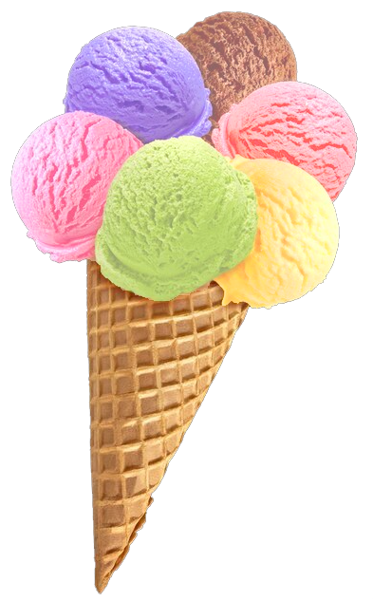
What is MVPA?
“Multi-Variate Pattern Analysis” (MVPA)
relates response patterns
to experimental conditions
Many (overlapping) flavours
Encoding vs decoding
(MVPA can be either)
Activation vs information?
MVB
IEM
cvMANOVA
PCM
RSA
Classification
MVPA
Notes:
For Multivariate Bayes, see e.g. Friston et al., 2008: https://pubmed.ncbi.nlm.nih.gov/17919928/
For Pattern Component Modelling see Diedrichsen et al. 2018: https://www.sciencedirect.com/science/article/pii/S1053811917306985 (this uses priors so is a hierarchical Bayesian model)
For cross-validated MANOVA see Allefeld & Haynes, 2014: https://pubmed.ncbi.nlm.nih.gov/24296330/ (I think this is equivalent to, or a specific case of, PCM)
For Inverted Encoding Models, see e.g. Sprague…Serences 2015: https://www.ncbi.nlm.nih.gov/pmc/articles/PMC4532299/

Slide 5
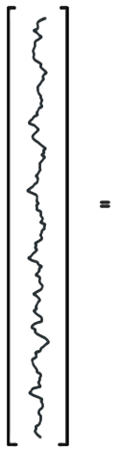
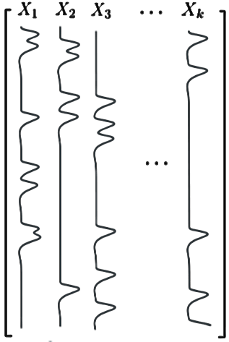
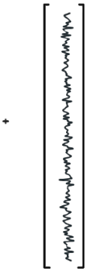






Per voxel (univariate) General Linear Model (GLM)…
…is an encoding model: can we predict the amount of activity in a voxel from the experimental conditions in X?
Activation
coefficients
Error
time
(t)
Data
(measured
BOLD signal)
Design
Matrix
In (multivariate) decoding we try to predict the experimental condition from the pattern of responses

Slide 6
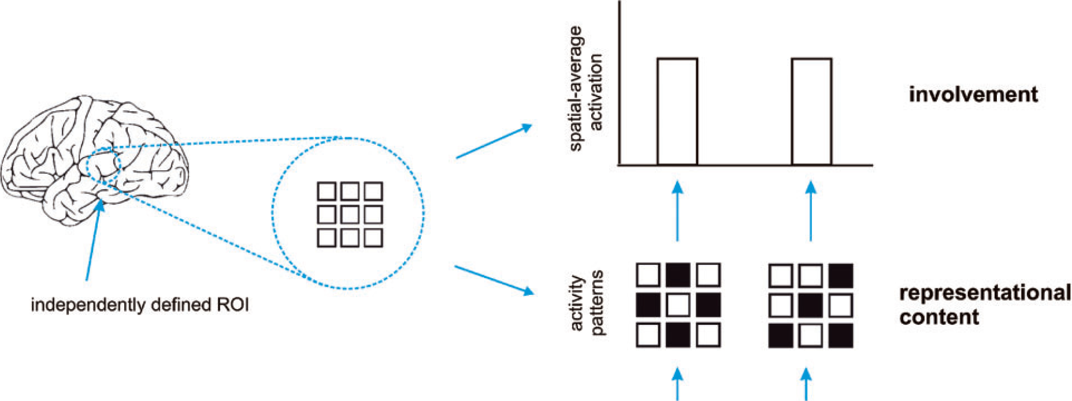
Activation-based (univariate) analysis
Pattern-information analysis
If we can classify experimental conditions based on activity patterns (better than chance)…
Then the activity pattern carries information about the experimental conditions.
Mur et al. (2009)
Notes:
…Real data are noisy, so we need to test whether pattern differences are consistent across repeated presentations…

Slide 7
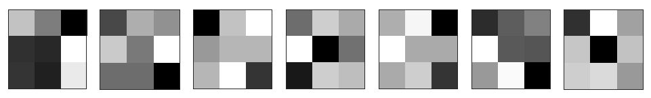
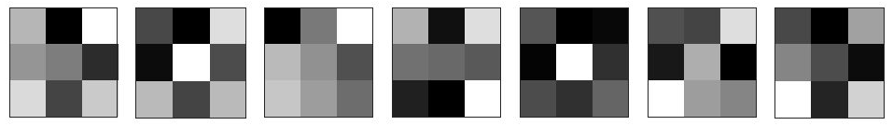
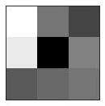
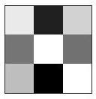
Terminology:
Sample / observation
Label
Class / condition
Patterns
Training set
variable,
feature,
dimension
(e.g. voxel)
Partition /
split /
fold
?
Testing
set

Slide 8
Why do MVPA?
Popularity
Scientific questions
  What information does a brain region represent?
  (classification: are patterns reliably different?)
  In what format does it represent the information?
  (RSA: what are distance relations between patterns?)
To make predictions based on brain data
  Disease status? Covert thoughts?
Typically more sensitive than univariate analysis
Notes:
Listed in reverse order of importance: It’s the sensitivity that allows interesting questions to be addressed, and in turn this makes it popular.

Slide 9
How does MVPA work?
classification example
1
2
Weight
vector
Classification boundary
True labels:
?
?
Compare
Voxel 2 activation
?
?
?
Predictions:
Voxel N
Voxel 1 activation
Notes:
Note – we won’t cover multivariate regression, but it’s conceptually similar: instead of predicting a binary label, the model predicts a continuous label. To evaluate performance, the predicted labels across items in the test set can be correlated with their actual labels

Slide 10
Play with SVMs…
LIBSVM:
https://www.csie.ntu.edu.tw/~cjlin/libsvm/

Slide 11
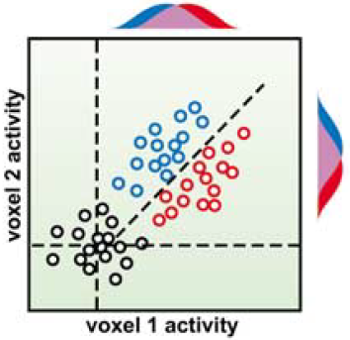
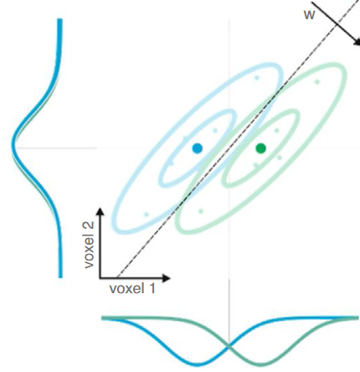
Why can MVPA be more sensitive?
Flexibly combines weak/noisy signal
across features
(including relative activation, non-uniform responses)
Suppresses correlated noise (Hebart & Baker 2018;
interpreting weight vector is tricky: Haufe et al., 2014)
Abstracts from subjects’ idiosyncratic response patterns
(information versus activation)
Cox & Savoy (2003)
Kriegeskorte
& Douglas (2019)
SUBJECT A
SUBJECT B
Voxel 2
Voxel 2
Voxel 1
Voxel 1
Notes:
Note that MVPA is not always more sensitive. Requirement for cross-validation means that 1) model does not use all data at once and 2) there is a risk of overfitting. Univariate analysis on smoothed/averaged data might be more sensitive if its assumptions of homogeneous and consistent activation are correct. (See e.g. Kriegeskorte 2006)

Slide 12
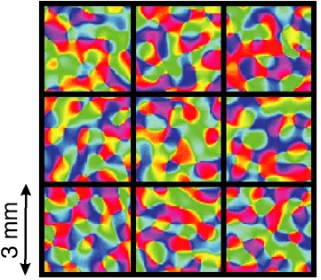
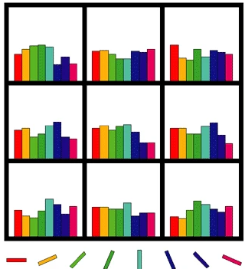
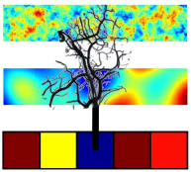
Physiology: fine or coarser scale patterns?
Original view: biased sampling of sub-voxel patterns
Later spatial filtering experiments:
  Removing high spatial frequencies doesn’t always hurt
  (e.g. Op de Beeck, 2010)
  Therefore sampled patterns may be coarse
Much evidence that information is represented at multiple scales
(e.g. FFA/PPA, Haxby 2001; radial orientation bias, etc.)
Veins as multipronged sensors?
(We sample from veins, which sample from neurons)
Often unimportant…
(we want to ask “is there information?”
not “what scale is the information?”),
but could have practical consequences
(consider smoothing and motion)
Kamitani & Tong (2005)
Haynes & Rees (2005)
Boynton (2005)
Kriegeskorte et al. (2009)
Notes:
Orientation column in human is about 0.8mm diameter (Yacoub 2008)

Slide 13

MVPA using
The Decoding Toolbox (TDT)

Slide 14
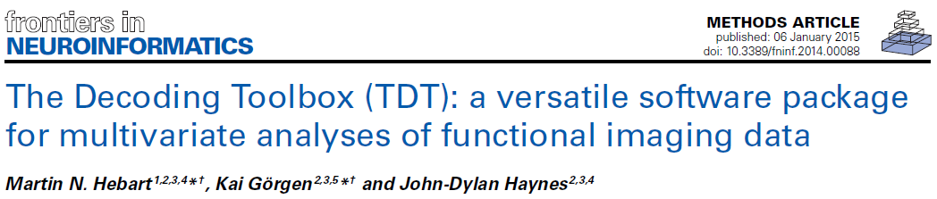
What is The Decoding Toolbox?
https://sites.google.com/site/tdtdecodingtoolbox/
Latest Version 3.999F (13/2/2024)
These demos will use 3.999E2 (05/7/2022)
Runs in Matlab
Minimal GUI, but good documentation and demos to familiarise you with the analyses
Template scripts provide a starting point for own analyses.

Slide 15



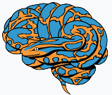

Many alternatives…
Matlab (or Octave) | Python
CoSMoMVPA http://cosmomvpa.org/ | PyMVPA http://www.pymvpa.org/
The Decoding Toolbox sites.google.com/site/tdtdecodingtoolbox/ | MNE-python (for EMEG) https://mne.tools/stable
PRoNTo (for SPM) http://www.mlnl.cs.ucl.ac.uk/pronto/ | NiLearn (general/fMRI) https://nilearn.github.io/stable
Princeton Decoding Toolbox (discontinued) | BrainIAK (+advanced non-MVPA) https://brainiak.org/
MVPA-Light, https://github.com/treder/MVPA-Light
Searchmight (focus on searchlights) http://www.franciscopereira.org/searchmight/
Built-in functions (e.g. fitcdiscr) | General ML packages e.g. scikit-learn
RSA Toolbox (focus on RSA) https://git.fmrib.ox.ac.uk/hnili/rsa https://github.com/rsagroup/rsatoolbox
Within larger packages (e.g. BrainVoyager; MNE; 3dSVM in AFNI)
Yet more in Matlab: MANIA, MANAS, MVPANI, Brain Decoder Toolbox 2…
Any I’ve missed?

Slide 16
Why use The Decoding Toolbox?
Benefits of The Decoding Toolbox:
  “Simplicity”
  Modularity, flexibility, extendibility
  Speed
  Error management
  Readability
  SPM interface (and AFNI)
  Active development
  Documentation and support
  (mailing list: https://neurostars.org/, tag “tdt”)

Slide 17
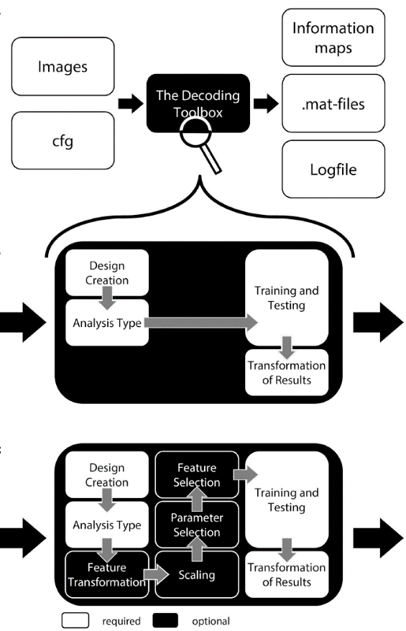
Simplicity, modularity, and flexibility:
Comprehensive reasonable defaults:
decoding_example(’searchlight’,…
’left’,’right’,beta_dir,output_dir)
Defaults can be changed
cfg = decoding_defaults();
regressors = design_from_spm (beta_dir);
cfg = decoding_describe_data(cfg,…
{’left’,’right’},[1 2],
regressors,beta_dir);
cfg.design = make_design_cv(cfg);
cfg.analysis = ’wholebrain’;
cfg.decoding.software = ’lda’;
cfg.results.output = {’dprime’};
results = decoding(cfg);
Optional steps can be added
(many are offered)
Extensions can be added
Hebart et al. (2015)

Slide 18
Currently available options
“Analysis type”
  “Searchlight”
  “ROI” (& “wholebrain”)
Feature transformation
  PCA (with dimension reduction)
Feature scaling
(only across samples per feature)
  Z-score
  Range [0 1]
  Cut-offs
Transformation & scaling “methods”
  “all”
  “across”
  “separate”
Parameter selection (grid search)
Various feature selection methods
“classifiers”
  LIBSVM (linear & non-linear SVMs)
  LIBLINEAR (SVM & Logistic regression; L1 & L2)
  Correlation nearest neighbour
  Linear discriminant
  (similarity)
  … and more…
Performance measures
  Accuracy
  Balanced accuracy
  D-prime
  AUC (area under ROC curve)
  Decision values
  …and more…

Slide 19
Some key components:
How does The Decoding Toolbox work?
cfg
  Structure containing all required information for decoding
cfg = decoding_defaults()
  Function to initialise default settings
Results = decoding(cfg)
  Function that does the work
  Lots of explanation about cfg settings at the top
Now describe your data and optionally change any settings

Slide 20
2 voxel simulation demos
(demos_simpletoydata_234_djm.m)
Simple simulations:
2-class example
3-class example
Unbalanced example

Slide 21
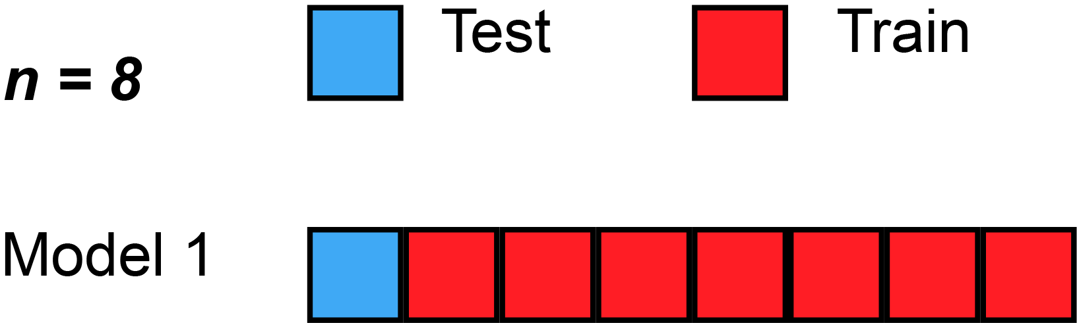
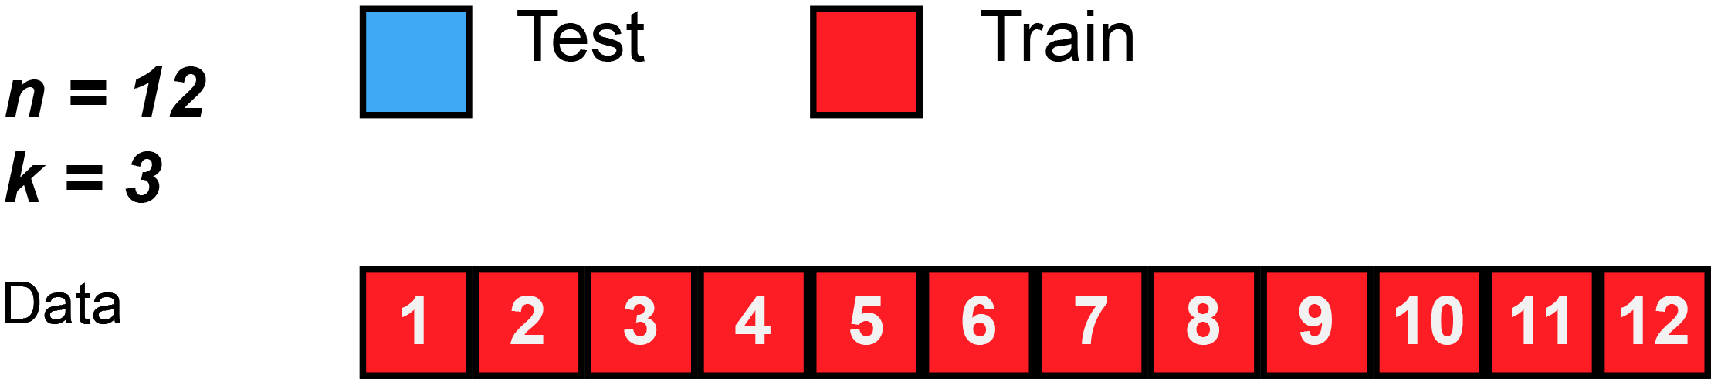
Data splitting
Holdout/validation set from single context
  Safe but often not efficient/stable
Separate datasets from different contexts (“cross-classification”, “cross-generalization”)
  used to test generalization & demonstrate common format
  (e.g. train on perception, test on imagery;
  train at time-point 1, test at time-point 2)
Cross-validation within full single dataset
  Reuse data for both training and testing in different splits/folds
  Average performance across folds
  “split half”…
  …“k-fold”…
  … “leave-one-out”
  Training and testing data should be independent within a fold (“decoding step”), but will be dependent across folds
  Ideally want conditions balanced within each partition (“chunk”)
More ways to split… more precise performance estimate?
More training data per split… better classifier performance?
Gifs from Wikipedia

Slide 22
Cross-validation granularity: generalise to….?
  new trial/stimulus pair
  (leave-stimulus-pair-out)
  new run (leave-run-out)
  new subject (leave-subject-out)
  (“hyperalignment”, Haxby, 2011; 2020)
Why do we need out-of-sample prediction at all?
  Classical univariate analysis uses within-sample statistical estimation
  (activation can be estimated in a direct and unbiased way)
  In MVPA we want to estimate “information”, and out-of-sample prediction provides an unbiased estimate of this (with minimal assumptions).
Fewer samples
More different distributions
Cleaner samples
More independence

Slide 23
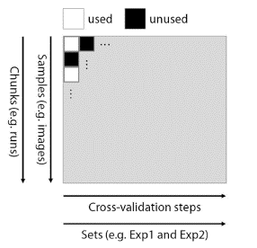
Specifying decoding ‘designs’
Response patterns
In
Rows
Test
Train
Classifiers
In
Columns
Hebart et al. (2015)

Slide 24
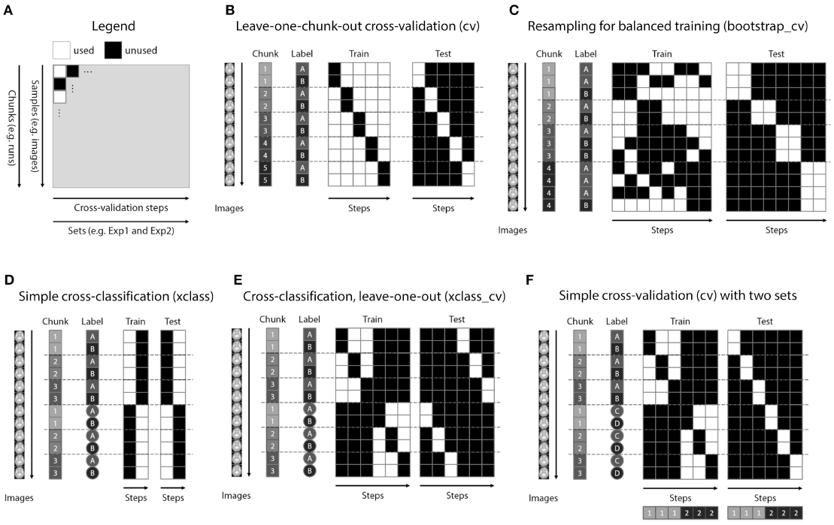
Specifying decoding ‘designs’
Hebart et al. (2015)

Slide 25
Back to 2-voxel demos…

Slide 26
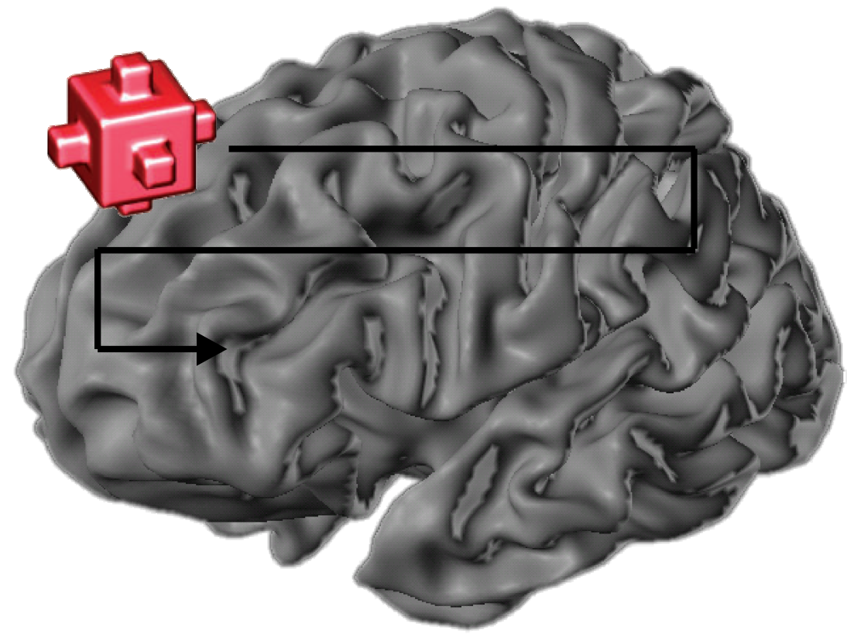
With many features, we need to choose, which of them we want to use
Voxel selection must be based on data independent from test data set
(not specific to MVPA!)
Choice of which features to use determines:
  inference that can be made;
  SNR/risk of overfitting
Most common ways of voxel selection:
  structural ROI (anatomy; e.g. traced per subject, or from an atlas)
  functional ROI (activity; e.g. from per-subject localizer, or coordinates from literature)
    univariate (activation differences)
    multivariate (pattern differences)
  “Searchlight” (roving ROI; often local/contiguous, but needn’t be)
  “whole brain” (global ROI; more for prediction applications)
Could do this at same time as training the model, but would need nested-cross-validation (complicated, slow, and loss of training data may outweigh any benefits)
Kriegeskorte et al.
2006

Slide 27
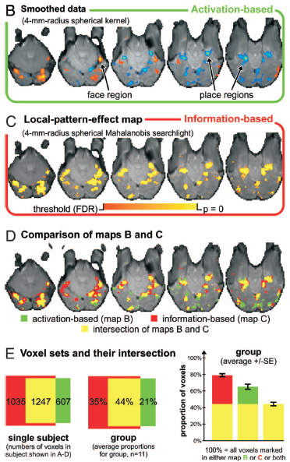
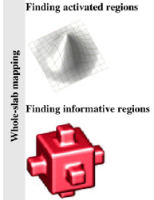
Example comparison of activation-based and information-based mapping
Kriegeskorte et al. 2006, 2007

Slide 28
Selecting voxels, continued
How many voxels?
  Depends on the expected spatial extent of effects,
  and the scientific question.
  few → risk of missing signal
  many → risk of overfitting (too noisy) & weaker localization
Might information be distributed across
non-contiguous regions?
Sometimes people select the same number of voxels in each subject, and for each region of interest.
But beware direct comparisons between regions!
(Equating voxel number doesn’t make them equal;
e.g. MT neurons might encode motion more strongly than V1/V2, but decoding is weaker because neurons are more finely intermixed.
Often important to consider interaction with condition)

Slide 29
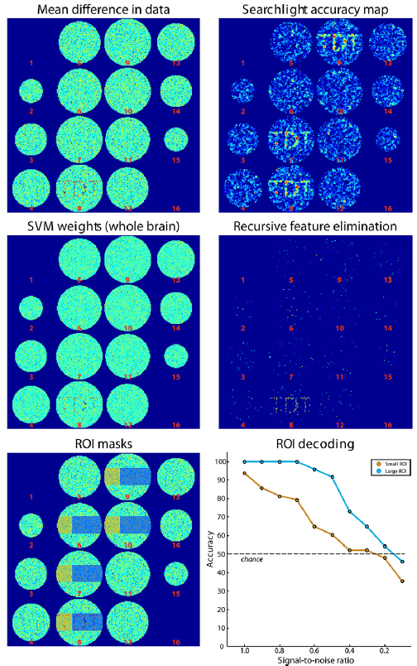
Many-voxel simulation demos
(demos_toybrain_567_djm.m)
Simulated brain data
Fig. 4 from paper
Searchlight example
‘wholebrain’ examples (RFE and SVM weights)
ROI examples
Hebart et al. (2015)

Slide 30
Specific considerations for fMRI data
Temporal autocorrelation:
  Dependencies between patterns within a run
  Safest for test/train patterns to come from different runs
Pre-processing:
  Similar to standard univariate analysis
    Probably:
      motion-correction
      Slice-scan-time correction
    Possibly:
      normalisation to template space (if random-effects searchlight analysis across subjects; could do this afterwards)
      Slight spatial smoothing (could increase or decrease SNR, depending on spatial scale of signal vs noise)

Slide 31
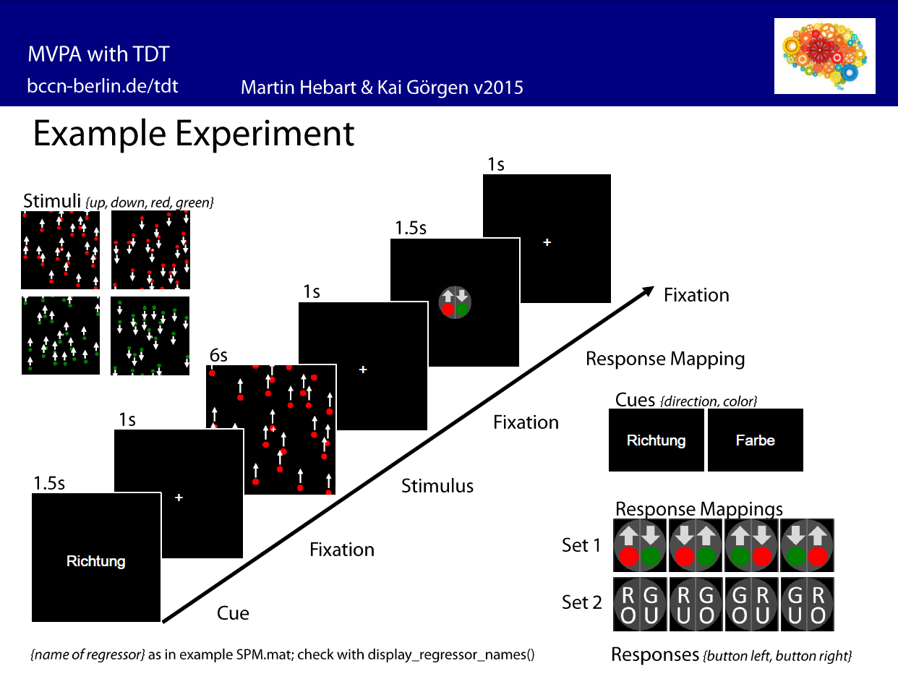
Examples with real fMRI data
(demos_realdata_motion_direction_89_djm.m)
searchlight
statistics

Slide 32
Statistical inference
Dominant in the literature:
Random-effects analysis across subjects, using standard one-sample
right-sided t test.
H₀: μ = 50% (for balanced 2-class); H_{a}: μ > 50%
Is this valid?
observations (i.e. subjects) are independent
reasonable to assume probability distribution of classification accuracy is identical across subjects
number of subjects is large enough for the central limit theorem to apply
(can assume sampling distribution approaches a normal distribution)
Take care over chance level (especially for unbalanced classes)
If any doubt, can use permutation test instead; wise to include negative control
If true value of dependent measure can not be negative, t-test only provides FFX inference (Allefeld et al. 2016)

Slide 33
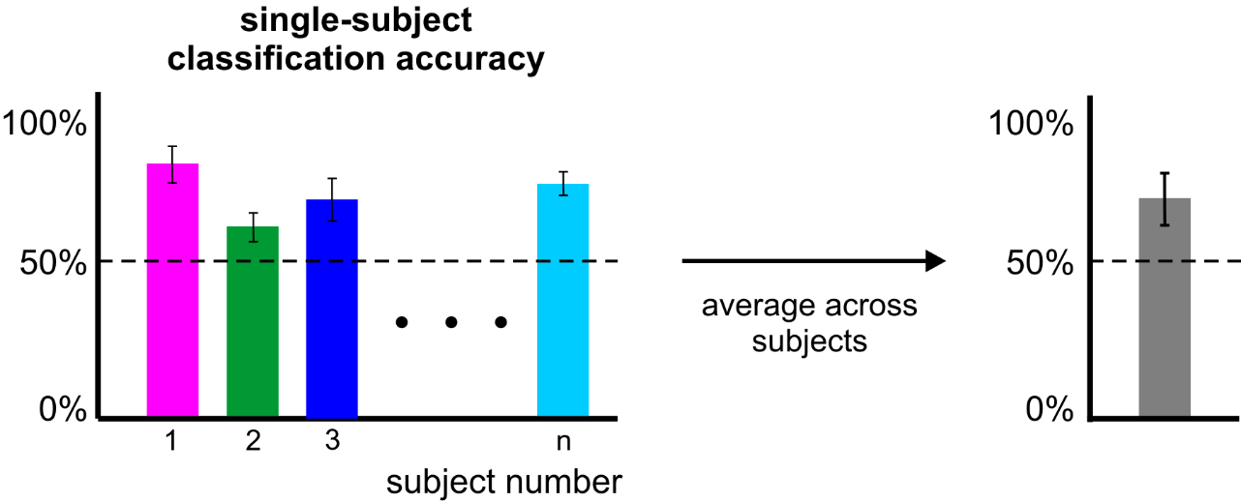
Statistical inference
error bars
= standard error
across folds (probably invalid)
error bar
= standard error
across subjects (probably valid)

Slide 34

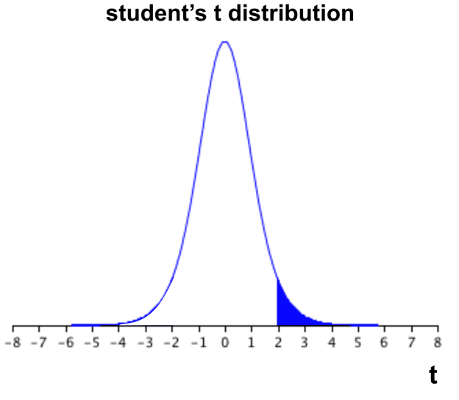

Statistical inference
subject-average
classification accuracy
If the computed t value falls within the top 5% (blue) of the t distribution → reject H₀.

Slide 35
Statistical inference
However:
can we always assume a t distribution?
are we sure that the accuracy is 50% under H₀?
What about stats within a subject?
→ use a permutation test:
  create null distribution by randomly shuffling condition labels many times (1000-10,000) before training
  remove relationship between labels and patterns
  assumes data are exchangeable (H₀: all classes come from same distribution)
  Slow; permutations limited by number of samples/classes

Slide 36
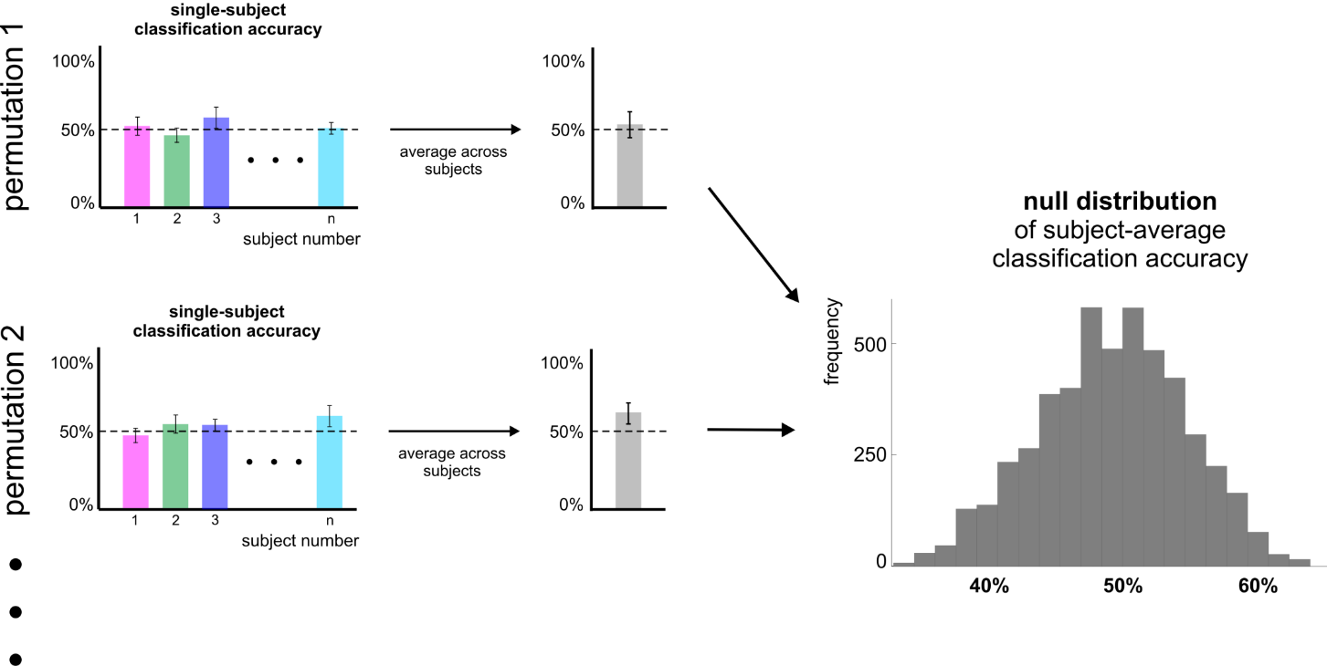
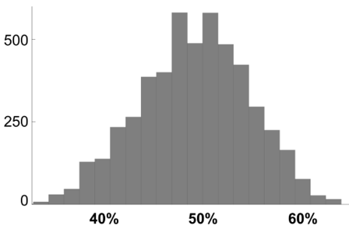
Statistical inference
Null distribution of
subject-n
classification accuracy

Slide 37
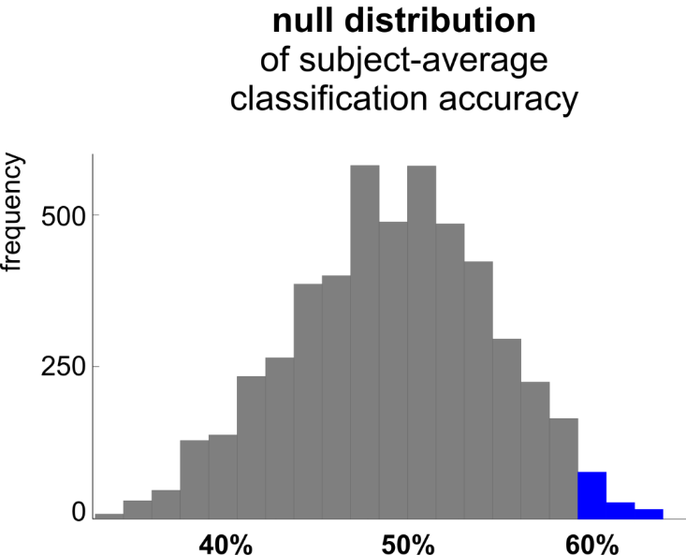
Statistical inference
If the actual classification accuracy falls within the top 5% (blue) of the null distribution → reject H₀.
Notes:
Safe (likely to be valid), but time-consuming, and fixed-effects inference.

Slide 38
Back to demo…

Slide 39
Examples with real fMRI data
(demos_realdata_motion_direction_89_djm_plus.m)
Same data
Now ROI examples comparing some different settings

Slide 40
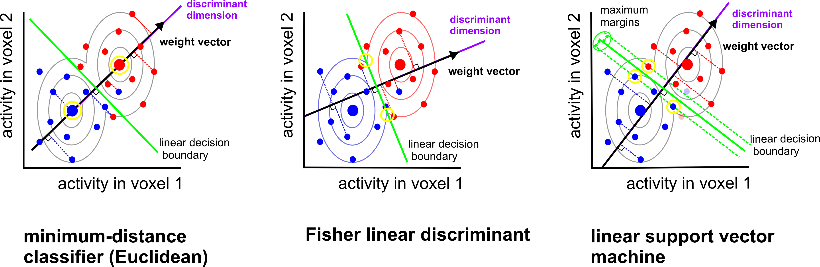
Boundary placement: some linear classifiers
(AKA LDA)
assumes identical and multivariate normal distributions (need to estimate covariance)
(AKA centroid-nearest neighbor)
assumes identical and isotropic distributions
no assumptions about distributions
(need to choose C, or nu)
Mur et al. (2009)
Notes:
LDA is equivalent to Linearly Constrained Minimum Variance Beamformer?
Also, Logistic regression
GNB, LDA and QDA are generative/parametric models
Logistic regression & linear SVM are discriminative models
Nearest neighbour classifiers are simpler in that no parameters are learned, but require a choice of distance metric and of neighbourhood definition

Slide 41
Which classifier is best?
Will depend on:
how well each classifier’s assumptions are met
how much data are available
desired inference/interpretation
Linear SVM and Fisher linear discriminant (with optimal-shrinkage covariance estimator) often seem to perform best.
Misaki et al. 2010
Notes:
LDA can do simultaneous multiclass classification, but SVM needs to combine pairwise classifications.
Covariance matrix estimation can be slow, especially for many voxels.
So with few voxels and many classes, perhaps prefer LDA? With few classes and many voxels, perhaps prefer SVM?
They will also differ somewhat in their sensitivity to outliers.
LDA gives a more direct measure of class membership probability

Slide 42
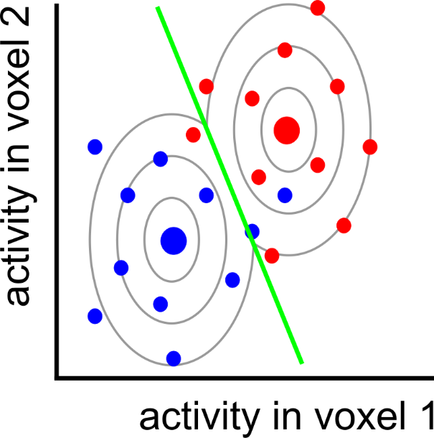
Can we do better?

Slide 43
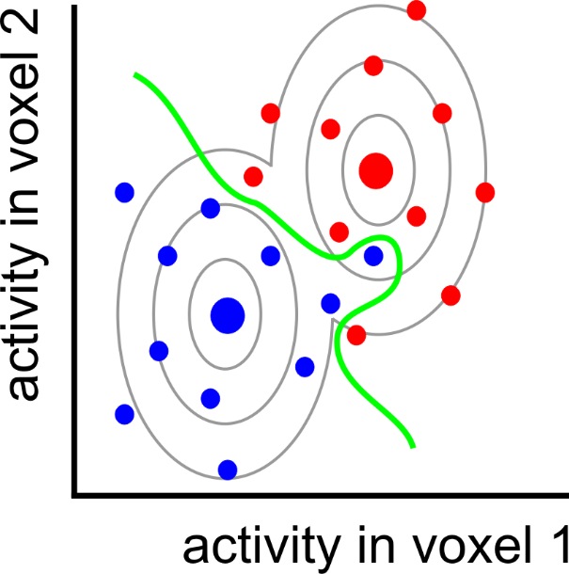
nonlinear
classifier

Slide 44
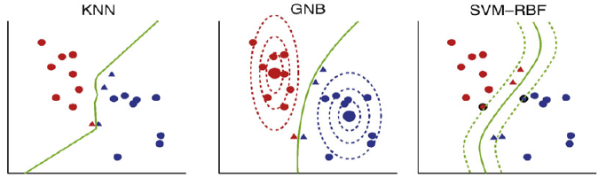
Some non-linear classifiers
K-nearest neighbour
(Quadratic)
Gaussian Naïve Bayes
SVM with radial/polynomial/sigmoid basis function
Nonparametric
(need to select k, and distance metric)
assumes multivariate, but non-identical, normal distributions
(ignores voxel correlation)
no assumptions about distributions
(need parameter selection)
Misaki et al. 2010

Slide 45
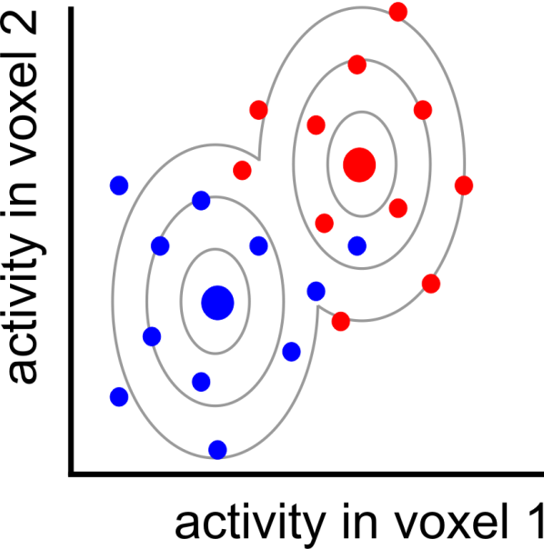
Pattern = signal + noise

Slide 46
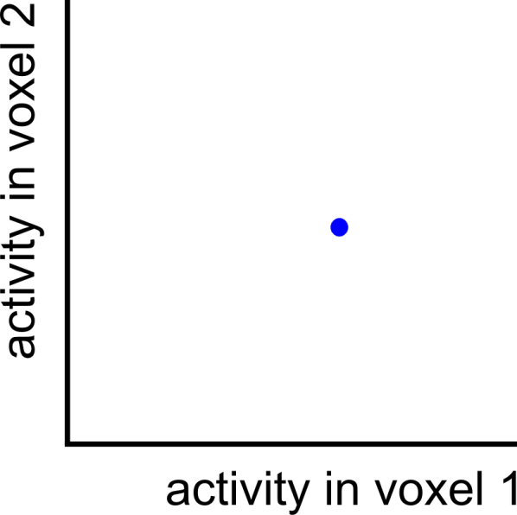
Pattern = signal + noise
measured pattern
(signal + noise)

Slide 47
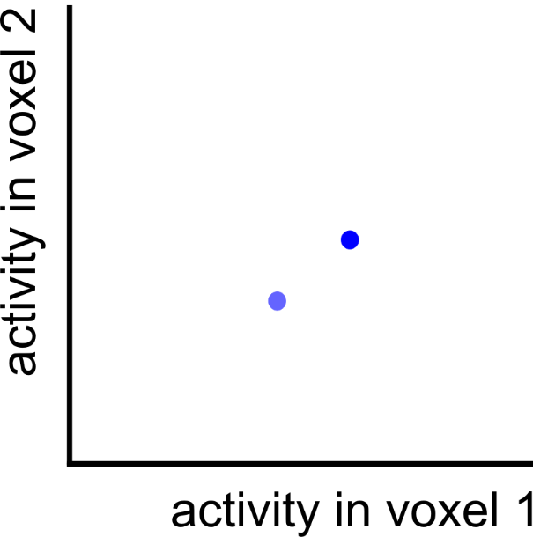
Pattern = signal + noise
measured pattern
(signal + noise)
true pattern
(signal)

Slide 48
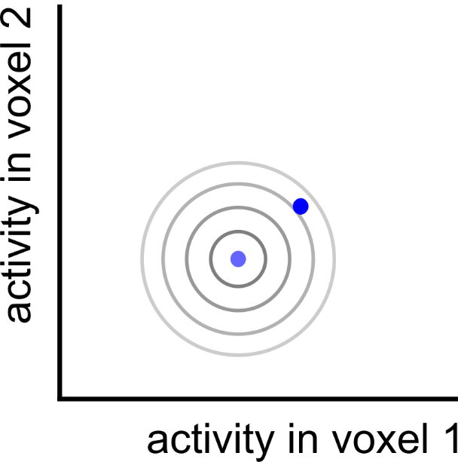
Pattern = signal + noise
measured pattern
(signal + noise)
true pattern
(signal)

Slide 49

Pattern = signal + noise
measured pattern
(signal + noise)
true pattern
(signal)
noise displacement

Slide 50
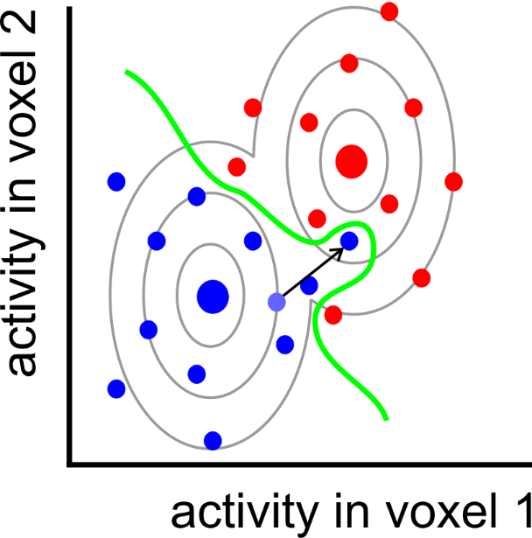
Overfitting

Slide 51
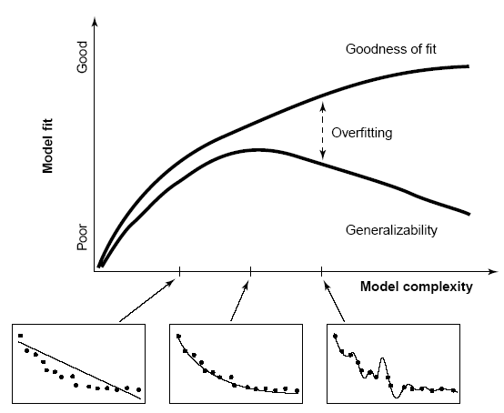

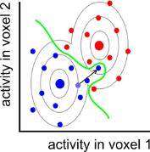
Overfitting
After determining the decision boundary, we need to test how well the boundary generalises to new data (e.g. cross validation).
(training data)
performance
(hold-out data)
boundary complexity
Notes:
Regularisation: use prior assumptions to constrain the ways in which the boundary is shaped and shifted so as to discriminate the categories in the training data.

Slide 52
Overfitting
After determining the decision boundary, we need to test how well the boundary generalises to new data (e.g. cross validation).
Linear classifiers usually perform better on fMRI data than nonlinear classifiers.
Overfitting can be further reduced by:
regularisation
dimensionality reduction of the activity patterns (e.g. voxel selection)
Notes:
Regularisation: use prior assumptions to constrain the ways in which the boundary is shaped and shifted so as to discriminate the categories in the training data.

Slide 53
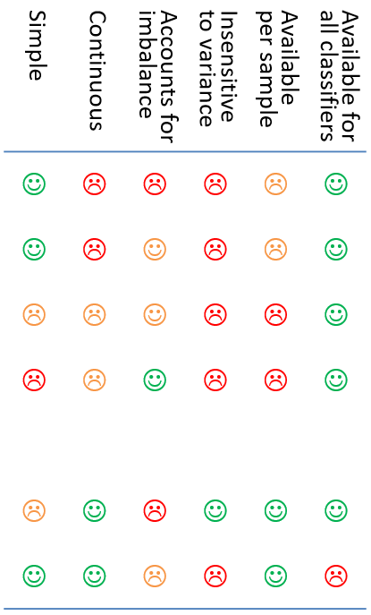
Performance measures
Possible pros/cons:
Simple | Continuous | Accounts for imbalance | Insensitive to variance | Available per sample | Available for all classifiers
☺ | ☹ | ☹ | ☹ | ☹ | ☺
☺ | ☹ | ☺ | ☹ | ☹ | ☺
☹ | ☹ | ☺ | ☹ | ☹ | ☺
☹ | ☹ | ☺ | ☹ | ☹ | ☺
☹ | ☺ | ☹ | ☺ | ☺ | ☺
☺ | ☺ | ☹ | ☹ | ☺ | ☹
Several options, e.g.:
Accuracy (proportion correct classifications)
Accuracy per class (balanced accuracy)
D-prime (and other sensitivity measures)
Area under ROC curve
Decision variable
  e.g. signed distance from margin
  Probability of correct classification

Slide 54
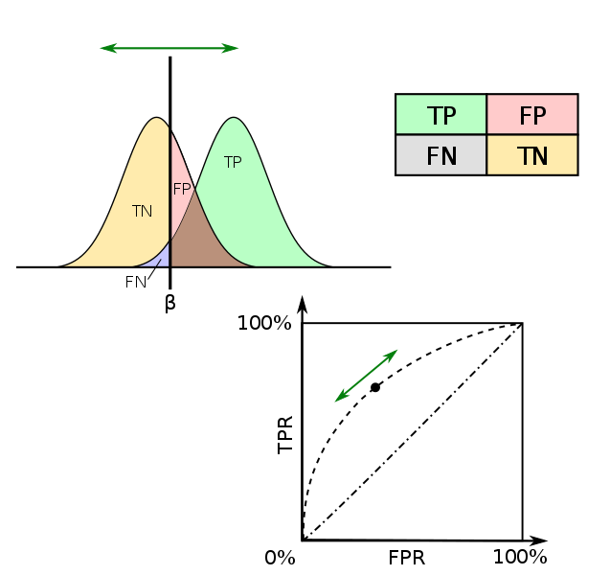
d’ (sensitivity)
Chance = 0
ROC curve
AUC
(area under curve)
chance = 0.5
Criterion

Slide 55
Back to demo…

Slide 56
Some example applications…

Slide 57
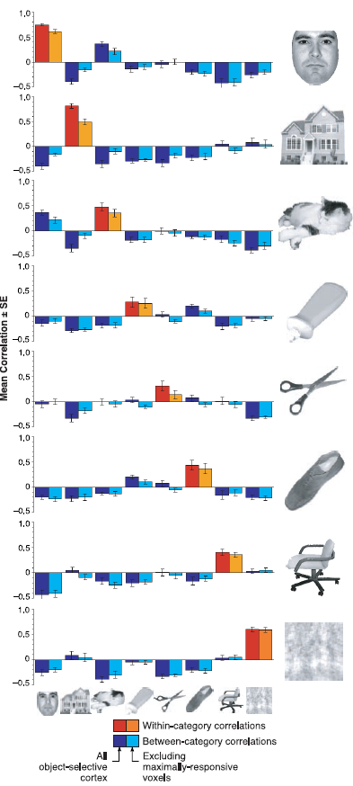
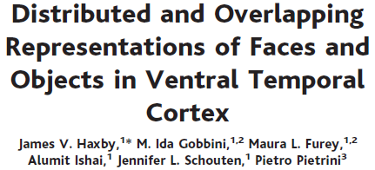
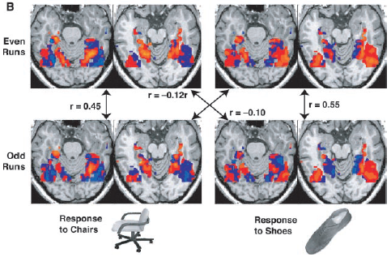

Slide 58
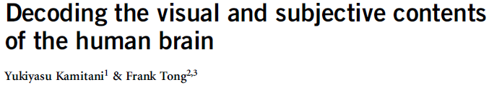
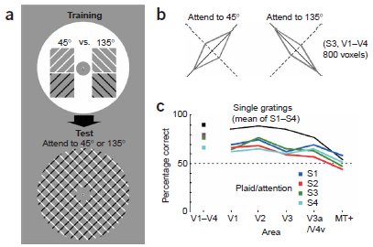
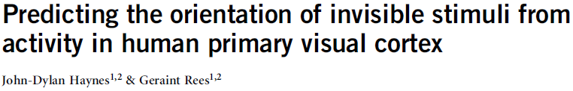



Slide 59




Slide 60





Slide 61






Slide 62



Slide 63



Slide 64





Slide 65



Slide 66



Slide 67
References (a selective list)
Linear classification tutorials
Mur M et al. (2009) Soc Cogn Affect Neurosci 4: 101-109. [conceptual introduction]
Pereira F et al. (2009) Neuroimage 45(1 Suppl): S199-S209. [introduction]
Schreiber K, Krekelberg B (2013) PLoS ONE 8(7): e69328. [cautionary comments on statistical inference]
Kriegeskorte N et al. (2006) PNAS 103(10): 3863-3868. [multivariate searchlight]
Linear classification reviews
Norman KA et al. (2006) Trends Cogn Sci 10(9): 424-430.
Haynes JD, Rees G (2006) Nat Rev Neurosci 7: 523-534.
Linear classification: a few example applications in neuroscience
Kamitani Y, Tong F (2005) Nat Neurosci 8(5): 679-685. [vision: classify orientations]
Formisano E et al. (2008) Science 322: 970-973. [voices: classify speakers & vowels]
Haynes JD et al. (2007) Curr Biol 17(4): 323-328. [cognitive control: task preparation]
Emrich et al. (2013) J.Neurosci. 33(15):6516–6523 [visual working memory]

Slide 68
References (a selective list)
Recursive feature elimination (RFE)
De Martino F et al. (2008) Neuroimage 43: 44-58.
Thoughts on choice of classifier & preprocessing options
Mourao-Miranda J et al. (2005) Neuroimage 28: 980-995. [SVM vs FLDA]
Kriegeskorte et al. (2009) Nat Neurosci 12(5): 535-540. [how to prevent selection bias]
Misaki M et al. (2010) Neuroimage 53: 103-118. [compares 6 different classifiers]
Garrido L et al. (2013) Front Neurosci 7(174): 1-4. [subtract the mean pattern?]
Relationships between classification (decoding), encoding, and RSA
Naselaris T et al. (2011) Neuroimage 56: 400-410.
Kriegeskorte N (2011) Neuroimage 56: 411-421.
Kriegeskorte & Douglas (2019) Curr Opin Neurobiol 55:167-79
Source of data for extra ‘hands on’ example
Mitchell & Cusack (2016) Scientific Reports 6:20232; DOI: 10.1038/srep20232

Slide 69





Extra demo data if time? (tutorial_djm2.m)
Mitchell & Cusack (2016) Scientific Reports 6:20232
200 objects, presented one each per condition
2 conditions (occasional cues to imagine knives or dolphin)
Tutorial data combined over subjects

Slide 70
Part 2: RSA

Slide 71
What is RSA?
“Representational Similarity Analysis (RSA) is
an MVPA method to:
describe and compare geometries of represented conditions
Generalisation of classification:
  More conditions
  More general notion of dissimilarity
  (not “are patterns different?” but “how different are they?” and “how are they different?”)
  Less need to predefine stimulus categories/dimensions
Notes:
(Assumes that the concepts can be embedded in a high-dimensional space, and that the measurements sample this space)

Slide 72
Why do RSA?
Quantifies neural relationships between conditions in an abstract space, derived from, but no longer dependent on, the measurement format…
Allows representational structures to be distinguished,
and compared in common format
Kriegeskorte et al. 2008

Slide 73

Kriegeskorte & Kievit (2013)
Notes:
Each example shows six stimuli from two conditions.
Blue lines show cases where a linear classifier would give identical (and in this case perfect) classification, despite clearly different representational structure that would be picked up by RSA.
Similarly, red lines show identically performing non-linear classifiers, despite different representational geometries.
The RDMs under each case capture all the relevant differences.

Slide 74


A real example
Classification of colour strongest in V1
But representation in V4 more closely matches perceptual colour space
Stimulus responses also cluster by category in V4
(in colour-naming task)
Brouwer & Heeger 2009, 2013

Slide 75



How does it work – the “Representational Similarity Trick”
RSA
dissimilarity
Voxel Receptive
Field Modelling
(many parameters
& little generalization)
Image from
Niko Kriegeskorte
RSA workshop 2015

Slide 76
Kriegeskorte et al. 2008

Slide 77
Representational similarity analysis using The RSA Toolbox

Slide 78
What is The RSA Toolbox?
Original Matlab implementation described in Nili et al. (2013), and can be downloaded here:
http://www.mrc-cbu.cam.ac.uk/methods-and-resources/toolboxes/
Or here: https://git.fmrib.ox.ac.uk/hnili/rsa
Current development in Python
(briefly called PyRSA, now called RSA 3.0): https://github.com/rsagroup/rsatoolbox
See Schütt et al., 2023
Decent documentation and multiple demos to familiarize you with the methods and as a starting point for your own analyses.

Slide 79
Why use the (Python) RSA Toolbox?
Pros:
  Open source
  Few dedicated alternatives
    Other toolboxes (e.g. The Decoding Toolbox and CoSMoMVPA) have some RSA capability, but less documented/comprehensive
    BrainIAK has a particular Bayesian version
    Others?
  Flexible/sophisticated statistics/modelling
  Attractive/clever visualisations
Cons:
  Dedicated to RSA, not classification
  (but crossnobis distance is an excellent classification measure)
  No GUI (but coding is more reproducible)
  Documentation has typos (what about the code??); no email list?
  Sometimes non-intuitive (“Euclidean” is squared Euclidean; “crossnobis” method defaults to neither “cross-” nor “-nobis”;
  may semi-overlapping bootstrap functions?)
  Searchlight not fully implemented (yet?)

Slide 80
Setting up the environment for these demos:
(One option: certainly not the only one; likely not the best)
conda create –n cognestic23 python
conda activate cognestic23
conda install –c anaconda spyder [optional, IDE]
conda install –c anaconda jupyter [used for demos]
Clone RSA Toolbox github repository and move to its directory
pip install .
[or: conda install -c conda-forge rsatoolbox]
pip install –U nilearn
pip install seaborn [optional, used for some demos]
Packages to probably import:
import numpy, scipy, matplotlib, rsatoolbox
Packages to possibly import:
import os, glob, pandas, collections, nilearn, nibabel, seaborn
Notes:
numpy provides arrays
scipy can load .mat files with io.loadmat and adds other matlab functionality like squareform
matplotlib provides matlab-like plotting
seaborn extends/simplifies matplotlib with more plot types and options (like despine to (re)move axis lines)
os provides methods like path.join
glob to search filenames with wildcards
pandas provides dataframes (i.e. tables)
collections provides extra datatypes e.g. defaultdict
nibabel can process analyze/nifti files with load() and load().get_fdata
nilearn for neuroimaging stuff like “plotting.plot_stat_map”
Can do: from [package] import [module] as [newname]
To use VScode:
Install Remote SSH
Click green button at bottom left; connect current window to host
Enter e.g. dm01@login-j03 + password
“conda env list” to see available environments
“conda list” to see software in active environment

Slide 81

Overview:
How does The RSA Toolbox work?
Notes:
blue: sub-packages
grey: classes
yellow: modules (functions)
orange: auxiliary materials

Slide 82
Some key components: Datasets and RDMs
How does The RSA Toolbox work?
data.Dataset [or data.TemporalDataset]
[ observations x channels [ x time] ]
from numpy array, pandas dataframe or .hdf5 file
Optional dataset/obs/channel descriptors, as dictionary of lists
Methods to: sort, split, subset, average
data.noise to estimate noise covariance/precision,
from measurements or residuals
demo_dataset
(create, describe,
and rearrange
datasets) (~5 s)
e.g. RDMs = rdm.calc_rdm(Dataset, method='euclidean‘)
RDMs = rdm.calc_rdm_movie(TemporalDataset, …)
RDMs = rdm.calc_rdm_unbalanced(…)
rdm.RDMs
[ n x patterns x patterns ] or [ n x upper triangular vector]
Optional RDM/pattern descriptors, as dict of lists
Methods to:
  concatenate, append, subsample and average RDMs
  subsample, reorder, or sort patterns (i.e. conditions)
  transform data (e.g. rank, or sqrt)
  compare RDMs (e.g. types of correlation)
To create an RDM, we need to define dissimilarity…
Notes:
descriptors – dict with general metadata about dataset
obs_descriptors – dict with array that defines condition labels
channel_descriptors – dict with array that identifies each channel
For multiple subjects, use a list of Datasets

Slide 83

How to measure representational dissimilarity
and other cross-validated “distance estimates”
Image from
Niko Kriegeskorte
RSA workshop 2015

Slide 84

Euclidean distance
Straight-line distance between two patterns in Euclidean space
Image from Alex Walther
RSA workshop 2015
Notes:
Square root of sum of squared displacements along orthogonal dimensions

Slide 85



Correlation distance
1 – correlation coefficient
Correlation = cosine of the angle between normalised patterns
Image from Alex Walther
RSA workshop 2015
Misaki et al. 2010
Notes:
Cosine similarity is dot product of unit vectors.
Pearson correlation is cosine similarity between centred vectors.
Spearman correlation is Pearson correlation between ranked vectors.

Slide 86

Image from
Niko Kriegeskorte
RSA workshop 2015

Slide 87

Image from Alex Walther, RSA workshop 2015
Notes:
Euclidean distance is more intuitive

Slide 88

One example of effect in practice:
Kriegeskorte et al. 2008

Slide 89
Cross-validated distance estimates
Linear Discriminant Contrast (LDC), aka Crossnobis estimator has two desired properties:
Multivariately noise-normalised
  Like Mahalanobis distance
  Potentially increases sensitivity
Cross-validated
  Generalises
  Not positively biased, with interpretable zero point
  Requires data splitting (may not always be possible, and potentially reduces sensitivity)
Note the cross-validation means it can be negative:
  it is an estimate of a distance
  necessary to remove positive bias

Slide 90


Noise normalisation
Noise normalisation of fMRI response patterns increases reliability of estimated pattern distances.
Univariate:
  Divide each voxel’s beta weight by its standard error → t value
Multivariate:
  Multiply patterns by inverse of (square-rooted) covariance matrix → Mahalanobis distance
A
B
Image from Alex Walther, RSA workshop 2015
Notes:
Consider this multivariate normal distribution. Which of the points A and B is more representative of the distribution? A and B are equally distant from the centroid in terms of Euclidian distance, but A is three times closer to the centroid using Mahalanobis distance.

Slide 91

Cross-validated dissimilarity measures
Distances are positive
In high dimensional space, noise is likely orthogonal to pattern separation
Noise means distance measures are positively biased.
Image from
Niko Kriegeskorte
RSA workshop 2015

Slide 92


Cross-validated dissimilarity measures
Cross-validated dissimilarity measures
are estimates of distances. So can be negative.
They are unbiased, have an interpretable zero point, and preserve ratio scale.
Noise covariance
(Squared Euclidean distance if identity matrix)
from Alex Walther, RSA workshop 2015
LDC ~ dot product of difference vectors
~ cosine of angle between them
= zero if orthogonal
Can divide by #voxels to compare ROIs of different sizes
LDt = LDC divided by its standard error
Nili et al. (2013)
Notes:
Dot product = inner product = scalar product
See fig 9c from Nili 2020

Slide 93



Nili et al. 2020
What if there is no separation of conditions, but one is noisier?
Image from
Niko Kriegeskorte
RSA workshop 2015
What would be the accuracy of a linear classifier?

Slide 94

Compare with LDA classifier
Image from
Niko Kriegeskorte
RSA workshop 2015

Slide 95
Datasets and RDMs
How does The RSA Toolbox work?
data.Dataset [or data.TemporalDataset]
[ observations x channels [ x time] ]
from numpy array, pandas dataframe or .hdf5 file
Optional dataset/obs/channel descriptors, as dictionary of lists
Methods to: sort, split, subset, average
data.noise to estimate noise covariance/precision,
from measurements or residuals
demo_dataset
(create, describe,
and rearrange
datasets)
e.g. RDMs = rdm.calc_rdm(Dataset, method='euclidean‘)
RDMs = rdm.calc_rdm_movie(TemporalDataset, …)
RDMs = rdm.calc_rdm_unbalanced(…)
demo_dissimilarities
(create, access,
and plot data RDMs,
including crossnobis)
(~10 s)
rdm.RDMs
[ n x patterns x patterns ] or [ n x upper triangular vector]
Optional RDM/pattern descriptors, as dict of lists
Methods to:
  concatenate, append, subsample and average RDMs
  subsample, reorder, or sort patterns (i.e. conditions)
  transform data (e.g. rank, or sqrt)
  compare RDMs (e.g. types of correlation)
demo_unbalanced
(for data with
missing values)
Notes:
First section of RDM demo repeats initial dataset creation from first demo.
For crossnobis dissimilarity, set e.g. cv_descriptor=‘runs’, noise=PrecisionMatrix
Toolbox uses precision matrix rather than covariance matrix;
can be calculated from deviations of many measurements: noise.prec_from_measurements(dataset, method=‘shrinkage_eye’);
or from per-channel residuals calculated at a previous step: noise.prec_from_residuals(residuals,…)
Shrinkage is essential otherwise inversion essentially leads to almost random numbers!
rdm.calc_rdm defaults to “squared Euclidean” but
rdm.calc_rdm_unbalanced defaults to “Euclidean”??
To average (potential partial) RDMS, use:
partials = rsatoolbox.rdm.combine.from_partials([rdms1, rdms2])
## all rdms should have the same number of conditions, with NaNs for missing data ## then we rescale/align these based on pairs in common (put them in the same space)
rescaledPartials = rescale(partials, method='evidence')
## then we can take a weighted average:
meanRDM = rescaledPartials.mean(weights='rescalingWeights')

Slide 96
96 object images
Stimuli from Kiani et al. 2007, Kriegeskorte et al. 2008

Slide 97

96-object-image fMRI experiment
25 axial slices covering ventral occipital and inferior temporal cortex (no gap)
voxel size: 1.95*1.95*2 mm³
TR: 2 s

Slide 98

Example RDM of IT activity patterns, to be used in demo
92 object images
4 healthy humans
rapid event-related design (4 s SOA)
300 ms stimulus duration
object images spanned a visual angle of 2.9°
fixation-cross
color-judgement task
12 runs/subject, each object image presented once per run
Kriegeskorte et al. 2008

Slide 99
Example RDM of IT activity patterns, to be used in demo
human faces
animate-inanimate
dissimilarity
[percentile]
4 subjects’ average
Kriegeskorte et al. 2008
Notes:
Interpretability depends on the ordering of the stimuli
Consider whether or not to rank the dissimilarities

Slide 100


Ways to visualize representational structure
Representational dissimilarity matrix (RDM)
  Contains all multidimensional dissimilarity information
  Interpretability depends on order of stimuli/rows
  (And colour scale/normalization)
  Input to statistical inference
Multidimensional scaling (MDS) or other dimension-reduction
  Finds low-dimensional representaion to best preserve
  the high-dimensional (metric or ranked) dissimilarities
  (i.e. plotted distance reflects neural dissimilarity)
  Intuitive; directly interpretable
  Discards information/distorts data; can assess with “Shepard plot” or “rubber bands”
  Generally not used for inference,
  but bootstrapped confidence ellipses could be added
  Orientation is arbitrary; Procrustes transform can be used for alignment
Dendrogram
  Defines multiscale clusters
  Assumes hierarchical structure

Slide 101
Datasets and RDMs
How does The RSA Toolbox work?
data.Dataset [or data.TemporalDataset]
[ observations x channels [ x time] ]
from numpy array, pandas dataframe or .hdf5 file
Optional dataset/obs/channel descriptors, as dictionary of lists
Methods to: sort, split, subset, average
data.noise to estimate noise covariance/precision,
from measurements or residuals
demo_dataset
(create, describe,
and rearrange
datasets)
e.g. RDMs = rdm.calc_rdm(Dataset, method='euclidean‘)
RDMs = rdm.calc_rdm_movie(TemporalDataset, …)
RDMs = rdm.calc_rdm_unbalanced(…)
demo_dissimilarities
(create, access,
and plot data RDMs,
including crossnobis)
rdm.RDMs
[ n x patterns x patterns ] or [ n x upper triangular vector]
Optional RDM/pattern descriptors, as dict of lists
Methods to:
  concatenate, append, subsample and average RDMs
  subsample, reorder, or sort patterns (i.e. conditions)
  transform data (e.g. rank, or sqrt)
  compare RDMs (e.g. types of correlation)
demo_unbalanced
(for data with
missing values)
demo_rdm_vis…
(plot RDM with
formatted image icons;
scatterplot e.g. MDS)
Notes:
[*args in function definitions treats args a tuple of variable inputs
**kwargs treats kwargs as a keyword dict of optional arguments]
For final scatterplot, try:
swapping image icons for string or marker
swapping MDS for iso (fast) or tSNE (slow)

Slide 102
Comparing geometries
– an example “model RDM”
from Marieke Mur 2013
How well do brain representations and subjective experience match?
Notes:
The power of RSA is in comparing geometries…

Slide 103


Conventional method:
Pairwise similarity ratings
How similar are these objects?
very similar
very dissimilar
0
5

Slide 104
Many pairwise dissimilarities
96
0
96 x 95 / 2 = 4560 pairs
0
0
0
0
96
0
0
4560 * 4 s = 5 hours per subject
0
0
0
0
0
similarity-judgment RDM

Slide 105
2D arrangement by dissimilarity
RDM
multidimensional
scaling
inverse
multidimensional
scaling
Goldstone, 1994; Risvik et al., 1994

Slide 106
Multi-object arrangement (MA) method
Kriegeskorte & Mur 2012
Subjects arrange objects in 2D by mouse drag-and-drop.
More efficient than pairwise similarity ratings.
Subjects arrange objects in the context of the other objects in the set.
16 healthy human subjects
each subject performed one 1-hour session (outside the scanner)

Slide 107

Please arrange these objects according to their similarity

Slide 108

Please arrange these objects according to their similarity

Slide 109
human IT
similarity judgments

Slide 110
2D arrangements by dissimilarity
human IT
similarity judgments
Notes:
Similarity judgements have more and stronger categories
Perhaps because IT is just one brain regions, whereas behaviour is downstream integration of distinctions from many brain regions?

Slide 111
human IT
similarity judgments
animate
inanimate
animate
inanimate
human
nonhuman
face
body
natural
artificial
face
body

Slide 112
Comparing RDMs
96
96
0
0
0
0
0
0
0
0
0
0
96
0
96
0
0
0
0
correlate
dissimilarities
0
0
0
0
0
0
0
0
0
Brain
(“reference RDM”)
Judgments
(“model RDM”)
Non-linear relationship might be expected,
so rank correlation (Spearman/Kendall tau-a) often preferred
Therefore RDMs often rank transformed for display
RDM entries are not independent, so statistical inference must be done across e.g. subjects, or using condition permutation/bootstrap
But, covariance can be calculated and used to pre-whiten RDM
Can also use multiple regression to predict data RDM from model components
Can compare model geometries with 2nd-order RDM

Slide 113
Models and fitting
How does The RSA Toolbox work?
e.g.:
RDM = rdm.get_categoricalrdm([‘A’, ’A’, ‘V’, ‘V’])
Think of the “model” as a set of
predictor RDMs (e.g. GLM design matrix)
and a method to “fit” their weights
(e.g. OLS, NNLS).
“Predict” returns a prediction
based on particular weights
“Fit” estimates the weights, by
“comparing” to single data RDM
These functions rarely need to be
called directly…
model.ModelFixed(‘name’, RDM)
model.ModelFixed
or model.ModelWeighted
or model.ModelSelect
or model.ModelInterpolate
Methods to:
  “predict” (an RDM)
  “fit” (in various ways)

Slide 114
Some key components: Inference
How does The RSA Toolbox work?
For statistical inference we want to test the reliability of
  (1) the similarity between model and data RDM
  (2) the difference between model fits.
In simplest case (fixed models; independent subjects), can use 1-sample & paired t-test:
Result = inference.eval_fixed(ModelsFixed, RDMs, method='corr_cov')
To generalise across conditions/patterns (non-independent), could bootstrap:
Result = inference.eval_bootstrap_pattern(Models, RDMs, …)
If fits are biased (e.g. flexible or constrained parameters), they can be cross-validated across splits of subjects and conditions (needing dual bootstrap & >5 conditions). E.g.:
Result = inference.eval_dual_bootstrap(Models, RDMs,
k_pattern=4, K_rdm=2, N=1000, …)
demo_bootstrap:
load & view model RDMs; “fixed” & “selection” model comparison; cross-validation & bootstrap
(~2.5 minutes)
Notes:
Crossvalidation “training and test sets…should not share either subjects or stimuli”
Bootstrapping subjects is usually unnecessary because they are independent.
Bootstrapping patterns and subjects separately, is noisy/conservative, so “dual bootstrap” is recommended in this case
(see “Statistical Inference on Representational Geometries”, Schutt et al. 2023, arXiv);
but this is less powerful than just bootstrapping the patterns?
To run cross-validation without bootstrap, could do:
train_set, test_set, ceil_set = inference.sets_leave_one_out_rdm(rdms)
inference.Result = inference.crossval(models, rdms,
train_set, test_set, ceil_set=ceil_set, method='corr')
What is the difference between:
inference.eval_dual_bootstrap()
and
inference.bootstrap_crossval() ?
Input parameters are basically the same, except the latter has the option of which dimension to bootstrap (RDMs, patterns or both). This is faster but may not include the “dual bootstrap” correction? Does dual_bootstrap include the correction for cross-validation sampling? Yes. So, dual_bootstrap should always be used unless only need to bootstrap a single dimension?
inference.bootstrap_cv_random() is apparently “even more optimised” version of inference.bootstrap_crossval()
Presumably, eval_dual_bootstrap_random is optimised version of inference.eval_dual_bootstrap()? It also has the boot_type option. But it seems to return larger error bars, no noise ceiling, and I don’t understand the difference between n_ and k_ inputs.
So, generally, I prefer eval_dual_bootstrap()?

Slide 115

Group mean RDM is best possible model (given the data) for comparing each subject to
Positively biased because comparison subject included in mean
Leave-one-out mean removes this dependence, but is negatively biased because does not use all data
Do we need a better model, or better data?
Nili et al. (2014)

Slide 116
Some key components: Visualization
How does The RSA Toolbox work?
Plotting RDM data:
  vis.show_rdm(RDMs, …)
  vis.show_2D(RDMs, method, …)
Available methods (using sklearn.manifold defaults):
    MDS (criterion of normalized_stress)
    Isomap
    t-SNE (what perplexity?)
    given coordinates
  Both can label conditions with “Icons” (as pattern descriptor in RDM object)
Comparing RDMs with scatterplots:
  vis.rdm_comparison_scatterplot(RDMs, …)
Plotting statistical inference:
  vis.plot_model_comparison(result, …)
  vis.map_model_comparison(result, RDMs) [WARNING: CHANGES RDMS?]
  various options for marking significance
Notes:
New visualisations in demos but not documentation:
rdm_comparison
model_map (passing in single subject data RDMs allows some sort of noise correction to reduce positive bias of data-model distances??; corr_cov method not yet handled)

Slide 117
Searchlights:
How does The RSA Toolbox work?
In rsatoolbox.util.searchlight…
  centres, neighbours = get_volume_searchlight(mask)
  RDMs = get_searchlight_RDMs(data_cXv, centres, neighbours, cond, …)
  evaluate_models_searchlight(RDMs, models, eval_func)
  Unfortunately this currently doesn’t seem to work with crossnobis dissimilarities, or with CV/bootstrapped inference!
demo_searchlight_volume
create and run searchlight for simple fixed model;
visualise with nilearn
(~6.5 mins)
Notes:
Creating searchlights took 15 s
Creating data RDMs took 5.3 mins (can’t be parallelised)
Evaluating Spearman similarity to model took 24 s with 16 cores
evaluate_models_searchlight(RDMs, models) evaluates each RDM separately and returns list of results.
In contrast to inference.eval_fixed(models, RDMs) which returns the average comparison.
How would you call evaluate_models_searchlight() with an eval_func that requires inputs e.g. eval_dual_bootstrap??
Other demos:
To run demo_meg_mne, would need to:
‘pip install mne’
but may run into memory issues, and for me it crashes at multiple points.

Slide 118
Summary recommendations
Use LDC (AKA “crossnobis”) dissimilarity to build RDMs
  accounting for noise covariance improves sensitivity, assuming Gaussian noise
  cross-validation centres null on zero, to remove positive bias
  invariant to shifts/rotations (unlike angular measures)
Compare RDMs using:
  cosine distance if cross-validated (0 is meaningful; scale is probably not)…
  correlation otherwise (neither zero nor scale are meaningful)…
  pre-whitened by known covariance (Diedrichsen et al., 2021)…
  or Spearman ρ_{a} for minimal assumptions
Evaluate fixed models using t-tests across subjects
  fast, simple & powerful
  valid RFX inference as RDMs can be systematically negative (cf. Allefeld et al. 2016)
Evaluate flexible/biased models using
[dual-]bootstrapped [dual-]cross-validation
  2 CV splits per bootstrap is enough to correct variance inflation
  higher k across patterns is slower but more powerful? (need >2 pat per split)
  k=2 across subjects seems best?

Slide 119

Spearman vs. Kendall tau-a for comparing RDMs
Kendall tau-a was previously recommended for models with ties.
Now a modified Spearman’s rho with random-tie-breaking is recommended
Nili et al. (2014)

Slide 120

Image from Niko Kriegeskorte, RSA workshop 2015

Slide 121

Image from Niko Kriegeskorte, RSA workshop 2015

Slide 122

Image from Niko Kriegeskorte, RSA workshop 2015

Slide 123
A few example applications…

Slide 124



Slide 125





Slide 126


Brouwer & Heeger 2009, 2013

Slide 127




Slide 128
References (a very incomplete list)
RSA methods and review
Kriegeskorte N et al. (2008) Front Syst Neurosci 2(4): 1-28. [original methods paper]
Kriegeskorte N, Kievit R (2013) Trends Cogn Sci 17(8): 401-412. [recent review]
Related methods
Allefeld & Haynes (2014) NeuroImage 89: 345-357 [cross-validated MANOVA]
Diedrichsen et al. (2011) NeuroImage 55: 1665–1678 [pattern component modelling]
Diedrichsen et al. (2018) NeuroImage 180: 119-33 [pattern component modelling]
Reviews of representational approaches
Davis & Poldrack (2013) Ann. NY Acad. Sci. 1296:108-134
Haxby et al. (2014) Annu. Rev. Neurosci. 37:435-56
Kriegeskorte & Diedrichsen (2019) Annu. Rev. Neurosci. 42:407-32
RSA toolbox
Nili et al. 2014 PLoS Comput Biol

Slide 129
References (a very incomplete list)
Some example RSA applications in neuroscience
Edelman et al. (1998) Psychobiology 26(4) 309-321 [first application of MDS to fMRI]
Kriegeskorte N et al. (2008) Neuron 60: 1126-1141. [object vision: human - monkey]
Brouwer & Heeger (2009) J.Neurosci. 29(44):13992–14003 [colour coding]
Mur M et al. (2013) Front Psychol 4(128): 1-22. [object vision: brain - behaviour]
Xue G et al. (2010) Science 330: 97-101. [memory: forgotten vs remembered items]
Ward EJ et al. (2013) J Neurosci 33(37): 14749-14757. [memory: implicit vs explicit]
Ritchey M et al. (2013) Cereb Cortex doi:10.1093/cercor/bhs258. [memory retrieval]
Charest et al. (2014) PNAS 111(4): 14565-14570 [individual differences]
Cichy et al. (2014) Nature Neuroscience: 17, 455-62 [Fusing fMRI & MEG]
Mitchell & Cusack (2016) Scientific Reports 6:20232; DOI: 10.1038/srep20232 [mental imagery, and neuro-feedback]
Haxby et al. (2020) eLife: 9:e56601 [hyperalignment]
So many more…!

Slide 130
Extra demo data if time? (tutorial_djm2.m)
Mitchell & Cusack (2016) Scientific Reports 6:20232
200 objects, presented one each per condition
2 conditions (occasional cues to imagine knives or dolphin)
Tutorial data combined over subjects

Slide 131
Thank you

