Slide 1
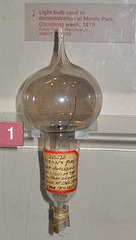
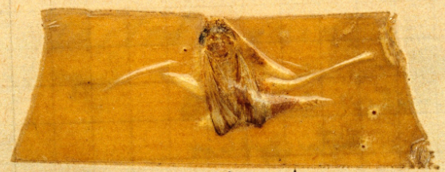






Introduction to Matlab workshop
November 2019
Structuring & debugging
Matlab code
Danny Mitchell
(originally adapted from Rhodri Cusack)
Please download and unzip today’s examples from: http:/imaging.mrc-cbu.cam.ac.uk/methods/MatlabLecturesSchedule and open them in the Matlab editor
Notes:
Possible overlap with previous lectures? No bad thing
Informal – encourage interruptions and questions at any point
Registration/feedback forms

Slide 2
Outline - goals
Writing code that works (debugging)
Writing clear code
Writing fast code
Writing code fast
In the following, red outlines highlight things that could be improved.
(Although this can be subjective!)
X
Notes:
What I plan to cover, but also goals when programming.
Approximate order of importance

Slide 3
Why write clear code?
Easier…
  to follow while writing and debugging
    less likely to make mistakes
    bugs are easier to spot
  to understand when you come back to it later
  to modify
  for others to understand and modify
    Easier for them to help you
    Less likely they will need your help
Notes:
E.g. Consider…
Writing methods section of paper/thesis
Changing variable for new experiment
Offering useful code to someone else
Asking someone for help
Altruistic but also selfish when sharing code

Slide 4
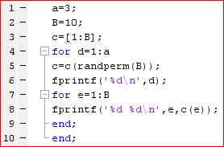
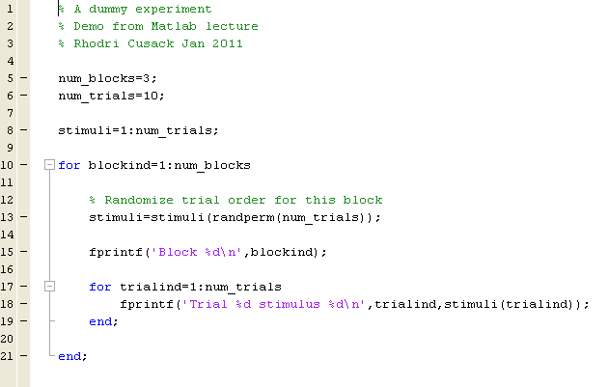
Making code more readable (example A)
X
Structure your code
  Leave spaces
  Indent (Ctrl-I)
Use meaningful variable names
Add comments
Be consistent
    myVariable
    MyVariable
    myvariable
    my_variable
    MYVARIABLE
Modularise (use sub functions)
Cells to demarcate regions (%%)
Ellipsis to continue line (…)
Print helpful comments to the command line
What is this script for?
Try running it
How might it be improved?
Notes:
See example A (& B)
What is it for?
Any idea after running it?
What can be improved?

Slide 5
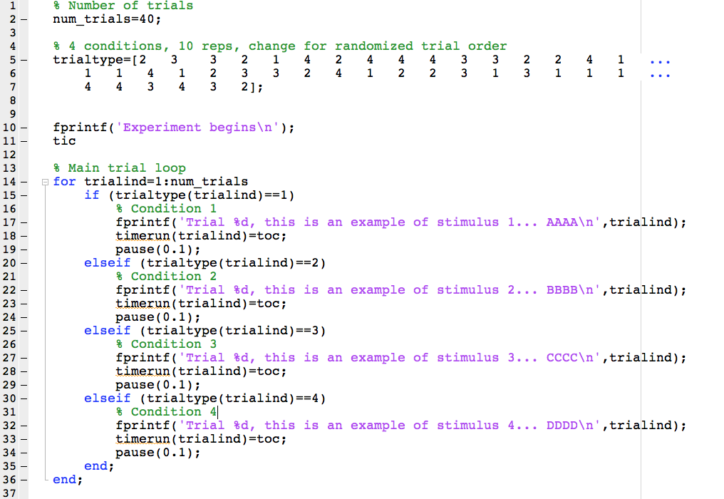
Making code more readable (example C):
Write this more clearly…
Repeated (especially non-independent) information
is hard to change, and allows odd inconsistencies
X
Long manually entered lists are easy to
get wrong, hard to check, and hard to change
Repeats of similar code are tedious to write, read and maintain.
Easy way to introduce bugs!
Notes:
See example C (& D).
Some lessons learnt – what aspects are good?
How to improve further?
E.g. might add more conditions to vector, but forget to change # trials
E.g. might want to change stim 4 to stim 5, or change ‘random’ order
Do we even know there are equal numbers of each trial type? Typos easy to make!
In loop, does code block match if clause? If change 1, need to remember to change all in same way

Slide 6
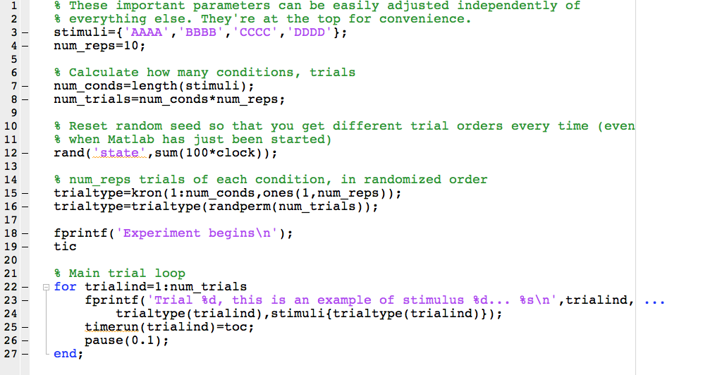
Making code more readable (example D): Maybe you did better?
Occasionally syntax changes between versions:
rng(‘shuffle’);
There are often many ways to skin a cat:
trialtype=repmat(1:num_conds,[1 num_reps]);
Notes:
Or might prefer to have a fixed random order with e.g. fixed seed, or subject number as seed.
Try starting Matlab and typing Rand. Likely get 0.8147

Slide 7
Structuring code into functions
As scripts become larger, they can become cumbersome
  Hard to find one section (though “code-folding” might help)
  Hard to run just one part (although “cell execution” might help)
  Hard to reuse one part – need to find it, remember what variables it needs, what variables are in the workspace, etc.
Functions are usually better:
  Encapsulate job, with well defined input and output interface
  Flexible, e.g. rerun same code on different inputs
  No need to worry about what might or might not be in the workspace
  Easier for Mlint to spot more potential problems
  Usually faster
Another good chance to make things clear and tidy:
  Choose descriptive function names
  Structure them into directories
    make sure they are on the path; check correct version is being used with:
    which <functionname> -all
  Document each function: What does it do? What are input and output variables? Who wrote it and when? Was it based on previous code? Keywords for lookfor in first comment line

Slide 8
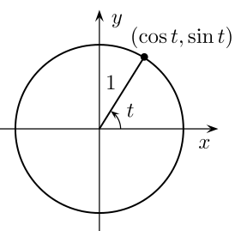
Tiny examples (Example E)
Circumference of unit circle is
C = 2 π r
= 6.28…
Will the example script always give the right answer?
The second part of the script prints a statement.
Is it correct? What if it’s run for a 2nd time? 3rd time...
Notes:
See small examples in E (& F).
(Problem with first example depends on what is in the workspace. Problem with second example only happened on later runs – depends unpredictably on command history. Both problems are solved by using functions, but could also be solved other ways e.g. explicit variable definition. Is there a better example?)

Slide 9
Keeping the workspace tidy, and optimizing memory
Good:
  Initialise variables prior to use (largest first)
  Use the appropriate data type (Consider sparse variables)
  Group related variables into structures?
    (good for organisation; not for memory use; example below)
  Prefer functions over scripts
Less good:
  Clear unwanted variables (but be careful!)
  Pack (command-line only)
Last resorts?
  Launch without Java Virtual Machine? (matlab.exe –nojvm)
  Save to file (slow).
    If loading/saving via .mat file, use structure, and specify required variables.
    E.g. load handel
    versus wav=load('handel‘); or wav=load('handel‘,’y’);
Notes:
Preinitialising variables has 3 benefits:
avoiding potential bugs (see last example)
less likely to run out of memory
faster to run (see later example)
What has been loaded by ‘load handel’? Hard to tell unless loaded to explicit variable.
Saving and loading whole workspace can be very slow and lead to huge file sizes. So, important to specify only required variables.

Slide 10


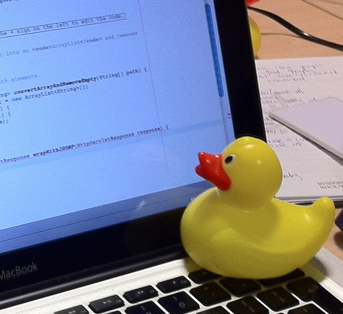
Debugging
It is rare for anyone to write a piece of code that works first time
When you identify a problem:
  Don’t Panic!*… (it’s normal)
  Read the error message! (and the function help)
  Stare at the code for a little while to try to work out what is wrong
  If this doesn’t work, test the code in different ways to narrow down the problem. USE THE DEBUGGER. At each step, does anything look odd?
    value of variables in workspace
    data type of variables
    shape and size of matrices
    functions on path
    Plot data (See upcoming talk)
  A programmer’s secret…
  Phone a friend
Anticipate bugs
  Expect that you will make mistakes
  Look for them & try to make them easy to spot (e.g. assert())
  Better for code to break, than to look like it worked when it didn’t!
Google www.mathworks.co.uk/matlabcentral/fileexchange/
* Arthur C. Clarke said Douglas Adams' use of "Don't panic” was perhaps the best advice that could be given to humanity.
Notes:
The “ping” is your friend!
Better for script to break, than to look like it worked but give the wrong answer.
Be sceptical of your code. Even if it doesn’t crash, test it as many ways as you can think of.

Slide 11
Integrated development environments (IDEs)
Integrated design/debugging environments
Typically consist of:
  Source code editor
  Compiler/interpreter
  Debugger
Makes coding much easier
  The cycle of “tweak code - rerun – examine output” is a major factor in how long a program takes to write.
  “Debuggers” let you run code line-by-line and examine what is happening
  “M-Lint” will…
    spot errors,
    potential errors,
    opportunities for optimization,
    suggests improvements and fix things automatically!
    Calculate McCabe complexity metric :
      checkcode filename.m –cyc (…aim for < 10)
    Shut up if you tell it to: %#ok, or set in preferences
  useful to fix own code, or to work out what another program (e.g. SPM) does.
Notes:
Try
checkcode C_writing_clear_code_2_toimprove –cyc
checkcode D_writing_clear_code_2_better –cyc
checkcode K_vectorization_exercise_loopy –cyc
checkcode L_vectorization_exercise_better –cyc

Slide 12
K>> Using the debugger
Breakpoints
  Adding breakpoints manually
  Triggering debug mode on an error (dbstop if error)
  conditional breakpoints (dbstop in MFILE at LINENO if EXPRESSION)
Moving in the stack (dbstack)
  dbup, dbdown
Progressing through the code…
  dbcont (F5)
  dbstep (F10)
  dbstep in (F11)
  dbstep out (shift+F11)
  dbquit (shift+F5)
Catching an error without the debugger
  try……
  %… to run some code that you think might fail…
  catch anError……
  %… in which case jump to here.
  end
  %… otherwise, continue from here…
Be careful!
Record the exception

Slide 13
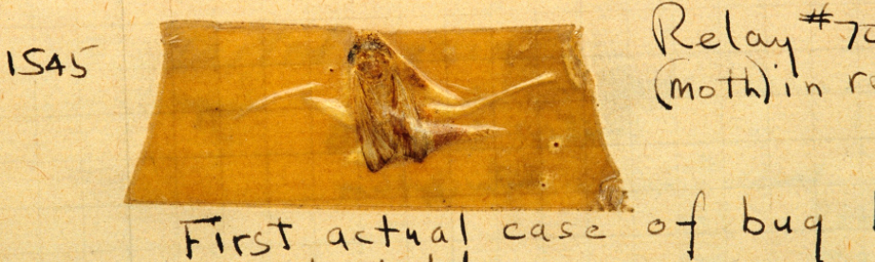
K>> Practice using the debugger
Example G. Try to get it to run to the end!
Some tips:
  Read the error message!
  Are brackets of the right type and do they match up?
  Are matrices of the right dimension? Should they be transposed?
  Have variables been misspelled, or deleted when still needed?
  Do functions have the correct inputs and outputs?...
  …use help <functionnname> if unsure what a function does
  Are multiplication/divisions matrix-wise or element-wise?
  etc…
Notes:
See example G (& H)
Possible first written use of “bug” by Thomas Edison (1878): “It has been just so in all of my inventions. The first step is an intuition, and comes with a burst, then difficulties arise—this thing gives out and [it is] then that "Bugs"—as such little faults and difficulties are called—show themselves and months of intense watching, study and labor are requisite.”
So, two lessons: (1) bugs are almost inevitable, so don’t worry too much about making them in the first place. (2) but they are important, so do worry about spotting and correcting them.
(Picture of first actual “bug” from 1947, Harvard Computation Lab)

Slide 14

Writing fast code: Vectorization & Pre-allocation (example I)
Matlab has been designed for maths
For some things (e.g., matrix maths) it is very fast:
Some things, e.g. loops, can be slow:
BUT…
  Sometimes loops are necessary, or more intuitive.
  If you are going to use a slow loop, try to:
    pre-allocate variables,
    indicate progress (e.g. fprintf; drawnow, perhaps every n^{th} iteration)
    Put slowest steps (e.g. file access) outside loop if possible
Surprising: matrix orientation can also make a small difference! (generally better to operate down columns)
1700 times slower!
Some of this can be recovered by pre-allocation – see demo
Notes:
See example I.
Running example outside of debugger would give more accurate timing, but using debugger is fine to illustrate the point. In this example, with Matlab 2018 on linux box, preallocation makes it ~10x faster, and vectorising the loop makes it ~10x faster again.

Slide 15
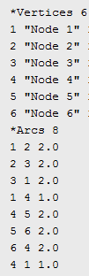
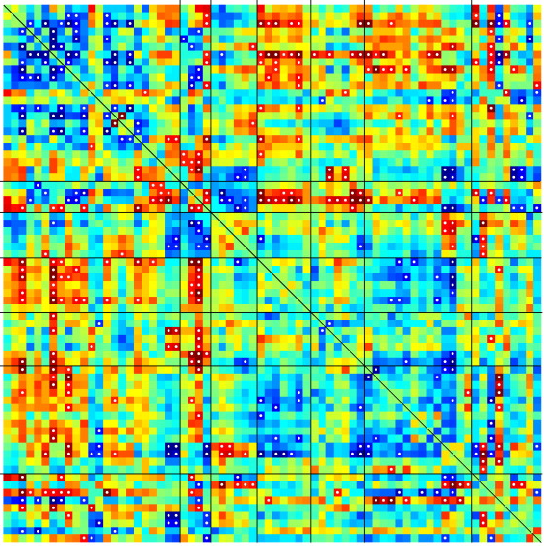
Vectorization: a real life case (Example J)
Write out a connectivity matrix to ‘Pajek’ format:
~11,000 nodes
~140,000,000 connections
If matrix is symmetrical, only need to save half of it
Looping through each cell to add each line to output file takes hours; preparing output variable then writing to file in one go takes seconds
Notes:
See example J.

Slide 16
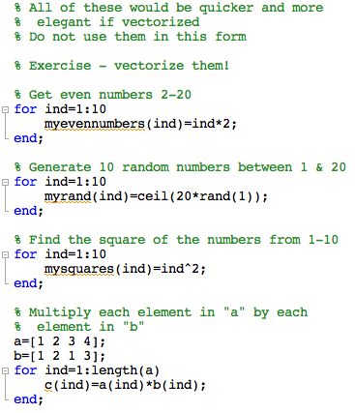
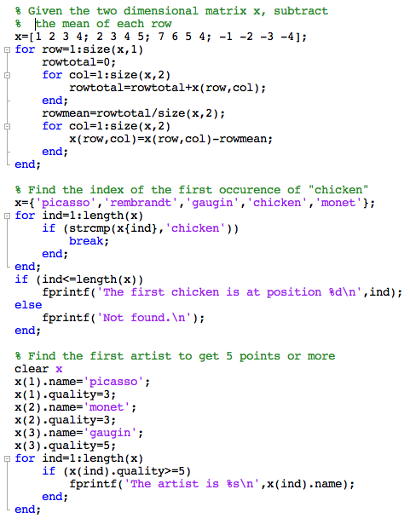
Vectorization exercises (Example K)
Notes:
See example K (& L)

Slide 17
Applying functions to multiple elements
arrayfun
cellfun
structfun
slower than vector maths, and often slower than loops but concise and often useful for cells & structures
bsxfun

Slide 18
Writing code fast
Optimization can become addictive – know when to stop!
Matlab Profiler will tell you which parts of your code take the most time (don’t need to optimise everything, just bottlenecks)
A rare case… run-once jobs (less need to optimise?)
  A. Spend 1 hour writing the code, and 10 hours running it
  B. Spend 10 hours writing the code, and 1 hour running it
Functions can be reused
Debug efficiently
Practise!
Notes:
Rare case example: run-once job… Would you prefer A or B, or are they equal?
What if job needs to be repeated for 10 participants? Or 100 datasets? Benefit to optimisation increases with times reused.

Slide 19
Topics that would need their own lecture:
Parallelization – is it worth it?
Various methods with pros & cons:
Submitting directly to CBU cluster using qsub
parfor, spmd
GPU
Initial overhead; limitations on syntax & memory
Complex if dependencies
Challenges of debugging
Version control – not specific to Matlab
Prime example is Git
A “repository” of the code keeps track of all changes
  Any previous version may be accessed
Can synchronise local copy with someone else’s
Particularly useful for large projects with many files, or collaborations
If not using version control:
  consider naming files with date, not e.g. FinalAnaysis_newer_version2b.m”
  highlight changes with comments
Notes:
Parfor and spmd are difficult to use, with many constraints on code and variable indexing etc.
Especially complex if jobs are not fully independent.
Overhead cost to initialising cluster of workers, and passing data between them.
Benefit will also depend on number of workers available etc.
GPU allows very many computations, but more limited in memory size.

Slide 20
Using objects to structure code in Matlab
Object-oriented programming is a way of programming first invented by the Xerox PARC & popularised by C++ & Java
  Combine the specification for storing data about something (“properties”) and the functions that can manipulate this data (“methods”)
  A description of a type of object is called a “class”
  A single object is called an “instance”
  Classes are hierarchical, so one class may derived from another, inheriting all of the properties & methods, and then adding new ones
Matlab has a way of implementing this – look out for directories called @something
  These are class descriptions
  (e.g., @nifti & @meeg in SPM; @mardo in MarsBar)
Essentially, another way of organizing things

Slide 21
Documentation
Some of the tips in this presentation should help you make code that is more “self documenting” (e.g. meaningful variable names)
However, explicit documentation is important
  Document each script or function at the top, saying what it does and what inputs and outputs it has, and give an example of usage.
  Say what changes you make subsequently
  Add documentation to wikis, websites and so on
  The chances are, it will be you that needs it most!
When making changes, better to save versions with the date in the filename, rather than “_new.m”, “_newer.m”, “_final.m”, “_final_final.m”, “final_final2b.m”…
For more complex or collaborative projects, consider version control software, e.g. SVN, or Git/GitHub.

Slide 22
Practice makes better.
Ever tried? Ever failed? No matter.
Try again. Fail again. Fail better.
Samuel Beckett, 1983
Good luck!
Notes:
Two general lessons: (1) bugs are almost inevitable, so don’t worry to much about making them in the first place. (2) but they are important, so do worry about spotting and correcting them.

