Slide 1
COGNESTIC workshop
Ajay Halai
Ajay.Halai@mrc-cbu.cam.ac.uk

Slide 2
Overview
Summary of brain stimulation
Building an experiment
Electric field modelling (TMS, TCS)
simNIBS tutorial
Acoustic field modelling (tFUS)
Questions
3.30-4.30 TMS live practical demo

Slide 3
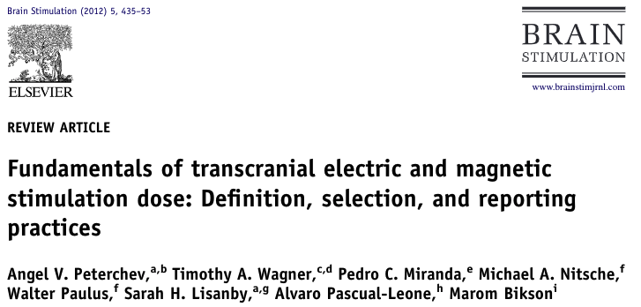
Summary of brain stimulation

Slide 4
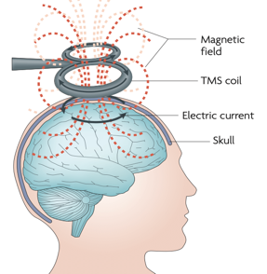
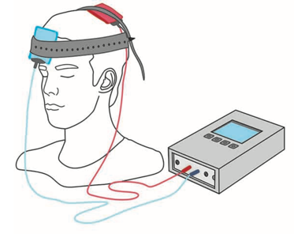
Summary of brain stimulation
Non-invasive brain stimulation (NIBS) methods
“Virtual lesion” approach
Transcranial Magnetic Stimulation
Transcranial Electrical Stimulation
Transcranial Focused Ultrasound Stimulation
TMS
Notes:
Different forms of NIBS, designed to modulate neural activity. Note, each have act upon different mechanisms as the cellular mechanisms level. For example, the amplitude and speed of at TMS pulse is far larger than TEs and therefore TMS is typically used to initiate action potentials while TEs modulates the thresholds at which axons fire. tFUS is largely mechanical in nature as it is acoustic energy being delivered. We are still far for a a full explaination of a mechanistic account of how these tools modulate the brain and its different properties at the micro and macro level.

Slide 5
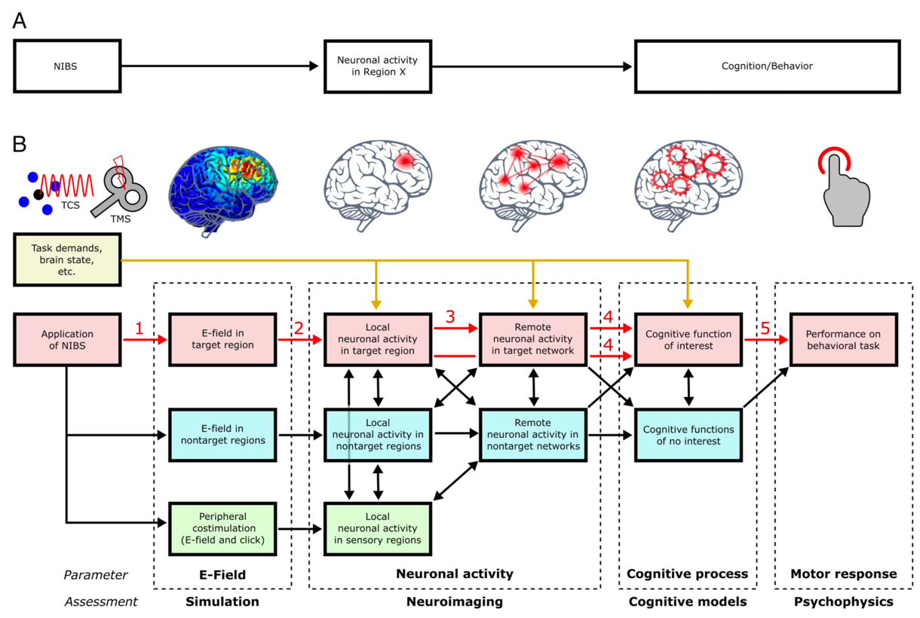
Summary of brain stimulation
Non-invasive brain stimulation (NIBS) methods
Causality (Ole Bergmann & Hartwigsen, 2020)
Notes:
The red chain is the core chain of causation. The yellow route indicate that task demands and brain states can drive changes at multiple levels. Blue and and green are potential confounds but may influence final outcome.
NIBS – creates E-field which interacts with neurons (evoke firing or change membrane threshold for firing). Possible plasticity in offline case. Activity drives changes to inter-cortical network. This combination of changes at the network level can facilitate or disrupt functions. Resulting in changes in behavior (reduced accuracy or RT).

Slide 6
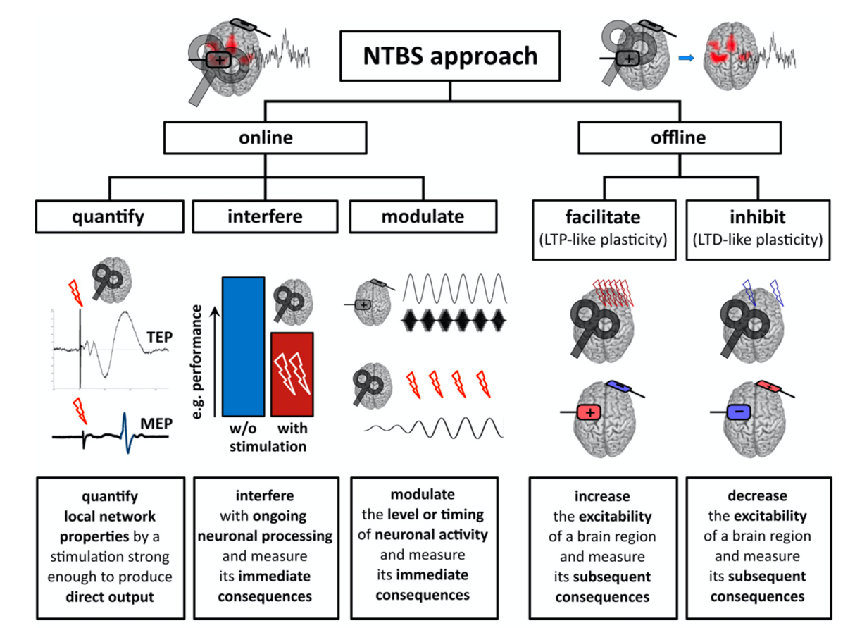
Summary of brain stimulation
Non-invasive brain stimulation (NIBS) methods
Approaches (Ole Bergmann et al., 2016)
Notes:
There are difference approaches to NIBS.
Traditionally, many studies used the offline approach that was thought to lead to long-term potentiation or depression, to facilitate or inhibit a particular brain region. Task behavior or imaging are read out as a measure of induced plasticity.
The online approaches measure immediate impact, depending on the protocol set up, one can quantify with a large stimulation input, interfere with task or spontaneous activity or modulate the level or timing of task or spontaneous activity.

Slide 7
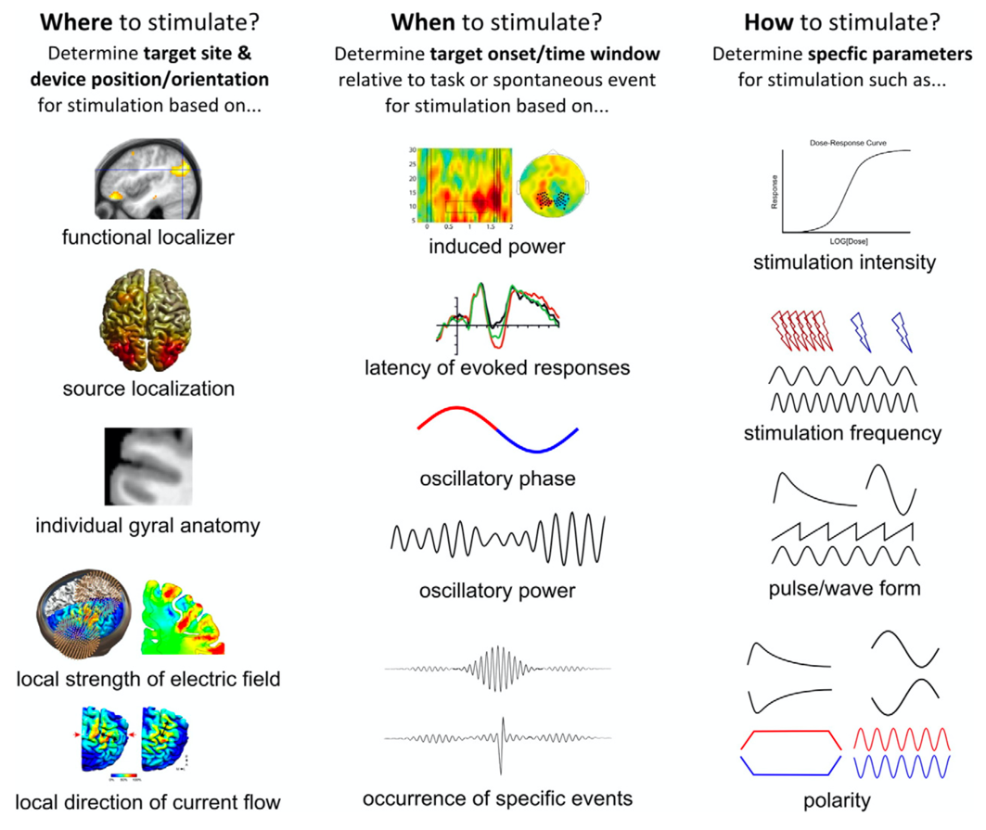
Building an experiment
Ole Bergmann et al., 2016

Slide 8
Summary of brain stimulation
Fundamentals of brain stimulation
https://doi.org/10.1016/j.brs.2011.10.001
Tutorials and videos
Youtube channel: Brain Stimulation Science
SIMNIBS tutorial https://www.youtube.com/watch?v=CzX7wDXeo6A&list=PLDCjI20ZMvu0YSaxrjQgM3ClObtzuZV99&index=9
Papers
Head modelling
https://onlinelibrary.wiley.com/doi/epdf/10.1002/hbm.21479
Importance of good segmentation
https://www.sciencedirect.com/science/article/pii/S1053811918301800?via%3Dihub
Causality
https://doi.org/10.1162/jocn_a_01591

Slide 9
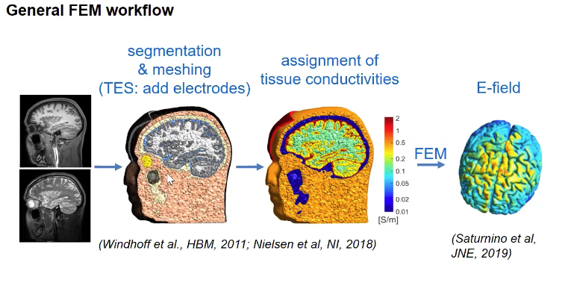
Electric field modelling (TMS, TCS)
Install simNIBs
https://simnibs.github.io/simnibs/build/html/installation/simnibs_installer.html
Notes:
Location of simNIBs install has lots of example code

Slide 10
Electric field modelling (TMS, TCS)
Structural MRI (T1, T2, DWI [optional])
“headreco all ernie T1.nii.gz T2.nii.gz”

Slide 11
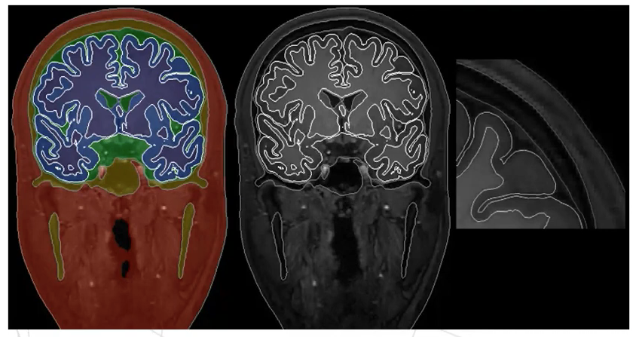
Electric field modelling (TMS, TCS)
Structural MRI (T1, T2, DWI [optional])
“headreco check ernie”

Slide 12
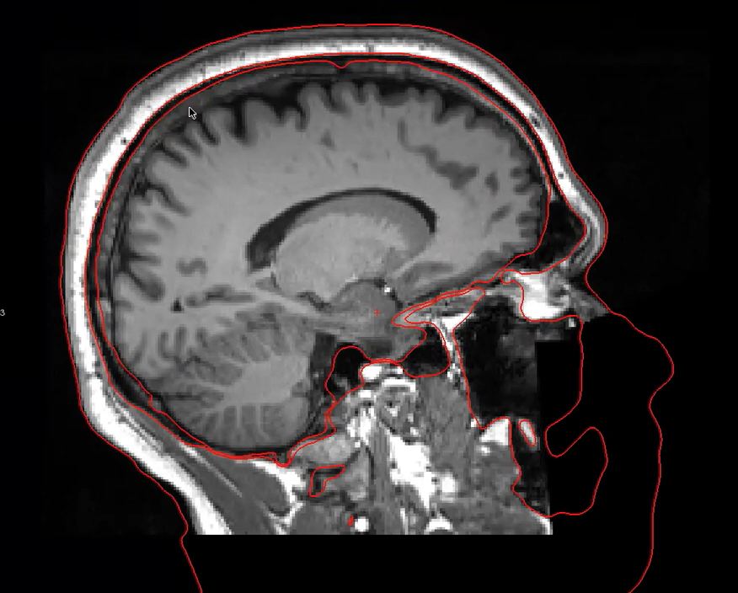
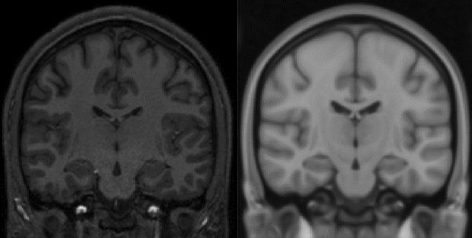
Electric field modelling (TMS, TCS)
Structural MRI (T1, T2, DWI [optional])
Segmentation errors Check MNI registration

Slide 13
Electric field modelling (TMS, TCS)
Structural MRI (T1, T2, DWI [optional])
“dwi2cond -all ernie DWI.nii.gz DWI.bvals DWI.bvecs”
dwi2cond -all ernie DWI.nii.gz DWI.bvals DWI.bvecs DWI_reverseb0.nii.gz
dwi2cond -all ernie DWI.nii.gz DWI.bvals DWI.bvecs fieldmap_mag.nii.gz fieldmap_phase.nii.gz
dwi2cond -T1reg ernie DTI_tensor.nii.gz
Lots of optional flags for dwi2cond –help
Opitz et al., 2011

Slide 14
Electric field modelling (TMS, TCS)
Structural MRI (T1, T2, DWI [optional])

Slide 15
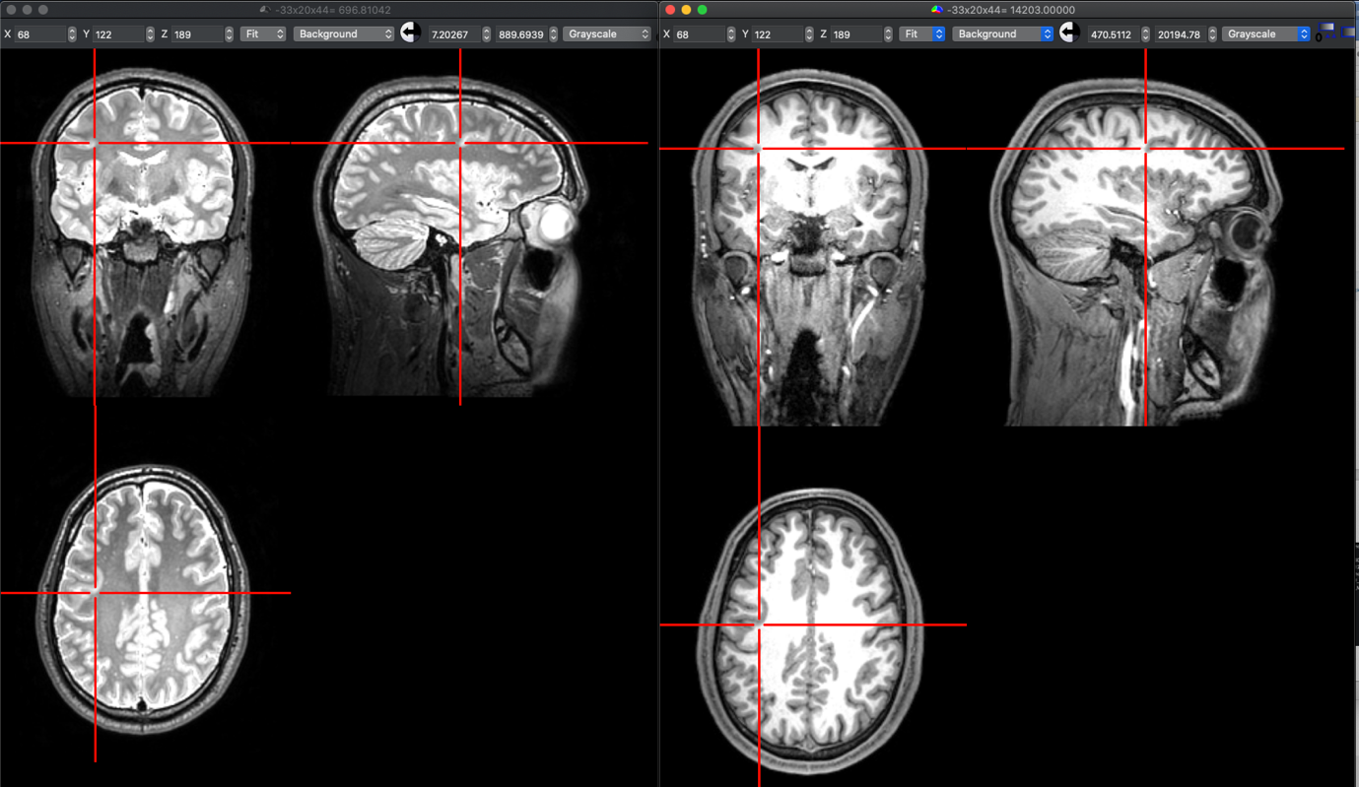
Electric field modelling (TMS, TCS)
Structural MRI (T1, T2, DWI [optional])

Slide 16
Electric field modelling (TMS, TCS)
Demo examples
headreco example (run and check)
dwi2cond example
GUI (show GUI interface and example)

Slide 17
Acoustic field modelling (tFUS)
What can simulations do
How to build a simulation for tFUS
k-Wave MATLAB example
Detailed video presentation (https://istu.org/january-21-2021-webinar/; Prof Bradley Treeby)

Slide 18
Acoustic field modelling (tFUS)
What can simulations do
Determine safety (temperature rise)
Optimising protocols (position, skull distortions, power)
Subject specific selection
Designing equipment (frequency, geometry)
Investigate adverse effects

Slide 19
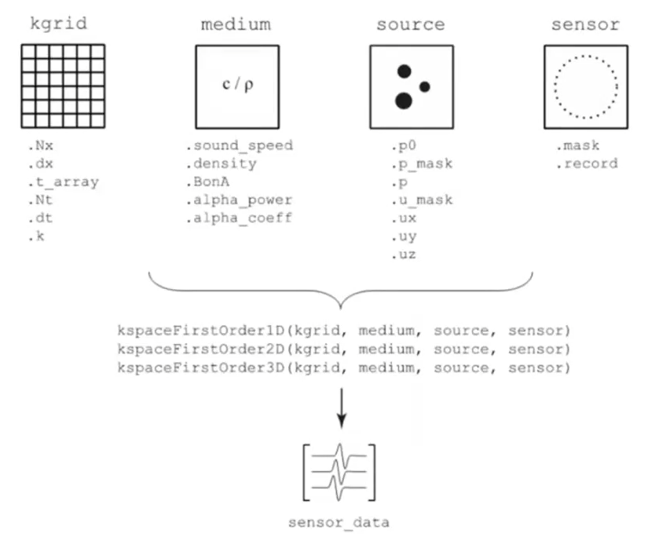
Acoustic field modelling (tFUS)
How to build a simulation for tFUS
Define space/gird parameters
Resolution, points in space
Define the head (medium) parameters
Skull geometry and acoustic properties
Define transducer parameters
Geometry, driving parameters, position
Define numerical parameters
Grid resolution, boundary parameters
Run through a simulation
E.g., k-Wave, m-sound, stride, babelviscoFTD

Slide 20
Acoustic field modelling (tFUS)
How to build a simulation for tFUS
k-Wave summary
http://www.k-wave.org/documentation/k-wave_examples.php

Slide 21
Questions

Slide 22
Thank you
MRC Cognition and Brain Sciences Unit
@MRCCBU
@Ajay_Halai
Ajay.Halai@mrc-cbu.cam.ac.uk

