Slide 1
A “Perturb and Measure” approach to cognitive neuroscience
Ajay Halai

Slide 2
Overview
Perturb
Measure
Combining perturb and measure approaches
Novel developments
  Targeting designed for each individual and trial
  Relationship to neurotransmitters
  Closed-loop brain stimulation
  Functional anatomical networks

Slide 3
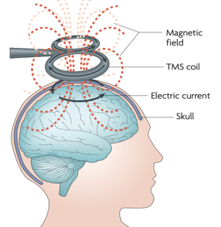
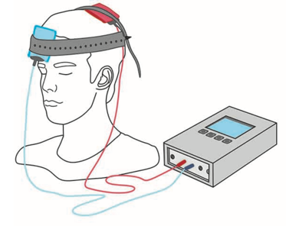
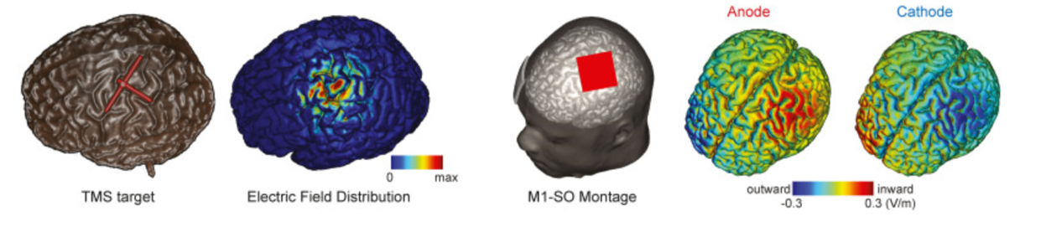
Perturbing the brain
Non-invasive brain stimulation (NIBS) methods
  “Virtual lesion” approach
Transcranial Magnetic Stimulation
Transcranial Electrical Stimulation
Transcranial Focused Ultrasound Stimulation
TMS
Notes:
Different forms of NIBS, designed to modulate neural activity. Note, each have act upon different mechanisms as the cellular mechanisms level. For example, the amplitude and speed of at TMS pulse is far larger than TEs and therefore TMS is typically used to initiate action potentials while TEs modulates the thresholds at which axons fire. tFUS is largely mechanical in nature as it is acoustic energy being delivered. We are still far for a a full explaination of a mechanistic account of how these tools modulate the brain and its different properties at the micro and macro level.

Slide 4
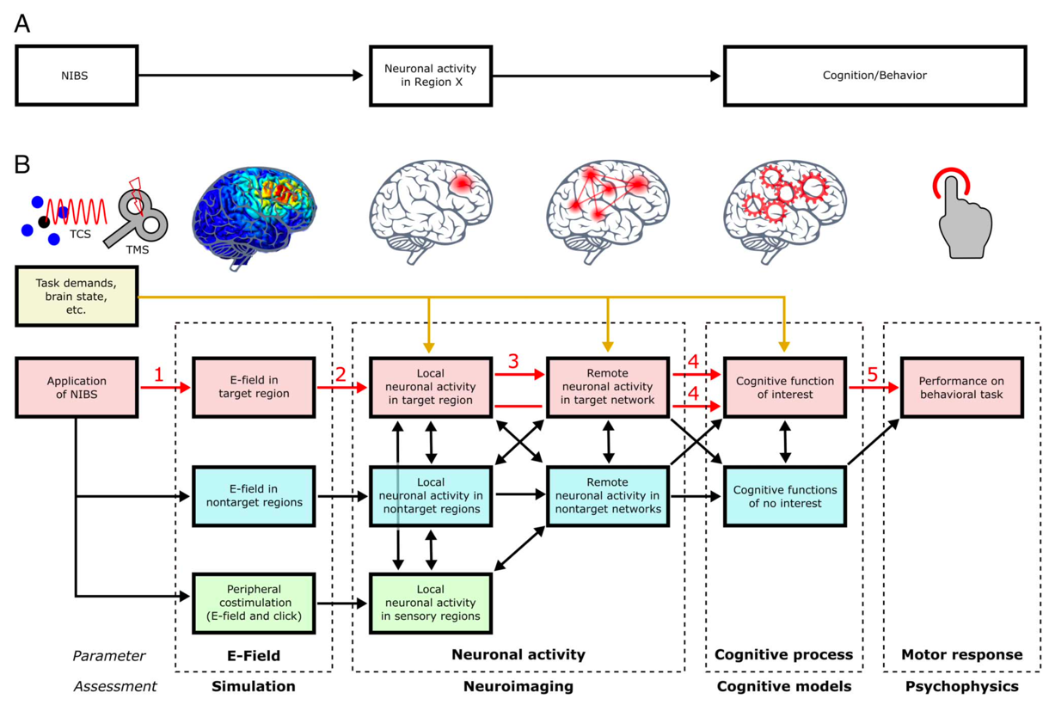
Perturbing the brain
Non-invasive brain stimulation (NIBS) methods
  Causality (Ole Bergmann & Hartwigsen, 2020)
Notes:
The red chain is the core chain of causation. The yellow route indicate that task demands and brain states can drive changes at multiple levels. Blue and and green are potential confounds but may influence final outcome.
NIBS – creates E-field which interacts with neurons (evoke firing or change membrane threshold for firing). Possible plasticity in offline case. Activity drives changes to inter-cortical network. This combination of changes at the network level can facilitate or disrupt functions. Resulting in changes in behavior (reduced accuracy or RT).

Slide 5
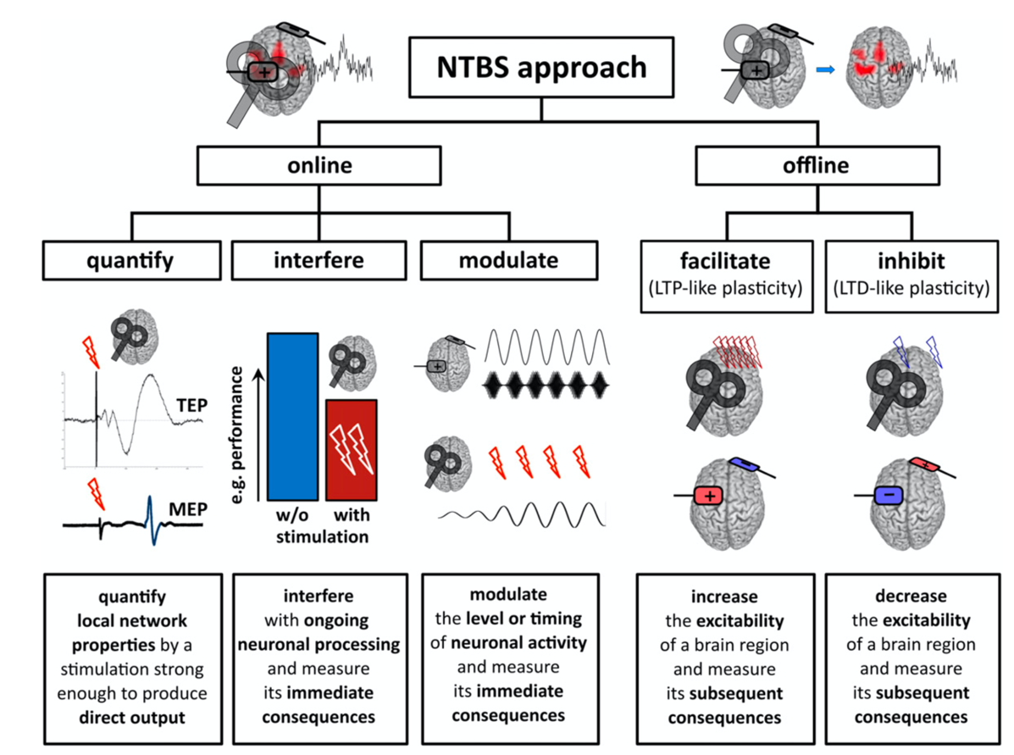
Perturb approaches
Non-invasive brain stimulation (NIBS) methods
  Approaches (Ole Bergmann et al., 2016)
Notes:
There are difference approaches to NIBS.
Traditionally, many studies used the offline approach that was thought to lead to long-term potentiation or depression, to facilitate or inhibit a particular brain region. Task behavior or imaging are read out as a measure of induced plasticity.
The online approaches measure immediate impact, depending on the protocol set up, one can quantify with a large stimulation input, interfere with task or spontaneous activity or modulate the level or timing of task or spontaneous activity.

Slide 6
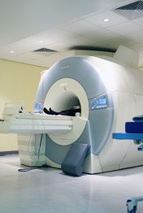
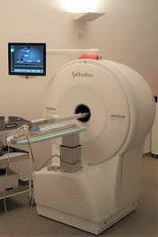
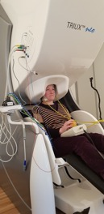
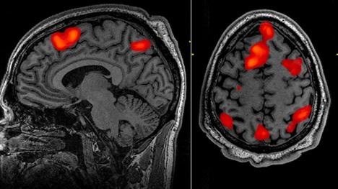
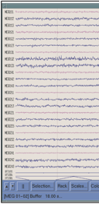
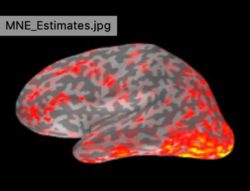
Measuring neural responses
Many neuroimaging tools available to researchers
fMRI
PET
MEG
EEG
EMG

Slide 7
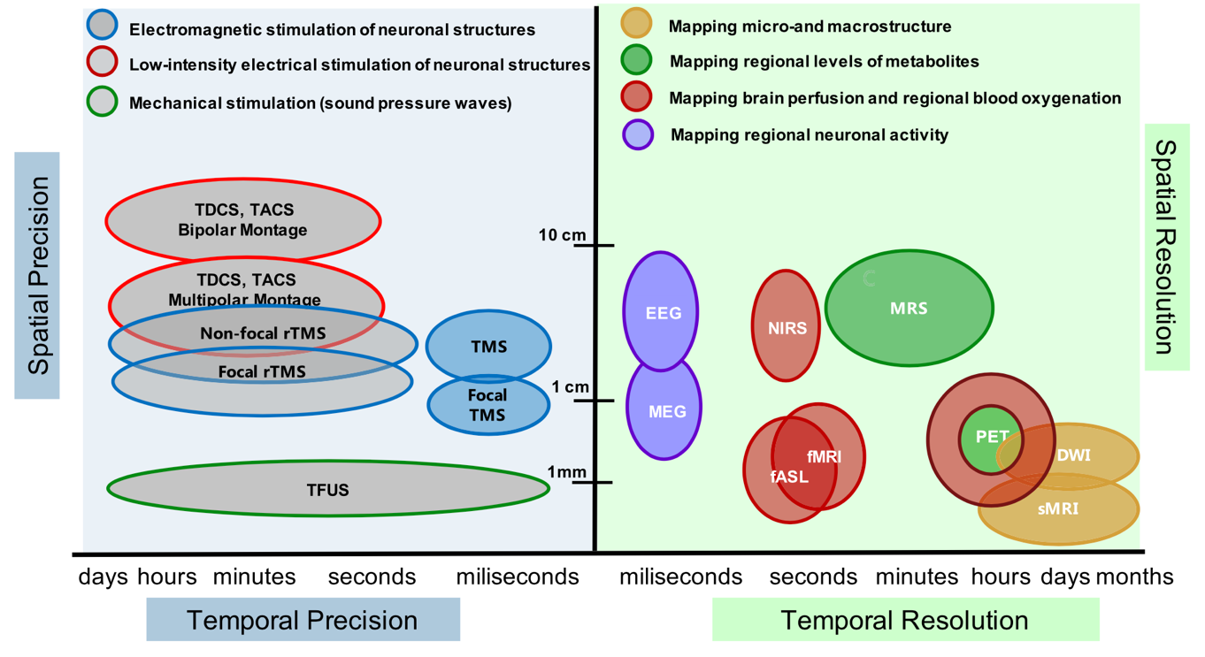
Spatial and temporal scales
Christainsen & Siebner, 2022

Slide 8
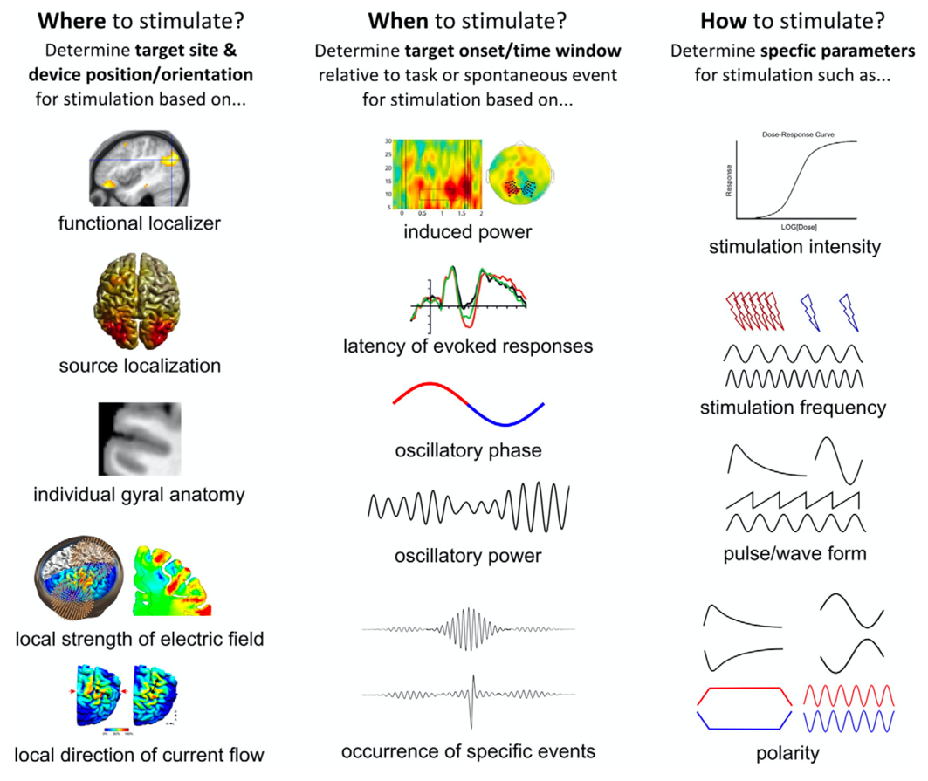
Combining perturb and measure methods
Ole Bergmann et al., 2016

Slide 9
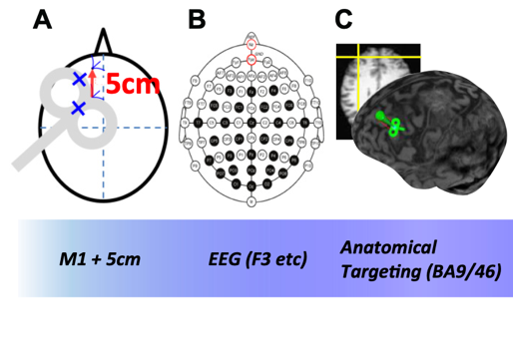
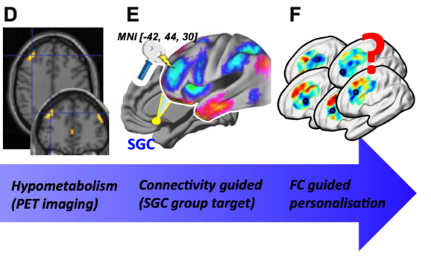
Novel developments
Minimise inter- and intra-subject variability
  Better individual targeting
    Spatial (sMRI and fMRI)
      Personalised functional connectivity (Cash et al., 2020)
    Temporal (EEG and MEG)
      Determine onset/latency of evoked potentials (Thut et al., 2003)
      Individualised alpha frequency (Haegens et al., 2014)
      Phase dependent stimulation (Hougaard Madsen et al., 2019)
    “Brain states” (Ole Bergmann, 2018)

Slide 10
Novel developments
*
Combining NBIS with MRS
  Jung et al., (2017; 2022)
    TMS effect for subjects with lower GLx/GABA ratio
    Regional ATL activity and connectivity lower for responders
    Baseline neurotransmitter levels might provide intra-subject marker for responsiveness to NIBS
Inhibitory
Facilitatory
r = 0.51, p < 0.01

Slide 11
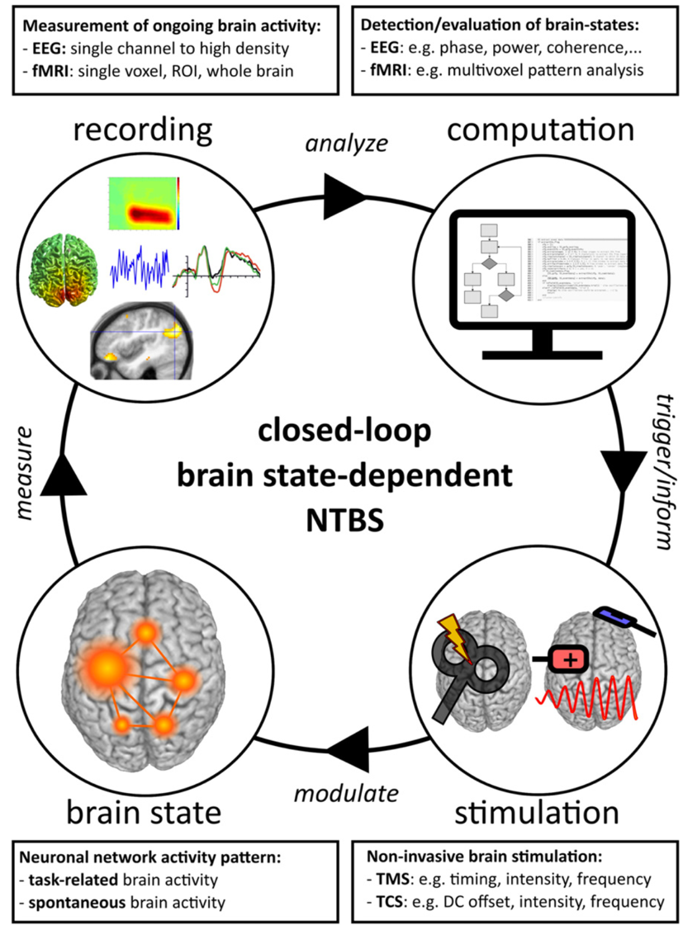
Novel developments
Open vs. Closed loop stimulation (Ole Bergmann et al., 2016)
  Adaptive
  Efficient
  Clinically applicable (Brittain et al., 2013)
    tACS in Parkinson’s at tremor frequency
  Technically challenging setup
  Computationally challenging

Slide 12
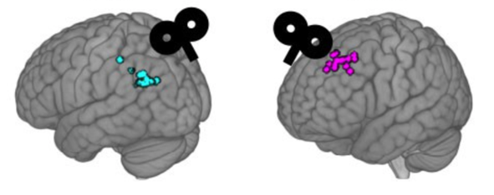
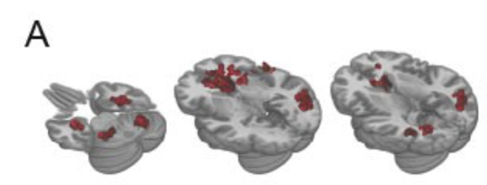
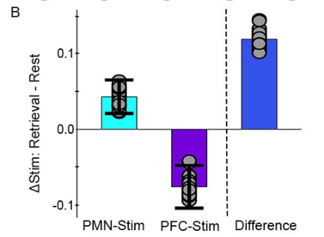
Novel developments
Functional anatomical networks (see Pitcher et al., 2021 review)
  Secondary effects of NBIS
    TMS to frontal eye field has top down effect visual cortex (Ruff et al., 2006)
  Higher functions are likely to distributed across the brain
    Multi-site stimulation
  Cortical and subcortical areas that can not reached by most NBIS tools
    Hippocampus modulation following posterior-medial network but not prefrontal cortex (Warren et al., 2019)
    Offline TMS to right pSTS found reduced fMRI responses in amygdala (Pitcher et al., 2017)

Slide 13
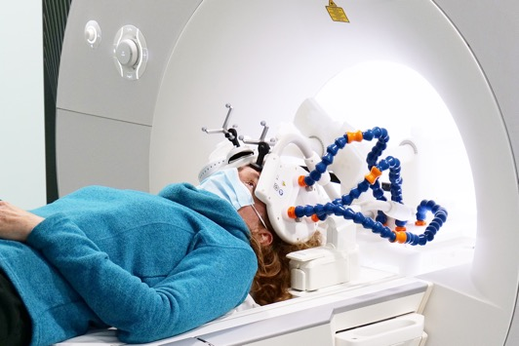
Facilities at CBU
BrainSight neuronavigation
Localite neuronavigation (fMRI)
TMS
  Offline
    DuoMag XT-100Hz stimulator
      Sham coil produces sound and muscle contraction
  Online
    Magpro XP MRI-B91 butterfly coils
      Two 7-channel receive-only surface coils
Transcranial focused ultrasound
  250kHz and 500kHz transducer
TEs systems available (see Matt Davis)

Slide 14

Thank you
MRC Cognition and Brain Sciences Unit
@MRCCBU
ajay.halai@mrc-cbu.cam.ac.uk

