Slide 1

An introduction to
Multi-Variate Pattern Analysis (MVPA) using
The Decoding Toolbox and
The RSA Toolbox
COGNESTIC, 2022
Daniel Mitchell
Daniel.Mitchell@mrc-cbu.cam.ac.uk

Slide 2
Plan for the day
9:05 – 9:45 | Introduction to MVPA Introduction to the Decoding Toolbox Simple classification demos on toy 2-voxel data
Break
10:00 – 10:45 | The many-voxel case – which features to use? Classification demos using searchlight, “whole-brain” and ROIs
Break
11:00 – 12:00 | Real brain data, and pre-processing Searchlight and ROI demos Statistics Comparing classifiers and other options
LUNCH
1:30 – 2:15 | Introduction to RSA Introduction to the RSA toolbox
Break
2:30 – 3:15 | RSA Toolbox Demos: RDMs, MDS, dendrograms, statistics
Break
3:30 – 4:30 | Time-resolved MVPA, with Olaf Hauk
5pm: Special talk by Duncan Astle - “Development Disorders & Data Science”

Slide 3
Directory structure for demos
In the top level folder, put:
The unzipped TDT folder
The unzipped RSA Toolbox folder
The unzipped folder “imageryexp” with extra example data
The “tutorial” & helper functions:
  tutorial_djm2.m
  fitplots2.m
  fdr_bh.m
  plotSVM_djm.m
AnyName/
  tdt_3.999E2/
    decoding_toolbox
      demos/
        djm/
        TDTdemo8data/
          Sub01_firstlevel
  rsa-master/
      Demos/
  imageryexp/
In the “demos” folder of The Decoding Toolbox, add:
A subfolder with the modified demos (“demos…_djm.m)
A subfolder called “TDTdemo8data” containing the example data downloaded from the TDT website
In the “demos” folder of The RSA Toolbox, add the modified demo files:
“DEMO#...djm.m”
Course materials linked from… https://imaging.mrc-cbu.cam.ac.uk/methods/COGNESTIC2022

Slide 4
Session 1 overview
Introduction to MVPA
  What is MVPA?
  Why do it?
  How does it work? (with simple 2-voxel examples)
The Decoding Toolbox
  What is it?
  Why you might want to use it (plus alternatives)
  How does it work?
    More simple 2-voxel classification demos with toy data
    Many-voxel demos, with different approaches to feature selection
    Searchlight and ROI demos with real brain data

Slide 5
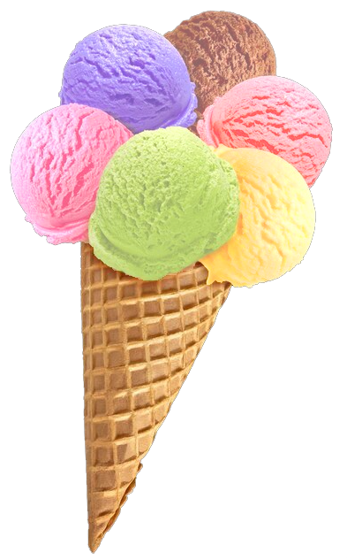
What is MVPA?
“Multi-Variate Pattern Analysis” (MVPA)
relates response patterns
to experimental conditions
Many (overlapping) flavours
Encoding vs decoding
(MVPA can be either)
Activation vs information?
MVB
IEM
cvMANOVA
PCM
RSA
Classification
MVPA
Notes:
For Multivariate Bayes, see e.g. Friston et al., 2008: https://pubmed.ncbi.nlm.nih.gov/17919928/
For Pattern Component Modelling see Diedrichsen et al. 2018: https://www.sciencedirect.com/science/article/pii/S1053811917306985 (this uses priors so is a hierarchical Bayesian model)
For cross-validated MANOVA see Allefeld & Haynes, 2014: https://pubmed.ncbi.nlm.nih.gov/24296330/ (I think this is equivalent to, or a specific case of, PCM)
For Inverted Encoding Models, see e.g. Sprague…Serences 2015: https://www.ncbi.nlm.nih.gov/pmc/articles/PMC4532299/

Slide 6
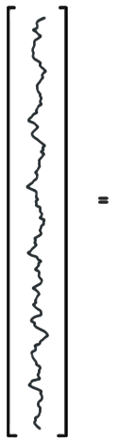
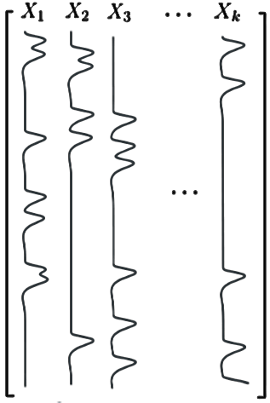
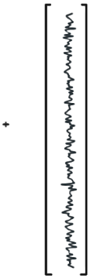






Per voxel (univariate) General Linear Model (GLM)…
…is an encoding model: can we predict the amount of activity in a voxel from the experimental conditions in X?
Activation
coefficients
Error
time
(t)
Data
(measured
BOLD signal)
Design
Matrix
In (multivariate) decoding we try to predict the experimental condition from the pattern of responses

Slide 7
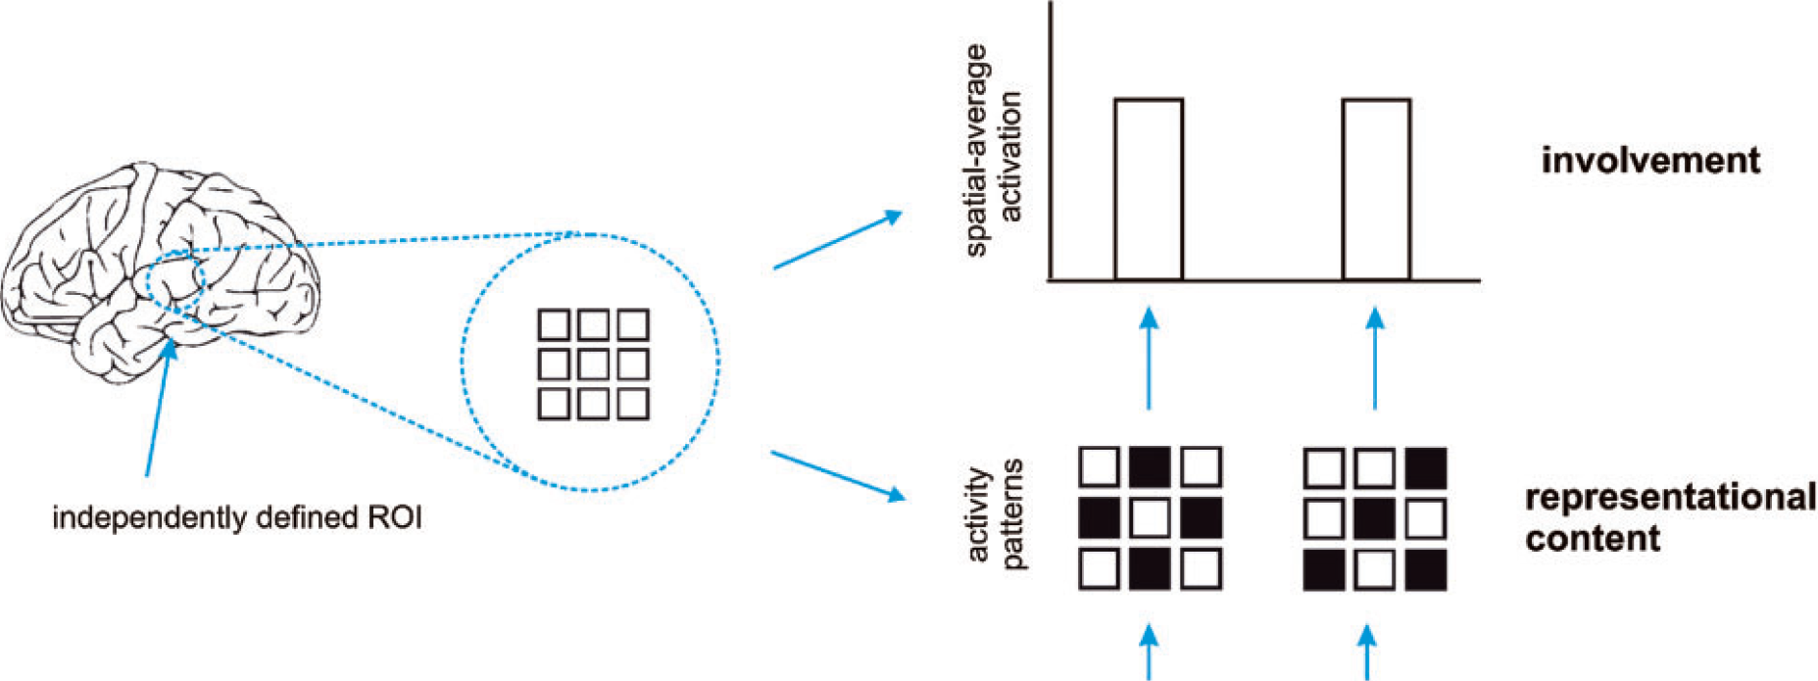
Activation-based (univariate) analysis
Pattern-information analysis
If we can classify experimental conditions based on activity patterns (better than chance)…
Then the activity pattern carries information about the experimental conditions.
Mur et al. (2009)

Slide 8
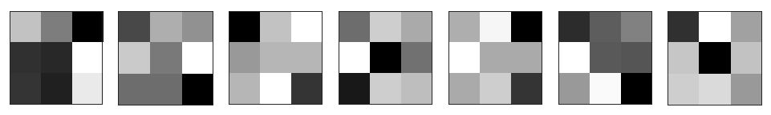
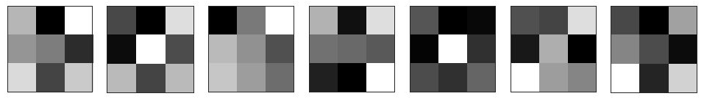
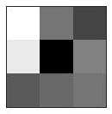
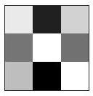
Sample
Label
Class
Patterns
Training set
variable,
feature,
dimension
(e.g. voxel)
?
Testing
set

Slide 9
Why do MVPA?
Popularity
Scientific questions
  What information does a brain region represent?
  (classification: are patterns reliably different?)
  In what format does it represent the information?
  (RSA: what are distance relations between patterns?)
To make predictions based on brain data
  Disease status? Covert thoughts?
Typically more sensitive than univariate analysis

Slide 10
How does MVPA work?
classification example
1
2
Weight
vector
Classification boundary
True labels:
?
?
Compare
Voxel 2 activation
?
?
?
Predictions:
Voxel N
Voxel 1 activation

Slide 11
Play with SVMs…
LIBSVM:
https://www.csie.ntu.edu.tw/~cjlin/libsvm/

Slide 12
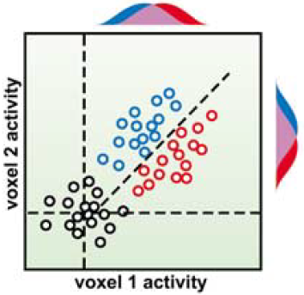
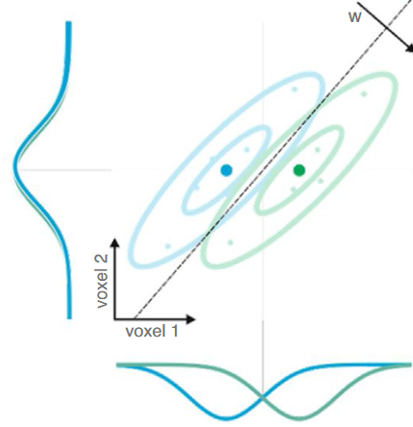
How does MVPA work?
Flexibly combines weak/noisy signal
across features
(including relative activation)
Suppresses correlated noise (interpreting weight vector is tricky: Haufe et al., 2014)
Abstracts from subjects’ idiosyncratic response patterns
(information versus activation)
Cox & Savoy (2003)
Kriegeskorte
& Douglas (2019)
SUBJECT A
SUBJECT B
Voxel 2
Voxel 2
Voxel 1
Voxel 1

Slide 13
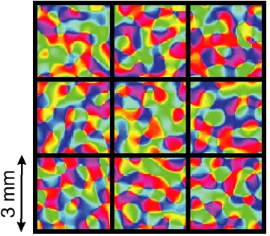
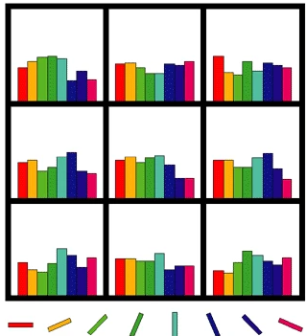
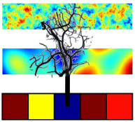
Physiology: fine or coarser scale patterns?
Original view: biased sampling of sub-voxel patterns
Later spatial filtering experiments
  Removing high spatial frequencies doesn’t always hurt
  (e.g. Op de Beeck, 2010)
  Therefore sampled patterns may be coarse
Multipronged sensors?
(We sample from veins , which sample from neurons)
Often unimportant
(we want to ask “is there information?”
not “what scale is the information?”),
but could have practical consequences
Kamitani & Tong (2005)
Haynes & Rees (2005)
Boynton (2005)
Kriegeskorte et al. (2009)

Slide 14

MVPA using
The Decoding Toolbox (TDT)

Slide 15
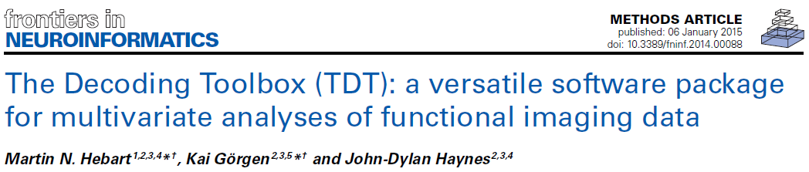
What is The Decoding Toolbox?
https://sites.google.com/site/tdtdecodingtoolbox/
Latest Version 3.999F (15/8/2022)
These demos will use 3.999E2 (05/7/2022)
Runs in Matlab
Minimal GUI, but good documentation and demos to familiarise you with the analyses
Template scripts provide a starting point for own analyses.

Slide 16


Some alternatives
PyMVPA (Python)
http://www.pymvpa.org/
PRoNTo (Matlab; SPM)
http://www.mlnl.cs.ucl.ac.uk/pronto/
CoSMo MVPA (Matlab; MRI and EMEG)
http://cosmomvpa.org/
Searchmight (just searchlights, but several fast options, esp. GNB)
http://www.franciscopereira.org/searchmight/
Princeton Decoding Toolbox (Matlab; development stopped?)
https://github.com/princetonuniversity/princeton-mvpa-toolbox
Brain Decoder Toolbox 2
https://github.com/KamitaniLab/BrainDecoderToolbox2
RSA toolbox (Matlab; now Python; focus on RSA rather than classification; see later)
Within larger packages (e.g. BrainVoyager; MNE - see later?)
3dSVM in AFNI? PROBID? MANIA? MVPANI? Others…?
Built-in functions in Matlab or other languages

Slide 17
Why use The Decoding Toolbox?
Benefits of The Decoding Toolbox:
  “Simplicity”
  Modularity, flexibility, extendibility
  Speed
  Error management
  Readability
  SPM interface (and AFNI)
  Active development
  Documentation and support
  (mailing list: https://neurostars.org/, tag “tdt”)

Slide 18
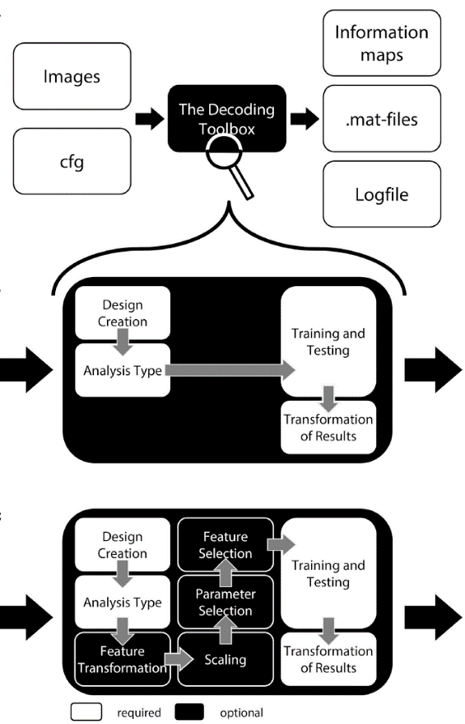
Simplicity, modularity, and flexibility:
Comprehensive reasonable defaults:
decoding_example(’searchlight’,…
’left’,’right’,beta_dir,output_dir)
Defaults can be changed
cfg = decoding_defaults();
regressors = design_from_spm (beta_dir);
cfg = decoding_describe_data(cfg,…
{’left’,’right’},[1 2],
regressors,beta_dir);
cfg.design = make_design_cv(cfg);
cfg.analysis = ’wholebrain’;
cfg.decoding.software = ’lda’;
cfg.results.output = {’dprime’};
results = decoding(cfg);
Optional steps can be added
(many are offered)
Extensions can be added
Hebart et al. (2015)

Slide 19
Currently available options
“Analysis type”
  “Searchlight”
  “ROI” (& “wholebrain”)
Feature transformation
  PCA (with dimension reduction)
Feature scaling
(only across samples per feature)
  Z-score
  Range [0 1]
  Cut-offs
Transformation & scaling “methods”
  “all”
  “across”
  “separate”
Parameter selection (grid search)
Various feature selection methods
“classifiers”
  LIBSVM (linear & non-linear SVMs)
  LIBLINEAR (SVM & Logistic regression; L1 & L2)
  Correlation nearest neighbour
  Linear discriminant
  (similarity)
  … and more…
Performance measures
  Accuracy
  Balanced accuracy
  D-prime
  AUC (area under ROC curve)
  Decision values
  …and more…

Slide 20
Some key components:
How does The Decoding Toolbox work?
cfg
  Structure containing all required information for decoding
cfg = decoding_defaults()
  Function to initialise default settings
Results = decoding(cfg)
  Function that does the work
  Lots of explanation about cfg settings at the top

Slide 21
2 voxel simulation demos
(demos_simpletoydata_234_djm.m)
Simple simulations:
2-class example
3-class example
Unbalanced example

Slide 22
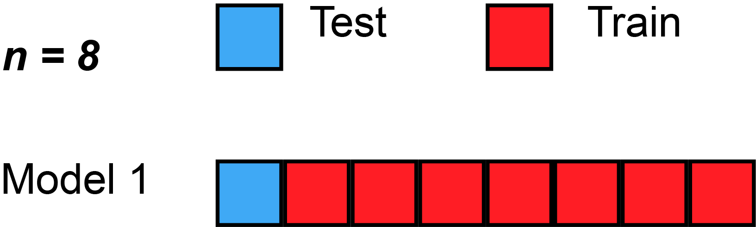
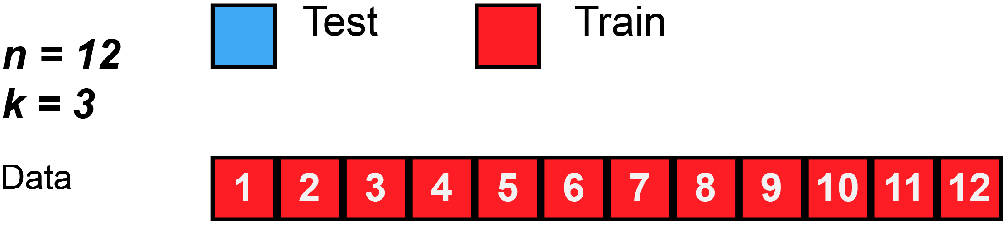
Data splitting
Holdout/validation set from single context
  Safe but often not efficient/stable
Separate datasets from different contexts (“cross-classification”, “cross-generalization”)
  used to test generalization & demonstrate common format
  (e.g. train on perception, test on imagery;
  train at time-point 1, test at time-point 2)
Cross-validation within full dataset
  Reuse data for both training and testing in different splits/folds
  Average performance across folds
  “split half”…
  …“k-fold”…
  … “leave-one-out”
  Training and testing data should be independent within a fold (“decoding step”), but will be dependent across folds
  Ideally want conditions balanced within each partition (“chunk”)
More ways to split… more precise performance estimate?
More training data per split… better classifier performance?
Gifs from Wikipedia

Slide 23
Cross-validation: generalise to….?
  new trial/stimulus pair (leave-stimulus-pair-out)
  new run (leave-run-out)
  new subject (leave-subject-out)
Common procedure: use each run/subject as test data once.
For example: 4 runs → repeat cross-validation 4 times (= 4-fold cross validation) → average accuracy across the 4 folds.
Fewer samples
Cleaner samples
More independence
More different distributions
“hyperalignment” (Haxby, 2011; 2020)

Slide 24
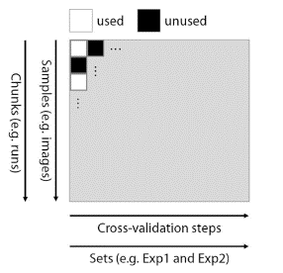
Specifying decoding ‘designs’
Response patterns
In
Rows
Test
Train
Classifiers
In
Columns
Hebart et al. (2015)

Slide 25
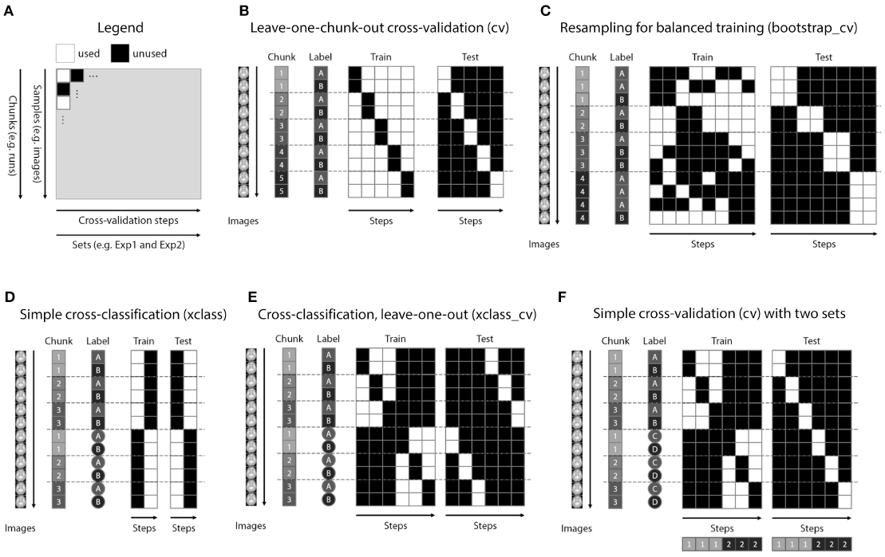
Specifying decoding ‘designs’
Hebart et al. (2015)

Slide 26
Back to 2-voxel demos…

Slide 27
With many features, we need to choose which to use
Voxel selection must be based on data independent from test data set
Choice of which features to use determines:
  inference that can be made;
  SNR/risk of overfitting
Most common ways of voxel selection:
  structural ROI (anatomy)
  functional ROI (activity)
    univariate (activation differences)
    multivariate (pattern differences)
  “Searchlight” (roving ROI)
  “whole brain” (global ROI)
Could do this at same time as training the model, but would need nested-crossvalidation (complicated, slow, and loss of training data may outweigh benefits)

Slide 28
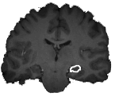
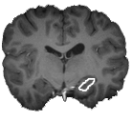
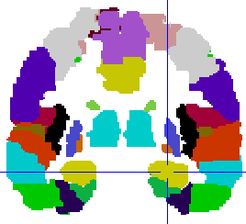
Selecting voxels: anatomical ROI
For example: hippocampus
subject 1
Per
subject
subject 2
.
.
.
subject n
Template
e.g. AAL, Brodmann areas, Anatomy Toolbox etc.

Slide 29



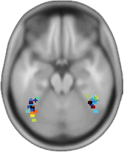
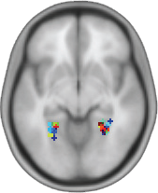
Selecting voxels: functional ROI (activation differences)
FFA
PPA
>
<
% signal change
% signal change
Again, per subject “functional localiser” (independent data)
Or, from group average (e.g. RFX cluster; published coordinates)

Slide 30
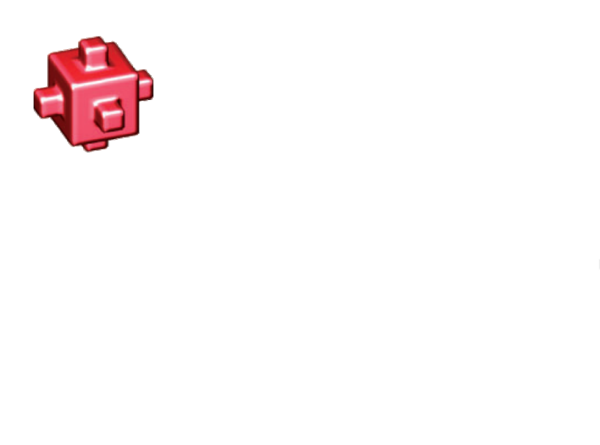
Selecting voxels: multivariate searchlight
Notes:
whole-brain searchlight (multivariate equivalent of conventional univariate mapping)

Slide 31
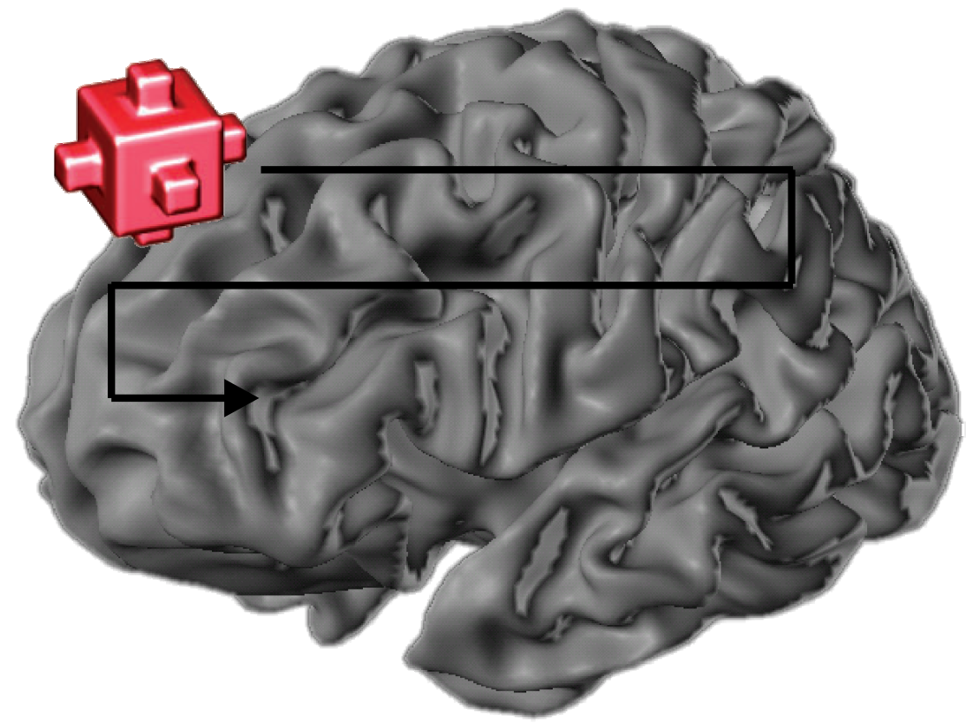
Step 3: select voxels multivariate searchlight
Kriegeskorte et al. 2006

Slide 32
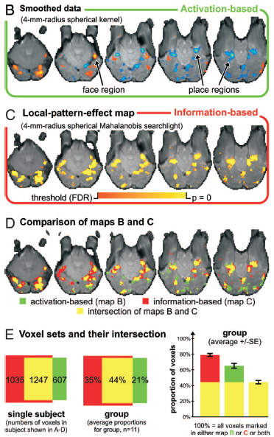
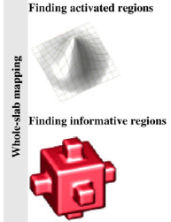
Example comparison of activation-based and information-based mapping
Kriegeskorte et al. 2006, 2007

Slide 33
Selecting voxels
How many voxels?
  Depends on the expected spatial extent of effects.
Find the right balance:
  too few → risk of missing signal
  too many → risk of overfitting (too noisy)
Common practice: select the same number of voxels in each subject, and for each region of interest.
Beware direct comparisons between regions!

Slide 34
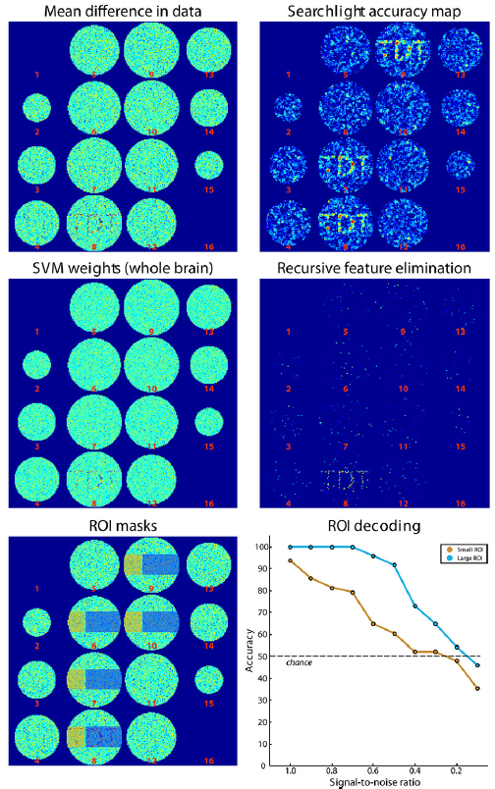
Many-voxel simulation demos
(demos_toybrain_567_djm.m)
Simulated brain data
Fig. 4 from paper
Searchlight example
‘wholebrain’ examples (RFE and SVM weights)
ROI examples
Hebart et al. (2015)

Slide 35
Other considerations with real fMRI data
Temporal autocorrelation:
  Dependencies between patterns within a run
  Safest for test/train patterns to come from different runs
Pre-processing:
  Similar to standard univariate analysis
    Probably:
      motion-correction
      Slice-scan-time correction
    Possibly:
      normalisation to template (if random-effects searchlight analysis across subjects; could do this afterwards)
      Slight spatial smoothing (could increase or decrease SNR, spatial depending on spatial scale of signal vs noise)

Slide 36
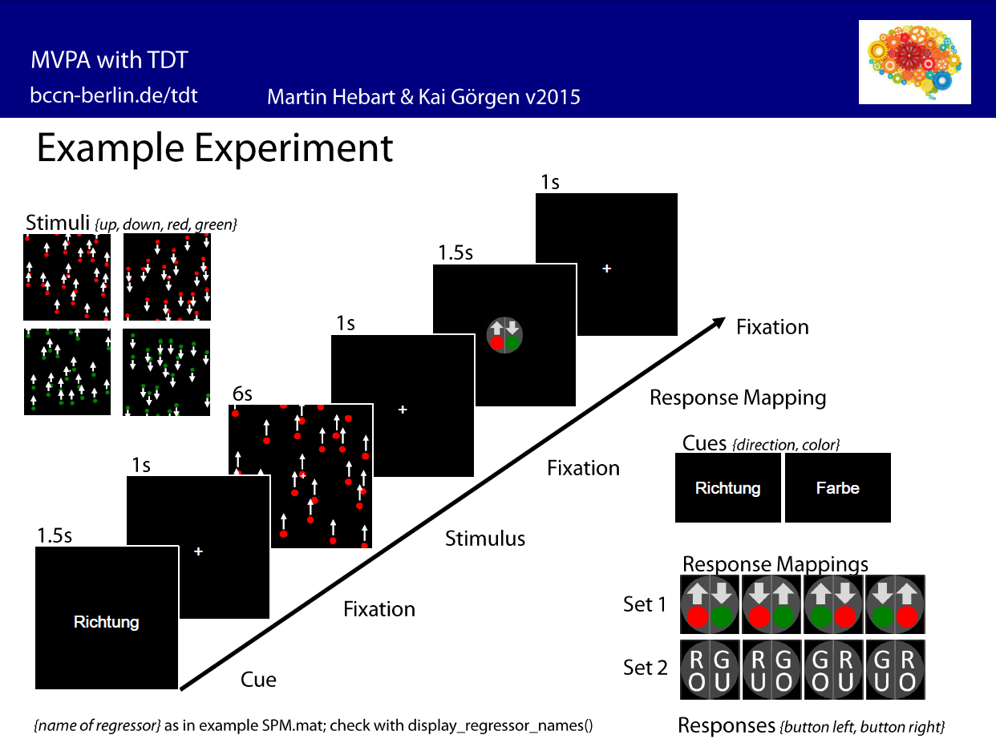
Examples with real fMRI data
(demos_realdata_motion_direction_89_djm.m)
searchlight
statistics

Slide 37
Statistical inference
Dominant in the literature:
Random-effects analysis across subjects, using standard one-sample
right-sided t test.
H₀: μ = 50% (for balanced 2-class); H_{a}: μ > 50%
Is this valid?
observations (i.e. subjects) are independent
reasonable to assume probability distribution of classification accuracy is identical across subjects
number of subjects is large enough for the central limit theorem to apply
(can assume sampling distribution approaches a normal distribution)
Take care over chance level (especially for unbalanced classes)
If any doubt, can use permutation test instead; wise to include negative control
If true value of dependent measure can not be negative, t-test only provides FFX inference (Allefeld et al. 2016)

Slide 38
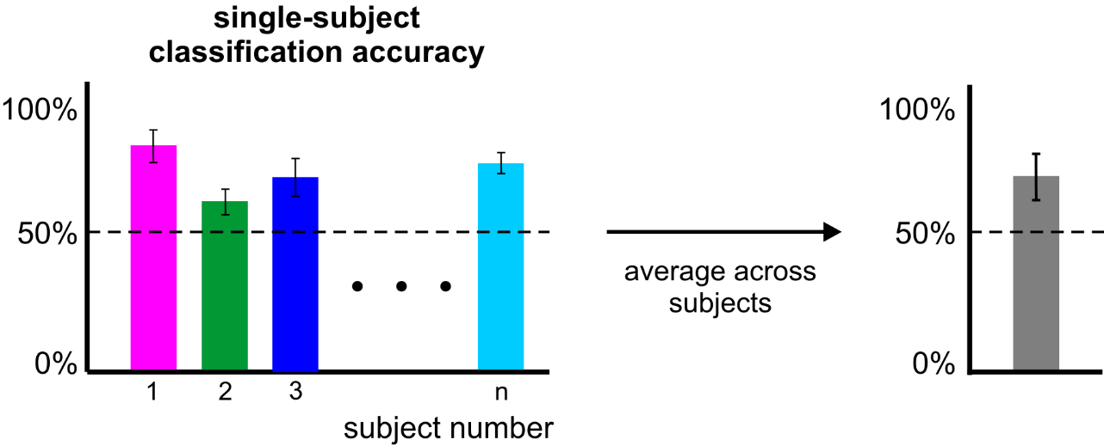
Statistical inference
error bars
= standard error
across folds (probably invalid)
error bar
= standard error
across subjects (probably valid)

Slide 39

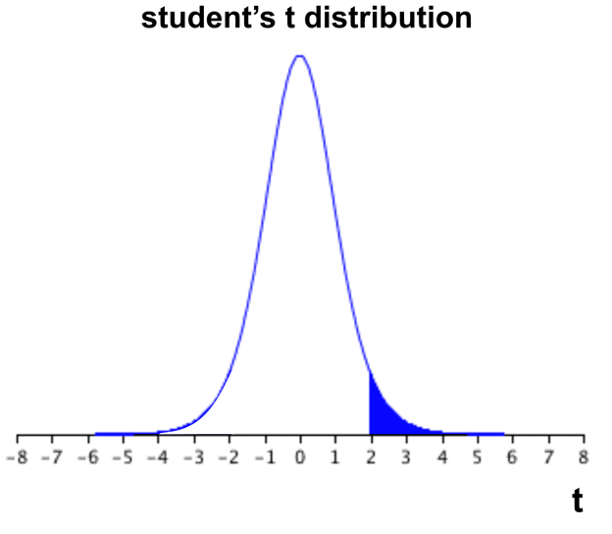

Statistical inference
subject-average
classification accuracy
If the computed t value falls within the top 5% (blue) of the t distribution → reject H₀.

Slide 40
Statistical inference
However:
can we always assume a t distribution?
are we sure that the accuracy is 50% under H0?
What about stats within a subject?
→ use a permutation test:
  create null distribution by randomly shuffling condition labels many times (1000-10,000) before training
  remove relationship between labels and patterns
  assumes data are exchangeable (H₀: all classes come from same distribution)
  Slow; permutations limited by number of samples/classes

Slide 41
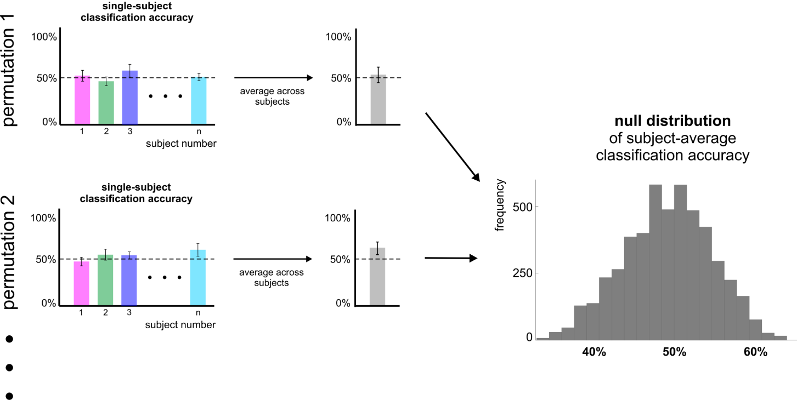
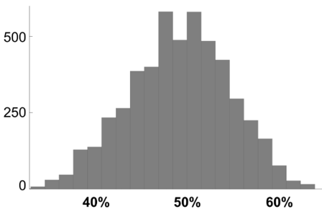
Statistical inference
Null distribution of
subject-n
classification accuracy

Slide 42
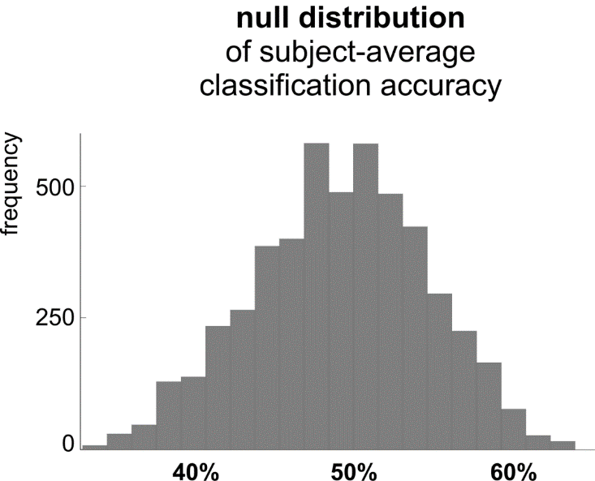
Statistical inference

Slide 43
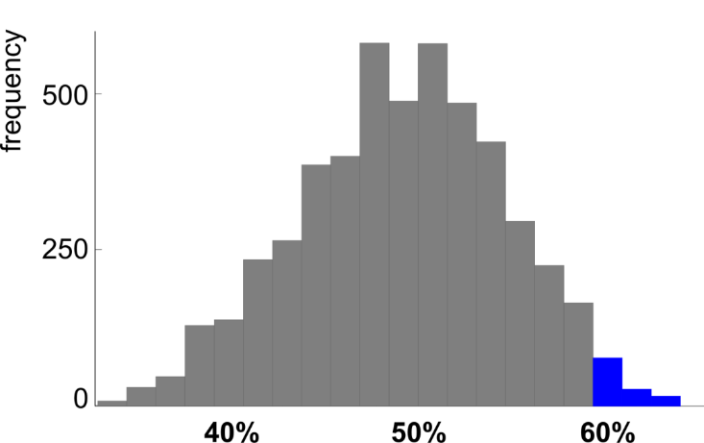
Statistical inference
If the actual classification accuracy falls within the top 5% (blue) of the null distribution → reject H₀.
Notes:
Safe (likely to be valid), but time-consuming, and fixed-effects inference.

Slide 44
Back to demo…

Slide 45
Examples with real fMRI data
(demos_realdata_motion_direction_89_djm_plus.m)
Same data
Now ROI examples comparing some different settings

Slide 46
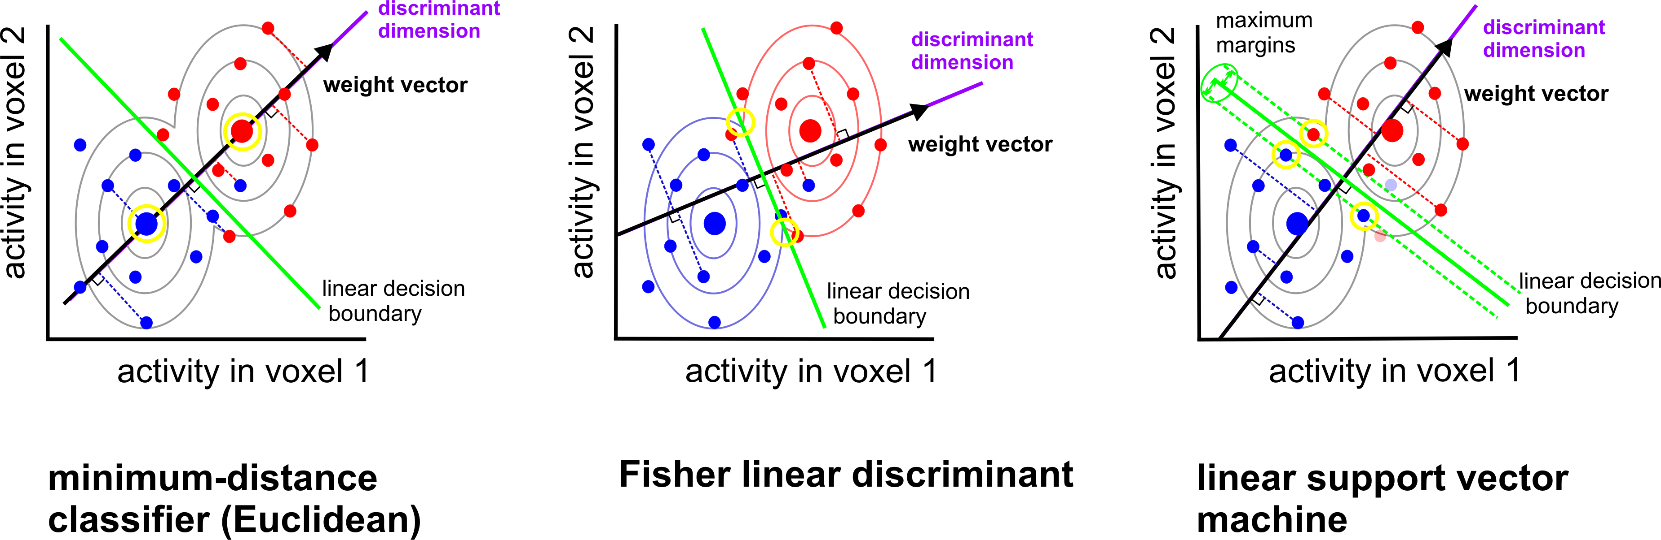
Boundary placement: some linear classifiers
assumes identical and isotropic distributions
assumes identical and multivariate normal distributions (need to estimate covariance)
no assumptions about distributions
(need to choose C, or nu)
Mur et al. (2009)
Notes:
Include assumptions.

Slide 47
Which classifier is best?
Will depend on:
how well each classifier’s assumptions are met
how much data are available
desired inference/interpretation
Linear SVM and Fisher linear discriminant (with optimal-shrinkage covariance estimator) often seem to perform best.
Misaki et al. 2010

Slide 48
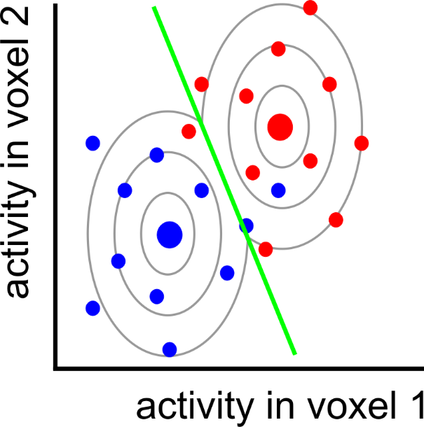
Can we do better?

Slide 49
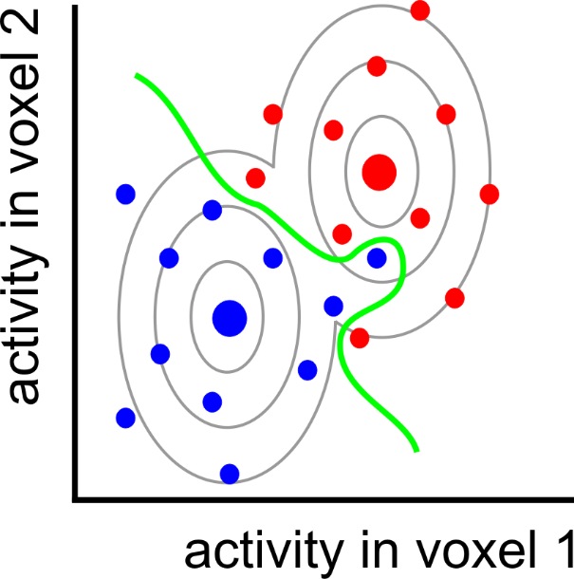
nonlinear
classifier

Slide 50
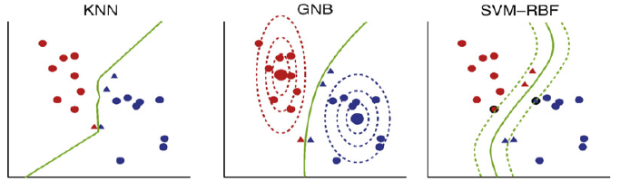
Some non-linear classifiers
K-nearest neighbour
(Quadratic)
Gaussian Naïve Bayes
SVM with radial/polynomial/sigmoid basis function
Nonparametric
(need to select k)
assumes multivariate, but non-identical, normal distributions
(ignores voxel correlation)
no assumptions about distributions
(need parameter selection)
Misaki et al. 2010

Slide 51
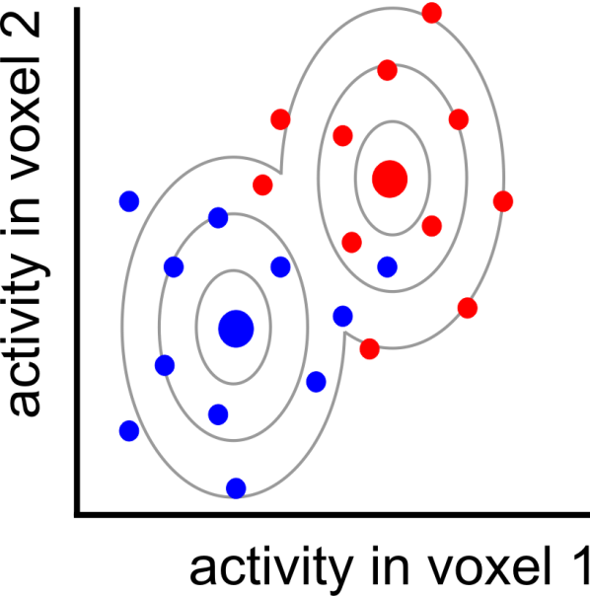
Pattern = signal + noise

Slide 52
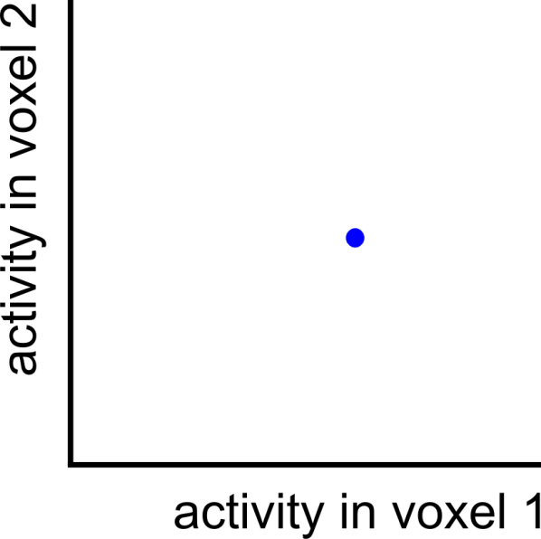
Pattern = signal + noise
measured pattern
(signal + noise)

Slide 53
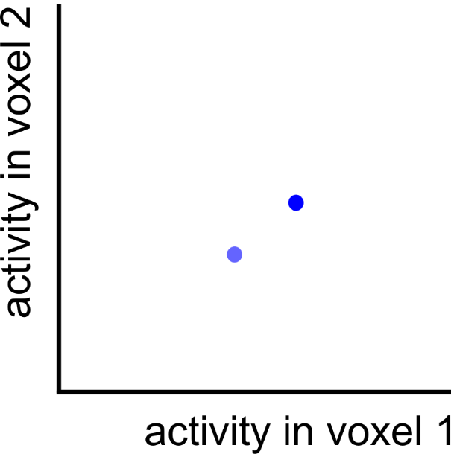
Pattern = signal + noise
measured pattern
(signal + noise)
true pattern
(signal)

Slide 54
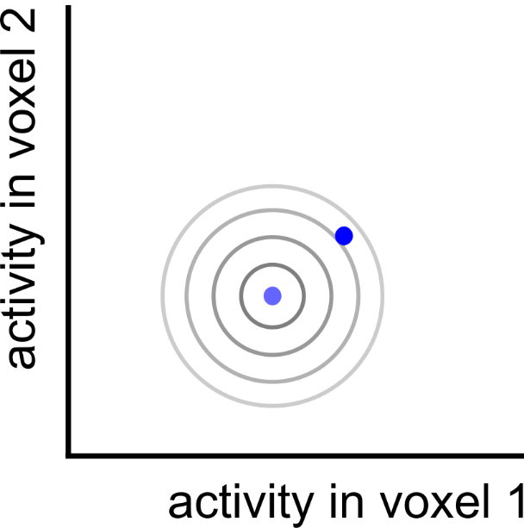
Pattern = signal + noise
measured pattern
(signal + noise)
true pattern
(signal)

Slide 55

Pattern = signal + noise
measured pattern
(signal + noise)
true pattern
(signal)
noise displacement

Slide 56
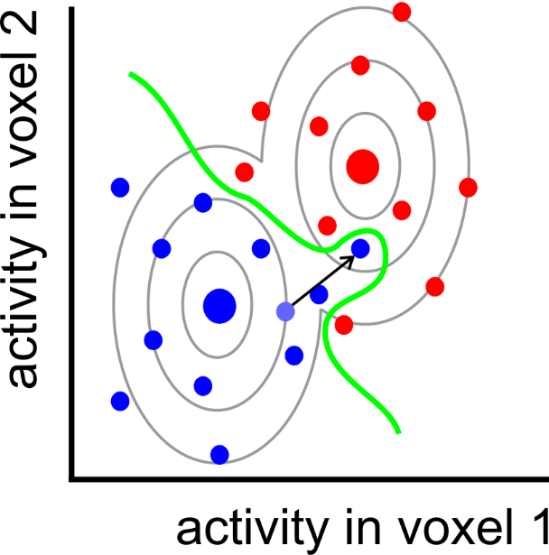
Overfitting

Slide 57
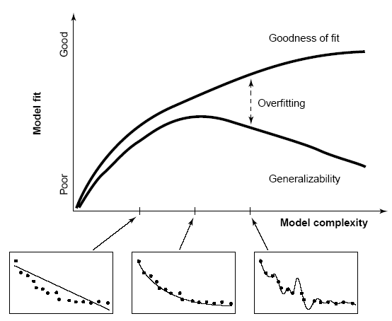

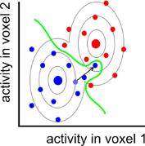
Overfitting
After determining the decision boundary, we need to test how well the boundary generalises to new data (e.g. cross validation).
(training data)
performance
(hold-out data)
boundary complexity
Notes:
Regularisation: use prior assumptions to constrain the ways in which the boundary is shaped and shifted so as to discriminate the categories in the training data.

Slide 58
Overfitting
After determining the decision boundary, we need to test how well the boundary generalises to new data (e.g. cross validation).
Linear classifiers usually perform better on fMRI data than nonlinear classifiers.
Overfitting can be further reduced by:
regularisation
dimensionality reduction of the activity patterns (e.g. voxel selection)
Notes:
Regularisation: use prior assumptions to constrain the ways in which the boundary is shaped and shifted so as to discriminate the categories in the training data.

Slide 59
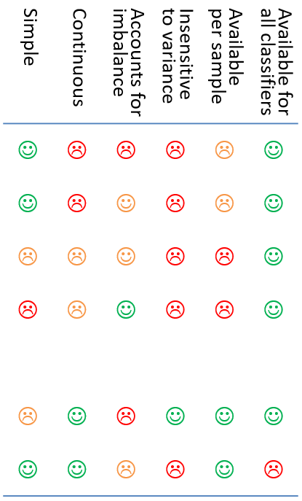
Performance measures
Simple | Continuous | Accounts for imbalance | Insensitive to variance | Available per sample | Available for all classifiers
☺ | ☹ | ☹ | ☹ | ☹ | ☺
☺ | ☹ | ☺ | ☹ | ☹ | ☺
☹ | ☹ | ☺ | ☹ | ☹ | ☺
☹ | ☹ | ☺ | ☹ | ☹ | ☺
☹ | ☺ | ☹ | ☺ | ☺ | ☺
☺ | ☺ | ☹ | ☹ | ☺ | ☹
Several Options:
Accuracy (proportion correct classifications)
Accuracy per class (balanced accuracy)
D-prime (and other sensitivity measures)
Area under ROC curve
Decision variable
  e.g. signed distance from margin
  Probability of correct classification
Possible pros/cons

Slide 60
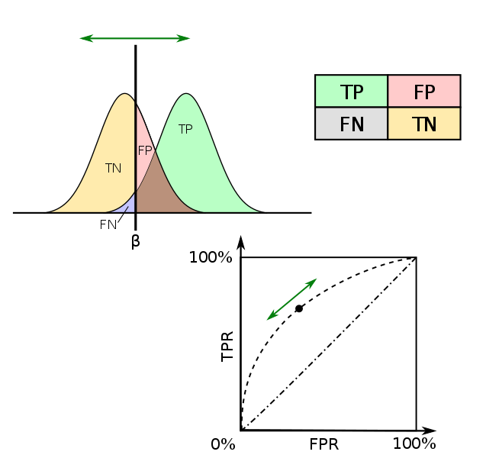
d’ (sensitivity)
Chance = 0
ROC curve
AUC
(area under curve)
chance = 0.5
Criterion

Slide 61
Back to demo…

Slide 62
Some example applications…

Slide 63




Slide 64






Slide 65




Slide 66





Slide 67






Slide 68



Slide 69



Slide 70





Slide 71



Slide 72



Slide 73
References (a selective list)
Linear classification tutorials
Mur M et al. (2009) Soc Cogn Affect Neurosci 4: 101-109. [conceptual introduction]
Pereira F et al. (2009) Neuroimage 45(1 Suppl): S199-S209. [introduction]
Schreiber K, Krekelberg B (2013) PLoS ONE 8(7): e69328. [cautionary comments on statistical inference]
Kriegeskorte N et al. (2006) PNAS 103(10): 3863-3868. [multivariate searchlight]
Linear classification reviews
Norman KA et al. (2006) Trends Cogn Sci 10(9): 424-430.
Haynes JD, Rees G (2006) Nat Rev Neurosci 7: 523-534.
Linear classification: a few example applications in neuroscience
Kamitani Y, Tong F (2005) Nat Neurosci 8(5): 679-685. [vision: classify orientations]
Formisano E et al. (2008) Science 322: 970-973. [voices: classify speakers & vowels]
Haynes JD et al. (2007) Curr Biol 17(4): 323-328. [cognitive control: task preparation]
Emrich et al. (2013) J.Neurosci. 33(15):6516–6523 [visual working memory]

Slide 74
References (a selective list)
Recursive feature elimination (RFE)
De Martino F et al. (2008) Neuroimage 43: 44-58.
Thoughts on choice of classifier & preprocessing options
Mourao-Miranda J et al. (2005) Neuroimage 28: 980-995. [SVM vs FLDA]
Kriegeskorte et al. (2009) Nat Neurosci 12(5): 535-540. [how to prevent selection bias]
Misaki M et al. (2010) Neuroimage 53: 103-118. [compares 6 different classifiers]
Garrido L et al. (2013) Front Neurosci 7(174): 1-4. [subtract the mean pattern?]
Relationships between classification (decoding), encoding, and RSA
Naselaris T et al. (2011) Neuroimage 56: 400-410.
Kriegeskorte N (2011) Neuroimage 56: 411-421.
Kriegeskorte & Douglas (2019) Curr Opin Neurobiol 55:167-79
Source of data for extra ‘hands on’ example
Mitchell & Cusack (2016) Scientific Reports 6:20232; DOI: 10.1038/srep20232

Slide 75





Extra demo data if time? (tutorial_djm2.m)
Mitchell & Cusack (2016) Scientific Reports 6:20232
200 objects, presented one each per condition
2 conditions (occasional cues to imagine knives or dolphin)
Tutorial data combined over subjects

Slide 76

A puzzle: what might be wrong?
Run 1
Run 2
Run 3
Run 4
100%
50% (chance)
0%
4 runs
2 patterns estimated per run, in response to coloured shape stimuli
Shape and colour are counterbalanced
Leave-one-run-out cross validation
Significantly below-chance decoding of shape (circle vs square)

Slide 77
Lunch time!

