Slide 1
Essentials of MRI Analysis
Multiple Subject Stats and
ROI Analysis

Slide 2


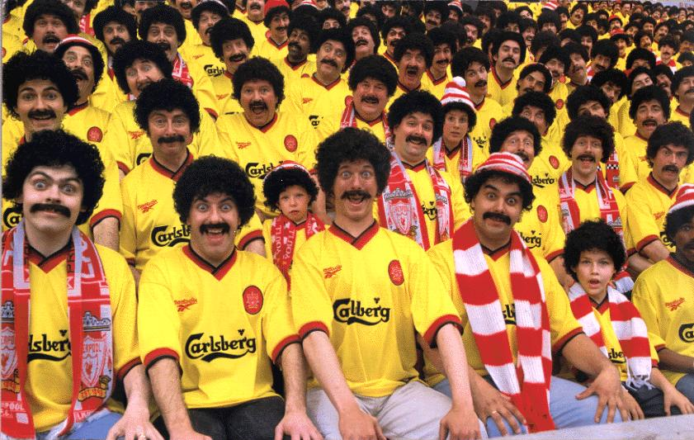
Essentials of MRI Analysis
Multiple Subjects
Fixed Effects
(FFX)
Group
Individual
Random Effects
(RFX)
Population
Notes:
With regards to the people that we scan, there are three possible levels of interest.
Firstly we may be interested in how an individual performs and what their responses are to a given task.
More often than not though, we want to get an understanding of what the neural responses of more than one person are because individuals are all different (some more different that others).
When looking at more than one person we may be interested in how a particular group of people perform. Say for example we want to know the difference in brain responses to post-docs and post-grads in the unit, it would be feasible to put everyone in each group into the scanner and test them. If we did this we could analyse the group data using what is called a fixed effects analysis. Fixed because the variation within the groups is fixed precisely because we’ve picked everyone we want.
However, maybe we’re interested in the difference between post-docs and post-grads in general. If this is the case taking participants from the unit is only a sample of all the potential post-docs and post-grads we could have selected across the world. In this case we would want to perform a random effects analysis. Random because my sample would be a random selection of all the potential participants.

Slide 3
Fixed Effects
You assume that you’ve got all of the possible subjects that you’re interested in.
If you have a significant activation, you can conclude that it is likely that brain region was involved in that task for those people.
Random Effects
Assume that your group is actually just a random sample of the population.
If you have a significant activation, you can conclude that it is likely that this brain region is involved in that task for everyone from that population.
Notes:
So, just to repeat, if you’re doing a fixed effects analysis you’re assuming that you’ve got all of the possible subjects that you could be interested in. In other words, you’re not interested in the differences or variance between individuals because this will ‘all come out in the wash’.
If, following a fixed effects analysis you have significant activations, you can only conclude that it is likely that those regions were involved in that task for those people. You can’t make any judgements about anyone else.
On the other hand, with a random effects analysis you’re assuming a lot less about your participants. This means that you are concerned about the differences or variance between individuals and so you’ll take this into account in your analysis.
As a result, with a random effects analysis you can make much broader conclusions. So if you find significant activations following a random effects analysis, you’re allowed to extrapolate to other people in the population.
I should note that I’ve used the term population several times – a population isn’t necessarily the world. There’s been a recent debate about the fact that perhaps the majority of psychology experiments are done on white, educated, middle class students at university so aren’t necessarily representative, but I digress…

Slide 4
Fixed Effects
Y = (X ∙ B) + E
Y = s1
s2
s3
…
Just like in the first level, you construct a GLM,
but now Y is a column vector with data from all
subjects
The result is an ‘average effect of the group’, i.e.
if you observe a significant activation, then the average magnitude of the response was significant.
You have more power than RFX because you have more degrees of freedom (100s) – each functional image is a DoF – therefore you’re more likely to reliably detect an effect.
Notes:
So how does a fixed effects analysis actually work?
Well you take your general linear model like you would with a single subject, but this time instead of a single value at Y, you’ve now got a column vector with the responses of all the participants.
Through the analysis, these values literally get averaged for the mean and that’s what gets tested.
Hopefully you can see how the response of any individual would get completely lost through the averaging.
A fixed effects analysis has more power than a random effects analysis because here, each row in the GLM is an EPI, just like in the single subjects. Rows = degrees of freedom, therefore you’ve got 100s of degrees of freedom and more power.

Slide 5
Random Effects
* If you have more than one group in your sample and you’re interested in the difference between them, you’d do a 2 sample t-test
1st level
With each single subject you construct a GLM to estimate their betas.
With this data you perform your contrasts to look for an effect of interest.
2nd level
You feed your contrast images from each subject into another GLM, which performs a 1 sample t-test* on the data.
This method is called ‘Summary-Statistics’
Less power because DoF are determined by the number of subjects (10s)
An RFX analysis is less likely to produce a significant result, however it allows you greater inference regarding your data and this is normally of utmost importance.
Notes:
So you may have heard the terms first and second level analysis – the random effects analysis refers to this. It’s a three step, two stage process – called summary-statistics method.
In the first level you analyse your single-subjects like normal and perform all of your contrasts on them.
Now you move into the second level and here’s the difference: now you’re working on the significance of contrasts from each individual. You feed this into a GLM and perform the usual statistics tests on this data. In this method, it’s important how each individual did.
In the second GLM each of your rows is now a participant. So your degrees of freedom are now only in the 10s. This means you’ve got less power to detect an effect.

Slide 6
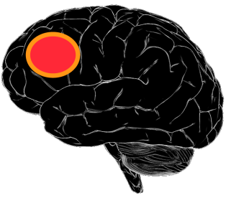
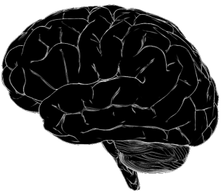
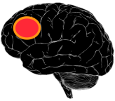

2nd level example
FFX
RFX
Is there an effect in the group?
A: The group average suggests that there is an effect.
Is there an effect in the population?
A: If I was to take another random person from the population, I would be unsure whether they would show an effect or not.
Notes:
To illustrate the difference between random and fixed effects analysis take this stylized example.
Here we have 3 brains that show a strong activation on left DLPFC.
In a fixed effects analysis we take the mean of these responses and test for significance. Here, 3 x strong beats 2 times none and we conclude that there is an effect. There’s no one else to measure, so this is a fair conclusion.
In a random effects analysis we analyse each brain for significance and then test those statistics for significance. If I asked you what you think would happen if I took average Joe off the street and put him into the scanner and bet you £1000 that he’d show an activation, you may not be so sure. That’s what the random effects analysis concludes too.
Just to really emphasize the difference, it would be theoretically possible for only one person out of this group to show a positive effect, but as long as it was huge and tipped the mean activation in its favour just enough, a fixed effects analysis would come out positive, not so far fetched if the other 4 were close to threshold.

Slide 7
Which one to go for?
Neither method is wrong
But… what conclusions do you want to make?
If you wan to make any inferences about people other than those you studied, it HAS TO BE RFX
Scan more people for less time
Notes:
The question that we’re always interested in is: the theory is all well and good, but what should I do?
Here’s it’s obvious. If you want to make inferences about more than the people you scanned you have to do a random effects analysis. No ifs, buts or maybes.
If you’re happy you’ve got a very specific study group though go for the random effects analysis as it’ll give you more power.
It’s worth noting that because the power limitations in RFX lie in the low degrees of freedom inherent in having 10s of subjects, it’s much better to scan more people for less time each than less people for more time.
However, you still need power at the single subject level, so the current time-slot allocation is a pretty good compromize.

Slide 8
To re-cap,
Individual
I tested Tina and these are her activations…
I tested Tina, Oliver and Mary. I averaged across the three of them and didn’t really care what each one was doing. If I pretend that they’re one brain, here’s the average result…
FFX
RFX
I tested Tina, Oliver and Mary. Here’s what we’d see in Tom’s brain if he wasn’t too scared to be scanned…
Notes:
OK, so that’s all I have to say on multisubject statistics, but here’s a summary of what are the valid conclusions for each type of analysis.
In individuals, so test one person and can only make inferences about that one person. The individual level GLM is also a fixed effects analysis – it can’t be any other way.
After fixed effects on a group, you can only say whether that group and only that group of people showed an effect.
After a random effects analysis you’ve tested a group, but can make estimates of what you’d expect to find in people that have never been scanned. This is only the case with random effects analysis.

Slide 9
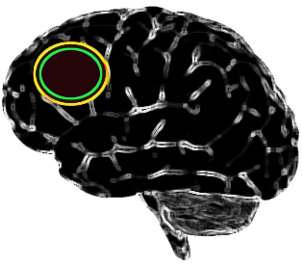
Essentials of MRI Analysis
ROI Analysis
Notes:
Now on to Region of Interest Analysis, Roy to it’s friends. I’m not that friendly with it, so I’ll just go for ROI.

Slide 10
ROI: what and why?
What
Region of Interest – before you did your experiment where were you expecting (hoping/wishing) to find activations?
Why
Multiple comparisons problem:
Reducing the number of voxels or resels that you are comparing decreases the corrections required by the family-wise error method.
More sensitive if you have an idea of where your activation will be
More fundamentally:
Are you really interested that the voxel at -54,14,22 was activated – no.
Are you interested in whether the Broca’s Area was activated – yes!
Notes:
What is a region of interest? The clue is in the name – it’s a region that you’re particularly interested in because you think you’ll find an effect there.
Why would you want to do it?
Well it helps you to overcome the multiple comparisons problem by restricting the number of voxels that you’re considering.
But at least in my opinion its more important because unless you’re doing an exploratory study looking for the neural correlates of something, i.e. completely exploratory, you probably had some hypotheses of where you were expecting to find an activation. These are your regions of interest.

Slide 11
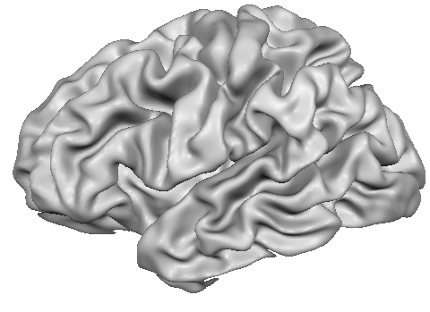
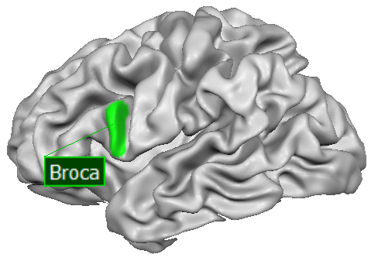

ROIs or Voxels?
?
Notes:
In your standard fMRI investigation you’ll do your whole-brain univariate analysis and get an activation map – pretty blobs on the brain. The basic element of theses anlayses are the voxels. So here’s a question, are you really interested in the voxel at -54,14,22 and whether it gets activated or not – no
– a voxel has no neurological meaning, it’s a random bit of cortex which is 3mm cubed – a voxel has no functional properties.
However, that voxel happens to be in the Brocas Area, which is of interest and you may be very interested to see whether the Broca’s Area was activated.
I’m not suggesting that the typical whole-brain univariate analysis isn’t interesting, but I am suggesting that what your ROIs are doing is more interesting and is also much more closely linked to your hypotheses.
ROI analysis can be used to complement whole-brain analysis, it doesn’t have to be either or.
Finally, ROI analysis are better at determining the absence of an effect – which isn’t so easy to do with authority using whole-brain analysis.

Slide 12
Steps in ROI analysis
Define your ROI
1
Where? Size? Shape?
Run your analysis
2
Choose your design, extract the data, estimate the model.
Do the stats
3
Do t-tests and F-tests on the results.
Notes:
Now that I’ve persuaded you that ROI analyses really are the best thing since sliced brains, or even if I haven’t that you can have your cake and eat it, what actually goes on in an ROI analysis?
The first and very very important step is how you go about defining your region of interest. Where is it in the brain, how big is it going to be and what form will it take?
Once you’ve carefully done this, you can run the analysis – which is easy as it’s mostly automated.
Then you’ve got a few options on what you do with the beta-estimates that you get out as well as the percentage signal change data that you also retrieve.

Slide 13
How to define an ROI
1
Use data from single
subjects not the group
There are three major types of ROI:
Anatomical/Structural
Interested in the putamen? No problem!
MarsBaR has a library of ROIs based on anatomically defined MNI regions.
Or you could try drawing it yourself…
Functional
Got a pattern from another contrast you want to use? No problem!
…but they gotta be orthogonal. No double dipping allowed.
Coordinate Geometrical
Want to use a peak activation from another paper? No problem!
Draw a sphere or cube (or some other funky shape) around that bad boy.
Notes:
What region are you interested in and what is the best way to define that region?
Well first of all you want to do your ROI analysis using the data from single subjects – it is possible to perform an ROI analysis on the group’s data, but I don’t know how to interpret those results or if they’re actually meaningful at all.
So, that means that you’ve got to define your region of interest within each subject. But how? Well there are three major approaches that you could take, all of which are valid, some of which may be more or less appropriate depending on context.
The first I’ll describe is the anatomical or structural method.
Let’s say you’re interested in a region that is well defined by anatomical boundaries such as the putamen or hippocampus. It makes a lot of sense to do an ROI analysis based around those anatomical boundaries.
You could do this two ways – if you decide to spatially smooth and normalized your data in the preprocessing, you may just want to use a ready-made ROI from a library.
However, if you want a greater resolution you could skip the smoothing and normalization step and go about drawing your region onto each individual. This will get you closer to the real activations, but by golly it’ll take a long time – remember, ROI’s are volumes not areas!
Perhaps you’re interested in a region that is less well defined anatomically, say the fusiform face area – you know it’s on the fusiform gyrus, but it’s exact location may vary and may be tricky to define anatomically.
What you want to then do is define it functionally – get people to look at a load of faces, map the activity, perhaps refine it a bit by eye and then bam! You’ve got your ROI ready for that individual. This method you’ll definitely want to do on the non-normalized and non-smoothed pre-processed data, as then you’ll be able to incorporate a lot of the anatomical variability that is normally lost.
This method is great – but there are easy errors to make which can really bias your results and make your conclusions invalid. Double dipping is a particular concern, but more on this in a bit.
The third method I mention here is pretty darn easy.
You take a paper that reports activity in your interesting region. Look for the peak voxel reported, and then draw a shape centred around that voxel – usually a sphere or a cube – and call that your ROI. As you’ll be using standard coordinates to define your ROI you’ll need to normalize and smooth prior to this analysis.
These ROIs will, by their nature, include neighbouring cortex that you’re not interested in, and/or miss some of the cortex that you are interested in – but the idea is that this all averages out as long as it’s a reasonable size.
What size for the ROI? Often papers will have performed an ROI analysis on their data and if so they should report the shape/size of their ROI so you could just do that. If not, it’s up to you but just think about the size of the region you’re interested in. The ROIs that I’ve used have all been spherical with a radius ranging from 5mm to 12mm.
You could also combine the functional and coordinate methods: find a peak voxel from an independent contrast from your study and then draw a shape around that. However, I personally feel that if you’re going to do functional localizing, you may as well do it properly and thoroughly.

Slide 14

A bit more on functional ROIs
The data that you use to select your functional ROI MUST be INDEPENDENT from and/or ORTHOGONAL to the data that you analyse for the effect of interest.
Voodoo fMRI
  You do a whole brain analysis on all of your data and find a peak activation voxel around IFG.
  Take this coordinate and draw a sphere around it.
  Do the ROI analysis on this sphere – surprise surprise your results are significant.
  Your experiment is split into three runs with same task, so take the activations from your contrast of interest from just the first run to define your ROI.
  Use this ROI to test your data from all 3 tasks – surprise surprise, significance galore.
Notes:
In this first scenario, you are checking significance in a region that you had chosen specifically because of its significance – therefore it’ll be of no surprise that your ROI analysis tells you that that region was significantly activated.
This is double dipping because you using the same data to both determine and test your hypothesis.
This may not be completely useless practice though – you could use this method for exploration of your data, just not for inference of an effect: e.g. you could do it using multiple small ROIs within a cluster to see whether the region is homogeneous. You wouldn’t be able to publish that inference though because it’s still double dipping – it could just motivate you test that hypothesis in a legitimate way if possible.
Also, if you have a lack of activation where you would expect it, ROI analysis using the first method may be informative. Poldrack tell a story where they had no activation at the group level, so selected the peak voxels from the regions they expected and ran an ROI. Because ROI is based on individuals it showed them that all but one subject showed an effect – the other was a massive outlier which was suppressing the significance at the group level.
In the second scenario you’re also using the same data to both define and test your hypothesis.

Slide 15

Notes:
There’s another scenario about which I’m not too sure of the legitimacy however: Imagine you go back to the second scenario, but actually only use the latter two runs to test the hypothesis. Here, your data is independent, however your ROI has been defined by performance on the same task. This isn’t double dipping, but your result must have a different interpretation – you’re now testing for the reliability of that region to be activated by that particular task, rather than a more general cognitive performance. It could be interesting in terms of looking for a learning effect though, perhaps.

Slide 16
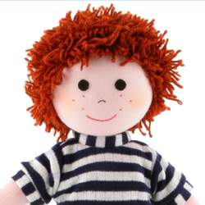
A bit more on functional ROIs
Independent and/or Orthogonal
Some Options:
I&O Do a completely different localiser task:
  Something else that should activate the same region.
O Do a different contrast:
A conjunction of task A and B to localize, then
test for differences within that region.
Notes:
That’s the what not to do, here’s what they should have done.
Perphaps the cleanest method is to perform a completely different task that you believe should activate the same region as the task that you’re interested in.
If this isn’t really feasible, you could perform a contrast on your data which is orthogonal to your test of interest. For example, if you’re interested in the regions that were activated for happy faces > sad faces, you could do a conjunction of happy faces + sad faces. Although you’d be using the same data, the criteria for choosing your region is different to your hypothesis, so this is legitimate.

Slide 17
Let’s talk about localizers
Are they worth it? Is a factorial design better?
Yes – go localizer
(Saxe, Brett, Kanwisher)
No – love factorial
(Friston, Henson, et al.)
Definitely avoids the chance of double dipping
Localizers may waste you precious EPI time.
You don’t end up with useless contrasts of no interest
You can achieve the same thing with a full factorial design
Bring consistency across experiments and labs
Factorial Designs will be in the same context – not necessarily true for localisers
Bottom line: if it doesn’t fit sensibly into a factorial design use a localizer
Notes:
There was a prominent debate in NeuroImage in 2006 regarding the use of functional localizers – a localizer being a completely different task, performed independently of your experiment – to define a functional region of interest.
Friston et al., expressed concern that they thought that they were a waste of time that could be used getting more power in your actual experiment and that if you properly designed your experiment into a factorial design, you could use contrasts within the design as a localizer. Also, by doing this your participants are in the same context, which they may not be for a localizer.
Saxe et al, counter that localizers really eliminate the chance of double-dipping, can bring consistency across experiments and labs because it standardizes the way in which an area is defined. Furthermore, they say many experiments don’t really fit that well into a factorial design and if you try to squeeze yours into one you may end up with lots of contrasts that are of no interest to you and basically end up wasting more EPI time and perhaps power than you would have done with a nice and simple localizer.
My own personal opinion is that localizers are a good thing, but if it just so happens that your design is a factorial one, then a localizer probably isn’t necessary.

Slide 18

Running the ROI Analysis
2
Choose your ROI and your SPM file (which has already undergone 1st level analysis)
Press Go
  The time-course data of each voxel in the ROI is extracted
  - this involves taking the activation of your conditions compared to the implicit baseline.
  2. A mean time course is calculated for each voxel
  - this has it’s pitfalls
Notes:
Now on to step two of the ROI method. Running the analysis.
You’ve got your ROI and you’ve got your SPM file that you’ve ran through your first-level analysis, therefore it will include your conditions. However, your contrasts are independent of this, so it doesn’t include any of the family-wise error or false discovery rate tests of significance that you may or may not have performed.
You start the analysis and MarsBaR, the ROI toolbox in SPM will take the beta’s from the voxels across your ROI for each relevant EPI image for that condition and find the mean response compared to the implicit baseline, when your participants weren’t doing anything – this mean response is then treated as the signal from that ROI.
The trouble with using mean time course is that outliers can skew the data in either direction, but it does make the result more straight forward to interpret. In practice it tends to be a little conservative according to Karl Friston. Also, if you have heterogeneity within the ROI, you’ll miss this: e.g. if half of it activates, but half deactivates you won’t know. Therefore really think about your size of ROI.
Other methods consider just counting the number of activated voxels in the image. This method is clearly sensitive to the threshold that you apply though and have also been shown not to be a particularly good measure of signal change (Cohen and DuBois, 1999)

Slide 19
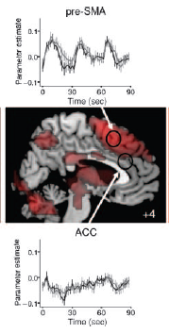
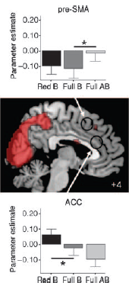
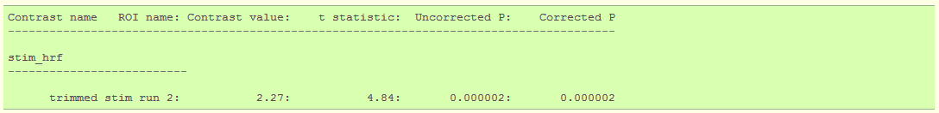
The Results – finally!
3
Put ‘em together and what have you got?
  Beta estimates
  → plot time course
  → for your t-tests/ANOVAs
  % signal change
  → intuitive and unavailable at whole
  brain level.
Notes:
After all of this, you finally get your results. And fingers crossed they’ll be beautiful.
The analysis provides two measures of activity – the beta estimates at each ROI for each condition and the % signal change for each ROI when that condition was on.
With the beta estimates you can plot the time course – how these values varied across the experiment, or at least a certain period within the experiment.
You can also perform t-tests and f-tests on the beta values between conditions to test for differential effects.
With the percentage signal change data, you can indicate how much the signal changed relative to the baseline in a fairly intuitive way.
All of this is excellent data on its own, and certainly a great accompaniment to your whole-brain analysis.

Slide 20

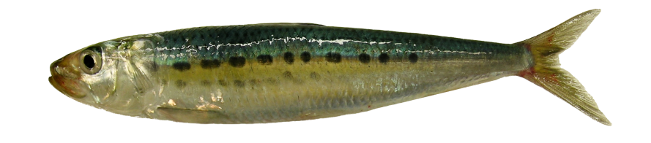
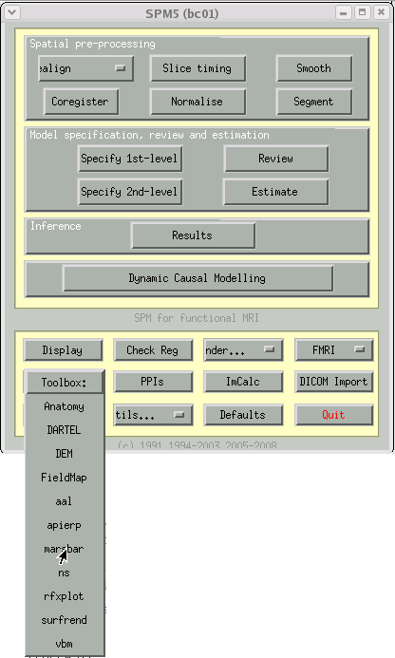
How do I actually do it?
In SPM, the best/easiest way is through using MarsBaR toolbox.
Open it thus:
Open the tutorial by googling
MarsBaR
(it’s excellent and written by Matthew Brett, so is actually readable
and understandable).
Notes:
Well that’s all the theory that you’re going to get from me – if you want to know how to actually do it I suggest using MarsBaR if you use SPM.
Open up the toolbox like shown and go to the MarsBaR home page where the creators have created a very readable and useful tutorial which should be fairly easily adaptable to your own needs.
If you’re doing a big ROI analysis, then a batch-script is invaluable, like in most things.

Slide 21
How do I actually do it?
Be careful about your coordinates
  Some people report in MNI space, others in Talairach and Tourneaux. They’re similar but slightly different. Marsbar uses MNI.
  Use tal2mni.m or mni2tal.m (on the wiki) to change into the coordinates you want. Add the scripts to your path then to change type:
  tal2mni([33 33 -10; 20 44 96]) this will convert these 2 tal points to MNI space
Localize for shorter with a liberal threshold
  A recent study by Kawabata and Devlin suggests that using a relatively short localizer (~10mins) with a liberal threshold (Z > 2.3) is just as effective as performing a longer localizer with a more conservative threshold (Z > 5).
  Therefore, go for the shorter localizer which is more cost-effective and will give you more scanner time.
Notes:
One important thing to remember when creating your ROIs from other papers is what coordinates they have recorded their activations in.
Also, what coordinates do you want to report your coordinates in? When choosing coordinates, do you want one based on 100+ healthy Canadians or one drunk old French woman with a little brain.
You can easily convert from MNI to Talairach space using the tal2mni or mni2tal functions that are downloadable from our wiki.

Slide 22
References
Multiple Subjects:
The MIT wiki: www.mindhive.edu/node/92
Random-Effects Analysis (2003) W.D Penny and A.J Holmes
ROI:
The MIT wiki: www.mindhive.edu/node/101
www.marsbar.sourceforge.net/index.html
tal2mni.m / mni2tal.m at: www.imaging.mrc-cbu.cam.ac.uk/imaging/MniTalairach
Friston, K. J., Rotshtein, P., Geng, J. J., Sterzer, P., & Henson, R. N. (2006). A critique of functional localisers. NeuroImage, 30(4), 1077-87.
Saxe, R., Brett, M., & Kanwisher, N. (2006). Divide and conquer: a defense of functional localizers. NeuroImage, 30(4), 1088-96; discussion 1097-9.
Poldrack, R. a, & Mumford, J. a. (2009). Independence in ROI analysis: where is the voodoo? Social cognitive and affective neuroscience, 4(2), 208-13.
Begging the Question: The Non-Independence Error in fMRI Data Analysis Edward Vul, Nancy Kanwisher
Nieto-Castanon, A., Ghosh, S. S., Tourville, J. a, & Guenther, F. H. (2003). Region of interest based analysis of functional imaging data. NeuroImage, 19(4), 1303-1316.
Poldrack, R. A., (2007) Region of Interest Analysis for fMRI. SCAN, (2) 67-70
Kawabata, Devlin (2011) Improving the reliability of functional localizers. NeuroImage

