Slide 1

Unwarping
Undistortion

Slide 2
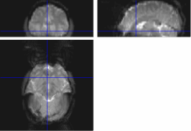
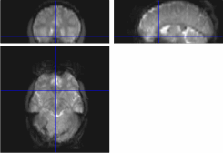
Effects of distortion
Causes signal loss & disruption of spatial encoding in EPIs (T2* weighted images)
Raw EPI (distorted)
EPI after distortion correction

Slide 3
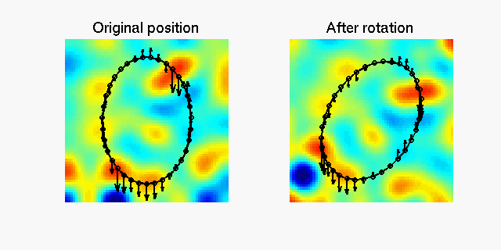
Why distortion?
Different substances (e.g. bone, tissue, air) differ in magnetic susceptibility.
Therefore distort magnetic field in different ways > inhomogeneity in magnetic field.
Actual shape
Notes:
Take a brain shaped object like this. Imagine small ovals represent fluid (e.g. CSF) and rest of oval = brain tissue
Red colour = distortion by CSF, turquoise/green = distortion by brain tissue (ignore other colours for now!)
See distortion when object in upright position (e.g. when first position person in scanner)
Seenwhat happens when someone rotates their head – distortion field changes

Slide 4
Movement x Susceptibility
Across scans (time series) - head moves in magnetic field > distortion changes
Therefore MRI Signal doesn’t change linearly with subject position
Realigment DOESN’T remove distortion
Actual shape
Notes:
Take a brain shaped object like this. Imagine small ovals represent fluid (e.g. CSF) and rest of oval = brain tissue
Red colour = distortion by CSF, turquoise/green = distortion by brain tissue (ignore other colours for now!)
See distortion when object in upright position (e.g. when first position person in scanner)
See what happens when someone rotates their head – distortion field changes

Slide 5
How might we account for this?
Movement parameters as covariates in design matrix
But, movements may be correlated with task, e.g., read word silently but mouth it too
So both good and bad variance will be discarded

Slide 6
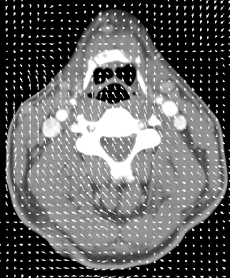
A better way to account for this?
Acquire a field map – direction and magnitude of location deflections throughout magnetic field with respect to real object
Work out these vectors by formulating inverse problem…
Given observed variance (after realignment) and known movements, estimate how deflections change in each scan
Deformation field

Slide 7
What actually happens
Don’t generate field map for every EPI image
Instead compute how one map warped across subsequent scans
> derivatives (change over time) of deformation field with movement of subject

Slide 8
Modelling magnetic field over time
Apply this time varying field to image
Can then assume voxels over time correspond to same part of the brain
B₀(θ, ϕ) = B₀ (Δθ, Δϕ) + [(δB₀/ δϕ) Δϕ + (δB₀/ δθ ) Δθ]
Magnetic field
The ‘static’ deformation field, which is the same throughout the time series.
Calculated using ‘Fieldmap’ in SPM
Changes in the deformation field with subject movement. Estimated via iteration. Procedure in UNWARP.

Slide 9

Measure deformation field (FieldMap).
Estimate new distortion fields for each image:
estimate rate of change of the distortion field with respect to the movement parameters.
Unwarp time series
Estimate movement parameters
Δϕ
+Δθ

Slide 10
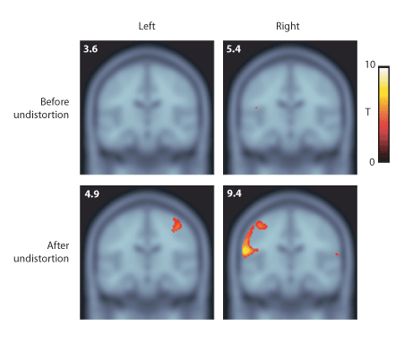
What does this help?
Improved power in 2nd level analysis
Better spatial registration to standard MNI template
Therefore better registration between subjects
Cusack, Brett & Osswald (2003)

Slide 11
But we don’t do this at the CBU!!
Siemens 3T scanner produces very little distortion!
Subject movements quite small
References
http://imaging.mrc-cbu.cam.ac.uk/imaging/FmBackground
http://www.fil.ion.ucl.ac.uk/mfd/
http://www.fil.ion.ucl.ac.uk/spm/doc/manual.pdf
Cusack, Brett & Osswald (2003). An Evaluation of the Use of Magnetic Field Maps to Undistort Echo-Planar Images, NeuroImage 18, 127-142

