Slide 1
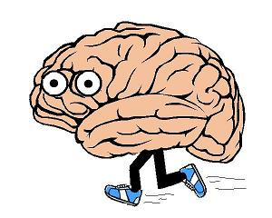
Normalization & Smoothing

Slide 2

Last week’s preprocessing extravaganza
Temporal realignment (Justin!) and unwarping (Jo!) ensure that each voxel contains data from a single brain region, as sampled at regular intervals throughout the time series
This will suffice for analysis of one person’s functional data, but we often want more than that…

Slide 3
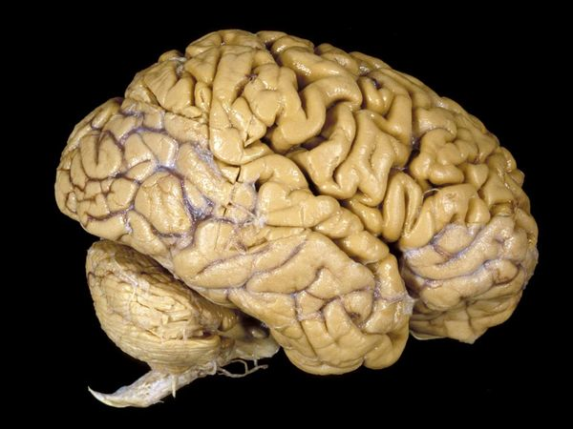
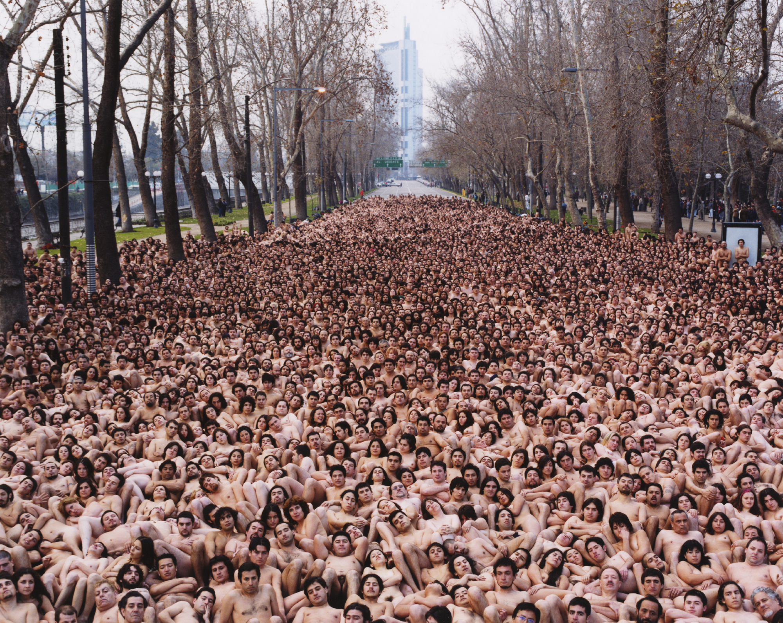
Today’s preprocessing fun
How does activity map onto anatomy?
  Coregistration (Michele!) enables us to understand how our functional data correspond to the underlying neuroanatomy
How consistent is that mapping across subjects?
  Need to normalize to transform each subject’s brain so that it is the same size and shape as all the others to compare activity across individuals
    Combination of data across subjects within a study (increasing statistical power!)
    Activation sites can be reported by their coordinates within a standard stereotactic space (e.g. Talairach, MNI)
Notes:
Registration – determines the parameters describing a transformation
Transformation – transforms one of the images according to the set of determined parameters
-Talairach space = one alcoholic old lady’s shriveled brain
MNI = an average of 152 T1-weighted images created by the Montreal Neuorological Institute

Slide 4

Normalization
Trying to make even the most bizarre brains look average. . .

Slide 5
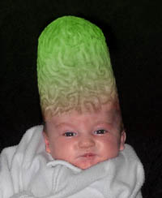
So what is normalization?
Actually, normalization is just a specific form of coregistration
  Coregistration (as a general term) = spatial alignment of two images or image volumes
    Remember that coregistration (as a preprocessing step) = align images of different modalities such as a T₂*-weighted functional volume with a T₁-weighted structural volume
  In normalization, the image volumes to be coregistered differ fundamentally in shape (not as a result of image distortion)
The goal of normalization is to compensate for brain differences by mathematically stretching, squeezing, and warping each brain so that it is the same as every other brain

Slide 6

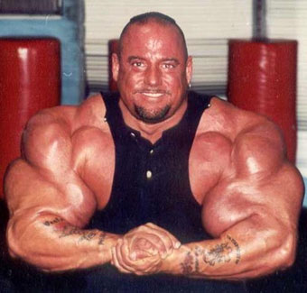
People are different, and so are their brains
Size
  Average brain is 1300 cc in volume
  Range is 1100 cc to 1500 cc
    So any two of your subjects may differ in brain size by 30%!
Shape and orientation
  Substantial variation in overall length and width
  Gyri and sulci also unique
    Even major landmarks such as the calcarine sulcus can have different positions and orientations across individuals

Slide 7
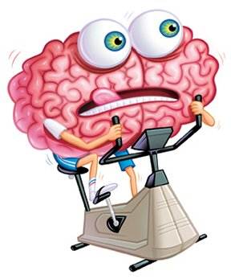
How could we possibly whip these brains into shape?
Label-based approaches (a la FreeSurfer)
  Identify homologous features in the source and reference images and warp to fit
  But, this often has to be done by hand which takes a long time and is only as good as the person doing it (it’s hard, there aren’t that many discrete points in the brain!)
Intensity-based approaches (a la SPM)
  Warp to optimize a voxel-similarity measure between a source and reference image
  But, vulnerable to poor starting estimates
Hybrid approaches also emerging, in which users gently guide intensity-based processes by identifying a few landmarks
Notes:
The best approach is probably to do a hybrid

Slide 8
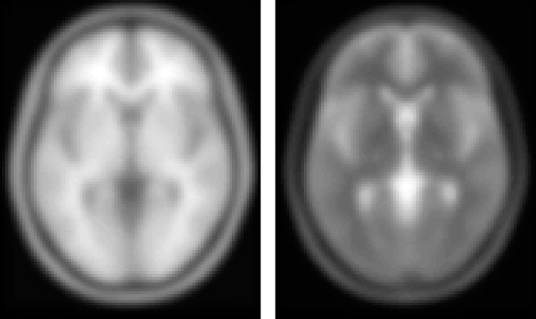
The method behind SPM’s normalization madness
Goal is to determine transformation that minimizes the sum of squared difference between your subjects’ structural image and a template image
Because it assumes that there are no differences among the shapes of brains, the rigid body approach (that we’ve been using for other preprocessing) won’t cut it for inter-subject registration
So, in addition to beefing up the number of affine transformations, we’ll add some bonus non-linear image registration to account for gross differences in head shape
MNI T1
MNI T2
Notes:
The rigid body approach that we’ve been using for other preprocessing isn’t enough to handle this, because it assumes that there are no differences among the shapes of brains

Slide 9
What exactly does SPM do?
First, linear (affine) transformation to match size and position of your subjects’ brains to a template brain
Second, a non-linear transformation (warping) to match overall brain shape to template brain shape
Utilizes a Bayesian framework to constrain affine and warps
  Priors/constraints are calculated using estimators such as the maximum a posteriori (MAP)
    Algorithm concurrently minimizes:
      Mean-squared difference between source and template images
      Squared distance between parameters and their expected values (regularization)
  Regularization decreases unrealistic distortions
Notes:
Using a single image from each subject; typically T₁-weighted and the MNI template (I think!)
- When the error for a particular fitted parameter is known to be large, then that parameter will be based more upon the prior information.
In order to adopt this approach, the prior distribution of the parameters should be known.
This can be derived from the zooms and shears determined by registering a large number of brain images to the template.

Slide 10
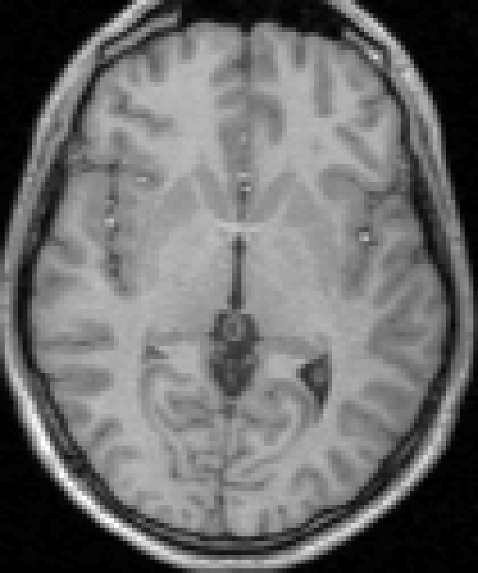
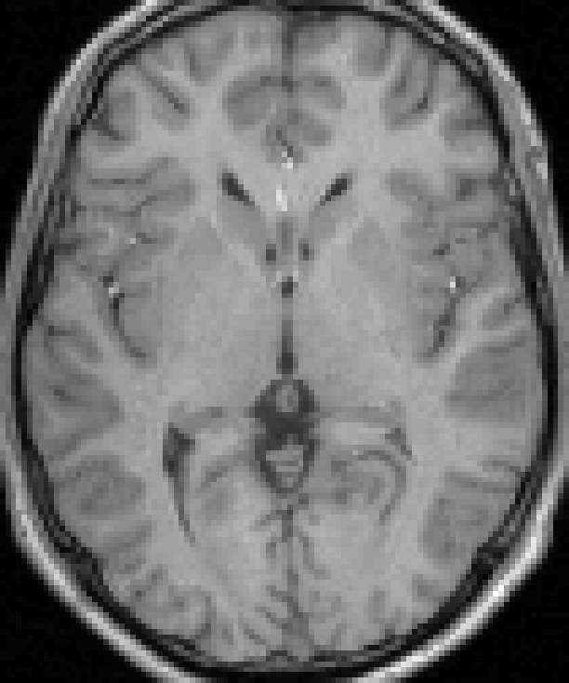
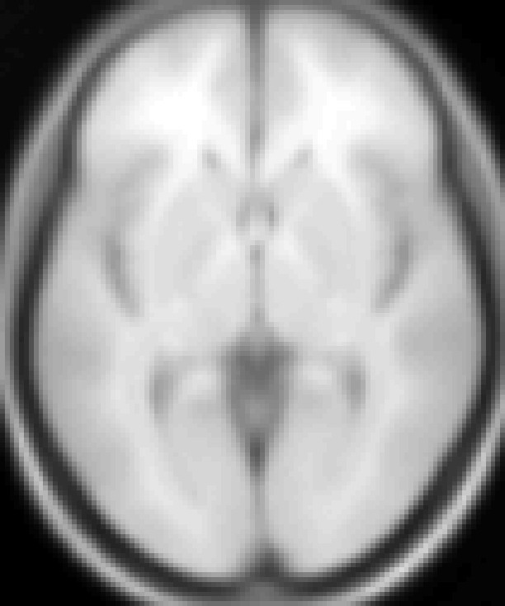
Original image
Spatially normalised
Spatial Normalisation
Template
image
Deformation field

Slide 11
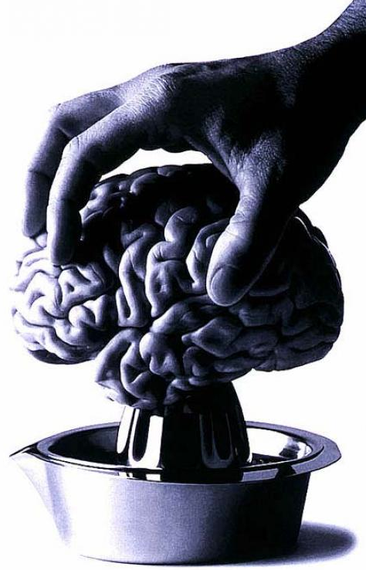
Step 1: affine transformation
Determine optimal affine transformation that fits the source image (usually a single T1 image) to the template image
  Prior knowledge of the variability of head sizes and overall proportions is used to increase the robustness and accuracy of this method
Twelve (!) parameter affine transformation
  3 translations
  3 rotations
  3 zooms
  3 shears

Slide 12
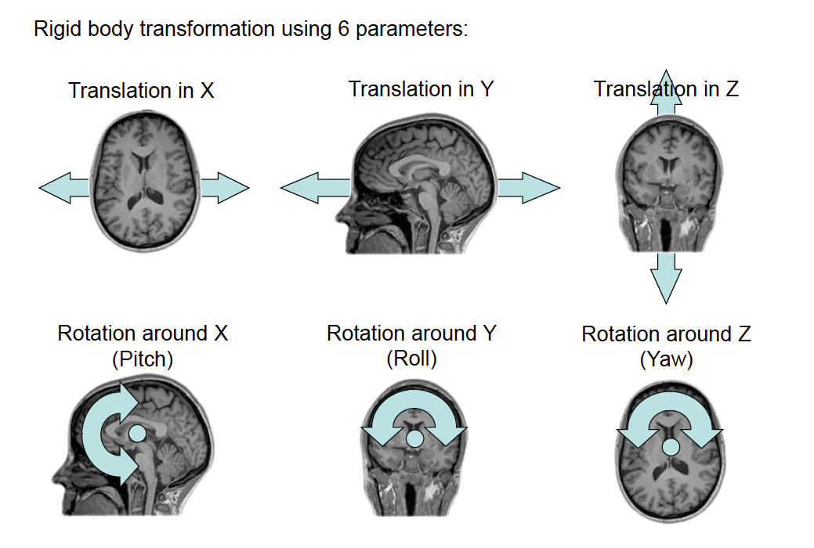
Start with rigid body transformation using the now familiar 6 parameters:
Then go crazy with 3 zooms and 3 shears…

Slide 13
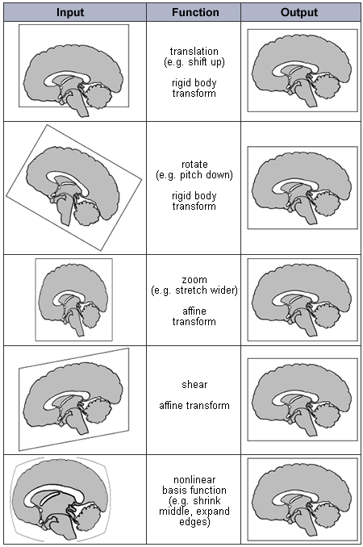

Slide 14
Step 2: non-linear image registration
Deformation consist of a linear combination of smooth basis images
  The deformations are parameterized by a linear combination of about 1000 low-frequency three-dimensional cosine transform bases
Parameters describing global shape differences determined in a small-deformation framework, and regularization is by the bending energy of the displacement field

Slide 15
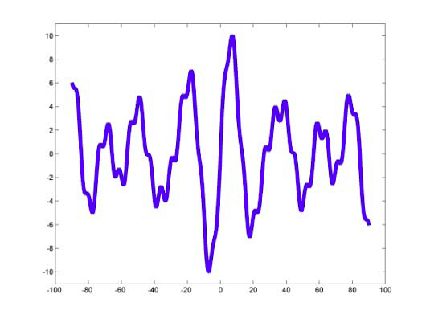
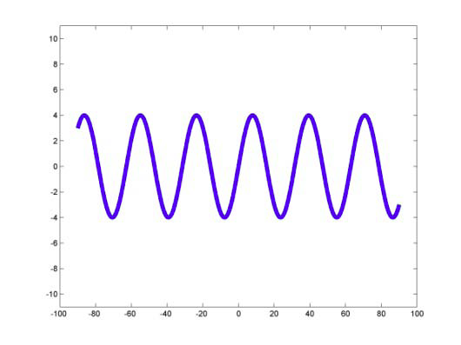
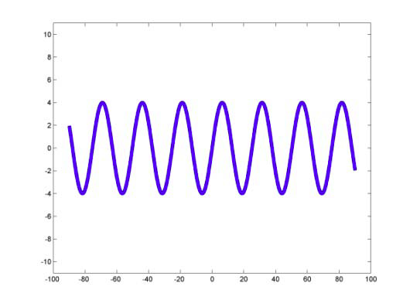
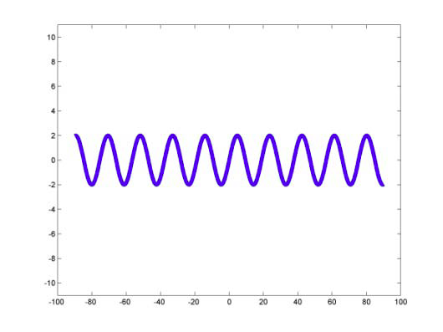
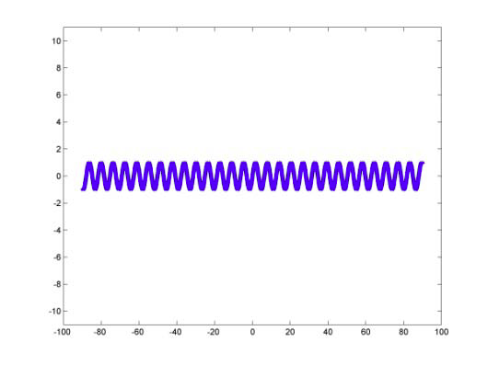
So what are basis functions?
A complex function can be described as a linear combination of a set of simpler basis functions
= ∑ w_{i}fn_{i}
w₁fn₁
w₂fn₂
w₃fn₃
w₄fn₄
Notes:
= Σ wifni w1fn1 w3fn3 w2fn2 w4fn4

Slide 16
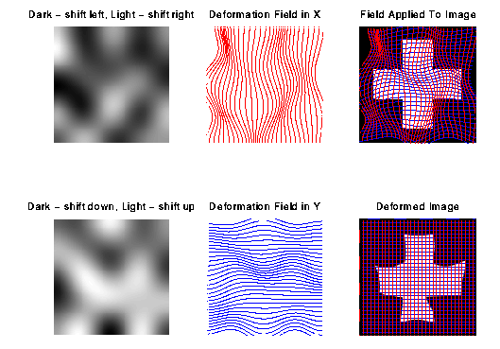
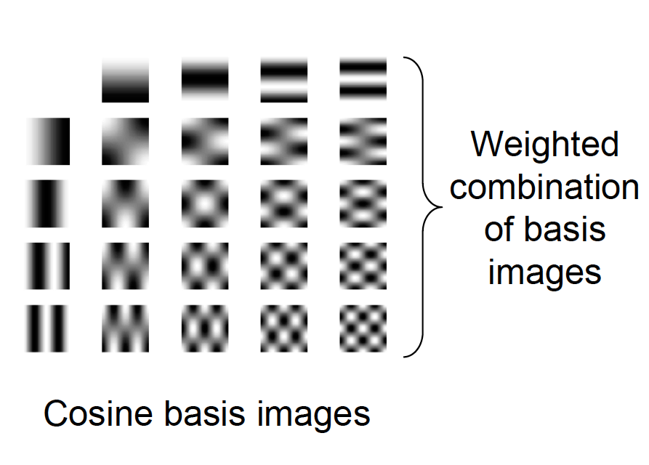
Non-linear basis functions used to warp image
Notes:
deformations are modelled with a combination of non-linear basis functions

Slide 17
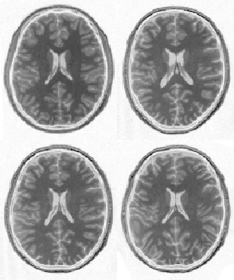
Step-by-step normalizing
Template
image
After affine registration
Affine and non-linear
registration
without
regularisation; can introduce overfitting and unnecessary warps
After affine and non-linear
registration
with
regularisation
Notes:
Regularization: use prior information (Bayesian scheme) about what fit is most likely (unlike rigid-body transformations where constraints are explicit, when using many parameters, regularization is necessary to ensure voxels remain close to their neighbours)

Slide 18
Normalized ≠ the same
Even if normalization algorithms were able to perfectly transform two brains into the same stereotaxic framework, such success would not mean that the brains would have activation in exactly the same voxels
  Normalization is based on gross morphological features
  These features do not necessarily indicate functional divisions between brain areas
    Cytoarchitecture (regional cellular properties) is much more predictive of function but is not visible on MR images
Notes:
-boundaries between cytoarchitectonically distinct regions are highly variable across individuals (just like sulci and gyri)

Slide 19

Other things to keep in mind
Normalization is really about correcting large differences, subsequent smoothing will mop up some residual variability
Normalization approaches are based on subject samples drawn from the typical fMRI pool (i.e. young healthy college kids)
  Many groups differ systematically from this population (e.g., with maturation, aging, or gender)
  Normalizing functional results across different subject groups can mask important group differences
Normalization can be challenging with non-typical brains
  Diseases, strokes, tumors, etc.
Normalization (necessarily) highlights commonalities between individuals and de-emphasizes uniqueness
  You can lose small but potentially meaningful variations in functional neuroanatomy, masking individual differences
Notes:
-elderly = atrophy (sulcal widening and enlarged ventricles); by 80 we lose 15% of our brain mass!
-kids = oddly shaped due to maturation (e.g. atypical frontal cortex) and reduced myelination

Slide 20
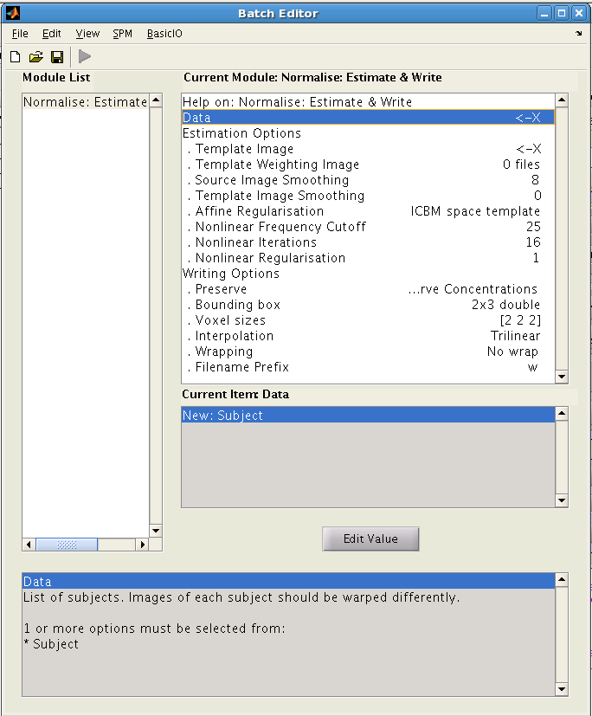
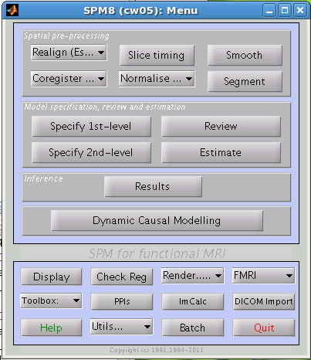
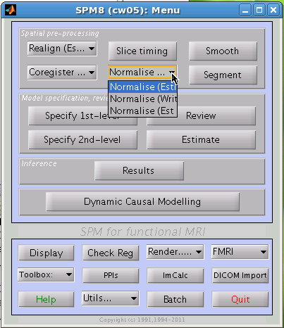
SPM basics
Data = the source image to be normalized
Template image = what you want your image to be warped to match
Voxel sizes= using standard CBU sequence: [3 3 3]
Interpolation = I saw that mine was set to 4th degree B-spline…
Estimate = determine optimal registrations
Write = apply the transformation
Estimate & Write = both

Slide 21

Smoothing
a.k.a. Spatial Filtering

Slide 22

Why smooth?
It increases functional signal to noise ratio
It improves the validity of subsequent statistical techniques
It facilitates averaging across subjects

Slide 23


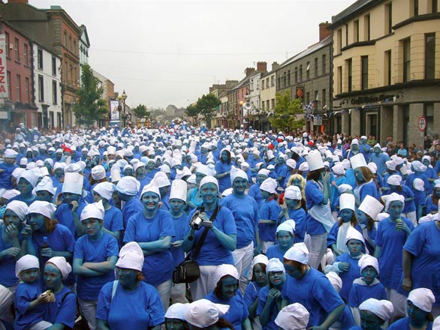
The logic of smoothing
And him?
How likely is it that he is a smurf?
What about her?
Using information about what is happening nearby can give you a better idea of what is going on right here!

Slide 24
Smoothing increases SNR within subjects
Can be understood in terms of the principle of matched filters
  Using a filter of the same frequency as the signal of interest maximizes SNR
  The width of the signal of interest can be understood in a literal sense: the typical spatial extent of regions of activity
  If there were no spatial correlation in fMRI data, so that one could not predict whether a voxel would be active by whether it’s neighbors were active, then spatial filtering would reduce SNR
    However, all fMRI data have spatial correlation, due both to functional similarity of adjacent brain regions and to blurring introduced by the vascular system
    Cortex is about 5 mm deep, so activation of one cortical column can result in two or three active voxels, depending on their size

Slide 25
Smoothing increases SNR across subjects
Additional spatial correlation is introduced when comparing across subjects
  Because all subjects’ brains differ from one another in shape and size and potentially even functional organization, areas of activity are rarely represented in exactly the same voxels
  Instead, combining data across many subjects distributes activity across a range of voxels
By using a filter that matches the expected spatial correlation of the data, one can increase SNR considerably with minimal loss of spatial resolution

Slide 26
Smoothing can reduce false positives
In the analysis of every fMRI data set there will be an enormous number of statistical tests
  In a typical functional imaging volume, there may be more than 100,000 voxels, each of which is evaluated for significance
  If the threshold for significance is set at α < 0.05, there should be ≈ 5,000 voxels active due to chance
  This is the multiple comparisons problem
However, if the data are spatially correlated, then there may be many fewer local maxima that exhibit significant activity

Slide 27
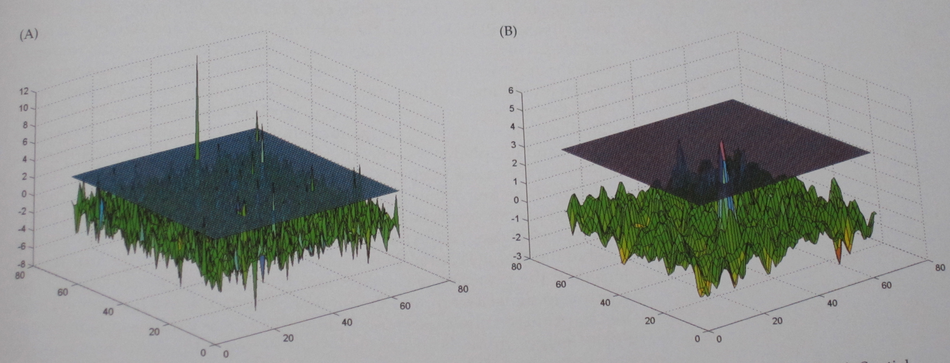
Smoothing can reduce number of local maxima, and subsequently reduce risk of false positives
Before smoothing
After smoothing

Slide 28
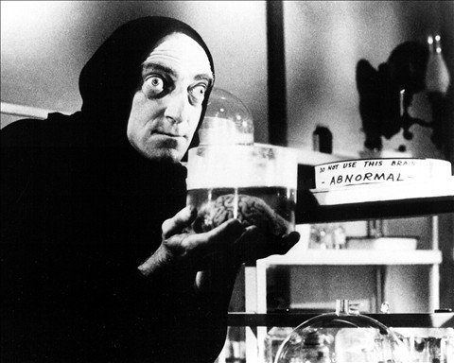
Smoothing increases normality
In addition to its effects on false-positive rates, smoothing provides the additional benefit of improving the validity of experimental tests by making parameter errors more normal
  Any derived parameter, such as the significance value measured at a single voxel, can be considered to be a combination of its true value along with some error
  Many common statistical tests assume that error in measurement is normally distributed
Smoothing increases the normality of the data because averaging of multiple observations tends toward the normal distribution regardless of the properties of the individual observations

Slide 29
Smoothing enables averaging across subjects
Reduces influence of functional and/or anatomical differences between subjects
Even after realignment and normalisation, residual between-subject variability may remain
Smoothing data improves probability of identifying commonalities in activation between subjects, but trade-off with anatomical specificity

Slide 30
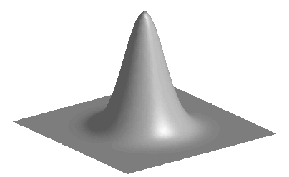
How do we smooth?
Low-pass spatial filters are used to reduce the high-frequency spatial components and “blur” the images
Most common blurring technique is the introduction of a Gaussian filter
  Has the shape of a normal distribution
  Effectively spreads the intensity at each voxel in the image over nearby voxels
  The narrowness or wideness of the the filter refers to the distance of its effect
    A narrow filter only spreads data over a few voxels, while a wide filter spreads data over many voxels
    Spatial filter width for fMRI data is generally expressed in millimeters at half of the maximum value (full-width-half-maximum, or FWHM)
Replaces the values at each voxel with a weighted average of the values in surrounding voxels
FWHM
Gaussian smoothing kernel

Slide 31
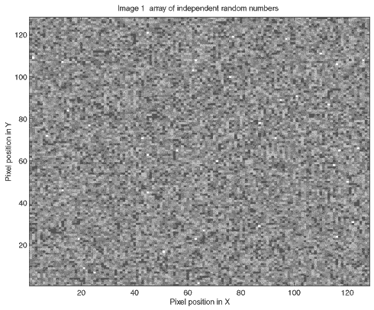
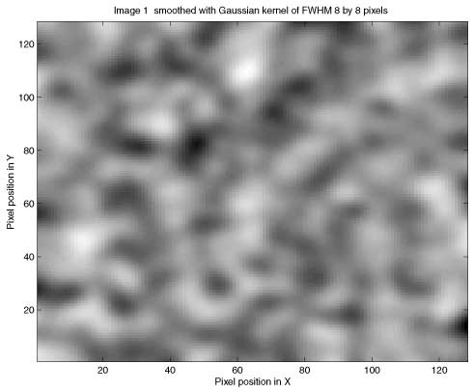
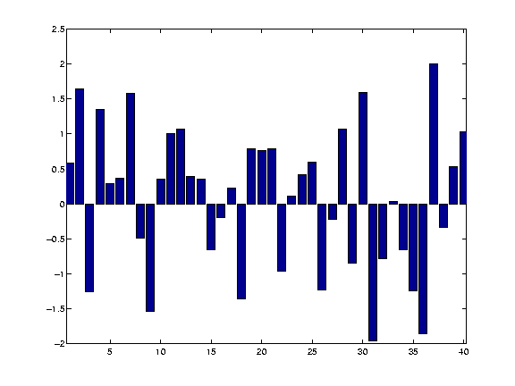
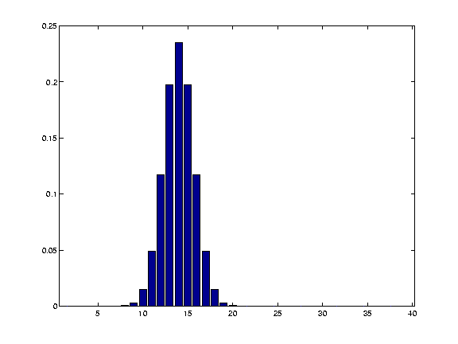
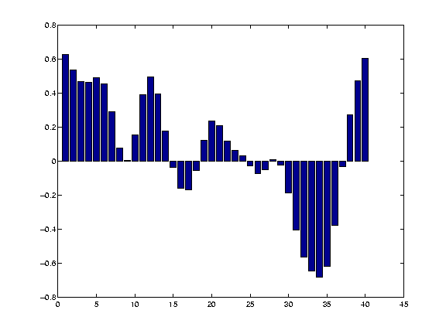
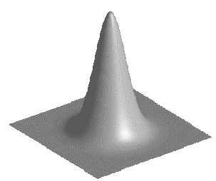
How smoothing works
Raw data
x
Gaussian function
=
Smoothed data

Slide 32
What does a smoothed brain look like?

Slide 33
Potential issues
Primary disadvantages result from the necessarily imperfect match between filter width and activation extent
  If the filter used is too large, then meaningful activations could be attenuated below the threshold of significance (especially problematic for functional structures that are very small e.g., nuclei within the midbrain)
  If the filter used is too small then it will have little positive effect on SNR, while reducing spatial resolution
  Typical filter widths for fMRI are 6-10 mm FWHM (2-3 voxels), although more or less may be best depending on the noise level of the data
  Final smoothness is a product of applied smoothing and intrinsic smoothness
Although smoothing is beneficial for voxelwise analyses, not as straightforward for ROI analyses:
  Experimenter constructs bounded functional regions for subsequent analysis
  Because the edges of these regions are considered to be meaningful, their blurring may introduce unwanted variability

Slide 34
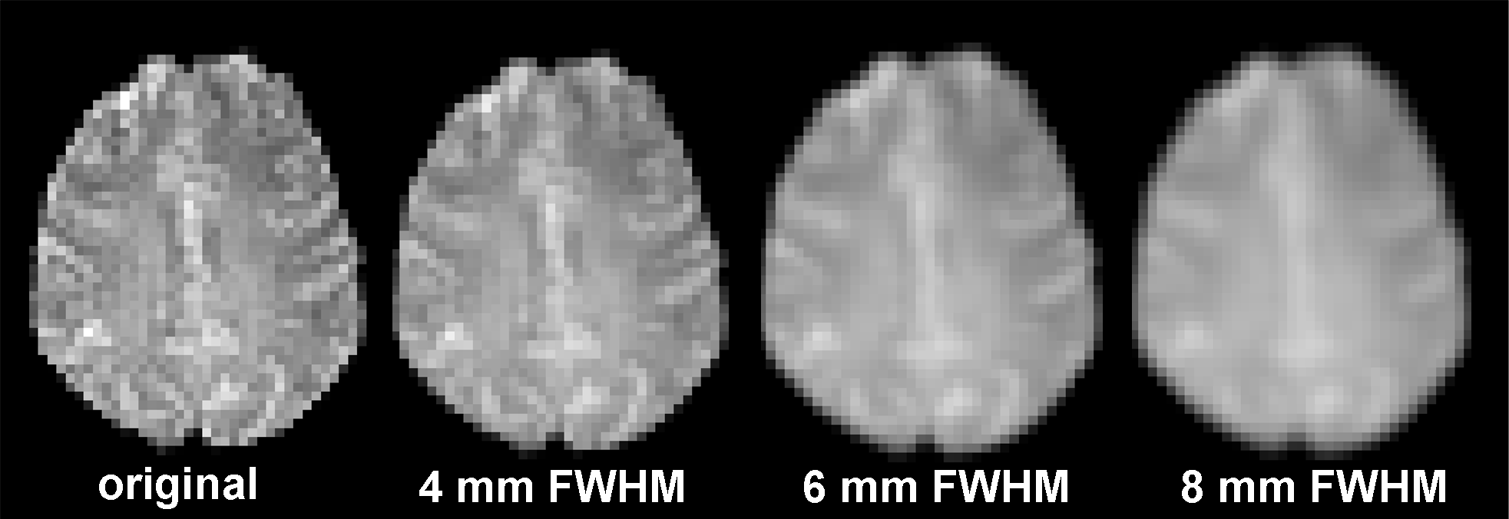
(Kernel) size matters

Slide 35
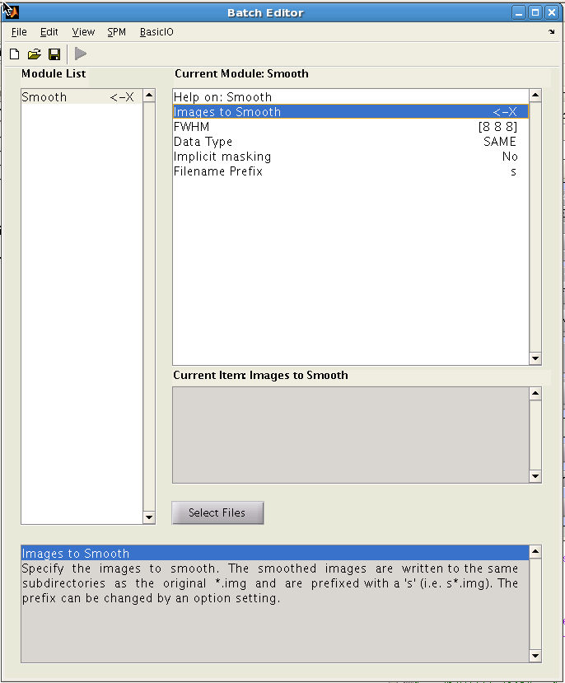
SPM basics
Images to Smooth = your input images
FWHM= kernel size; typically between [6 6 6] and [10 10 10]

Slide 36
Sources
Functional Magnetic Resonance Imaging. (2004). Huettel, S.A., Song, A.W., & McCarthy, G. p 269-279.
Statistical Parameteric Mapping: The Analysis of Functional Brain Images. Edited by KJ Friston, JT Ashburner, SJ Kiebel, TE Nichols and WD Penny. p. 13-14, 63-78.
Slides from the fil Methods for Dummies series, Rik Henson, and Russell Thompson

