Slide 1
Functional Connectivity in MEG
Rik Henson
MRC CBU, Cambridge

Slide 2
Functional Connectivity
Background
Much interest in functional connectivity in fMRI
And yet many neural interactions (e.g, coupled oscillations) occur at a timescale faster than visible by fMRI
Beyond localization: the same set of brain regions could perform different functions depending on how they interact
So, real promise of MEG/EEG is functional connectivity?

Slide 3
Talk Overview
1. Problem of Field Spread (Volume Conduction)
2. Linear vs Nonlinear measures
3. Directed vs Undirected measures
4. Direct vs Indirect measures
5. Generative Models

Slide 4
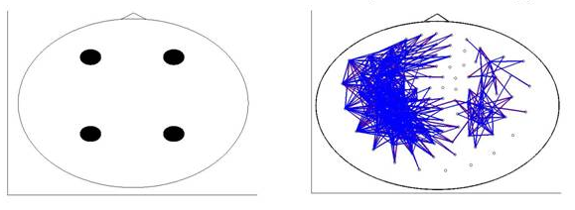
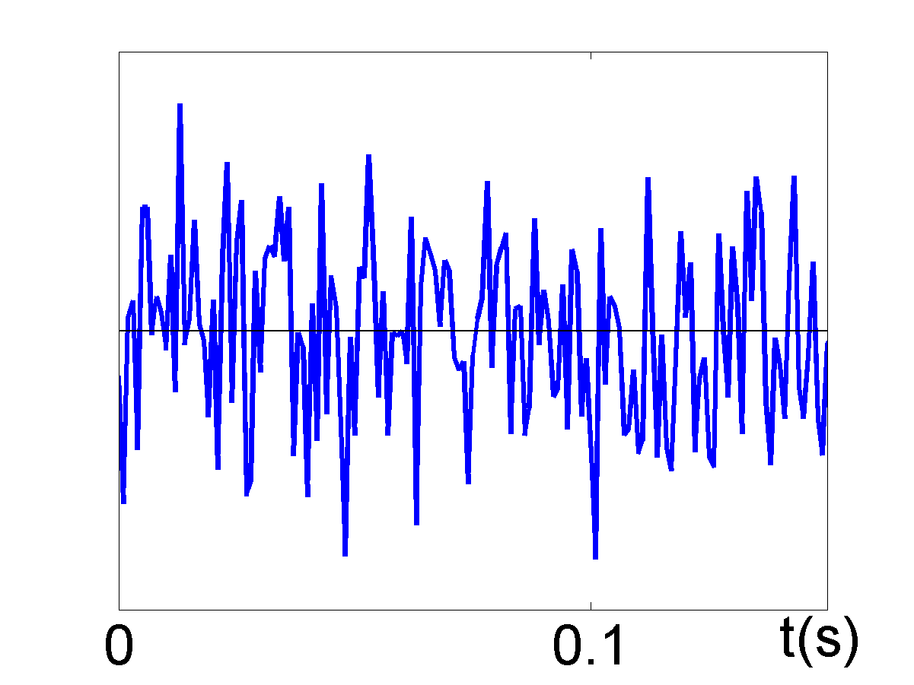
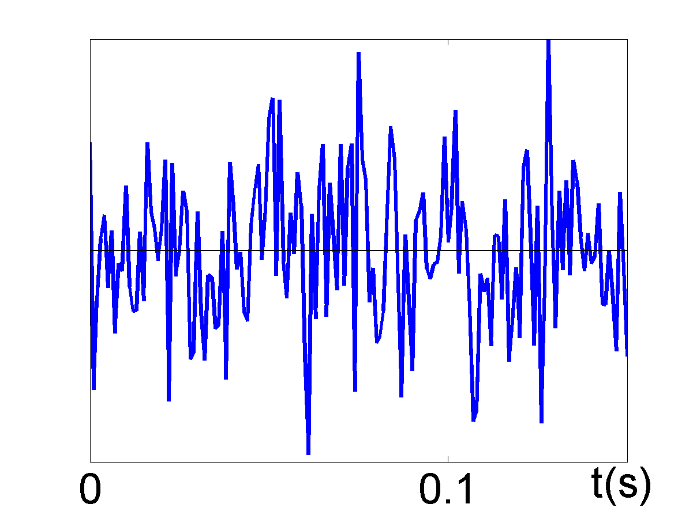
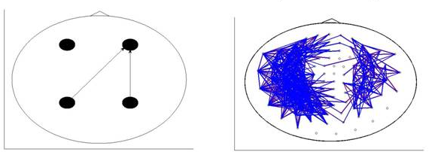
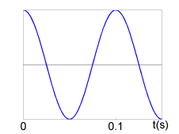
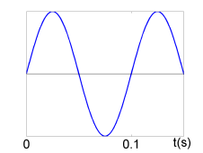
Field Spread Problem
Many (zero-lag) measures of functional connectivity between sensors can be spurious, i.e, reflect activity from single source
No true source connectivity
Spurious sensor connectivity
0-lag correlation
True source connectivity
True sensor connectivity
PDC (see later)

Slide 5
Field Spread Problem
Source reconstruction reduces field spread problem…
…and allows easier comparison with fMRI connectivity
BUT spurious connections between sources can remain (“point-spread”)
…and field-spread is instantaneous (zero-lag), so some measures of connectivity between sensors are immune to field spread (e.g, time- or phase-lagged measures)
Hillebrand et al (2012) Neuroimage

Slide 6
Different Types of Connection
Undirected, Indirect (bivariate)
Directed, Indirect (bivariate)
Directed, Direct (multivariate)
(“effective connectivity”)

Slide 7
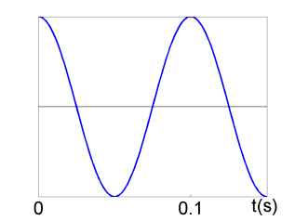
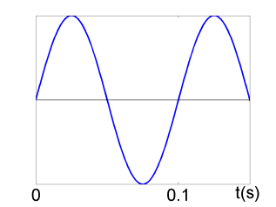
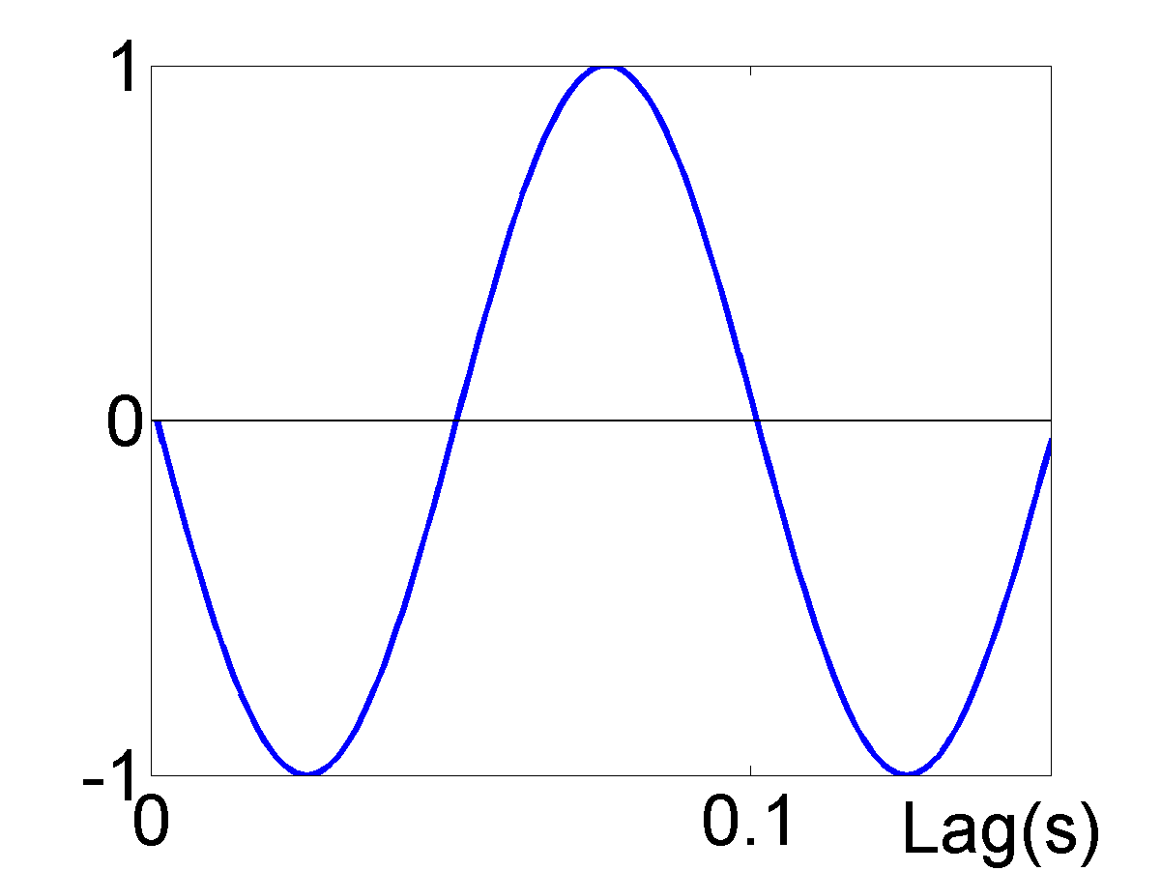
Cross-Correlation
Sensitive to Field-spread (when =0), Undirected, Indirect, Linear
Cross-covariance
=“lag”
Cross-correlation

Slide 8
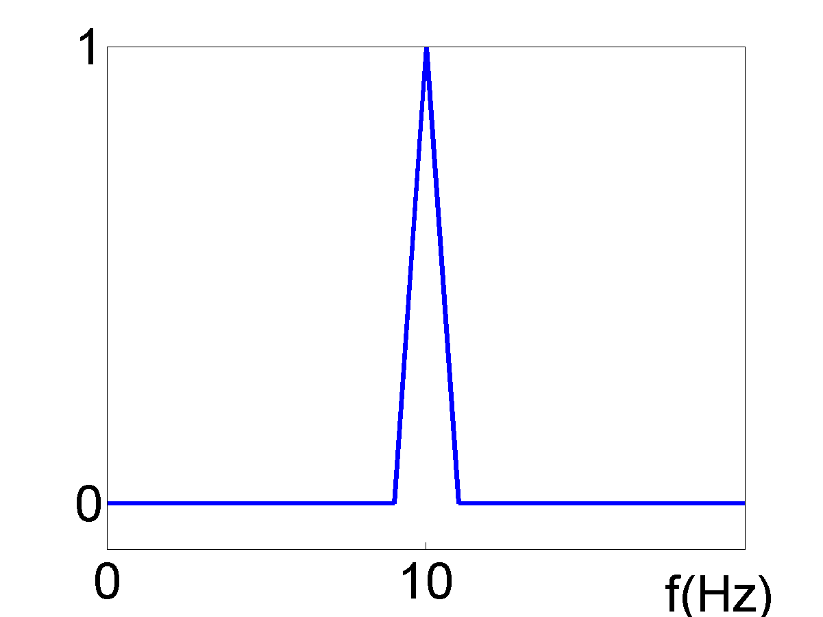
Coherency
(Fourier transform of cross-covariance)
Sensitive to Field-spread, Undirected, Indirect, Linear
Cross-covariance
Coherency
(Magnitude-squared) Coherence

Slide 9
Digression on Complex Numbers
An oscillation of frequency f can be represented in terms of amplitude and phase (polar coordinates), which can also be represented by a complex number

Slide 10
Coherence
Sensitive to Field-spread, Undirected, Indirect, Linear
Cross-covariance
Coherency
(Magnitude-squared) Coherence

Slide 11
Imaginary Coherency
Immune to Field-spread, Undirected, Indirect, Linear
Coherency
Imaginary Coherency
Nolte et al (2004) Clin Neurophys

Slide 12
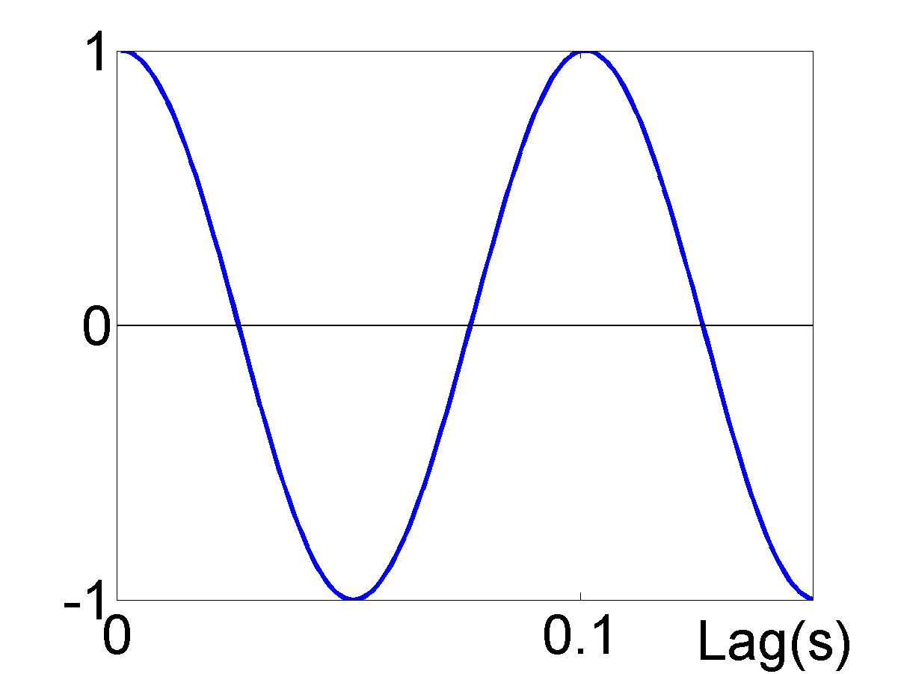
Imaginary Coherency
A zero imaginary component implies a phase of the coherency of either 0º or 180º, which could be caused by field-spread…
Nolte et al (2004) Clin Neurophys

Slide 13
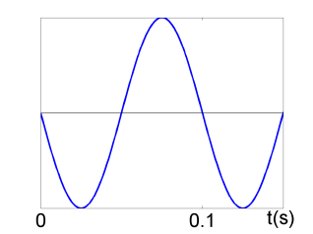
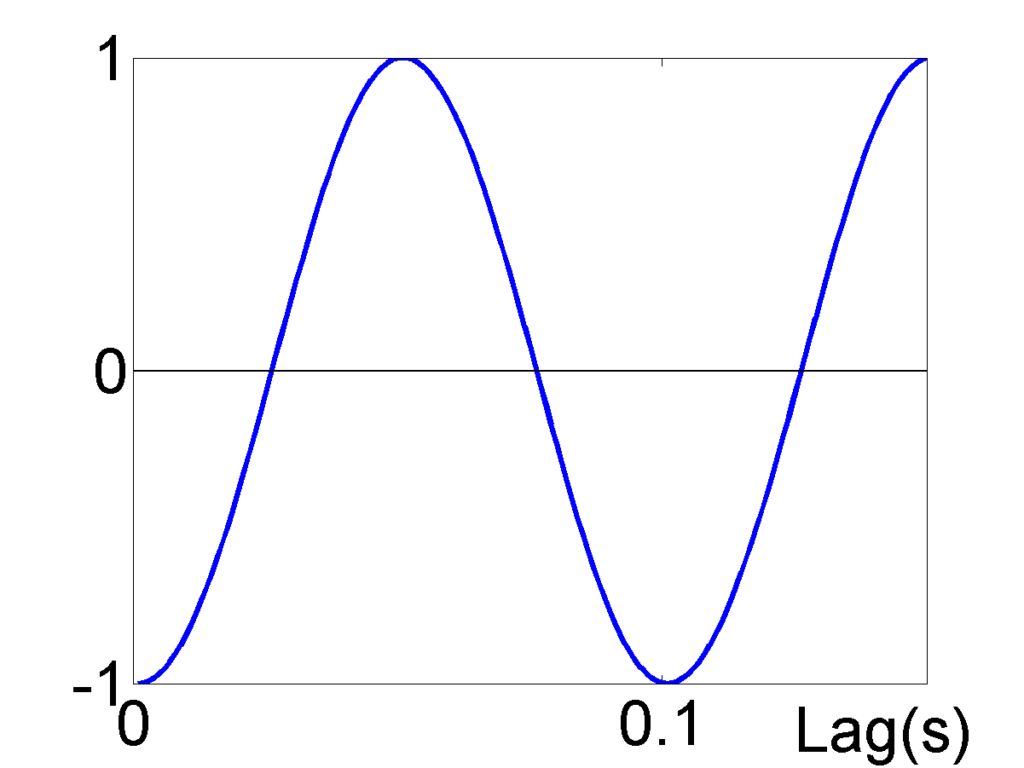
Imaginary Coherency
A zero imaginary component implies a phase of the coherency of either 0º or 180º, which could be caused by field-spread…
Nolte et al (2004) Clin Neurophys

Slide 14
Imaginary Coherency
…whereas a NON-zero imaginary component implies a phase of the coherency other than 0º or 180º, which can NOT be caused by field-spread
Nolte et al (2004) Clin Neurophys

Slide 15
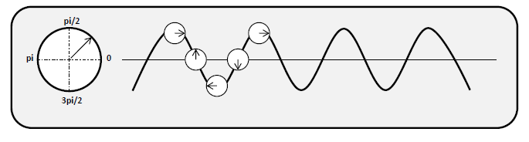
Digression on Analytic Signals
A signal can be represented analytically in terms of its amplitude and phase over time (within a narrow frequency band) (e.g, using Hilbert transform)

Slide 16
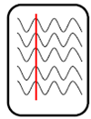
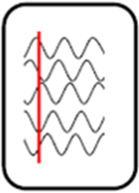
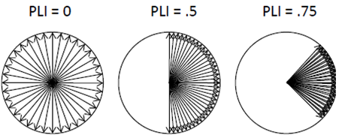
Phase-related Measures
Immune to Field-spread, Undirected, Indirect, Linear
PLV=0 PLV=0.5 PLV=0.75
Phase-Locking Value
Phase-Lag Index
Stam et al (2007) Human Brain Mapp

Slide 17
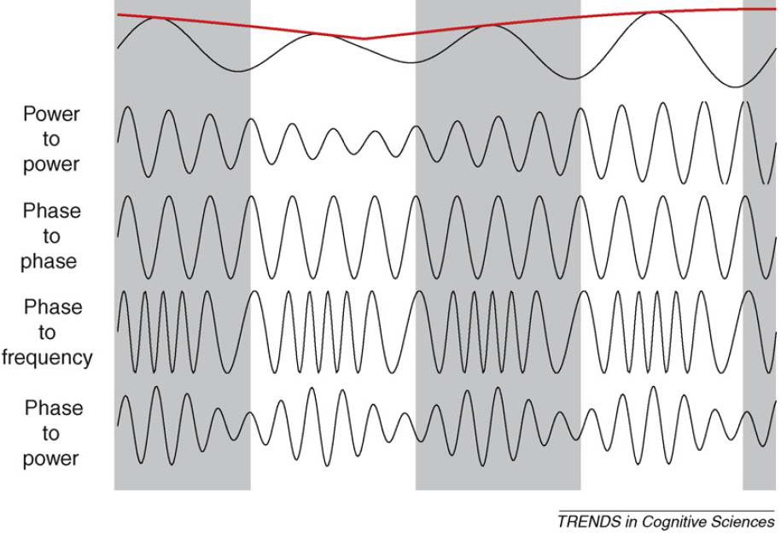
More complex coupling
Power-Power
Phase-Phase
Phase-Freq
Phase-Power
Jenson & Colgin (2007) TICS

Slide 18
Talk Overview
1. Problem of Field Spread (Volume Conduction)
2. Linear vs Nonlinear measures
3. Directed vs Undirected measures
4. Direct vs Indirect measures
5. Generative Models

Slide 19
Nonlinear Measures

Slide 20
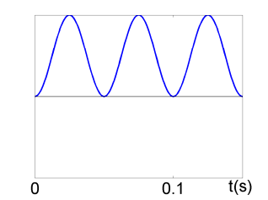
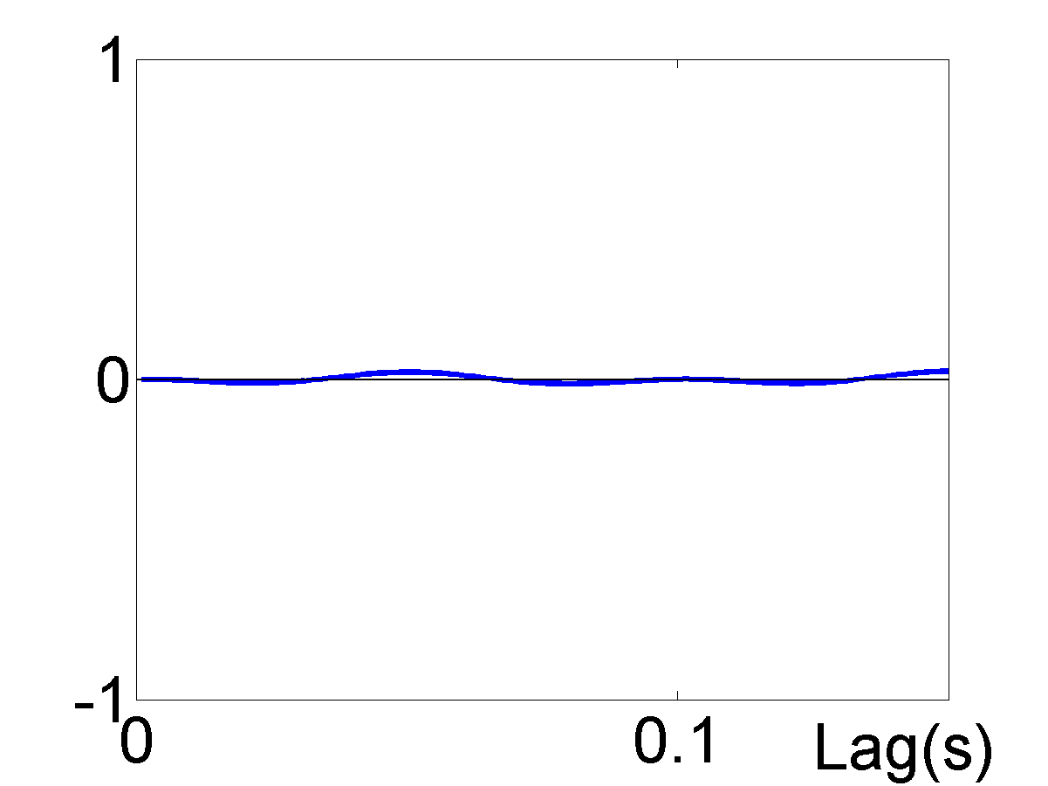
Nonlinear Measures
Cross-correlation/coherence insensitive to nonlinear dependencies

Slide 21
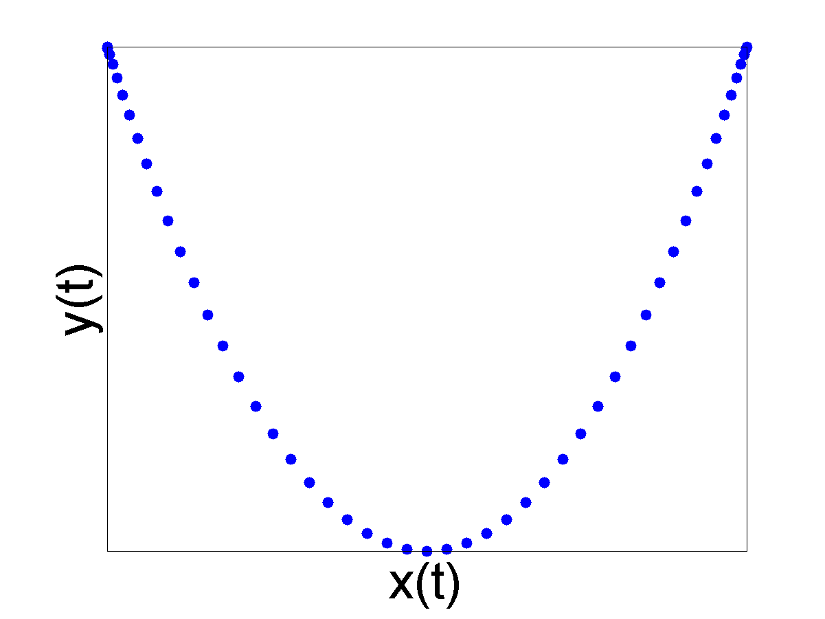
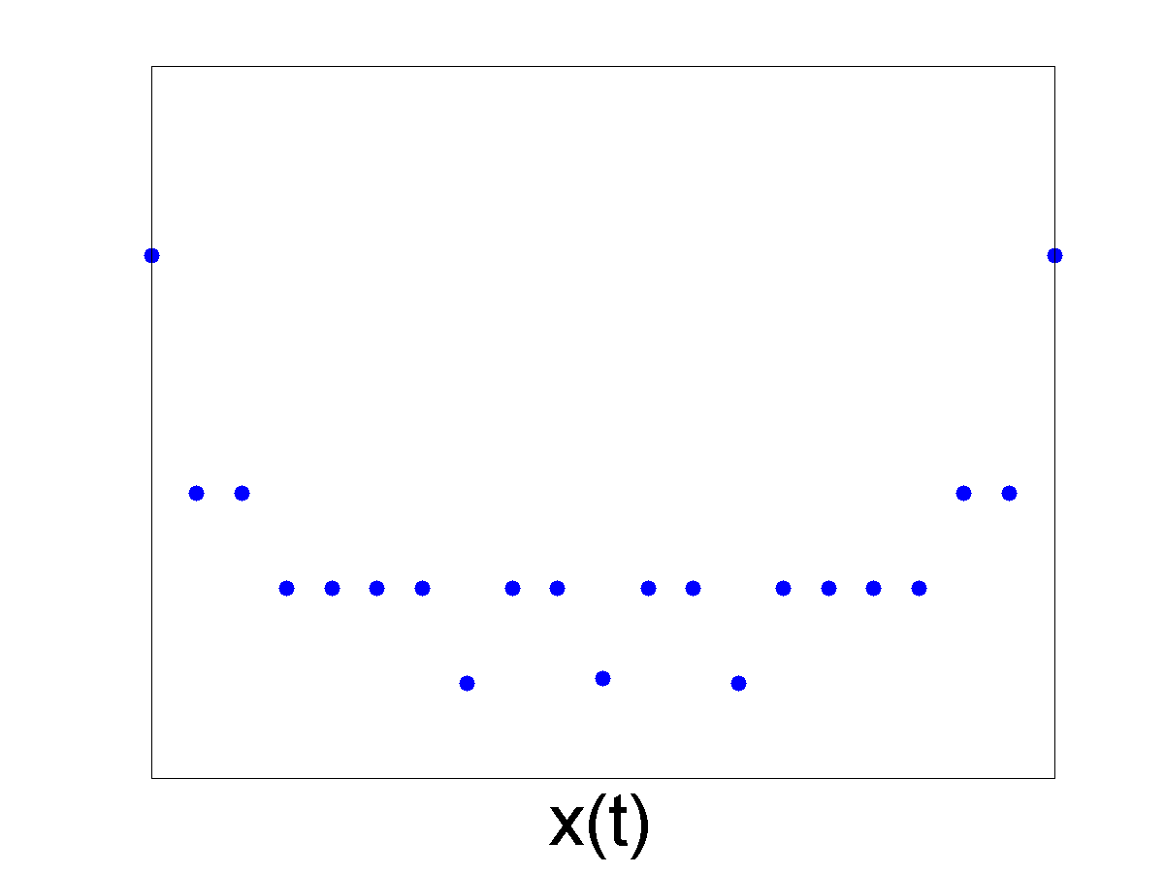
Mutual Information
Sensitive to Field-spread, Undirected, Indirect, Nonlinear

Slide 22
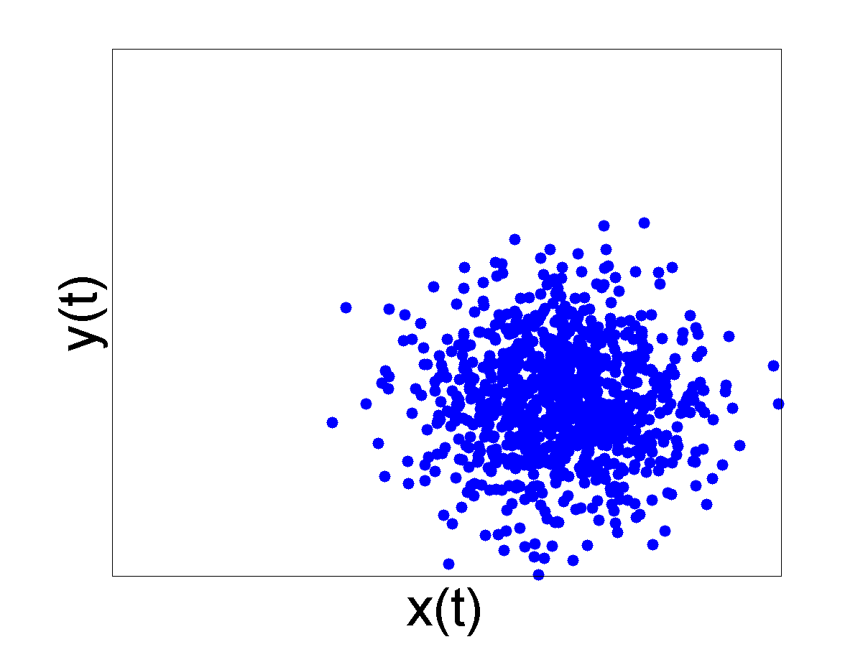
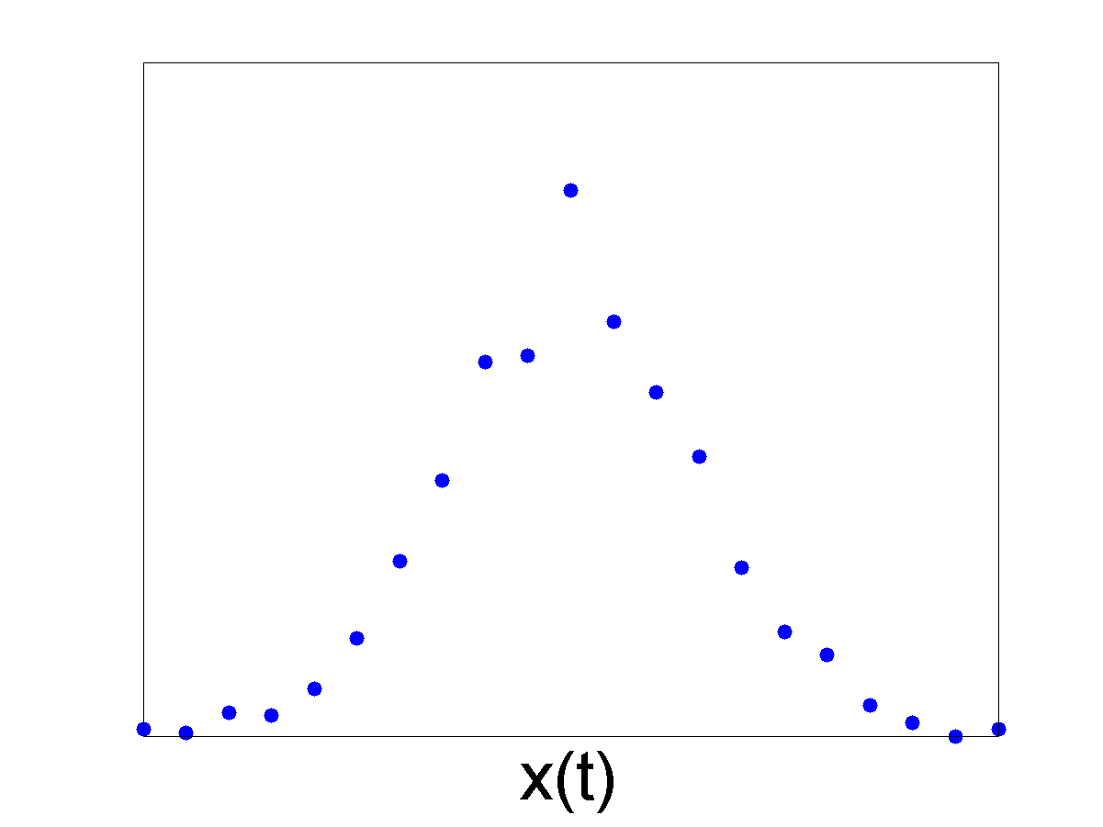
Mutual Information
Sensitive to Field-spread, Undirected, Indirect, Nonlinear

Slide 23
Talk Overview
1. Problem of Field Spread (Volume Conduction)
2. Linear vs Nonlinear measures
3. Directed vs Undirected measures
4. Direct vs Indirect measures
5. Generative Models

Slide 24
Directed Measures
(bivariate) Granger Causality
Immune to Field-spread, Directed, Indirect, Linear
Auto-regressive model to order p
(assuming mean-corrected, with residuals e)
Augmented model including past values of x (to order q)
If classical F-test shows b parameters are non-zero, then x “Granger-causes” y
(special case of MVAR; see later)

Slide 25
Directed, Nonlinear Measures
Transfer Entropy (lagged generalisation of mutual information)
Immune to Field-spread, Directed, Indirect, Nonlinear
Schreiber (2000) Phys Rev Letters
Generalised Synchronisation
Sensitive to Field-spread, Directed, Indirect, Nonlinear
m is the embedding dimension and l lag
D is the Euclidean distance between x_{t} and embedded neighbours
Quian Quiroga et al (2000) Phys Rev E

Slide 26
Talk Overview
1. Problem of Field Spread (Volume Conduction)
2. Linear vs Nonlinear measures
3. Directed vs Undirected measures
4. Direct vs Indirect measures
5. Generative Models

Slide 27
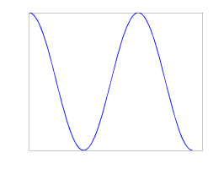
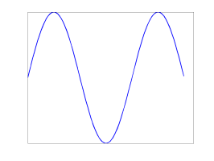
Direct Measures
Multivariate Autoregressive Modelling (MVAR)
Immune to Field-spread, Directed, Direct, Linear
Various summary measures, eg,
Partial Directed Coherence (PDC):
Generalised form of Granger Causality
Though insensitive to true zero-lag dependencies (occur in reality?)
Baccala & Sameshima (2001) Biol Cybernet

Slide 28
Talk Overview
1. Problem of Field Spread (Volume Conduction)
2. Linear vs Nonlinear measures
3. Directed vs Undirected measures
4. Direct vs Indirect measures
5. Generative Models

Slide 29
Generative Models
Immune to Field-spread, Directed, Direct, Nonlinear, model-driven
Connectivity modelled between sources
Projected to sensors via headmodel
Typically a handful of sources, and a range of networks fit to data
Bayesian methods for comparing which network model is best
Dynamic Causal Modelling (DCM) is one approach
Chen et al, 2009, Neuroimage

Slide 30
Measure | Immume to Field Spread | Directed | Nonlinear | Direct
Cross-Correlation | Y (l>0) | N | N | N
Coherence | Y (imaginary) | N | N | N
PLV/PLI | Y | N | N | N
Granger (bivariate) | Y | Y | N | N
Mutual Information | N | N | Y | N
Transfer Entropy | Y | Y | Y | N
Generalised Synchrony | N | Y | Y | N
MVAR (eg, PDC) | Y | Y | Y | N
Generative (eg, DCM) | Y | Y | Y | Y

Slide 31
The End

