Slide 1
Basic probability and Bayes rule
Nikolaus Kriegeskorte
1 October 2013

Slide 2
Overview
Counts, probabilities and continuous densities
Frequentist versus Bayesian: What’s the probability that your significant result is true?
Joint probabilities and conditional probabilities
Sum and product rule
Bayes rule

Slide 3
probabilities and probability densities

Slide 4
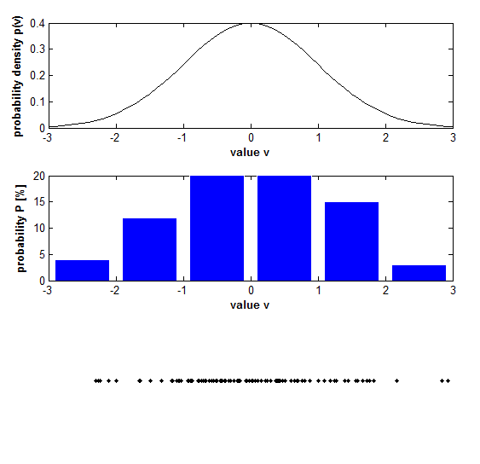
Counts, probabilities, and densities

Slide 5
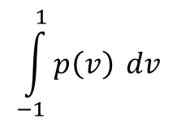
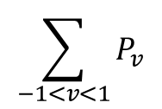
Counts, probabilities, and densities

Slide 6
Frequentist versus Bayesian: What’s the probability that your significant result is true?

Slide 7
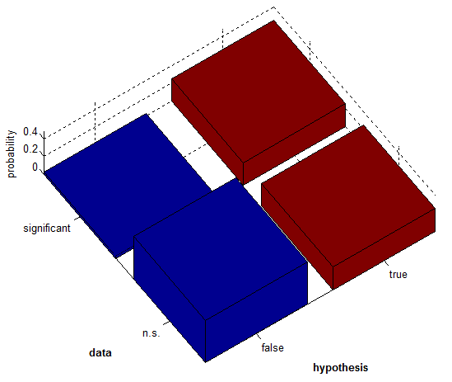
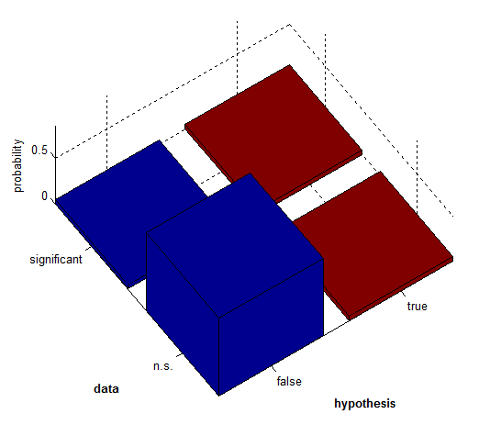
What’s the probability that your significant result is true?
likelihood | specificity: p(signif|false)=0.05 | sensitivity (power): p(signif|true)=0.5
prior | p(false) = 0.5 | p(true) = 0.5
posterior | p(false|signif)=0.09 | p(true|signif)=0.91
likelihood | specificity: p(signif|false)=0.05 | sensitivity (power): p(signif|true)=0.5
prior | p(false) = 0.9 | p(true) = 0.1
posterior | p(false|signif)=0.47 | p(true|signif)=0.53

Slide 8
What’s the probability that your significant result is true?
likelihood | specificity: p(signif|false)=0.05 | sensitivity (power): p(signif|true)=0.5
prior | p(false) = 0.5 | p(true) = 0.5
posterior | p(false|signif)=0.09 | p(true|signif)=0.91
likelihood | specificity: p(signif|false)=0.05 | sensitivity (power): p(signif|true)=0.5
prior | p(false) = 0.9 | p(true) = 0.1
posterior | p(false|signif)=0.47 | p(true|signif)=0.53

Slide 9
% truthOfSignificantResult.m
%% likelihood: p(data|truth)
pSignifGivenTrue=0.5; % sensitivity (= power)
pSignifGivenFalse=0.05; % specificity (= false pos. rate)
%% prior: p(truth)
pTrue=0.1;
pFalse=1-pTrue;
prior=[pFalse pTrue];
%% joint probability mass function
PMF=[pSignifGivenFalse*pFalse pSignifGivenTrue*pTrue
(1-pSignifGivenFalse)*pFalse (1-pSignifGivenTrue)*pTrue];
%% posterior (Bayesian inference)
pTrueGivenSignif = pSignifGivenTrue*pTrue/(pSignifGivenFalse*pFalse+pSignifGivenTrue*pTrue);
%% visualise
h=figure(200); set(h,'Color','w'); clf;
bar3(PMF); view(-35,55); axis equal;
xlabel('\bfhypothesis'); ylabel('\bfdata'); zlabel('probability');
set(gca,'XTickLabel',{'false','true'},'YTickLabel',{'significant','n.s.'});
title({['false-pos. rate: p(signif | false) = ',num2str(pSignifGivenFalse),', power: p(signif | true) = ',num2str(pSignifGivenTrue)],['prior: p(false) = ',num2str(pFalse),', p(true) = ',num2str(pTrue)],['posterior: p(false | signif)=',num2str(1-pTrueGivenSignif,2),', p(true | signif)=',num2str(pTrueGivenSignif,2)]});

Slide 10
probability: sum and product rules

Slide 11
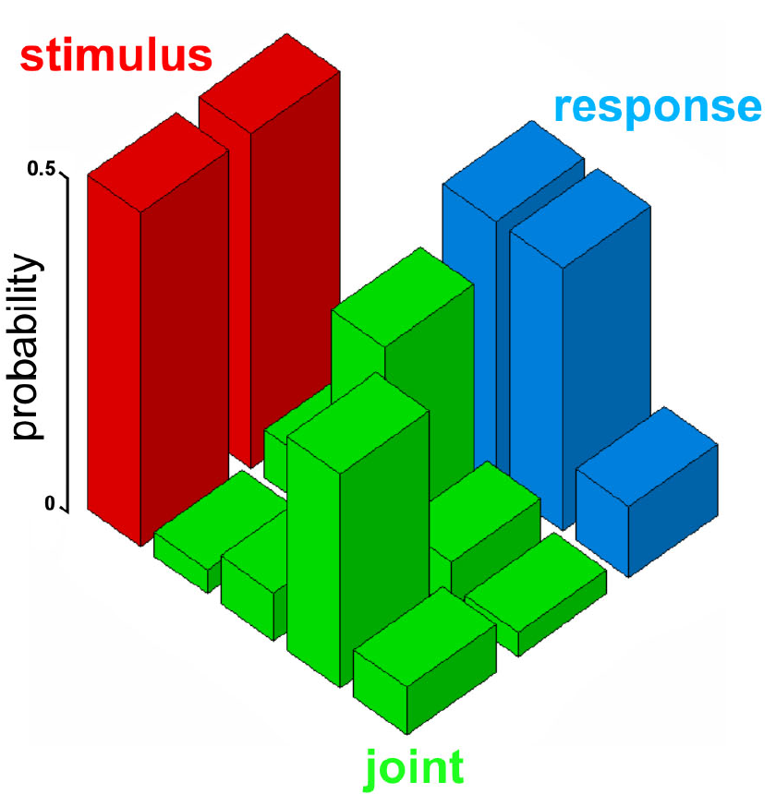
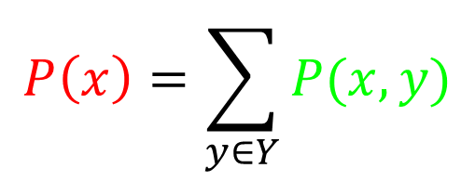
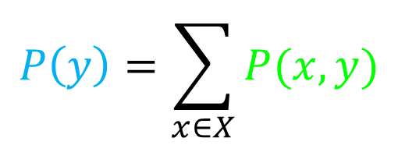
Sum rule
$$P\left(x\right)=\sum_{y∈Y}{P(x,y)}$$
x
y
$$P\left(y\right)=\sum_{x∈X}{P(x,y)}$$

Slide 12
x
y

Slide 13
Product rule
$$P\left(x,y\right)=P\left(x | y\right)P(y)$$
$$=P\left(y | x\right)P(x)$$
x
y
$$\frac{P\left(x,y\right)}{P(y) }=P\left(x | y\right)$$

Slide 14
Bayes rule
$$P\left(m | d\right)=\frac{P\left(d|m\right)P(m)}{P(d) }$$
$$=\frac{P\left(d|m\right)P(m)}{\sum_{m′∈M}{P\left(d | m^{′}\right)P(m′)} }$$
m
d

Slide 15
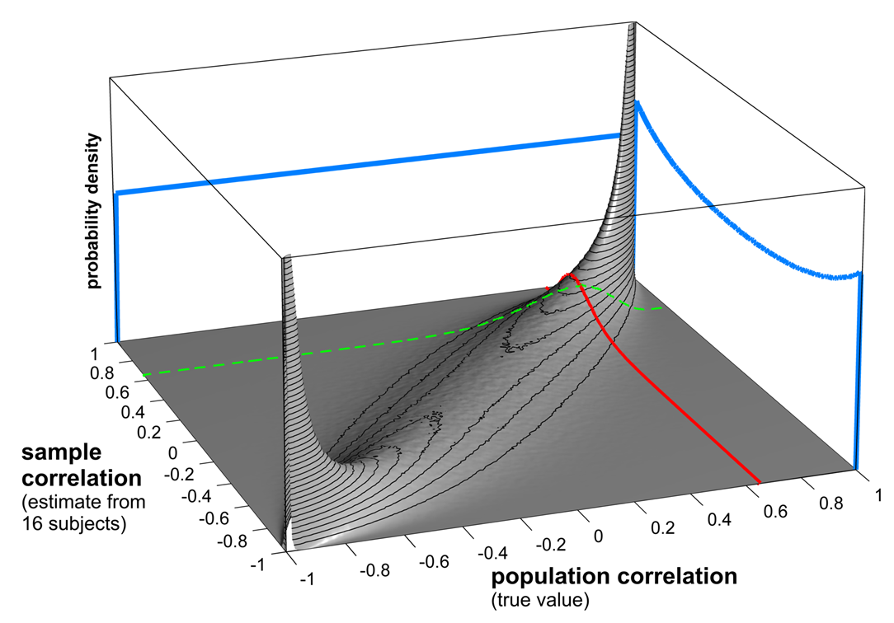
Sample and population correlation
p(population r |
sample r = 0.65)
p(sample r |
population r = 0.65)

