Slide 1
Bayesian Interest Group Session Two
Andrew Thwaites & Fawad Jamshed

Slide 2
Reminder
Bayesian inference:
Inferring something about the world by optimally combining existing beliefs with new evidence.
If new evidence = Ev, existing beliefs= $B_{existing}$ and new belief= $B_{new}$
Then by Bayes’ rule:
Prior
Likelihood
p($B_{new}$ |Ev, $B_{existing}$) = p(Ev| $B_{new}$, $B_{existing}$) * p($B_{new}$ | $B_{existing}$)
p(Ev| $B_{existing}$)
Posterior
marginal likelihood

Slide 3
Examples of Bayesian inference
p($B_{new}$ |Ev, $B_{existing}$) = p(Ev| $B_{new}$, $B_{existing}$) * p($B_{new}$ | $B_{existing}$)
p(Ev| $B_{existing}$)
A scientist can use this framework to work out ‘how sure’ he/she is of a hypothesis (i.e. its ‘probability’) from data….
… to work out the ‘true’ value of unknown parameters of a hypothesis’…
… or to choose between hypotheses.
p($H$ |data, existing-knowledge) = p(data | $H$,existing-knowledge) * p($H$ |existing-knowledge)
p(data|existing-knowledge)

Slide 4
Areas we will try to cover today:
What is a probabilistic generative model?
What is “inference on a model”?
What is Bayesian inversion of a model?
What is the Bayesian Occam’s razor?

Slide 5
-We have some data of the daily temperature and how many people went out-side that day
-Given today’s temperature value, can we guess how many people might be outside?
-We have some data of smells and what foods they come from.
-Smelling something in the kitchen, can we guess what food is being cooked?

Slide 6
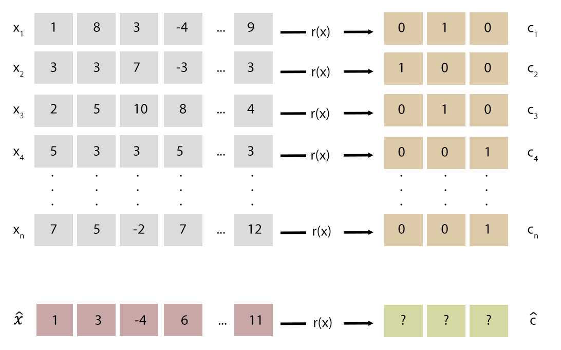
What is a probabilistic generative model?
X
C

Slide 7
What is a probabilistic generative model?
We don’t know the true relationship as a function. i.e. ‘r(x)’
We could simply guess, but…
a) the number of possible functions is infinite
b) the data may be many to one making finding a well- defined function impossible.

Slide 8
What is a probabilistic generative model?
What about a procedure that can infer some sort of mapping probabilistically?
Let us say that $c_{k}$ stands for a possible value $\hat{c}$.
If we could approximate the $p(c_{k}|\hat{x},X,C)$ for each $c_{k}$, accurately enough, we could just choose the $c_{k}$ with the highest probability, and this would be $\hat{c}$!
Approximating r(x) is thus a by-product of trying to estimate $p\left(c_{k} | \hat{x},X,C\right)$
For example:
We have some blood_result/infection pairs (X, C).
Given some blood results for a new patient and X,C, we would like probability of infection for this new patient, ie:
p(infected|ann’s_blood_results, X, C) = 0.7
p(not_infected|ann’s_blood_results, X, C) = 0.3

Slide 9
Reminder
$c_{k}$ = our possible values of c, in this case ‘0’ and ‘1’
‘x’ (on its own) = is our notation for all possible values of x
p(i|j,m) = the probability of i being true given j and m
$\hat{x}=the new x$
$\hat{c}=the new c we need to make a best guess at$

Slide 10
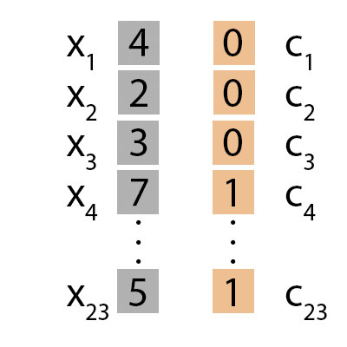
First: discriminative
models
Using X and C, we could try and estimate the $p(c_{k}|\hat{x}, X,C)$s directly (‘discriminative’ modelling).
Example:
if $\hat{x}=$ 3 what is $\hat{c}$?

Slide 11
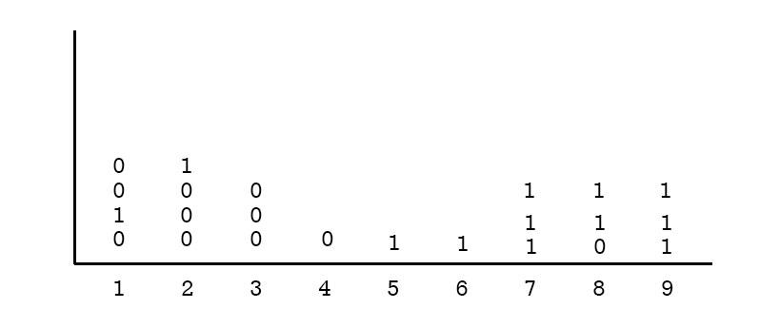
First: discriminative
models
First we choose a suitable way to estimate the $p(c_{k}|\hat{x}, X,C)$s directly
For this example a ‘logistical regression model’ might work well (there are plenty of discriminative models for different problems).
P($c_{k}$=1|x,X,C)$=\frac{1}{1+exp⁡(w_{o}+\sum_{i=1}^{n}{w_{i}X_{i}})}$
Notes:
Explain frequency visuallisation, laying over th top probability density functions, and contiuous/discreet.

Slide 12
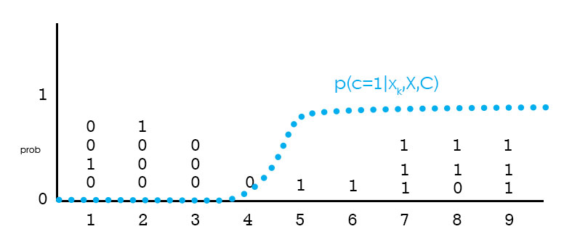
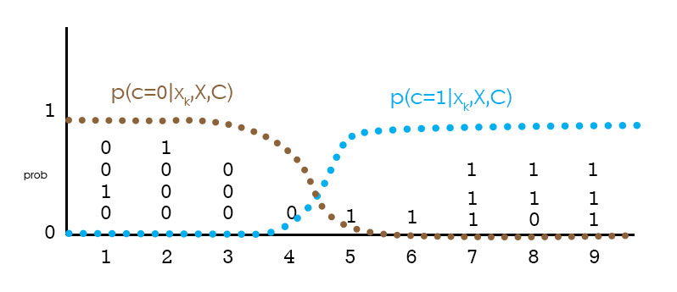
First: discriminative
models
Doing logistic regression on the data estimates p($c_{k}$|x, X, C) for all $c_{k}$, for all values of x
The unknown relationship between C and X is being estimated directly by the process of logistic regression.
Thus if $\hat{x}$=3
then p($c_{k}$=0|3,X,C) = 0.999
and p($c_{k}$=1|3,X,C) = 0.001
Notes:
Explain decision bondary!

Slide 13
What is a probabilistic generative model?
So that was descriptive modelling…
- but what is probabilistic generative modelling?
Notes:
Estimating pxc, X,C, pcX,C and p(x|X,C)and then using this as the basis for pcx, X,C is called ‘probabilistic generative modelling’.

Slide 14
What is a probabilistic generative model?
In the last example we estimated $p\left(c_{k} | \hat{x},X,C\right)$ for all possible values of $c_{k}$ and then chose the maximum.
But can we make this estimation better?
$p\left(c_{k} | \hat{x}, X,C\right)= \frac{p\left(\hat{x} | c_{k}, X,C\right)∗ p\left(c_{k} | X,C\right)}{p(\hat{x}|X,C)}$ (by Bayes’ rule)
Estimating $p\left(\hat{x} | c_{k}, X,C\right)$, $p\left(c_{k} | X,C\right)$ and $p(\hat{x}|X,C)$and then using this as the basis for $p\left(c_{k} | \hat{x}, X,C\right)$ is called ‘probabilistic generative modelling’.
Notes:
Estimating pxc, X,C, pcX,C and p(x|X,C)and then using this as the basis for pcx, X,C is called ‘probabilistic generative modelling’.

Slide 15
What is a probabilistic generative model?
How is this different? Surely they must give us the same answer?
No - we are only ever approximating all these probability distributions. These approximations are necessarily going to be different for a DM and a GM, because we are approximating different things in both cases.
How different any two estimations of $p\left(c_{k} | \hat{x}, X,C\right)$will be (say, between any DM and GM) will depend on the problem, on the nature of the available data, and on the assumptions used.
Notes:
No - we are only ever…. These will almost certainly contain different assumptions
(Ng & Jordan, 2002)

Slide 16
What is a probabilistic generative model?
Let’s look at the same X, C and $\hat{x}$ as before, but this time estimating $\frac{p\left(\hat{x} | c_{k}, X,C\right)∗ p\left(c_{k} | X,C\right)}{p(\hat{x}|X,C)}$
First we will estimate the probability density function $\frac{p\left(x | c_{k}, X,C\right)∗ p\left(c_{k} | X,C\right)}{p(x|X,C)}$
Notes:
Explain frequency visuallisation, laying over th top probability density functions, and

Slide 17
What is a probabilistic generative model?
$$p\left(c_{k} | x, X,C\right)=\frac{p\left(x | c_{k}, X,C\right)∗ p\left(c_{k} | X,C\right)}{p(x|X,C)}$$
First: $p\left(c_{k} | X,C\right)$.
This is the probability of being any particular $c_{k}$. In the case above, we can estimate this very easily, because there are only two classes, $c_{k}=0 (ie \hat{c}=0)$ and${ c}_{k}=1 (ie \hat{c}=1)$. The relative number of instances of each ${ c}_{k}$ found in C will be a good estimation of this.
$p\left(\hat{c}=0 | X,C\right)=\frac{11}{23}$
$$p\left(\hat{c}=1 | X,C\right)=\frac{12}{23}$$

Slide 18
What is a probabilistic generative model?
$$p\left(c_{k} | x, X,C\right)=\frac{p\left(x | c_{k}, X,C\right)∗ p\left(c_{k} | X,C\right)}{p(x|X,C)}$$
N$ext p\left(x | c_{k}, X,C\right).$
This involves estimating with what probability we would see data $x$ if $c_{k}$were true.
$p\left(x | c_{k}, X,C\right)$ is modelled as a probability density function. Estimating this pdf involves some assumptions about the probability of each value of x given a c. For instance, in this case, seeing that 0s are clustered around 2 and 1s around 8, we might think that that the probability of being a 0 or a 1 was normally distributed around theses data values.
This assumption having been made, we can then tailor this assumption to the data, by ‘training’ it on the data (in the case of our two normal pdfs, finding their mean and sd (their ‘hidden parameters’ or ‘θ’)).
This tailoring ‘stage’ is known variously as the ‘learning’/’training’/’optimising/fitting’ stage
Notes:
$p\left(x | c_{k}, X,C\right)$ - class conditional densities

Slide 19
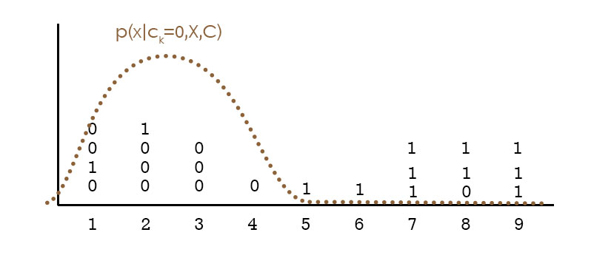
Training the likelihood function
$$p\left(c_{k} | x, X,C\right)=\frac{p\left(x | c_{k}, X,C\right)∗ p\left(c_{k} | X,C\right)}{p(x|X,C)}$$
Finding the hidden parameters:
1. Make assumption about distribution of data.
These assumptions will contain hidden variables ‘Θ’
3. Try to work out what these ‘Θ’ are by adjusting their values to best generate the data
This training regime can itself be done using Bayesian inference (MAP, ML etc)
mean?
sd?
Notes:
$p\left(x | c_{k}, X,C\right)$ - class conditional densities

Slide 20
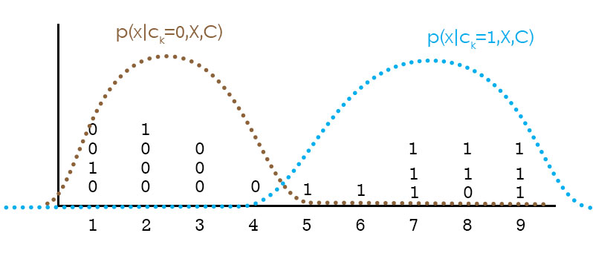
What is a probabilistic generative model?
$$\frac{p\left(x | c_{k}, X,C\right)∗ p\left(c_{k} | X,C\right)}{p(x|X,C)}$$
Let us assume that we have now trained the θs for the two class conditional densities in our example
This means $p\left(x | c_{k}, X,C\right)$ for both $c_{k}$ have now been estimated
Notes:
Probability density functions

Slide 21
What is a probabilistic generative model?
$$p\left(c_{k} | \hat{x}, X,C\right)=\frac{p\left(x | c_{k}, X,C\right)∗ p\left(c_{k} | X,C\right)}{p(x|X,C)}$$
Now, lastly, $p(x|X,C)$.
$$p\left(x | X,C\right)=\sum_{k}{p\left(x | c_{k},X,C\right)∗p(c_{k}|X,C)}$$
So in our example this expand to
$$p\left(x | c=1,X,C\right)∗p\left(c=1|X,C\right)+ p\left(x | c=0,X,C\right)∗p(c=0|X,C)$$
We have estimations for all these from above already.
To put it a bit more visually:

Slide 22
What is a probabilistic generative model?
Putting it all together
$$p\left(c_{k} | \hat{x}, X,C\right)=\frac{p\left(\hat{x} | c_{k}, X,C\right)∗ p\left(c_{k} | X,C\right)}{p(\hat{x}|X,C)}$$
$$c_{k}=0$$ | $$c_{k}=1$$
$$p\left(\hat{c}=0 | x, X,C\right)= \frac{p\left(x | \hat{c}=0, X,C\right)∗ p\left(\hat{c}=0 | X,C\right)}{p\left(x | X,C\right)}$$ | $$p\left(\hat{c}=1 | x, X,C\right)= \frac{p\left(x | \hat{c}=1, X,C\right)∗ p\left(\hat{c}=0 | X,C\right)}{p\left(x | X,C\right)}$$
$$= \frac{ ∗11/23}{ }$$ | $$= \frac{ ∗12/23}{ }$$
Now find out the numbers for when x = 3
$$= \frac{ ∗11/23}{ }$$ | $$= \frac{ ∗12/23}{ }$$
$p\left(\hat{c}=0 | \hat{x}=3, X,C\right)$ = 0.99 | $p\left(\hat{c}=1 | \hat{x}=3, X,C\right)$ = 0.01

Slide 23
What is a probabilistic generative model?
If we are only interested in the maximum $p\left(c_{k} | \hat{x}, X,C\right)$ ie because we want to know which $c_{k}$is most likely given $\hat{x}$, then we don’t need to know $p(\hat{x}|X,C)$, because it will be the same, regardless of the c or x.
In other words, to work out the $c_{k} with the highest p\left(c_{k} | \hat{x}, X,C\right)$ using generative modelling we only need:
$p\left(x | c_{k}, X,C\right)∗ p\left(c_{k} | X,C\right)$
(This is also written $p\left(c_{k},x | X,C\right)$ and known as the joint probability of c and x.)
You will often see text-books refer to the fact that discriminative models estimate $p\left(c_{k} | x, X,C\right)$ while generative modelling estimate $p\left(c_{k},x | X,C\right)$.
Notes:
This is why you see joint probability in the generative model literature. - But remember, this is only the case where the one wants to compare the probabilities coming out of generative models that the marginal likelihood can safely be ignored (ie the max or min).

Slide 24
What is a probabilistic generative model?
A ‘discriminative estimation’ makes no direct attempt to model the underlying distribution of the variables and features; it jumps straight to trying to estimate $p\left(\hat{c} | \hat{x},X,C\right)$.
A ‘probabilistic generative estimation’ attempts to model the underlying distribution of the features more directly (the ‘learning’ stage) before estimating $p\left(\hat{c} | \hat{x},X,C\right)$.
As a result, training a generative model is more computationally demanding than training a discriminative model, and generally requires a larger training set to estimate the various components of
$$\frac{p\left(\hat{x} | \hat{c}, X,C\right)∗ p\left(\hat{c} | X,C\right)}{p(\hat{x}|X,C)}$$

Slide 25
What is a probabilistic generative model?
However - generative models, when estimated well, can often predict $\hat{c}$ better than discriminative models as they can pick up on various subtleties of the X-C training set that ‘discriminative estimation’ might miss.
A second advantage to generative models is that one can incorporate unsupervised data into it.
This is because the assumptions about the shape of the underlying data are being estimated in the ‘learning’ phase of GM, and the distribution of unlabeled data can be used to improve this step.
Notes:
Explination

Slide 26
Relationship between probabilistic generative models and discriminative models
Generative-Discriminative Pairs
Given certain assumptions about the relationship between X and C one can think of certain models having an obvious ‘twin‘ in the other camp
‘Discriminative modeling’ | ‘Generative modeling’
Logistic Regression | (Gaussian) Naive Bayes ((G)NB)
Linear-Chain CRFs | Hidden Markov Models
Conditional Random Field Models | Markov Random Field Models
…Gaussian Processes, Regularization networks, Support Vector Machines, Neural Networks, Entropy models, Perceptrons | …Gaussian Mixture Models, Mixtures of multinomials, Mixtures of experts, Sigmoid Belief Networks, Bayesian Networks, N-gram models, Probabilistic content free grammars
Both are linear classifiers
Both are sequentialized versions of the above
But the in most cases there is not an obvious pairing:
Notes:
But the in most cases there is not an obvious pairing: And this isn’t really a surprise – we are estimating different things after all

Slide 27
Assorted terms of interest related to generative models
Maximum a posteriori estimation (‘MAP’)
The general process of ‘finding the value x when p(x|y) is maximised using $\frac{p\left(y | x\right)∗ p(x)}{p(y)}$’.
We used MAP above to work what $\hat{c}$ was in the generative model example.
This technique is often used to try and estimate Θ (aka ‘training’ Θ; aka ‘optimising’ Θ; aka ‘learning’ Θ; aka ‘inferring’ Θ).
$\max_{\text{Θ}}{\frac{p\left(training_data | \text{Θ}\right)∗ p(\text{Θ})}{p(training_data)}}$
To estimate this properly for a continuous function we have to work out how to deal with local maxima and minima)
Maximum likelihood (‘ML’)
Same as above, but missing the prior (i.e it is a special case of ‘MAP’)
i,e: $\max_{\text{Θ}}{\frac{p\left(training_data | \text{Θ}\right)}{p(training_data)}}$
Expectation Maximisation Algorithm (‘EM’)
Algorithm for working out ML and MAP
Notes:
(i.e it is a special case of ‘MAP’) explain why.

Slide 28
What is “inference on a model”?
What is Bayesian inversion of a model?

Slide 29
Inferring a model, inference on a model and inversion of a model
‘Inferring a model’ and ‘inversion of a model’:
Refer to estimating (‘learning’, ‘training’) the hidden parameters Θ from the X-C pairs (Using ML, MAP etc.).
The term “inversion of a model” is not so common, but is used in Karl Friston’s papers quite a lot (ie Friston and Penny (2011), Friston et al, (2007), Kiebel et al (2008)).
So in the case of the previous example, inferring a model refers to estimating the mean and variance of the normal probability density functions.
‘Inference on a model’ refers to the finding out what $\hat{c}$ is, given $\hat{x}$.

Slide 30
The brain and probabilistic generative models
In this talk we have given very simple examples, and (purposefully) examples that are nothing to do with neuroscience.
Generative models can be made to be very complicated, with different components (and their accompanying Θ) of a model standing in for various different features that would help work out $\hat{c}$ from $\hat{x}$.
So it should be clear that, in theory, the brain, needing to move from, say, ‘eye-data’ ($\hat{x}$) to ‘object class’ ($\hat{c}$) could be iteratively learning Θs that model the likelihood p($\hat{x}$|$c_{k}$, X, C) with components of the model keeping track of the pdfs of many different features: for instance, the current light direction, current object’s colour, current object’s shape, current object’s density and so forth.
i.e. the brain has a probabilistic conception of all the various features in the world.
For a discussion on whether it is easy to test models based on Bayesian inference see
Bowers & Davis (2012) and the reply Griffiths et al. (2012)
Notes:
- classifying a sound into phones,
- learning a native language,
- estimating how far away an object is
- how a scene is lit

Slide 31
What is the Bayesian Occam’s razor?
Occam’s razor is the assertion that a simple hypothesis should be accepted over complicated hypothesis when both explain the data equally.
‘Bayesian probability automatically embodies Occam’s Razor’
- MacKay (2003) p. 344
Imagine we are comparing between two hypotheses.
As mentioned last week, we can ascertain the relative plausibility of two hypotheses, by dividing the posterior of one by the other.

Slide 32
What is the Bayesian Occam’s razor?
The hypothesis with a higher posterior should be preferred over another. But how much higher?
3-20: Positive evidence that H1 is to be preferred over H2
20-150: Strong evidence that H1 is to be preferred over H2
> 150: Very strong evidence that H1 is to be preferred over H2
Kass and Raftery (1995)
What happens if we have two hypotheses for which we have equal prior probabilities, explain the data equally well, but H2 is much more complicated than H1?
Let’s take a closer look at (1)
Looking at the right hand side, the first bit ($\frac{P(H_{1})}{P(H_{2})}$) represents the ratio between the prior probabilities. If they are equal then this is 1, and contributes nothing.
But what about the second bit? ($\frac{P(D|H_{1})}{P(D|H_{2})}$) This term is the likelihood ratio.
“The more complicated hypothesis Hc always suffers [in this situation] because it has more [variables], and so can predict a greater variety of data sets”
-MacKay (2003)
$\frac{P(H_{1}|D)}{P(H_{2}|D)}$
$=\frac{P(H_{1})}{P(H_{2})}\frac{P(D|H_{1})}{P(D|H_{2})}$ (1)
Notes:
Cereal
Clearly akin to p-values and fishers
<1 is the opposite case.

Slide 33
What is the Bayesian Occam’s razor?
You have the sequence ‘-1, 3, 7, 11’
We are told some ‘law’ accounts for the data – what is it?
$$H_{1}:x →x+4$$
$$H_{2}:x →x−\frac{1}{11}x^{3}+\frac{9}{11}x^{2}+\frac{23}{11}$$
Both account for the above data. But assuming they have the same priors, are the likelihoods different?
Notes:
Both account for the above data. But assuming they have similar priors (not necessarily – addition is more common than cubic functions!)

Slide 34
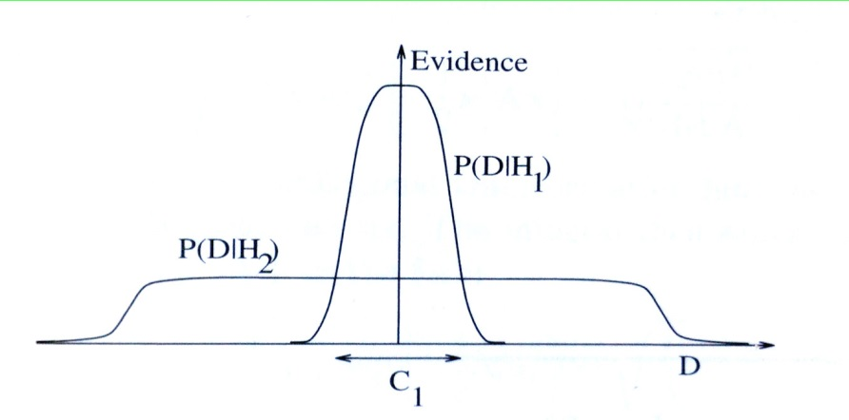
What is the Bayesian Occam’s razor?
It depends how $P(D|H_{1})$ is estimated. If the hypotheses look like this:
$$H_{1}:x →x+m_{1}$$
$$H_{2}:x →x−\frac{n_{1}}{n_{2}}x^{3}+\frac{n_{3}}{n_{4}}x^{2}+\frac{n_{5}}{n_{6}}$$
And we say that $m_{1}$ to $n_{6}$ are values with all the numerators and integers being are equally likely to be between say, -50 and 50 and all denominators between 1 and 50, then probability that the $m_{x} and{ n}_{x}$ happen to be the correct numbers to match the data is:
P(D|$H_{1}$) = 1/101*(1/101) = 0.0001
P(D|$H_{2}$) = 1/101*(4/101*1/50) *(4/101*1/50) *(2/101*1/50) = 2.5 x ${10}^{−12}$
$\frac{P(H_{1}|D)}{P(H_{2}|D)}$ = 1 X $\frac{\text{P}\text{(}\text{D}\text{|}H_{1}\text{)}}{\text{P}\text{(}\text{D}\text{|}H_{2})}$ = $\frac{0.0001}{\text{2.5 }\text{x} {10}^{−12}}$ = 4,000,000 = Very strong evidence that H1 is to be preferred over H2
Notes:
Crikey – the lanaguage does have an effect!

Slide 35
What is the Bayesian Occam’s razor?
Notes:
There is no easy way to extend the likelihood ratio measure to the non-binary case, ie where we have more than one hypothesis to test.
However, you could do the above for every pair of hypotheses to build a matrix of likelihood ratios between all– although this would get very large.
[see Jaynes (2003) for discussion]

Slide 36
Summary
Discriminative and generative models are used to approximate the underlying relationships between sets of data.
Generative models are more ‘powerful’, but generally require more data to estimate their hidden parameters (Θ)
“Inferring a model” and “inverting a model” refer to finding the hidden parameters of some model using training data.
“Inference on a model” refers to finding $\hat{c}$ given $\hat{x}$, X, and C
The ‘likelihood ratio’ is a useful measure as to how ‘probable’ one hypothesis is compared with another.
The ‘likelihood ratio’ penalises complicated hypotheses, thus embodying the sentiment of Occam’s Razor

Slide 37
References
‘Bayes Factor’/ ‘likelihood ratio’
ET Jaynes (1979) Inference, Method and Decision: Towards a Bayesian Philosphy of Science by R Rosenkrantz: book review Jour. Amer. Stat. Assoc. 74:740-741
ET Jaynes (2003) Probability Theory: The Logic of Science. Cambridge University Press (Chapter 4)
MacKay DJC (2003) Information Theory, Inference and Learning Algorithms. Cambridge University Press (Chapter 28)
Discussion about the difficulties of testing whether parts or all of the brain is ‘Bayesian’
Bowers JS, Davis CJ (2012) Bayesian Just-So Stories in Psychology and Neuroscience. Psychological Bulletin 138: 389–414
Griffiths TL, Chater N, Norris D, Pouget A (2012) How the Bayesians Got Their Beliefs (and What Those Beliefs Actually Are): Comment on Bowers and Davis Psychological Bulletin 138:415–422
Discriminative vs Generalised models
Bishop CM (2007) Pattern Recognition and Machine Learning. Springer (p. 43)
Jebara T (2004) Machine Learning: Discriminative and Generative. Springer
Talk videos
Discriminative vs Generalised models
Stanford course videos on YouTube http://www.youtube.com/watch?v=qCA1Dk_Ih_c

